Slide 1
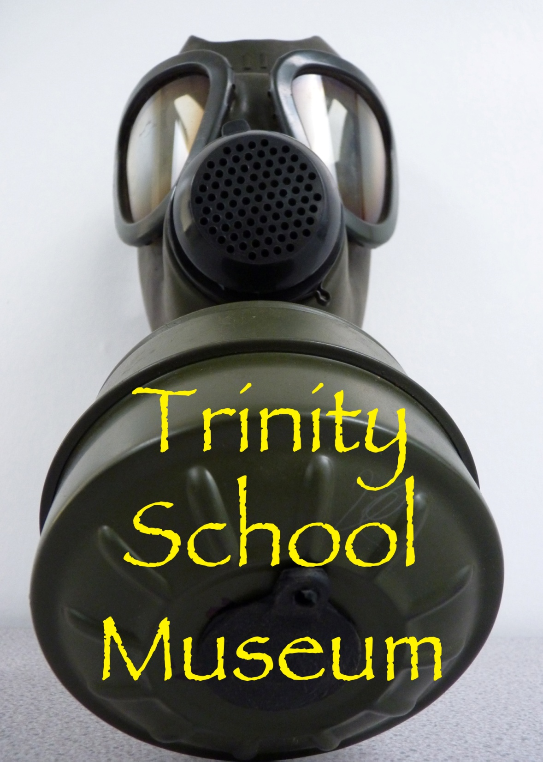

Slide 2
“The project sounds like an innovative and engaging way to increase an understanding of history for pupils and the wider community”
Nick Gibb MP, Minister for Schools

Slide 3
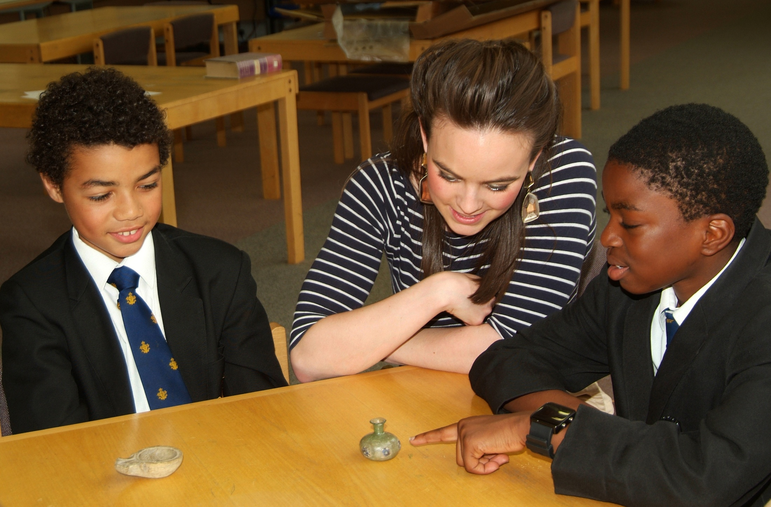

Slide 4
“Projects like this are exactly what our education system needs to ensure that the next generation continues to engage with the past”
Tristram Hunt MP, History Lecturer and Television Presenter

Slide 5
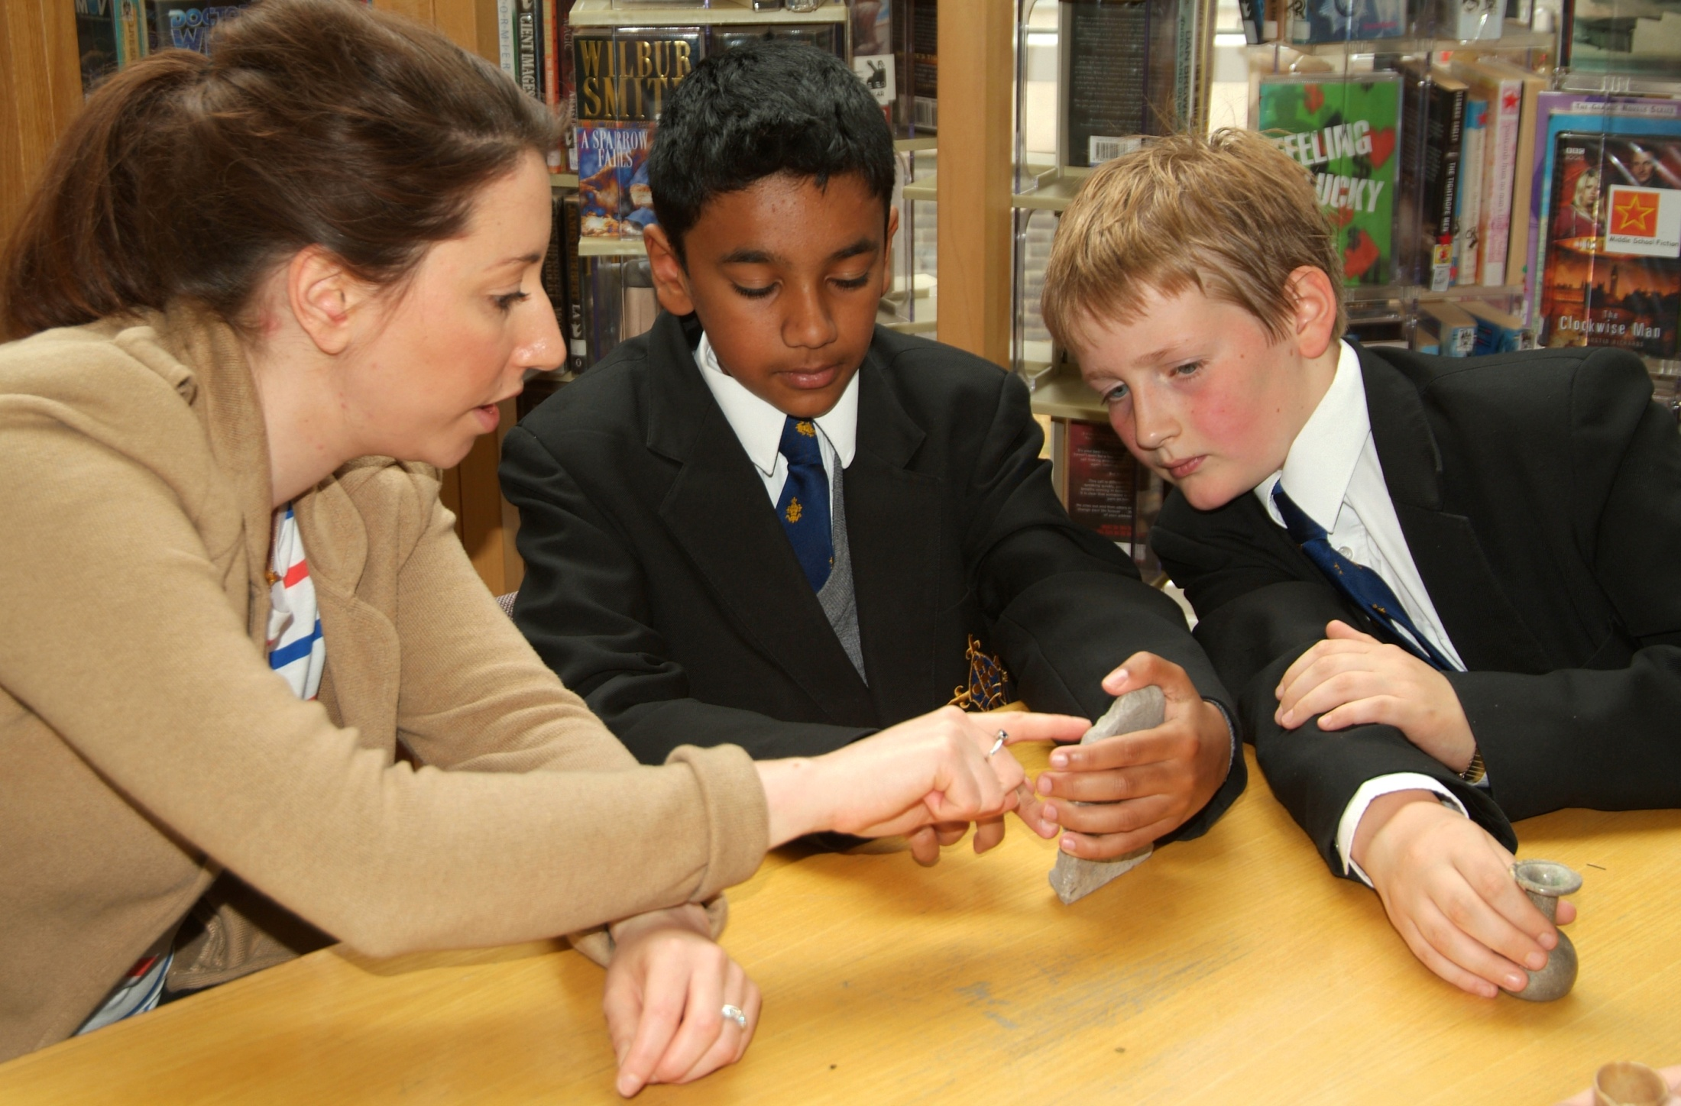

Slide 6
“I realise now that the objects people have in their homes can be just as historically valuable as ones we see in museums, but they are just not aware of it”
Jacob, Third Year

Slide 7
Who......?

Slide 8
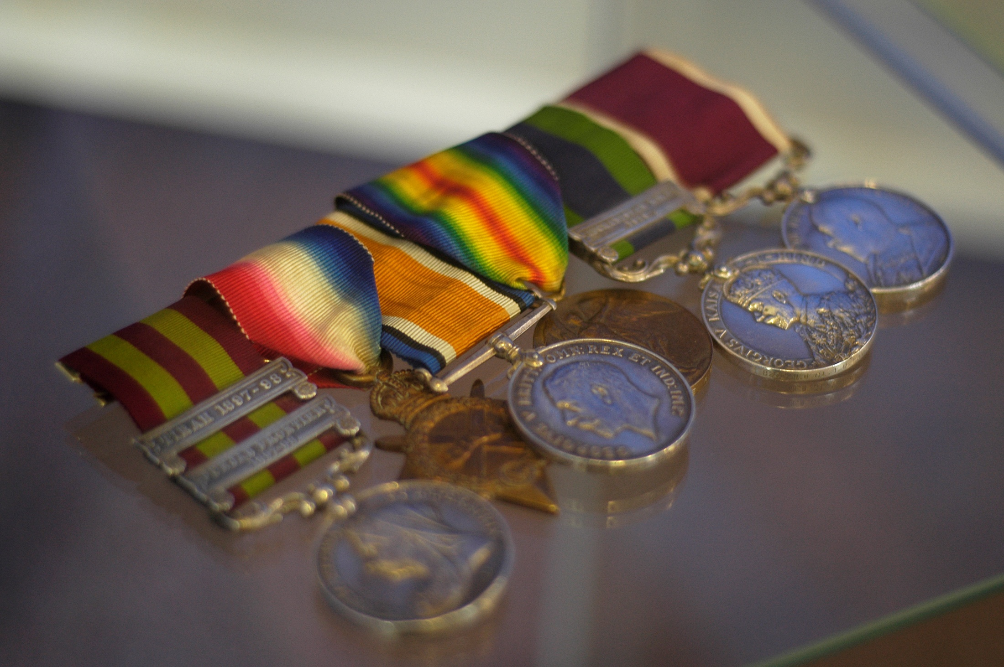

Slide 9
What......?

Slide 10
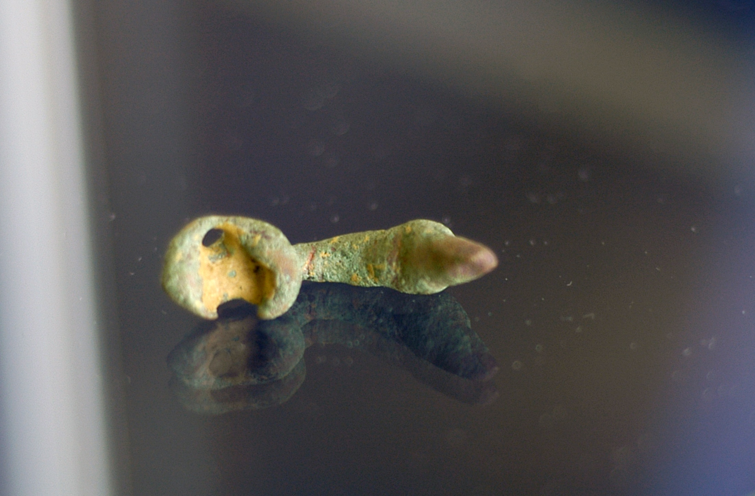

Slide 11
When......?

Slide 12
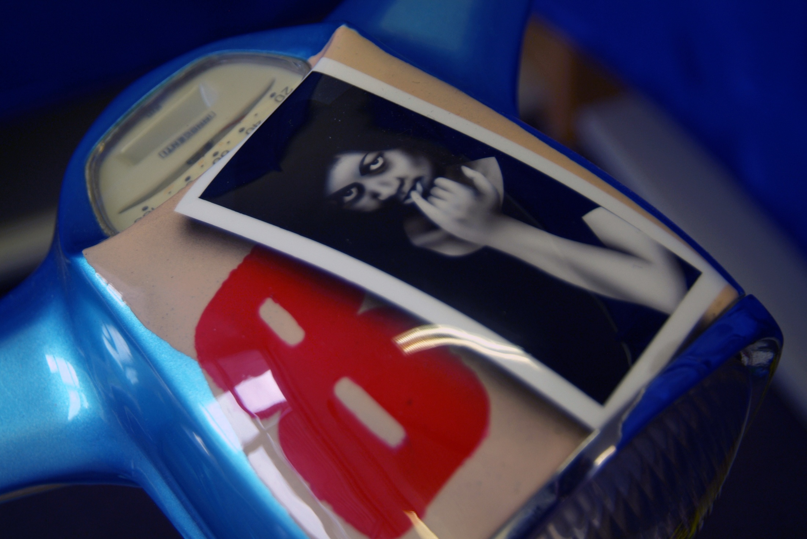

Slide 13
Where......?

Slide 14
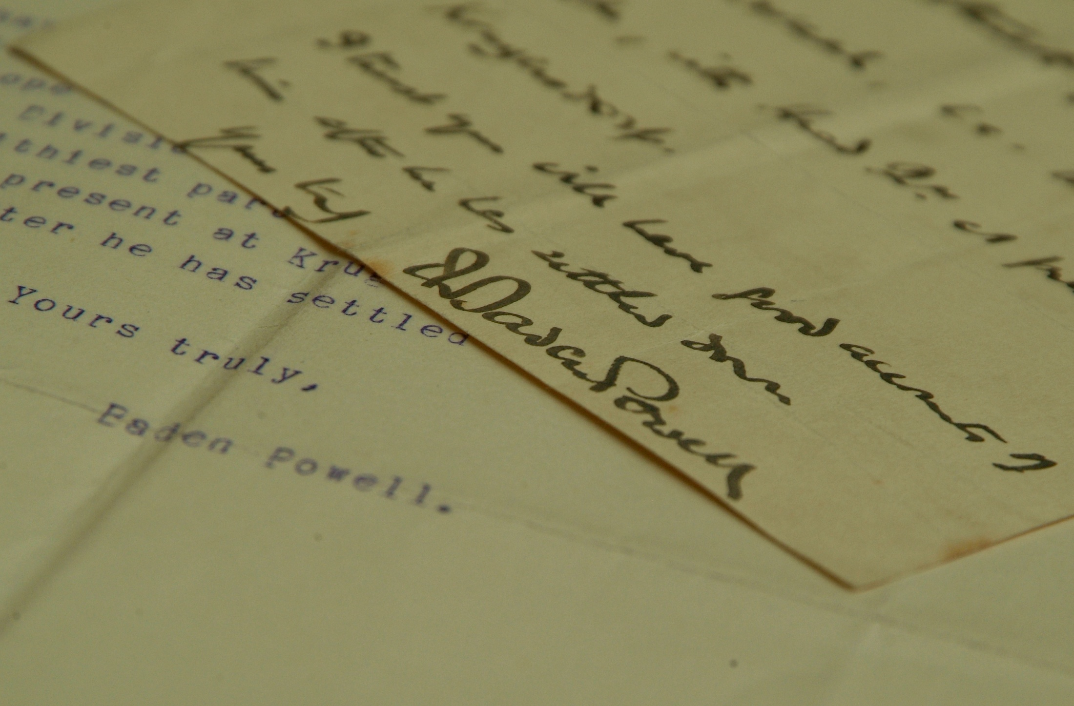

Slide 15
Why......?

Slide 16
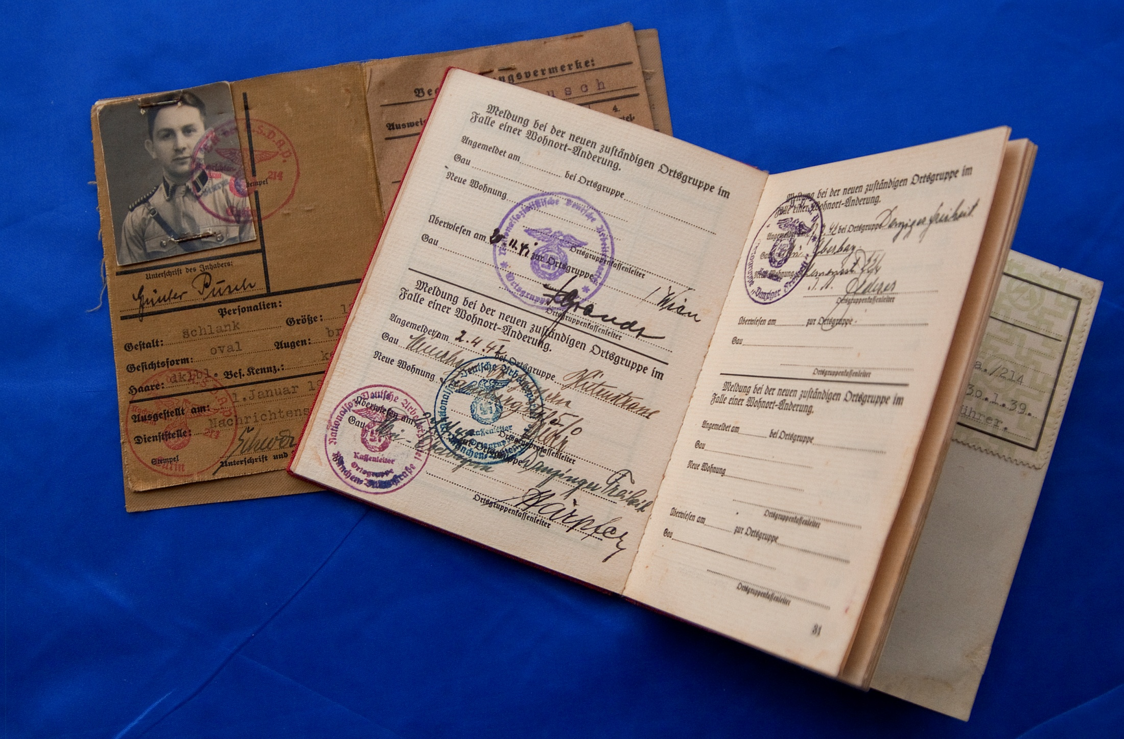

Slide 17
“After doing the project I have realised that anything can be researched and found out about, if we ask the right questions. Whereas before I believed that some things just couldn’t. My researching skills have really improved.”
Anthony, Third Year

Slide 18
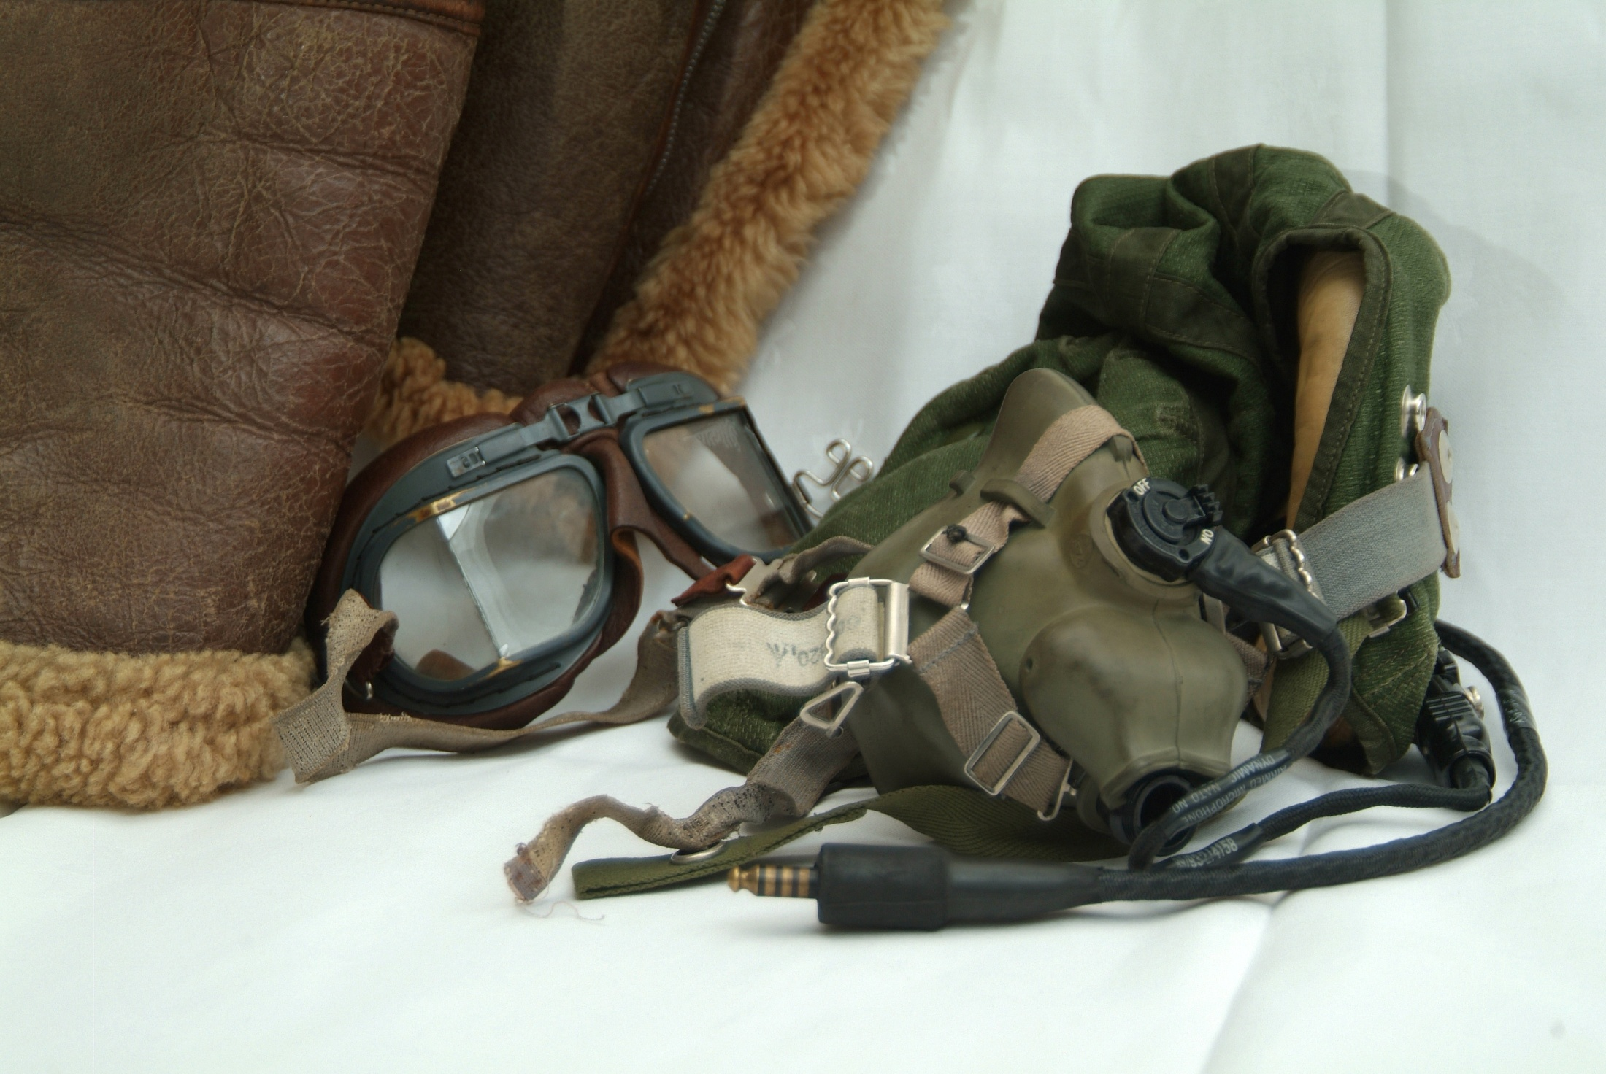

Slide 19
“I really enjoyed this project. I’m much more likely to notice the historical objects around me now, and much more interested in visiting museums.”
Archie, Third Year

