Slide 1
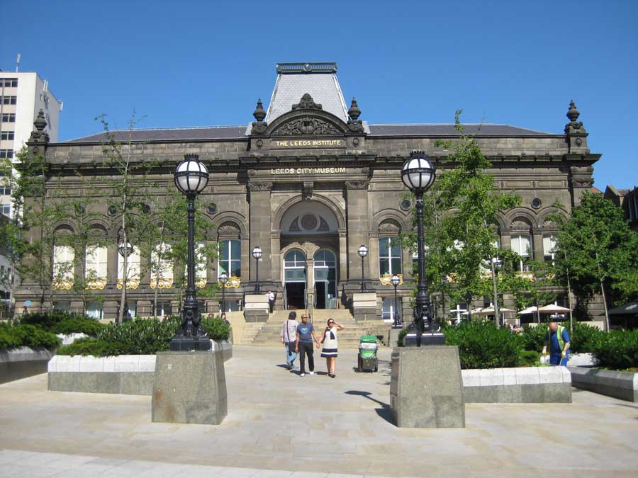
Chronology in the Primary School: it’s not just kings and queens and dates!
Dr. Hilary Cooper, Historical Association Northern Forum 04.10.2012

Slide 2
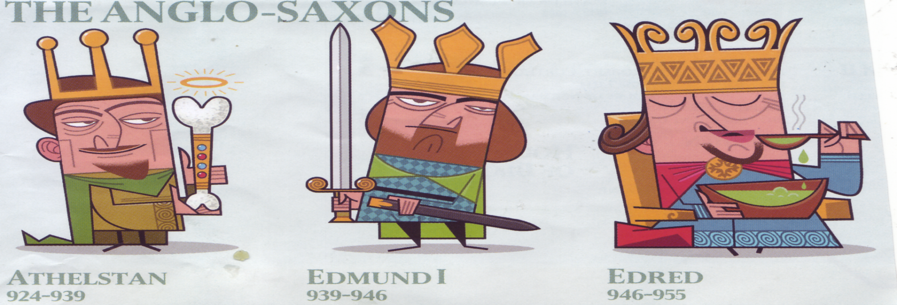
Extract from Poster Published in The Times (2011)
Athelstan 924-939
He liked to collect relics and to hunt
Edmund 1
Made first laws to punish burglars
Edred 946
Described as having a ‘weakness of the feet’ and had to spit out food he couldn’t swallow.
DO WE REALLY NEED TO KNOW THIS?!
Notes:
THE TIMES
Athelstan 924-939
He liked to collect relics and to hunt
Edmund 1
Made first laws to punish burglars
Edred 946
Described as having a ‘weakness of the feet’ and had to spit out food he couldn’t swallow.

Slide 3
Learning to ask and answer questions about time from personal time lines
The teacher’s time line is a good model!
SEQUENCE:In the following slide what is the correct sequence of photographs? Why? Do others disagree? Why?
MEASUREMENT: What is the time span between each photo?
LANGUAGE: What ‘time language’ did you use?
NARRATIVE: What might be the causes and effects in the story which the photos tell?

Slide 4
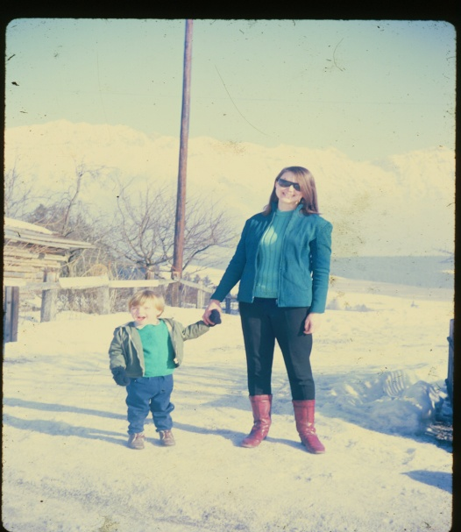
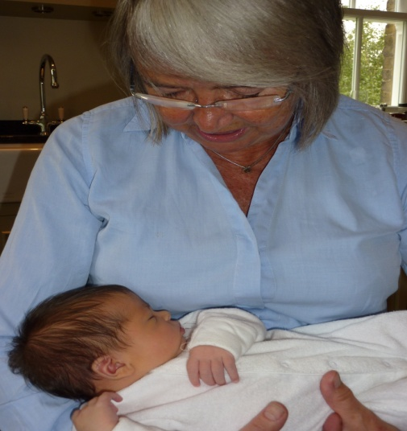
Notes:
Sequence: 1st Why? 2nd Why? 3rd Why? Problems?
What can you work out from the sequence?
Time spans 1-2 (14-23 = 11 years)
2-3 (23 – c. 55 = 32 years)
3-4 (55-67 = 12 years)
Calculations and language of time

Slide 5
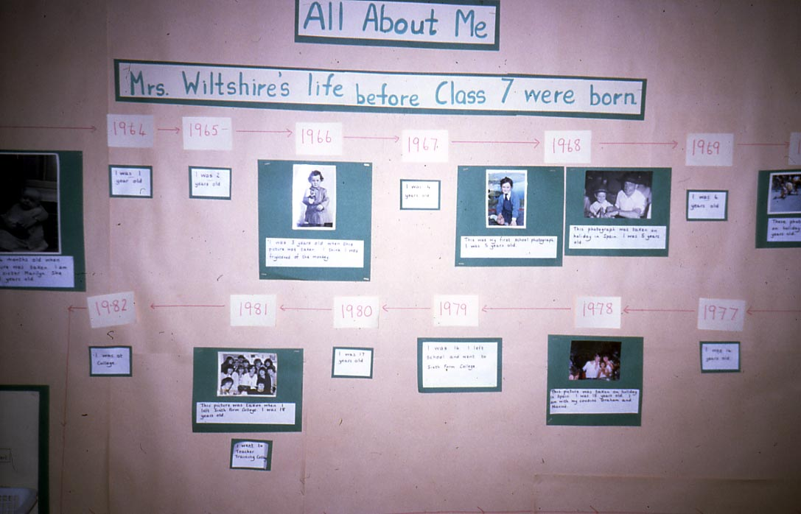
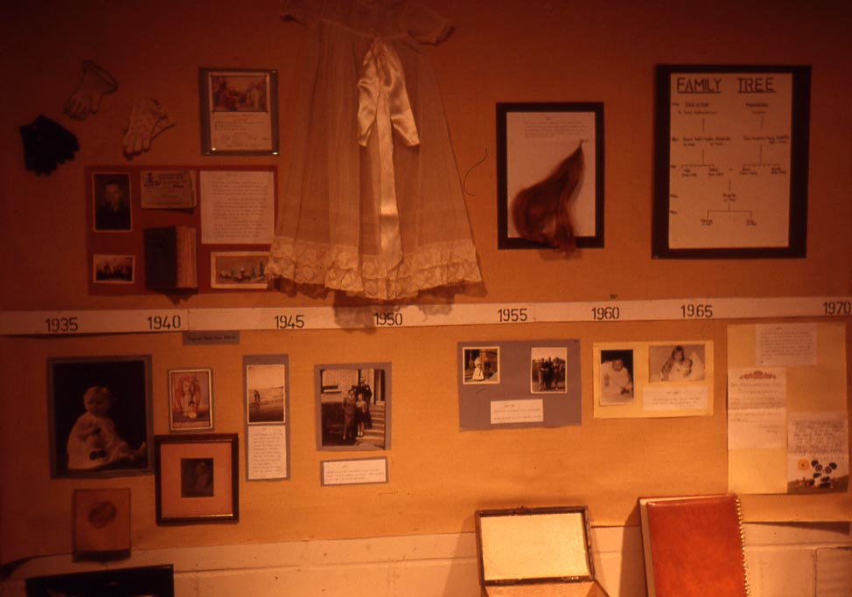
5 year olds shared their time lines.
Then their 25 year old teacher shared hers – a much longer one!
Then a new head teacher shared hers. She was 50 years old, so hers was a VERY long time line! It went all around the foyer. Children, staff and parents were fascinated.
Notes:
Sets – old/new
Sequencing children’s clothes, toys
Family members (plasticene snake flags)
Sequencing narrative – cause/effect, motives,
Measuring time – patterns of days, days of weak, seasons, birthdays

Slide 6
Constructivist Approach
Children should construct their own time lines.
This involves reasoning, argument, questioning, discussion.
They should learn to ask and offer deductions and inferences about: sequence, duration, similarities, difference (i.e. continuity and change).
The process often raises more questions than it answers.
Notes:
Time lines are not just to measure passing of time in units.
They raise questions and help to answer them
I am nor suggesting you do this activity in school. You are teachers and can organise the children and devise time lines for different purposes.
WHAT I WANT YOU TO GET OUT OF THIS SHORT SESSION IS THE EXPERIENCE AT YOUR OWN LEVEL OF ASKING AND ANSWERING QUESTIONS USING TIME CONCEPTS:
1. SEQUENCE,
2. DURATION
3. CAUSES AND EFFECTS
4. IMPACT ON PEOPLE’S LIVES
5. ISSUES ARISING

Slide 7
Why does chronology matter?
Concept of time is at centre of history
Children need to build up ‘a’ Big Picture
Which can be interrogated
And is meaningful
History for All (Ofsted 2011); Michael Gove’s rationale

Slide 8
What changes between periods and what stays the same? (The Times 13.08.12)
Under age drinking, immigration, celebrities……1790
Britishnewspaperarchive.co.uk

Slide 9
This was not intended as an activity for children. Teachers are already skilled in organising pupils in creating time lines on appropriate scales and themes.
This activity was intended to stimulate participants to explore concepts of time, ask and answer questions and raise issues, at their own levels.
Participants were invited to construct 4 parallel time lines on 4 selected themes, agriculture, transport, beliefs and homes.
The scale was 50 cm. represent 100 years. Century intervals were marked on florists’ ribbon. The time span was 6,000 years…(it ended up going all over the room!)
They worked in 4 groups.
Each group was given about 20 cards with coloured images on one side (These were cut from a secondary school textbook)
The text accompanying the picture was on the back of the card, with the date underlined, so that there was no difficulty in placing it in the correct place on the time line.

Slide 10
Constructing a time line A proforma is given in the session handout. Discussion 1
Themes:
Agriculture
Houses
Beliefs
Transport
Please jot down what you can work out from your time line about:
Sequence
1. Duration
2. Causes/ Effects of changes
3. Effects on people’s lives
4. Similarity/Difference between periods
(Continuity /Change)
6. Questions, issues, problems that occur to you.
Notes:
Not suggesting you replicate this activity with children
Experience at your own level asking and answering questions using time concepts

Slide 11
Whole group discussion 2 Are there connections across the themes?
16c. farming/houses/beliefs, transport?
18c. farming/houses/beliefs/transport
19c. farming/houses/beliefs /transport
20c. Farming, houses, beliefs, transport?

Slide 12
Whole group discussion 3
What cross-references (connections) can you make between the time lines?

Slide 13
Whole group discussion 4 Concepts of Period – how useful are they?
Collect/imagine key images of different periods (e.g. furniture, dress, houses, entertainment). What do key images of each period have in common? What are the similarities/differences between key features in different periods? Discuss how/why key features of one period extend outside this period.
Medieval?
Tudor?
Victorian?

Slide 14
Discussion 5: What Progression in SKILLS needed in asking and answering questions about time
Language?
Arithmetic?
An indicative table is included in the session handout

Slide 15
An alternative view
If children HAVE to learn the names and dates of kings and queens a useful aid to recital can be found on Google an excerpt is given below!
Willie, Willie, Harry, Stee, Harry, Dick, John, Harry Three, One-To-Three Neds, Richard Two, Harrys Four-Five-Six... then who?
Edwards Four-Five, Dick the bad, Harries twain, Ned Six (the lad), Mary, Bessie, James, you ken Then Charlie, Charlie, James again...

