Slide 1
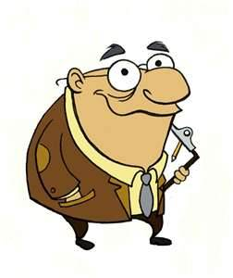
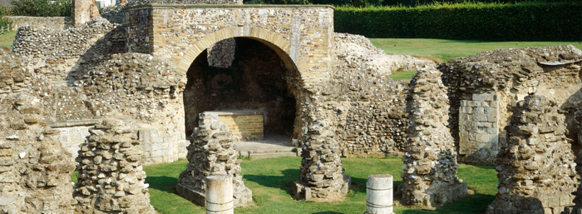
Why were the monks forced to leave St Augustine’s Abbey?
This is such a good question, Year 7! So good, that I will help you research this topic and then you can write a two page essay about it.
WHAT?!
You want to do something else other than a piece of historical writing?!
Well, I suppose we could do something a bit different…
This is St Augustine’s Abbey as it stands now. With the person next to you, think about what could have happened to the monks that lived in this Abbey.
Invasion!
The Black Death!
A mass murder!
They went and got a better job…

Slide 2
AIM1: to investigate the disappearance of the monks from St. Augustine’s Abbey.
Aim 2: To use our research to create an historical film about the fate of St. Augustine’s Abbey.
So, Year 7. what is the First thing any historian needs to do when starting an investigation?

Slide 3
Step One: Research – Who, what, where, when and why.
You have all now been placed in your research groups.
Your task is to use the research materials provided to answer the 5 W’s that we have previously identified.
Think back to your answers from the starter – is there any evidence to suggest that your ideas are correct?
As a whole class we will then share our research and start to solve our historical mystery.
The Historian’s Challenge!
Our Historian is what one would call a source snob.
He doesn’t think that Year 7’s can successfully analyse sources and explain whether or not they are reliable.
Who can prove him wrong? And how?

Slide 4
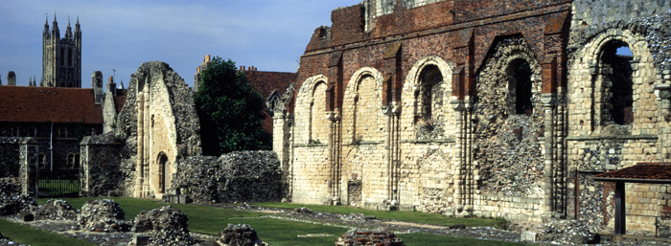
Step Two: Constructing an argument
The most important thing that we need to is explain why the monks were forced to leave St Augustine’s Abbey…and did they go without a fight?
In your groups, produce a clear and concise argument explaining why the monks were forced to leave the Abbey.
You should structure your argument in the following way:
The long term causes
The short term causes
The trigger cause
Opposition
The authors of the most convincing argument will get the opportunity to structure the script and direct (that means be in charge!)

Slide 5
Step Three: Ideas Storm
What makes a good historical film and why?
Think about this question in your pairs and then write your idea, with a justification, on the board.

Slide 6
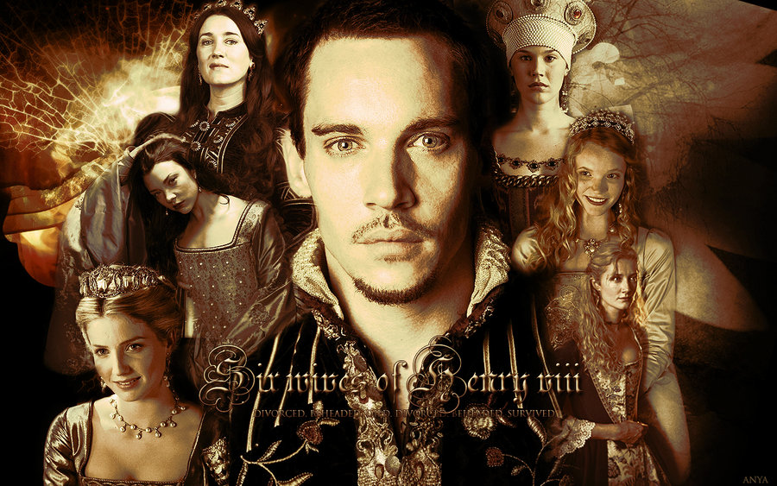
Step Four: Casting
Now you have structured your arguments, you need to come up with a list of historical characters who are going to appear in your film – remember that these need to be the individuals you identified in the ‘who’ section of your research.
Who will be our leading man?

Slide 7
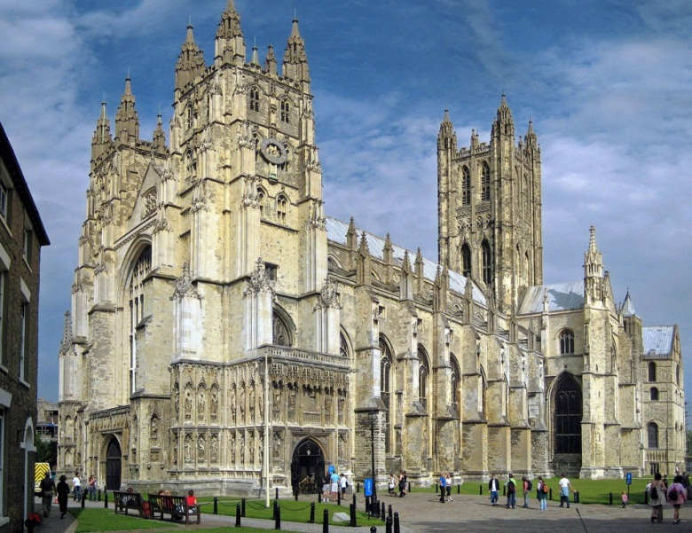
Step Five: Scriptwriting and Editing
You are now all in the groups that you will be working with during the scriptwriting and rehearsal practice.
In your groups, read through the scene you have been given.
Evaluate what is good about your scene – what would you like to keep?
Consider what is missing from your scene – what might you need to add?
Canterbury Cathedral Education Centre have kindly given us a basic script to work from that you can edit and adapt to meet your criteria.

Slide 8
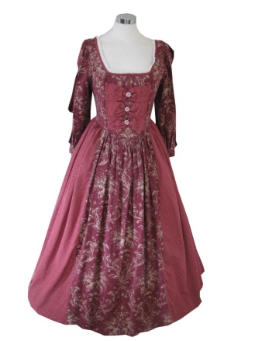
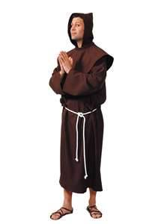
Step Six: Rehearsing and Revising
Now you have added to your scenes and we have placed them in order, it is time for you to rehearse your parts and make any final revisions.
To add a touch of authenticity (this is what we are aiming for, remember) Canterbury Cathedral Education Centre have kindly allowed us to borrow a selection of costumes…
Remember the success criteria that you established!
Each scene needs to be as historically authentic as possible.
Each scene needs to explain the causes of the dissolution and the effect it will have upon the characters.

Slide 9
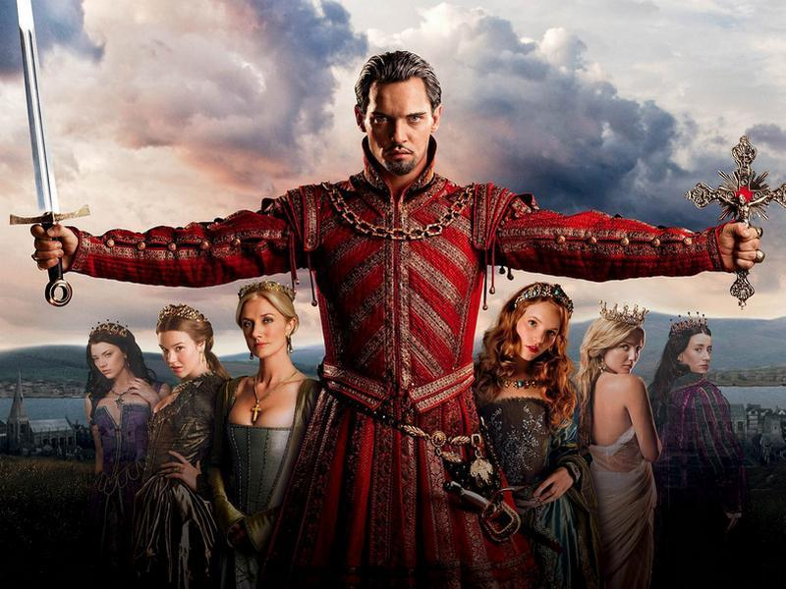
Step Seven: Action!
This is the moment!
You have rehearsed and revised and now the time is hear for you to perform the film!
Each group will perform their scene and, if the class agrees that it has met the criteria (remember, we are a democracy here), then it will be included in the final edit.
Four of the scenes you are about to view were inspired by material kindly supplied by Canterbury Cathedral Education. There were supplemented with several ideas from the students. The other three scenes are the students own original creations.
Will Yours be as good as our TV production?

Slide 10
Henry VIII: I have decided to close all of the monasteries in my Kingdom.
Henry’s bodyguard: Indeed, my lord. It’s about time that we discussed this.
Cranmer: Many people who live near monasteries will be angry. The monks are kind to the poor.
Cromwell: the monks could be very dangerous. They obey the Pope and now King Henry is in charge of the Church they could be a source of trouble.
Henry VIII: Take Canterbury for example. Cromwell, how many monks live there now?
Henry’s bodyguard: Yes, how many monks do live there?
Cromwell: About 60, my lord.
Cranmer: What will happen to them? They haven’t got any families to go to and they haven’t got any money or property. They gave all these things up when they became monks.
Henry VIII: No matter. Most of them don’t keep their promises anyway. They have property, don’t say their prayers and some don’t even live in the monasteries anymore. Anyway, I will give them some money, a pension – that should be enough to keep them going.
Cranmer: Who will look after the Cathedral?
Henry VIII: I will make one of my priests the Dean and he can have twelve other priests called Canons to help him.
Cromwell: What about all the monastery buildings?
Henry VIII: Knock them all down or turn them into houses. The monastery must be entirely destroyed.
Henry’s bodyguard: Yes my lord! Knock them down and turn them into houses.
Scene One: The King’s Court

Slide 11
Anne: Where’s Henry? Have you seen Henry?
Lady One: No me lady, I think he is in privy chamber.
Lady Two: Yes, I saw him enter the chamber at about one.
Lady Three: Same me lady.
Anne: Oh! Have you heard the news?!
Ladies: What me lady?
Anne: Henry’s closing down the monasteries, starting with the one at Canterbury. Isn’t that wonderful?
Ladies: Yes me lady, wonderful!
Anne: He’s going to destroy all the evil monks that sole money from the poor and the hungry!
Ladies: Fantastic me lady!
Scene Two: Anne Boleyn’s Chamber

Slide 12
Prior: I have just had a letter from Thomas Cromwell. He is going to send the soldiers here to close down the monastery on the orders of King Henry VIII.
Monk 1: Why can’t we be left alone? We haven’t done any harm.
Prior: The King is afraid we are loyal to the Pope. He doesn’t like the monks and he wants control of the Cathedral.
Monk 2: What about the services in the Cathedral?
Prior: I’m sure the King will find someone to run it for him.
Monk 3: What can we do? We haven’t got a family to go to or any money.
Monk 4: I’ve been a monk since I was eighteen. I’ve never known any other life.
Prior: It says in the letter we will be given pensions.
Monk 1: Yes, but how much? Shall we be able to live on it? I hear it is £10 a year.
Monk 2: I think we should resist the soldiers, they can’t force us to go.
Prior: If you disobey the King you will be treated as a traitor. You know what happens to them!
Monk 3: It’s terrible! They hang you and cut out your heart and cut your body into bits!
Monk 4: We shall have to give up the monastery, there’s nothing else to do!
Scene Three: Canterbury

Slide 13
Catherine: Bad news! I have just heard that Henry is shutting down the monasteries!
Lady 1: Oh no! What about the poor monks?
Lady 2: Oh no my lady!
Catherine: Oh no, where are my poor monks going to go?
Lady 1: Oh, I’ll go and see if it is true my lady!
Catherine: What will the poor monks do? They have families and no were to go!
Scene Four: Catherine of Aragon’s Rooms

Slide 14
Captain: Order of King Henry VIII, 1540. All monks to leave the monastery instantly! Here are your pensions. You are advised to leave quietly.
Prior: What are you going to do with the buildings?
Captain: Well, the new Dean and the Canons have got to live somewhere, haven’t they? We might use some and knock some down.
Monk 1: You are vandals! We aren’t doing any harm. We live a life of prayer and study and work.
Captain: Silence, you are traitors, all of you! King Henry VIII is in charge of the Church of England and there are going to be some changes. The new Dean and Canons will keep the services going and be loyal to the King. We don’t need monks in England anymore.
Captain con’d: We’ve heard all about you – you don’t keep your promises to be poor. You have big feasts when visitors come. And look at these buildings, with only a few of you living here. It’s a waste. Any trouble and you’ll be hanged as traitors.
Scene Five: Outside the Monastery

Slide 15
Martyr Monk: I can’t just stand here and watch my church fall!
Executioner: Ok then we will use you as an example – come with me!
Martyr Monk: At least I will die in the name of my beliefs!
Executioner then kills the Martyr Monk.
Scene Six: The Execution

Slide 16
Scene Seven: The King’s Court
Cranmer: The King wants Nicholas Wotton to be in charge of the Cathedral now that the monks have gone. He will be the first Dean.
Cromwell: I have just received a message from Kent. The monastery at Canterbury has been closed and the Prior and monks sent away. Henry will be pleased that it has gone so smoothly. Canterbury is very important because the Archbishop comes from there.
Cranmer: Yes, I wish I didn’t have to be at court so often. I don’t get to my palace at Canterbury very often. I must meet Dean Wotton. After all, when I am in Canterbury we shall be neighbours.
Cromwell: Here comes the King.
Henry VIII: What news from Canterbury? Is the monastery closed down?
Cromwell: Yes my lord, and the Prior and the monks sent away.
Henry VIII: Excellent, there will be no rebellion in Canterbury. When I come and see you in your palace, Archbishop, I will go and visit Dean Wotton in his Deanery. These old monasteries buildings will make splendid houses.
Cranmer: We must make sure that the services are held properly in the Cathedral and the building is looked after. It is a wonderful place.

