Slide 1

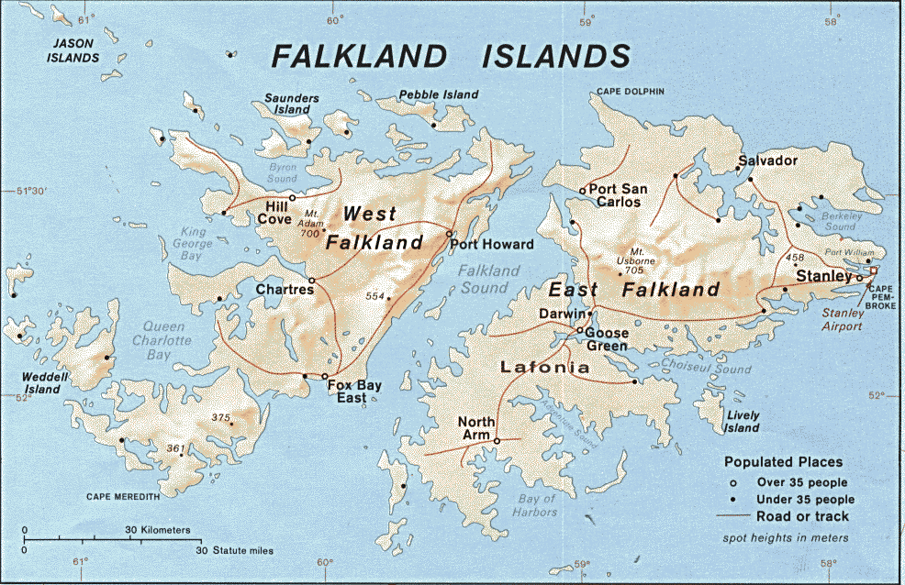
FALKLANDS WAR 1982
The Junta
My part in its downfall

Slide 2
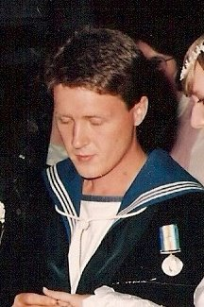
ME!
Who am I?
or
as I sometimes ask, who WAS I?
Notes:
Radio Operator 1st Class Leishman Royal Navy 1979-1992 (as was) Lanarkshire Mining Stock, now working in the RHF Museum for the Army

Slide 3
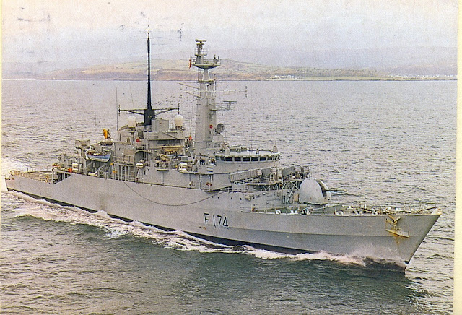
My Ship
The Frigate HMS Alacrity F174
Sleek grey messenger of death
Notes:
Plymouth Based type 21 Amazon Class General Purpose Gunship

Slide 4
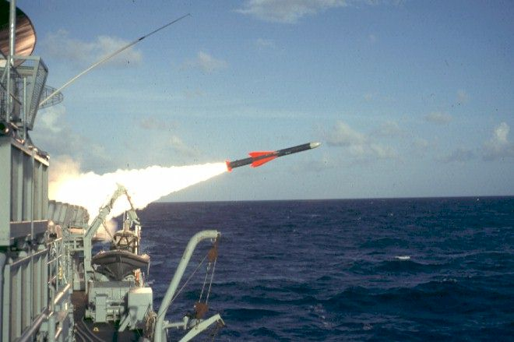
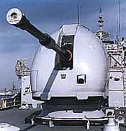
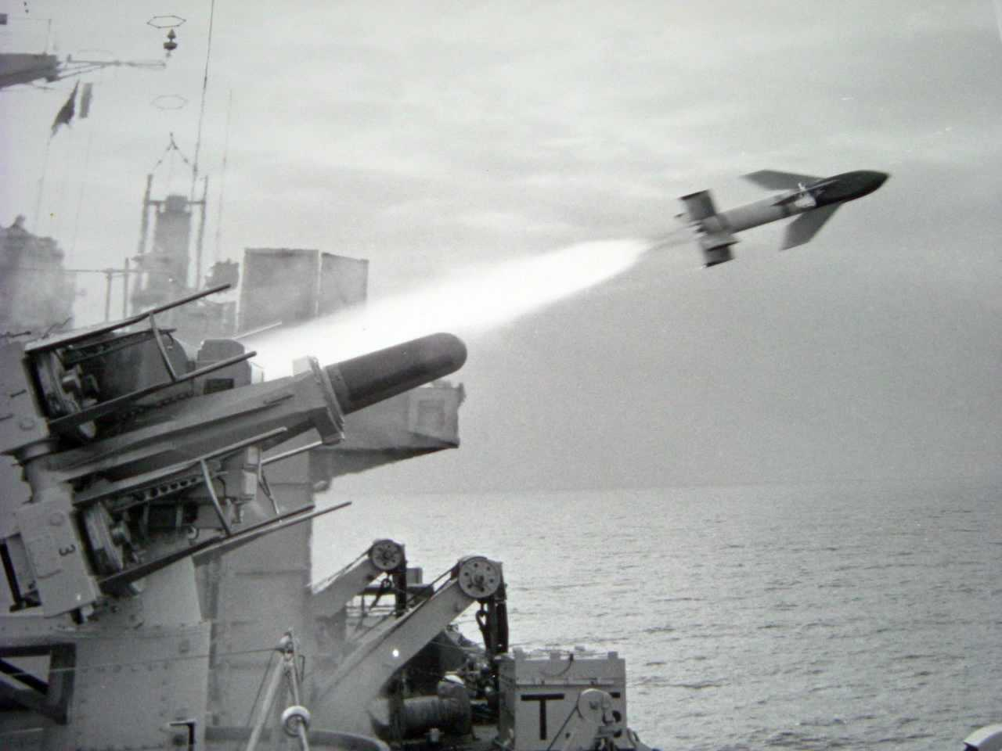
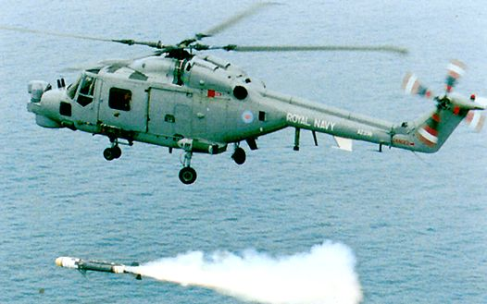
Armament
Her weaponry
For those who like that sort of thing
Exocet Missile System
Seacat Missile System
4.5inch Naval Gun
Lynx Helicopter Armed with Seaskua Missiles and Stingray Torpedoes
Notes:
Exocet 100NM - gun 25rpm+12 NM -––seacat ½ NM – Lynx 200mph - seaskua 15nm – stingray 5nm 40+Kts

Slide 5
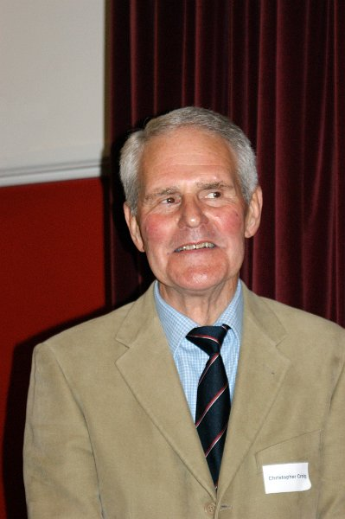
The Skipper
Commander Chris Craig CB DSC
Notes:
An Old Eatonian, who enjoyed a flutter on the Horse’s. A Top Class guy

Slide 6
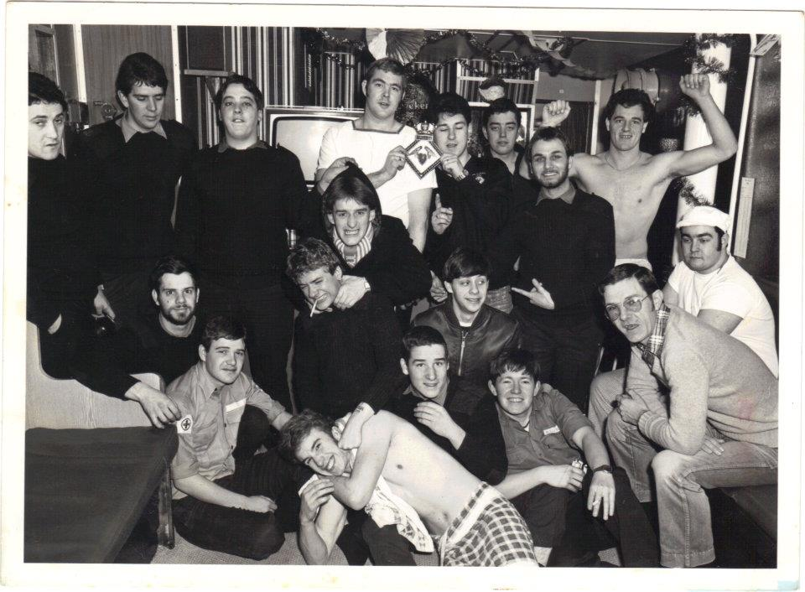
Mess Mates
From all over the UK if not the world
Notes:
We had a tremendous Mess, very happy times

Slide 7
Going to war
Friday 2nd April 1982 Alongside Portland - instructed to 'make all preparations for war'
4th April Devonport Naval Base - My 21st Birthday
5th April – Sailed for Falklands from Devonport at 0500
Notes:
The most hectic weekend ever, stripped Portland and Plymouth Naval Bases in preparation for war. We had stores lashed down in every available inch of spare space, various specialist joining and men being accommodated in the mast

Slide 8
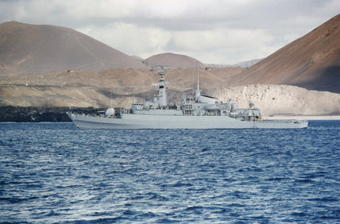
Ascension Isles – the halfway mark
Notes:
Taking on stores and completing training after meeting up with the Task Force from exercise Springtrain coming down from Gib

Slide 9
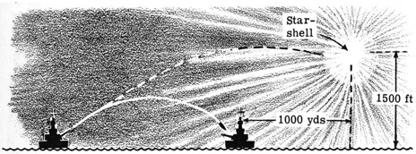
30th Apr - A Run in with the Argentine Ship the Narwhal
Notes:
The Narwhal was an Argentine Spy Ship, it gave my friend and fellow communicator Phil Jones a chance to practice his Spanish – she was later sunk after being attacked by two R.N. Lynx Helicopters firing Harpoon Missiles

Slide 10
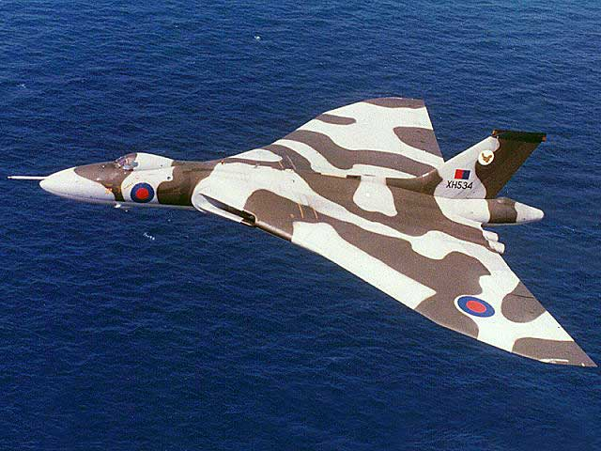
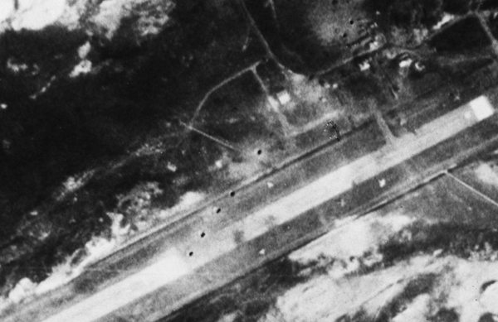
30th Apr - Operation Black Buck – Bombing Stanley Airport by Vulcan Bombers
Notes:
Tasked with standing by listening for a report of success or in case of ditching in the sea

Slide 11
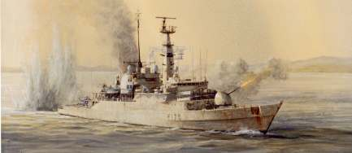
Alacrity in action with HM Ships Glamorgan and Arrow Saturday 1st May
Notes:
Saturday 1st May - All 3 ships were attacked by Mirage Jets, narrowly avoiding disaster (both Glamorgan and Arrow are damaged) while conducting inshore daylight Naval Gunfire Support against Stanley Airport (Fired 51 rounds), our Helicopter was badly shot up whilst spotting
Sunday 2nd May - We return to the same gun line later that night, but after firing just 3 rounds our gun mechanism jams, Lots of AAA Fire and RADAR Contact made with a FPB who departed after being illuminated by our Fire Control RADAR’s

Slide 12
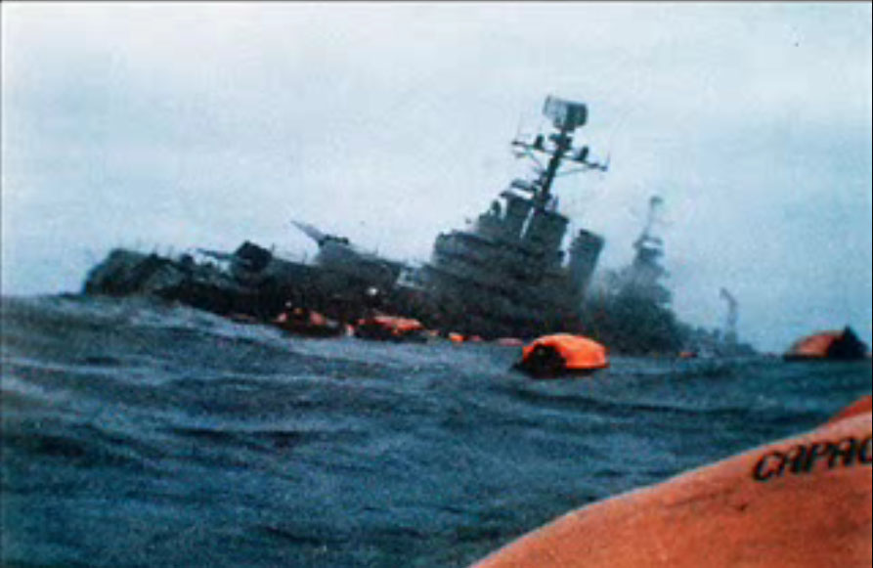
2nd May 1982
ARA General Belgrano is sunk by HMS Conqueror
Notes:
323 Men perished as she manoeuvred to attack the Task Force

Slide 13
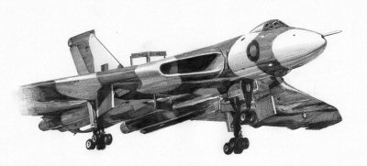
Notes:
Tuesday 4th May – Black buck 2. As for Black Buck 1

Slide 14
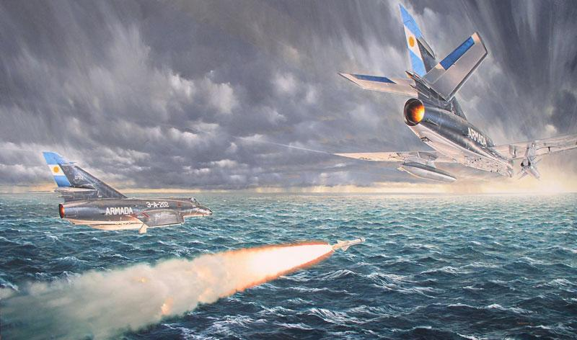
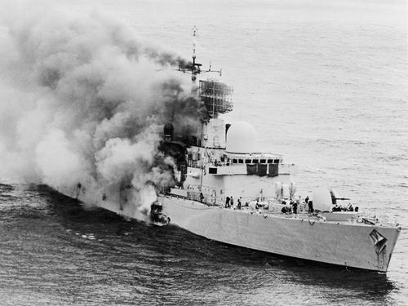
HMS Sheffield hit by Exocet Missiles fired from Super Étendard Aircraft
Notes:
A worrying time as I had friends onboard the Shiny (none of whom died) twenty hands were lost
She was about 4 miles off on our Port Quarter

Slide 15
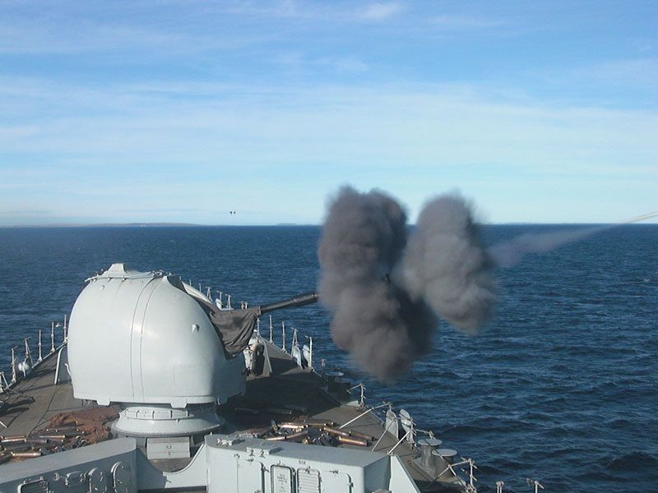
Notes:
Sunday 9th May – Naval Gunfire Support against Wireless Ridge, Moody Brook and Mount Longdon firing 90+ rounds with the Helicopter acting as spotter

Slide 16
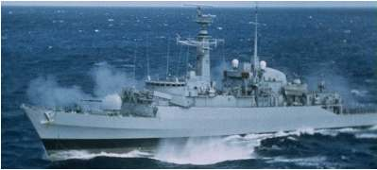
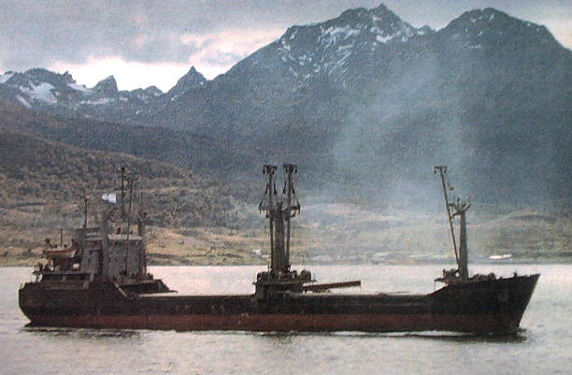
10th /11th May - Alacrity sinks the Argentine Supply Vessel Isla de los Estados
Notes:
Alacrity had been tasked to transit the sound between East and West Falklands, to establish whether it had been mined and what, if any, Artillery emplacements had been installed along the coast prior to the landings at San Carlos, she came across the Estados during this transit and prosecuted the Target, as the Naval Terminology phrase it, only 3 of her crew survived.
We were attacked by torpedo’s from the Argentine submarine San Lious whilst in Company with HMS Ardent on our exit from the sound

Slide 17
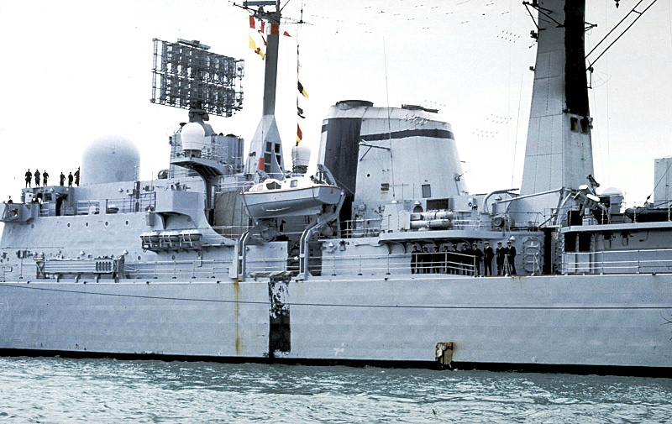
Damage to HMS Glasgow
Notes:
Wednesday 12th May – HMS Glasgow and HMS Brilliant attacked whilst providing air cover for us whilst providing NGS , the bomb passed right through the ship without exploding, 3 of the 4 aircraft are ‘splashed’ by Brilliants Sea Wolf Missiles

Slide 18

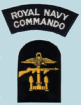
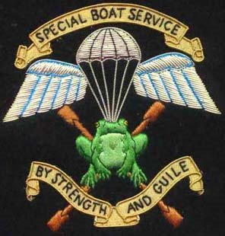
Special Ops in Grantham Sound , San Carlos and Sussex Mountains
Notes:
Saturday/Sunday 15/16th May - Alacrity tasked with inserting operatives behind enemy lines
HMS Brilliant also involved in inserting teams on Fanning Head (aborted due to the presence of the enemy)
It was a very clear night, with the land VERY visible on our port side we were sure we would be spotted (there was a full moon). Suddenly the whole horizon is lit up by shell fire, after worrying the rounds are being directed at us, we realise it must be HMS Glamorgan providing NGS on Stanley and Fitzroy
The Boat’s crew snatch a large stone from the beach whilst landing the troops and have it painted for the Skippers birthday
Padre visit’s and is chucked off the Ship for preaching peace and love!

Slide 19
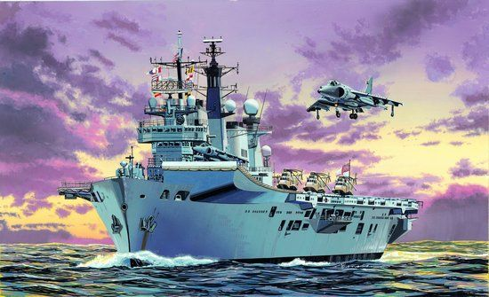
HMS Illustrious
Notes:
Tuesday 18th May – acted as goalkeeper vice Brilliant (type 22 Seawolf fitted) – horrible duty – sacrificial shield
Alacrity was to remain as an escort to the Carrier Battle Group during the Landings

Slide 20
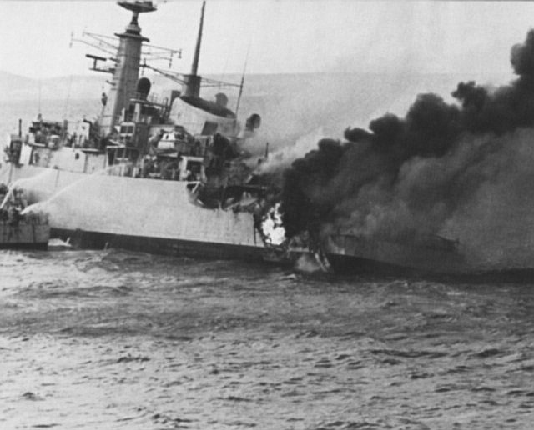
21st May - HMS Ardent is sunk after being hit by almost a dozen bombs in San Carlos during operation Sutton with the loss of 22 men
Notes:
Ardent was our sister ship, we had conducted most of our operations in the South Atlantic with her and the Glamorgan, who is the only warship known to have survived being struck by an Exocet

Slide 21
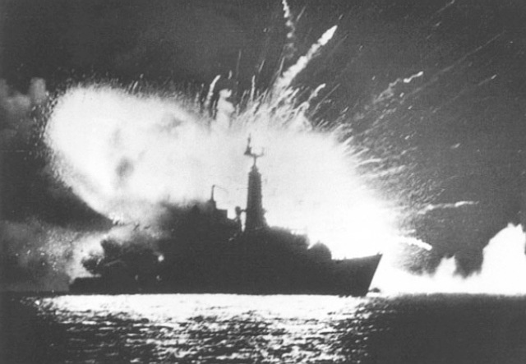
23rd May – HMS Antelope sinks after being hit by 1000lb Bombs on her first full day in the TEZ
Notes:
One of my best friends ship – he survived happily

Slide 22
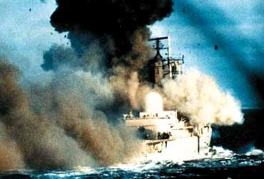
HMS Coventry is sunk after being hit by 3 1,000lb Bombs
Notes:
Tuesday 25th May – capsized and sunk within 20 mins of being hit with the loss of 19 men

Slide 23
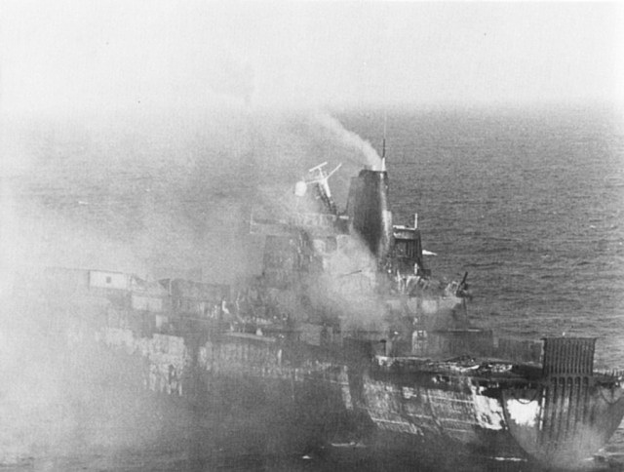
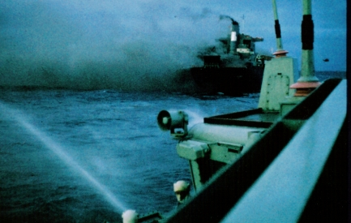
25th May Atlantic Conveyor is hit by Exocet and is badly damaged
Notes:
Alacrity went alongside and saved 77 men, 3 of whom died of wounds and were buried at sea, another 12 did not make it off the ship, Our Chinese laundryman Mr Chang, who had bravely elected to remain with the ship decided it was best to go home after seeing one of his fellow countrymen buried that morning

Slide 24
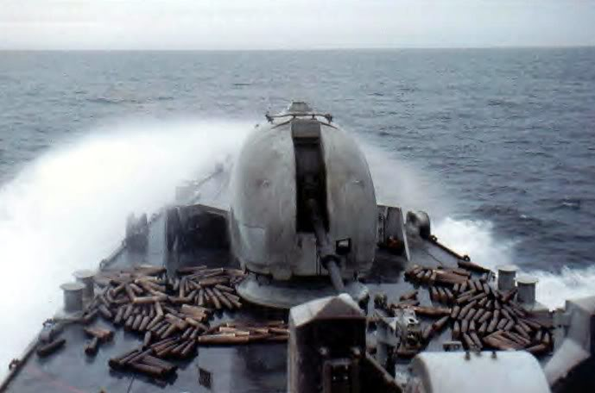
Notes:
Wed 26th May – NGS – Came under shore artillery fire for the 1st time

Slide 25
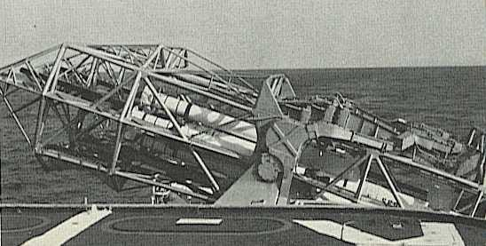
HMS Glamorgan’s Sea Slug ready for firing
Notes:
Thursday 26th May – NGS Glamorgan fires her 2000lb Sea Slug AA Missile at Argentine Troop Positions
HMS Avenger fired on by shore based Exocet
Saturday 28th NGS – Mount Kent (it was also the FA Cup Final Spurs beat QPR)
Sunday 29th May – Orange Survival suit spotted in water, diver sent in to investigate (bloody dangerous, the diver was given a tot for his courage)
Monday 30th May – Last attack by Airbourne Exocet (phew!) NGS – Sapper Hill
Tuesday 31st May – NGS
Wednesday 1st June – Last day on the Gunline, providing NGS against Two Sisters and Moody Brook

Slide 26
5th June – HMS Alacrity is ordered home due to our gun being worn out through over use

Slide 27
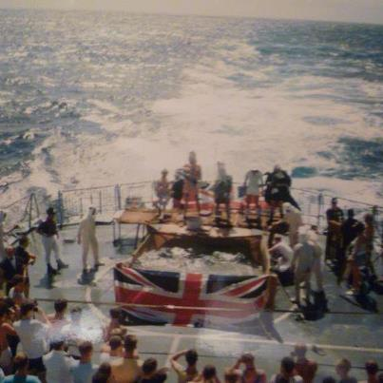
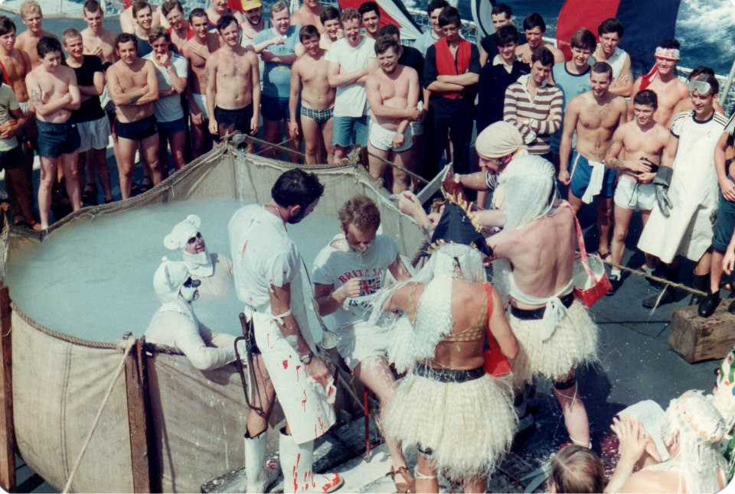
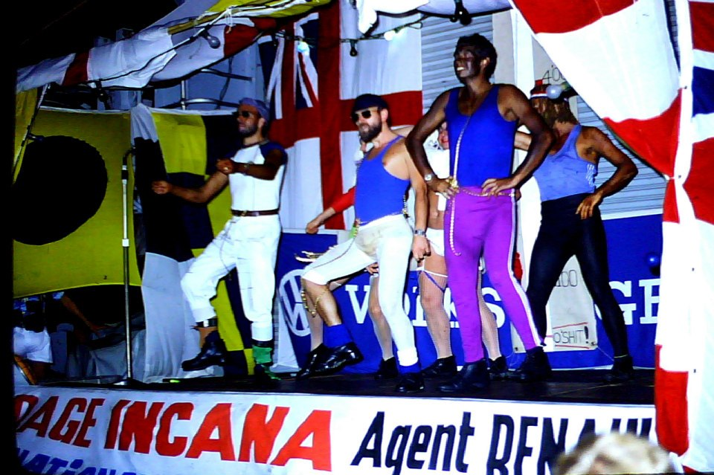
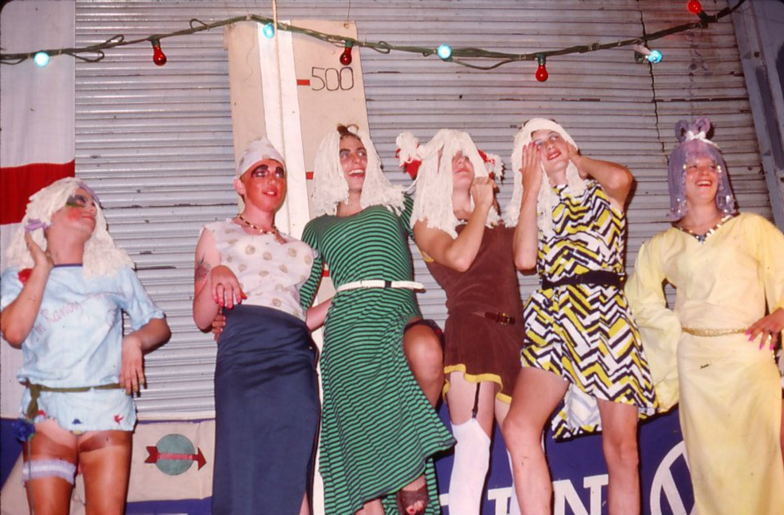
Homeward Bound
Notes:
On the way home the crew took time to relax, managing to fit in a crossing the line ceremony and a sods opera
The ships heating was turned back on

Slide 28
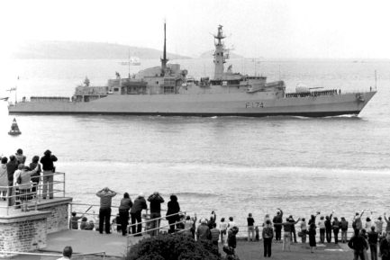
HMS Alacrity comes home
Notes:
The most emotional day I think I ever had, we were totally unprepared for the welcome home we got, there were only a handful of families on the fore shore to wave us goodbye in April, 10’s of thousands turned out to welcome us home, some of the crew were in tears

Slide 29

Home to my Mammy

