Slide 1
Planning for the new national curriculum
Jerome Freeman
Historical Association Conference
York, 11th May 2013

Slide 2
Activity 1 A quick test of your historical knowledge
Match the picture to the correct label
Group the pictures and labels into 4 periods/eras and give each period/era your own title e.g. “Ancient Civilisations”

Slide 3
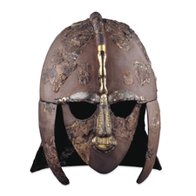
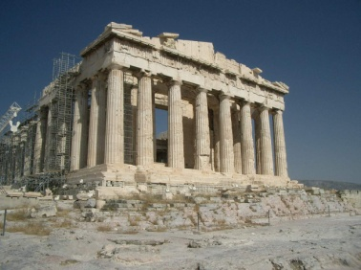
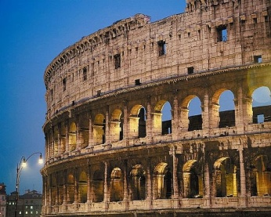
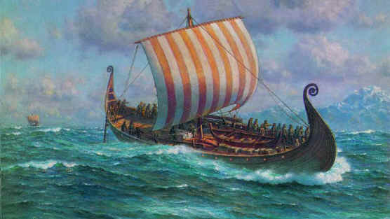
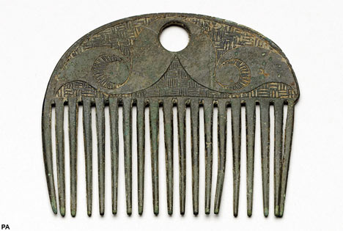
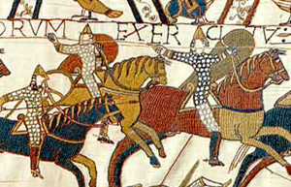
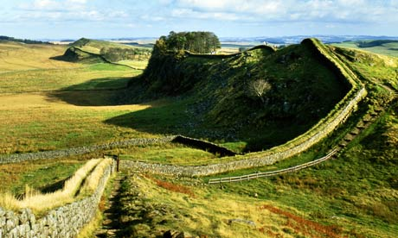
Answers
Ancient Greece
Ancient Rome
Iron Age
Romans in Britain
KS2 has changed radically
Anglo Saxons
Vikings
Normans

Slide 4
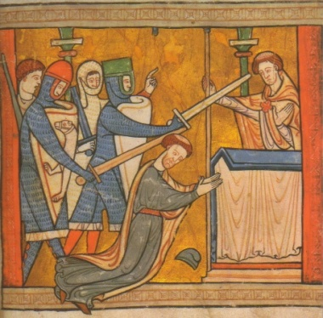
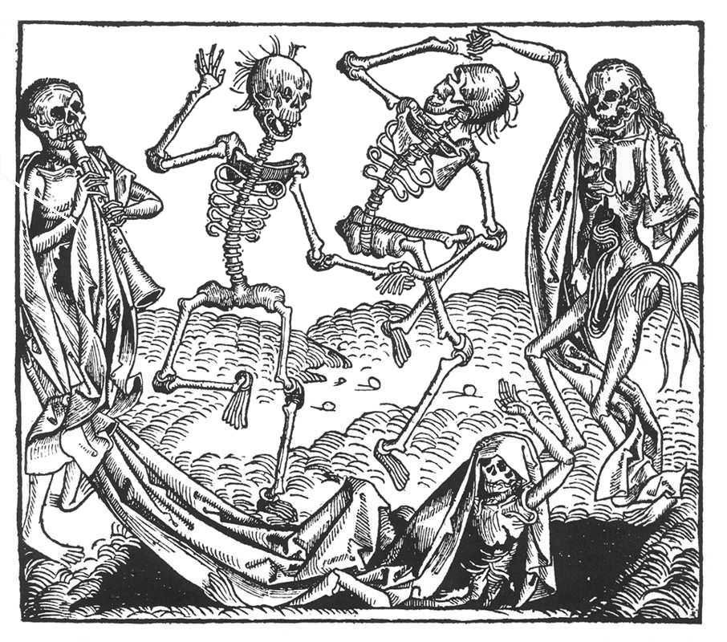
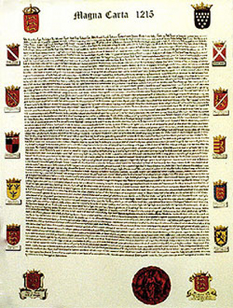
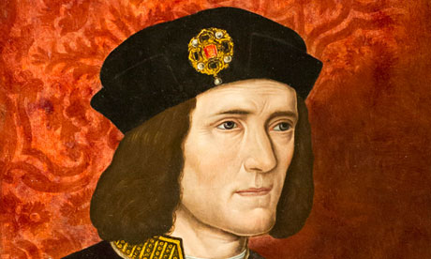
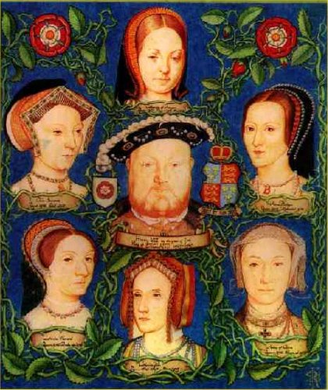
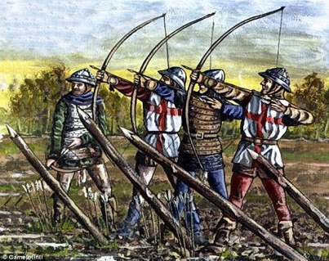
Answers
The murder
of Becket
Magna Carta
The Hundred
Years War
KS2 has changed radically
The Black
Death
Richard III
Henry VIII

Slide 5
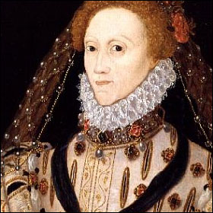
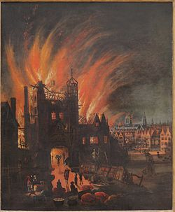
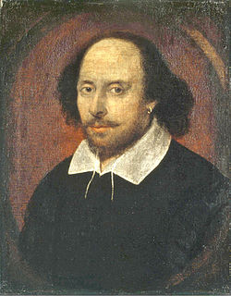
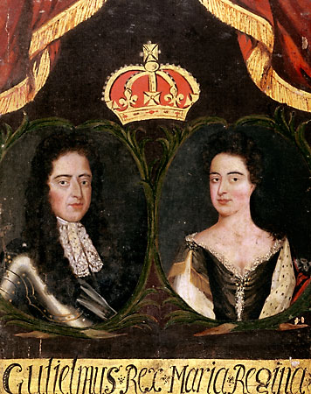
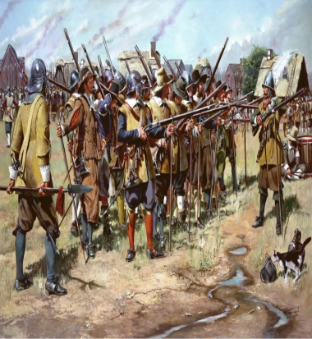
Answers
Elizabeth I
Shakespeare
The English
Civil Wars
The Great Fire
of London
William and Mary

Slide 6
One way of organising the KS2 content
Period/Era | Year Group
Ancient Civilisations | Year 3
Invaders & Settlers | Year 4
Plantagenet England | Year 5
The Tudor & Stuart World | Year 6

Slide 7
Still too much to ‘cover’ in 4 years!
So how do we organise the content to create
schemes of work that:
fire pupils' curiosity and imagination
develop pupils’ understanding of history at personal, local, national and international levels
help pupils to ask and answer meaningful questions
about the past
enable pupils to make connections within and across different periods and societies?

Slide 8
Why not study some of the content in outline and select some to explore in more detail?
Overview studies (enquiries)
that enable children to develop a broad knowledge and
understanding of the main events and people across a long
time span, develop a sense of period/era, and identify the
links and developments.
Depth studies (enquiries)
that enable pupils to immerse themselves in the rich detail
of the past through exploring some of the key events,
people or changes and making the big ideas and stories
more memorable.

Slide 9
An example for Key Stage 2
Year 3
Overview: Ancient Civilisations Who were the Ancient Greeks & Romans? How was life in Ancient Greece & Rome different from life today? What happened to the Ancient Greek & Roman Empires?
Depth enquiry
Why do we remember Alexander the Great?
Depth enquiry
What can we learn from Greek myths and legends?
Depth enquiry
Why did the Romans conquer Britain and how did life change?
Depth enquiry
What kinds of sources tell us about the Romans in our local area?
Significance
Similarity & difference
Cause & consequence
Evidence

Slide 10
An example for Key Stage 2
Year 4
Overview: the Invaders & Settlers Who were the Anglo-Saxons, Vikings and Normans? How was life in the Medieval period different from life today? How did the way England was ruled change?
Depth enquiry
How can Sutton Hoo help us to find out about the Anglo Saxons?
Depth enquiry
Why have people changed their minds about the Vikings?
Depth enquiry
How did life change under the Norman kings?
Depth enquiry
Why did the Normans go on the Crusades?
Evidence
Interpretations
Change & continuity
Cause & consequence

Slide 11
An example for Key Stage 2
Year 5
Overview: Plantagenet England Who were the Plantagenets? How did people’s everyday lives change in this period? How did England get on with its neighbours in Wales, Scotland and France?
Depth enquiry
How should Henry II be remembered?
Depth enquiry
Why did John I sign the Magna Carta?
Depth enquiry
Why was the Black Death so terrifying?
Depth enquiry
What kinds of sources tell us most about the Wars of the Roses?
Interpretations
Cause & consequence
Change & continuity
Evidence

Slide 12
An example for Key Stage 2
Year 6
Overview: the Tudor and Stuart World Who were the Tudors and Stuarts? How was life different for the rich and poor in this period? How did the knowledge of the world change during this period? What happened to the House of Stuart?
Depth enquiry
Why did Henry VIII marry so many times?
Depth enquiry
What “age” was the reign of Elizabeth I?
Depth enquiry
How did the English Civil War affect our local area?
Depth enquiry
Why do people keep changing their minds about Oliver Cromwell?
Cause & consequence
Significance
Change & continuity
Interpretations

Slide 13
Activity 2 One idea for teaching the past in overview
Who were the Anglo-Saxons, Vikings and Normans?
A human timeline

Slide 14
More ideas for teaching overviews
Remember, we want to begin to develop the children’s knowledge
and understanding across a long time span:
Dynamic timelines
Card sorts
Artefacts
Get the children to create a display, their own timelines, a
museum exhibition encapsulating the key events, people and
changes.
Help them to build up a mental image of the past.
More ideas from Ian Dawson’s website: Thinking History

Slide 15
More ideas for teaching overviews
BBC history timelines
http://www.bbc.co.uk/history/interactive/timelines/
Use the ones on the website and customise them by adding your own events etc.
Timetoast
http://www.timetoast.com/
Create your own using the templates provided

Slide 16
Finally, how we plan the history curriculum really does matter

