Slide 1
When was Robert Clive born?
1725

Slide 2
What country was Robert Clive born in?
Shropshire

Slide 3
Where did Robert Clive first live in India?
Chennai

Slide 4
What was unusual about the elephants at the Battle of Arcot?
They wearing armour

Slide 5
How did the Prime Minister Pitt refer to Clive after the Battle of Arcot?
Heaven sent General

Slide 6
What Hindi nickname was Clive given after the Battle of Arcot?
Sabat Jung

Slide 7
What atrocity of 1756 led to the Battle of Plassey?
Black hole of Calcutta

Slide 8
How did Robert Clive die?
He committed suicide.

Slide 9
Why was Robert Clive criticised on his return to England?
Being too rich

Slide 10
Robert Clive gets expelled from three schools.
Move back two

Slide 11
Robert Clive tried to commit suicide after arriving in India.
Move back two

Slide 12
Robert Clive escapes from the French in 1746.
Move forward two

Slide 13
Robert Clive is made a Baron.
Move forward two

Slide 14
Robert Clive is described by the Prime Minister as a Heaven sent general.
Move forward two

Slide 15
Clive fought off an attack from elephants with armour at the Battle of Arcot!
Move forward two

Slide 16
3000 soldiers with Clive defeat an army of 68,000 at the Battle of Plassey.
Move forward two

Slide 17
Thousands of Indian soldiers lose their lives in battles for their land.
Move back two

Slide 18
The people of India do not have independence from Britain until 1948.
Move back two

Slide 19
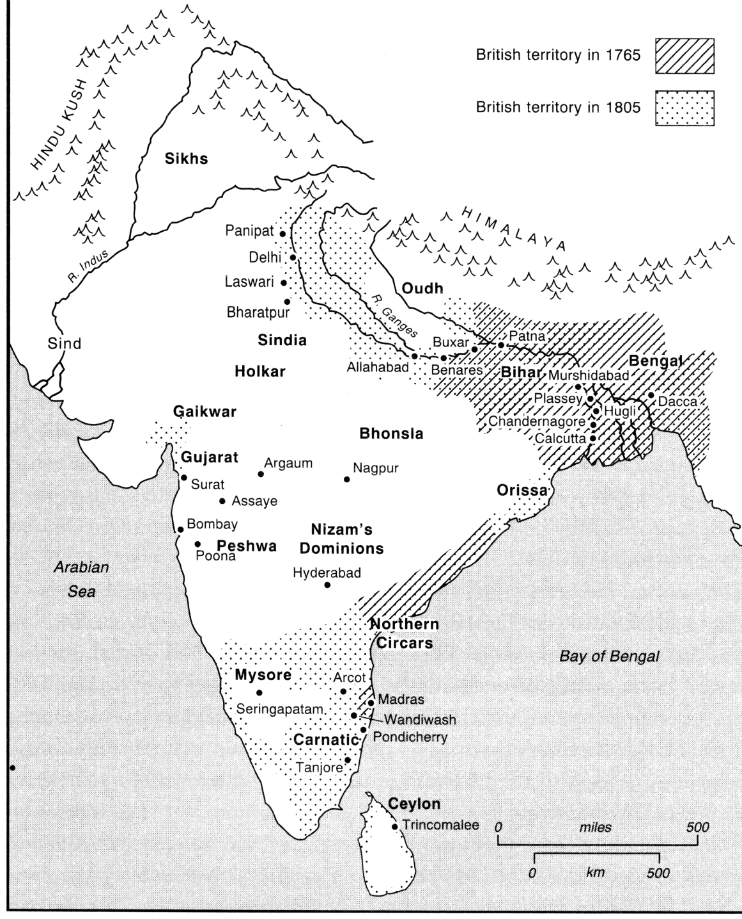
What country is this?

Slide 20
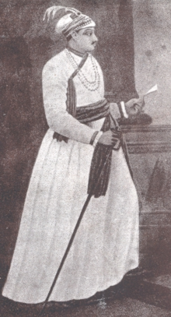
Who is this?

Slide 21
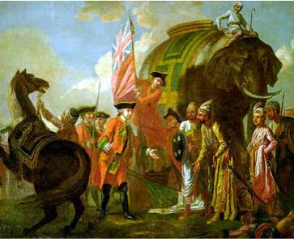
In what battle of 1751 did Clive fight elephants in armour?

Slide 22
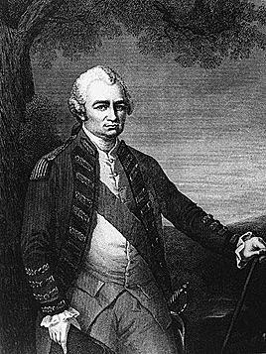
Who is this man?

Slide 23
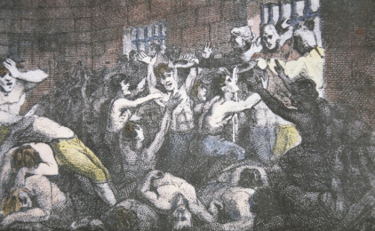
What atrocity does this show?

Slide 24
What title was this man given when he returned to England?

Slide 25
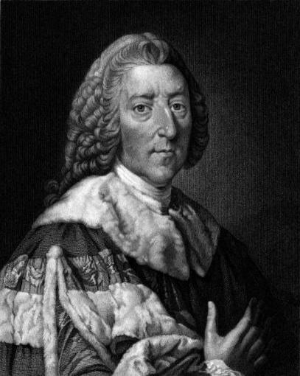
This British Prime Minister called Robert Clive a “heaven born general”. Who is he?

Slide 26

What British trading company does this represent?

Slide 27
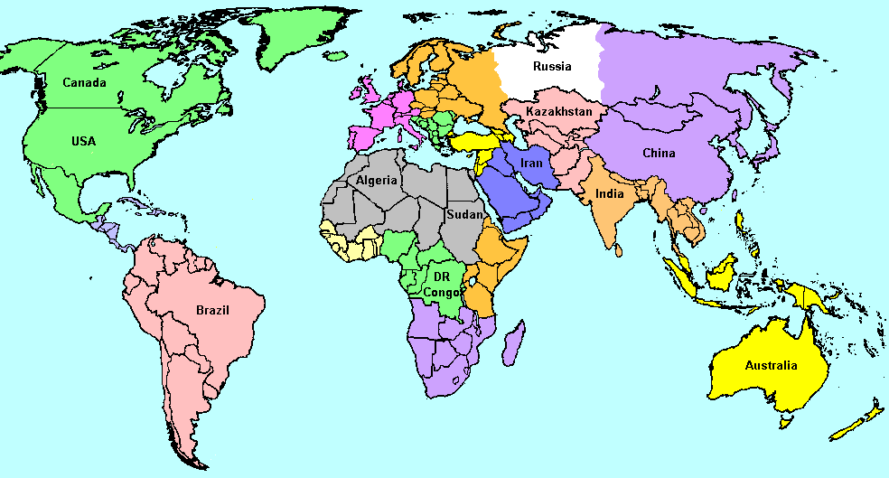
Which country did Robert Clive stay on for nine months on the way to India?

Slide 28
Battle for Arcot

Slide 29
Nawab Siraj

Slide 30
India

Slide 31
Baron Clive of Plassey.

Slide 32
Black hole of Calcutta

Slide 33
Robert Clive

Slide 34
Brazil

Slide 35
East India Company

Slide 36
William Pitt

