Slide 1
Getting them learning…
making it fun!
Aim of this session
To think about the different ways children learn.
To look at strategies to address these different ways.
To have some fun!
To leave with some knowledge of Mr Gove’s new curriculum.

Slide 2
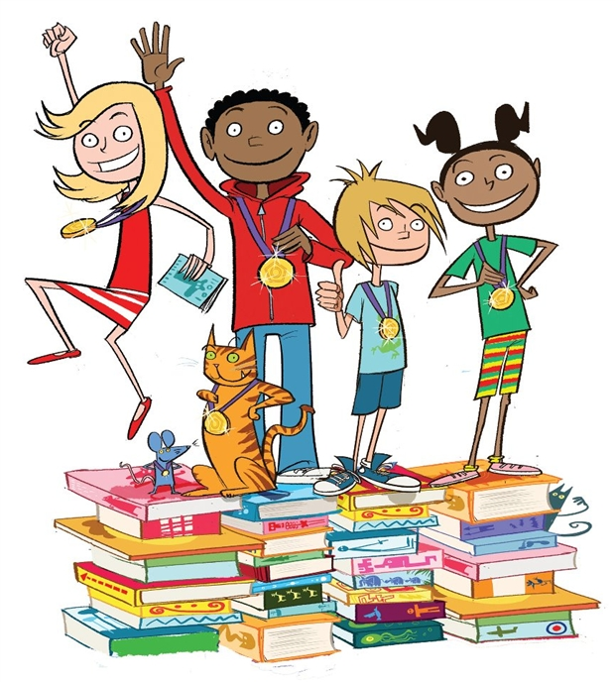
Reading!
It’s essential for all learners!
Why is it a problem with lower ability children?
What puts them off?
What puts us off asking them to read?

Slide 3
Speech.
We learn to talk
before we learn to write for a reason!
Saying things!
Explaining things!
Singing things!
Good written literacy can only develop after good oral literacy – particularly important for EAL learners.

Slide 4
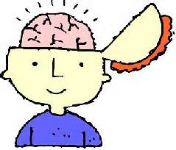
Remembering
The initial learning has to work!
The initial learning has to be recorded in a form that will make sense often more than a year later.
Techniques need to be tried and developed – students need to find a motivation to want to remember.

Slide 5
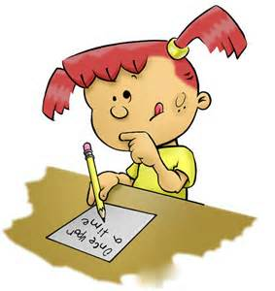
Writing
Writing to record information
Writing to explain and analyse information.
Writing in timed conditions.
Writing that makes students proud!

Slide 6
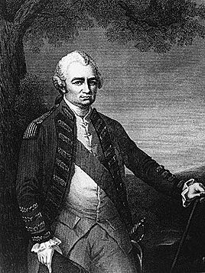
Who is this man?
Why does Michael Gove think 11-14 years should know about him?

Slide 7
Reading!

Slide 8
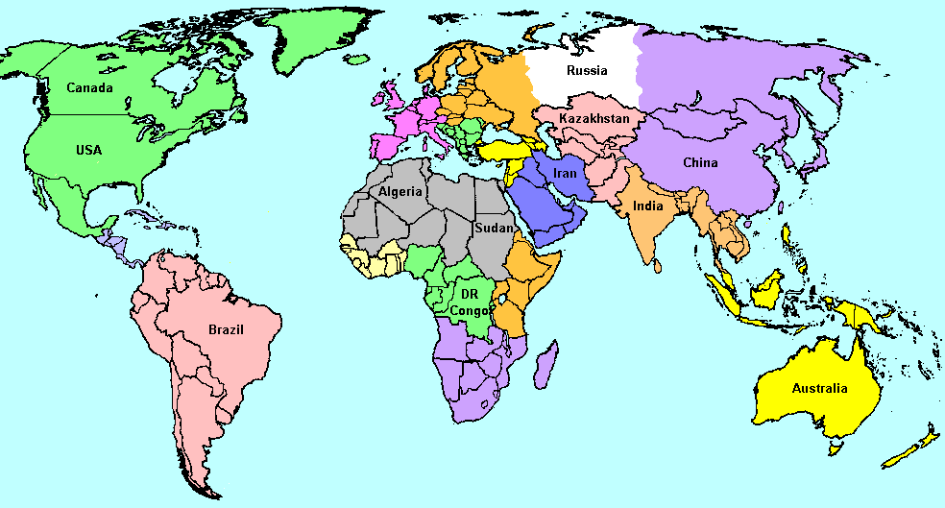

Slide 9
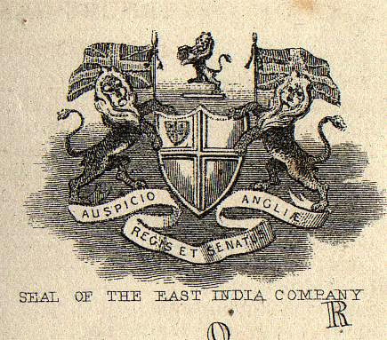

Slide 10
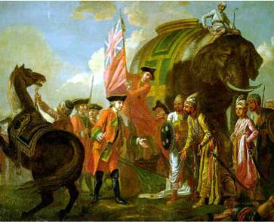

Slide 11
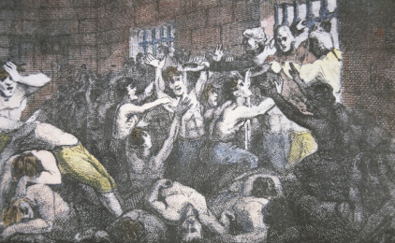

Slide 12
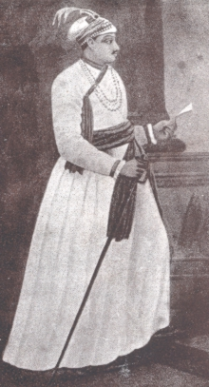
Nawab Siraj

Slide 13
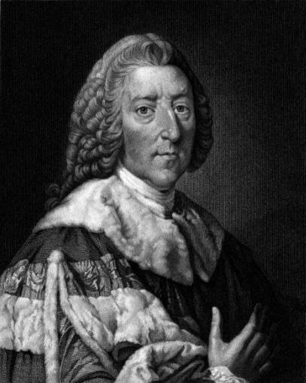

Slide 14
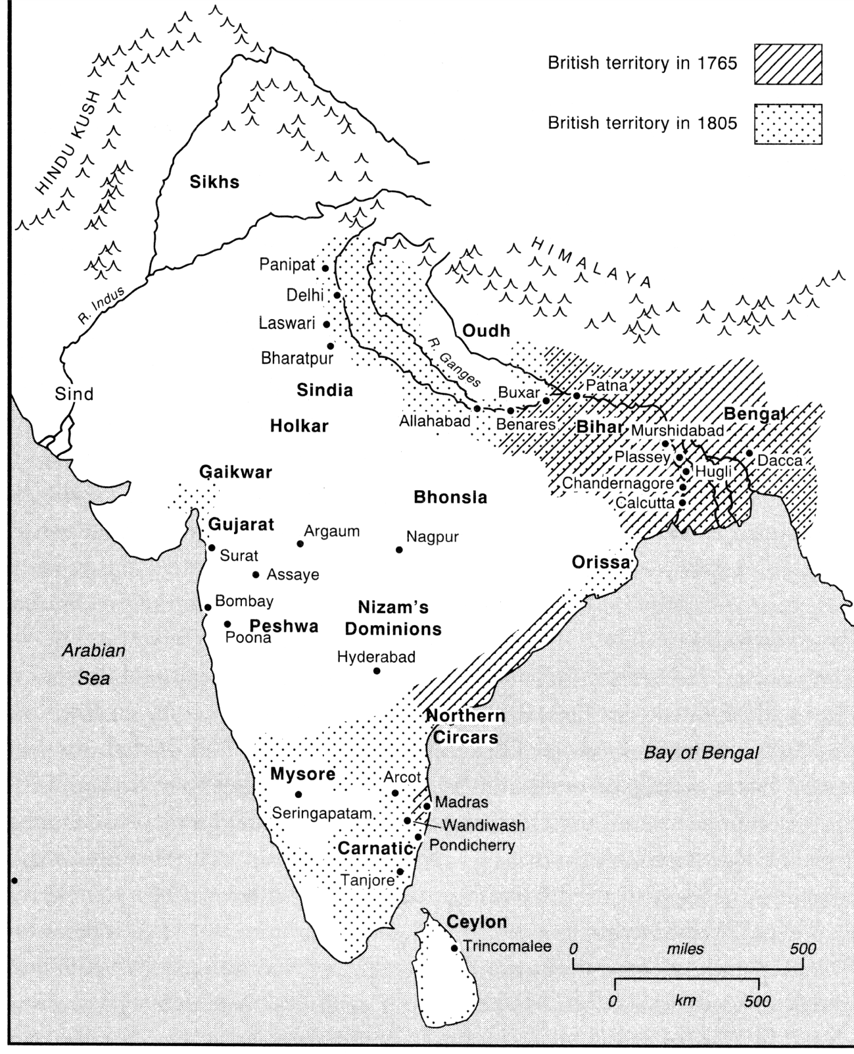

Slide 15
Singing!

Slide 16
Robert Clive,
Problem child,
Sent by dad to India,
Became a clerk.
1744,
Arrived in Chennai,
East India Company employed him,
Buying goods

Slide 17
1746,
French attack
Clive is captured,
Soon escapes,
He becomes a soldier,
Has huge victories,
Sabat Jung,
General heaven sent,

Slide 18
1756,
Reputation confirmed
Revenge for Calcutta,
Plassey victory,
Returns to England,
Becomes an MP,
Criticised for riches,
Suicide.
Why’s he significant,
The British Empire,
India the jewel,
Because of Clive.

Slide 19
30 seconds on Robert Clive – select three cards and use these words.
Speaking!

Slide 20
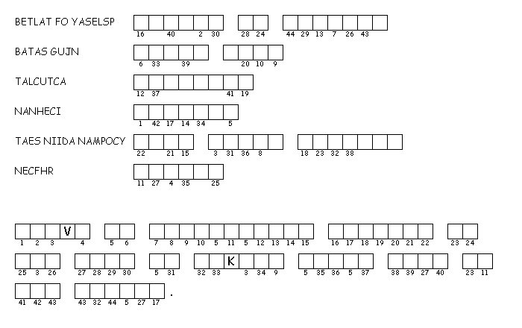
Robert Clive
Where Clive defeated Nawab Siraj.
His nickname after the Battle for Arcot.
Place where British soldiers died in a prison.
Place where Clive first worked in India.
What army was Robert Clive part of?
These Europeans were also trying to control land and trade in India.
www.discoveryeducation.com/puzzlemaker
Key Words to confirm learning

Slide 21
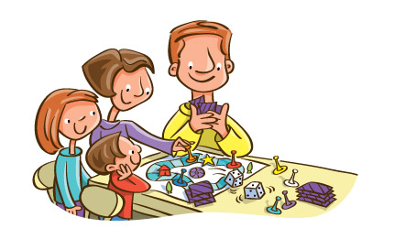
Remembering…
and caring about it!

Slide 22
Writing ….
Learn to walk before you can run
If you can walk… you can run!

Slide 23
Cloze exercises
Robert Clive was born in _______ in the country of ___________. His father was an _________. He was _________ from many schools.
Heads and Tails
the East India Company.
made him join the company army.
to work in India by his Dad.
Robert Clive was sent
He was employed by
Being captured by the French

Slide 24
Paragraphs with mistakes
Robert Clive first became known as a chef after the Battle of Arcot. This took place in 1758. He defeated French backed Chinese soldiers. He also had to fight elifants wearing armour. His fame grew after the atrocity in Chennai.

Slide 25
Sentence starters
I believe Clive is significant because ….
My evidence for this is …
His long term significance is…
Not everyone would agree about him because…

Slide 26
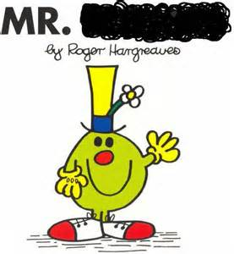
A plenary!

Slide 27
Shropshire

Slide 28
1744

Slide 29
Sabut Jung

Slide 30
signifcant

Slide 31
Battle of Arcot

Slide 32
Calcutta

Slide 33
Nawab Siraj

Slide 34
MP

Slide 35
Chennai

Slide 36
suicide

Slide 37
1760

Slide 38
Battle of Plassey

Slide 39
British Empire

Slide 40
Jewel in the Crown

Slide 41
East India Company

Slide 42
1725

Slide 43
1774

Slide 44
Baron

Slide 45
richardsonpaige@yahoo.co.uk

