Slide 1
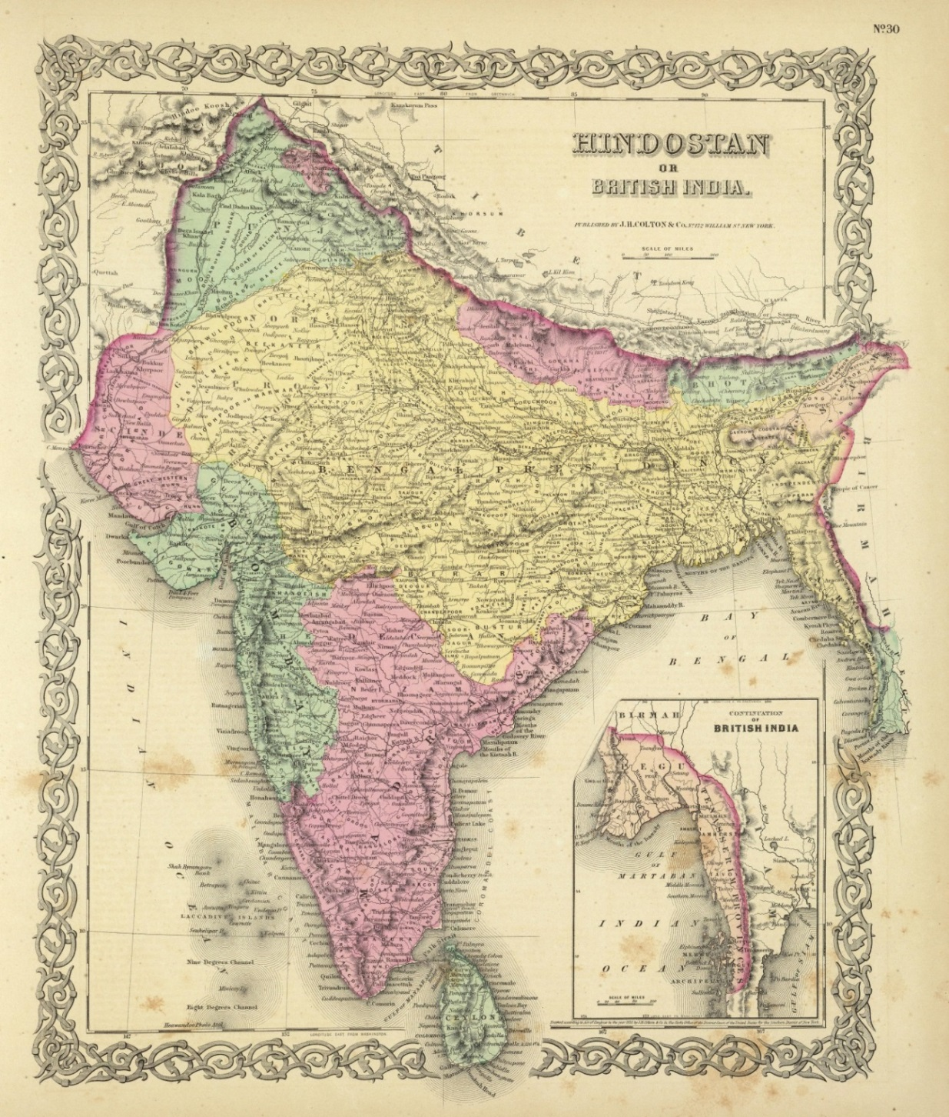
LIONS OF THE GREAT WAR LESSON 1: RESOURCE C
Notes:
Slide 1
Map of 'Hindostan Or British India' in 1856. By this time, Britain dominated India but in 1845 its power was challenged by the independent north Indian kingdom of Punjab sometimes known as the Sikh Empire.
UKPHA Archive

Slide 2
LIONS OF THE GREAT WAR LESSON 1: RESOURCE C
Notes:
Slide 2
Map of the Sikh Empire in 1839.
Designed by Jugasingh.com/Grfik.com.

Slide 3
LIONS OF THE GREAT WAR LESSON 1: RESOURCE C
Notes:
Slide 3
A Sikh warrior bathes in the pool around the Golden Temple of Amritsar.
Courtesy of Taran Singh Padam.

Slide 4
What do Sikhs believe and how are they supposed to live?
LIONS OF THE GREAT WAR LESSON 1: RESOURCE C
Sikhism began in the fifteenth century (AD/CE) in Punjab, a region in South Asia that is now split between India and Pakistan. Sikhs (meaning learners) read, sing and learn from their holy book, the Guru Granth Sahib. Sikhism teaches that:
all religions have truth in them;
all people have God within them and are therefore equal;
everyone (whatever caste they may be from) can find God with no need of ceremonies or priests;
Sikhs should act with purity, honesty, faithfulness and self-control;
Some Sikhs go through a special ceremony after which Sikh males take the surname ‘Singh’ (lion) and women ‘Kaur’ (prince);
These Sikhs are to act as saintly warriors, ready to defend the weak, the poor and themselves if they have to;
They are also are also expected to follow certain customs as symbols of their faith such as not cutting their hair and avoiding smoking.

Slide 5
LIONS OF THE GREAT WAR LESSON 1: RESOURCE C
Notes:
Slide 5
Maharaja Ranjit Singh with his favourite, Raja Heera Singh, c. 1835-38.
Toor Collection.

Slide 6
LIONS OF THE GREAT WAR LESSON 1: RESOURCE C
Notes:
Slide 6
A British Victorian print showing Sir Henry Hardinge, British Governor-General of India and his officers surveying the battlefield at Ferozeshah (a village in Punjab, North India) on the first night of this crucial battle during the first Anglo-Sikh War in December 1845 when British forces faced defeat. The images show exhausted British soldiers sleeping amid the British dead.
Courtesy of the Council of the National Army Museum, London (acc. no. 1971-02-33-165)

Slide 7
IMAGE CREDITS
LIONS OF THE GREAT WAR LESSON 1: RESOURCE C
Slide 1 Map of 'Hindostan Or British India' in 1856. UKPHA Archive
Slide 2 Map of the Sikh Empire in 1839. Designed by Jugasingh.com/Grfik.com.
Slide 3 A Sikh warrior bathes in the pool around the Golden Temple of Amritsar. Courtesy of Taran Singh Padam.
Slide 5 Maharaja Ranjit Singh with his favourite, Raja Heera Singh. Toor Collection.
Slide 6 Engraving of the battlefield at Ferozeshah in December 1845. Courtesy of the Council of the National Army Museum, London (acc. no. 1971-02-33-165).

