Slide 1
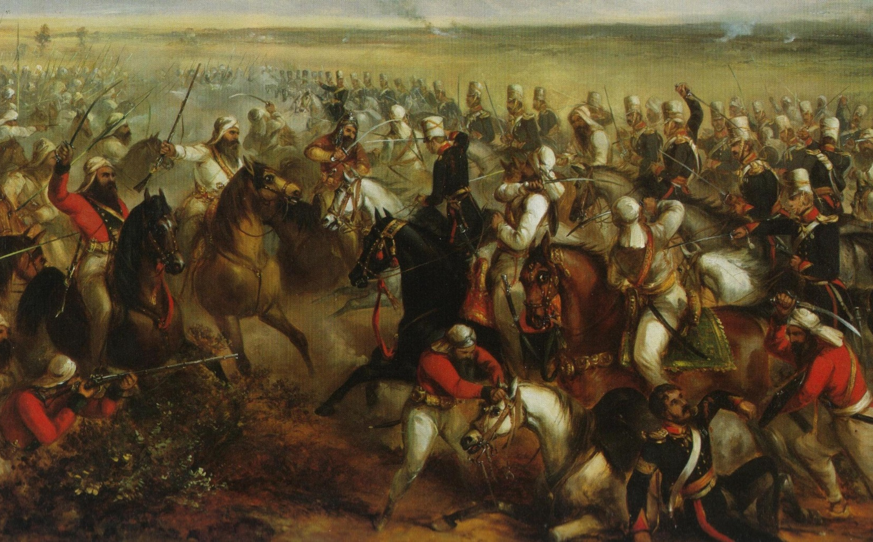
1845-46 & 1848-49: Anglo-Sikh Wars fought in the Punjab
LIONS OF THE GREAT WAR LESSON 1: RESOURCE F
Notes:
Slide 1
3rd King's Own Light Dragoons and the Khalsa Army clash in the Battle of Chillianwalla during the Second Anglo-Sikh War.
Courtesy of www.thequeensownhussars.co.uk

Slide 2
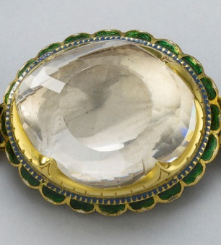
1850: The British confiscated the
Koh-i-noor diamond
LIONS OF THE GREAT WAR LESSON 1: RESOURCE F
Notes:
Slide 2
The Koh-i-noor (Persian for ‘Mountain of Light’) diamond in its original setting.
Royal Collection Trust/© Her Majesty Queen Elizabeth II 2014

Slide 3
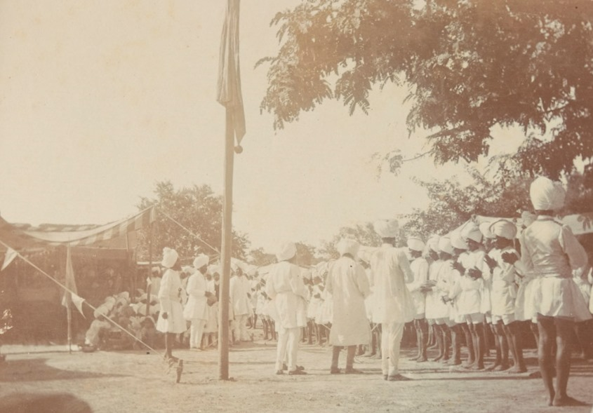
1851: The British introduced Sikh customs to their new Sikh regiments
LIONS OF THE GREAT WAR LESSON 1: RESOURCE F
Notes:
Slide 3
Sikh recruits of the 34th Sikh Pioneers taking the Khalsa initiation at the Mian Mir Cantonment, Lahore, in 1906.
Courtesy of the Council of the National Army Museum, London (acc. no. 7109-25-2-45)

Slide 4
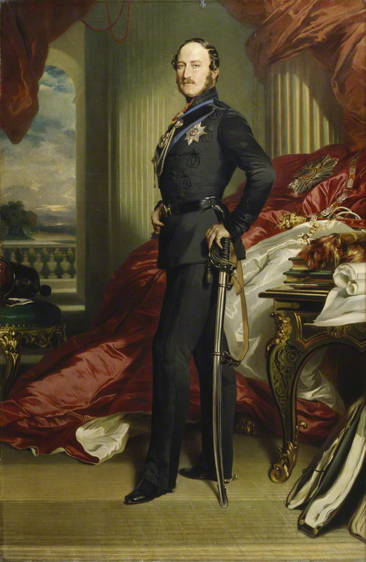
1852: Prince Albert recut the Koh-i-noor
LIONS OF THE GREAT WAR LESSON 1: RESOURCE F
Notes:
Slide 4
Prince Albert (1819–1861), the husband of Queen Victoria, had the Koh-i-noor diamond cut in Amsterdam so that it could be set in a brooch for her.

Slide 5
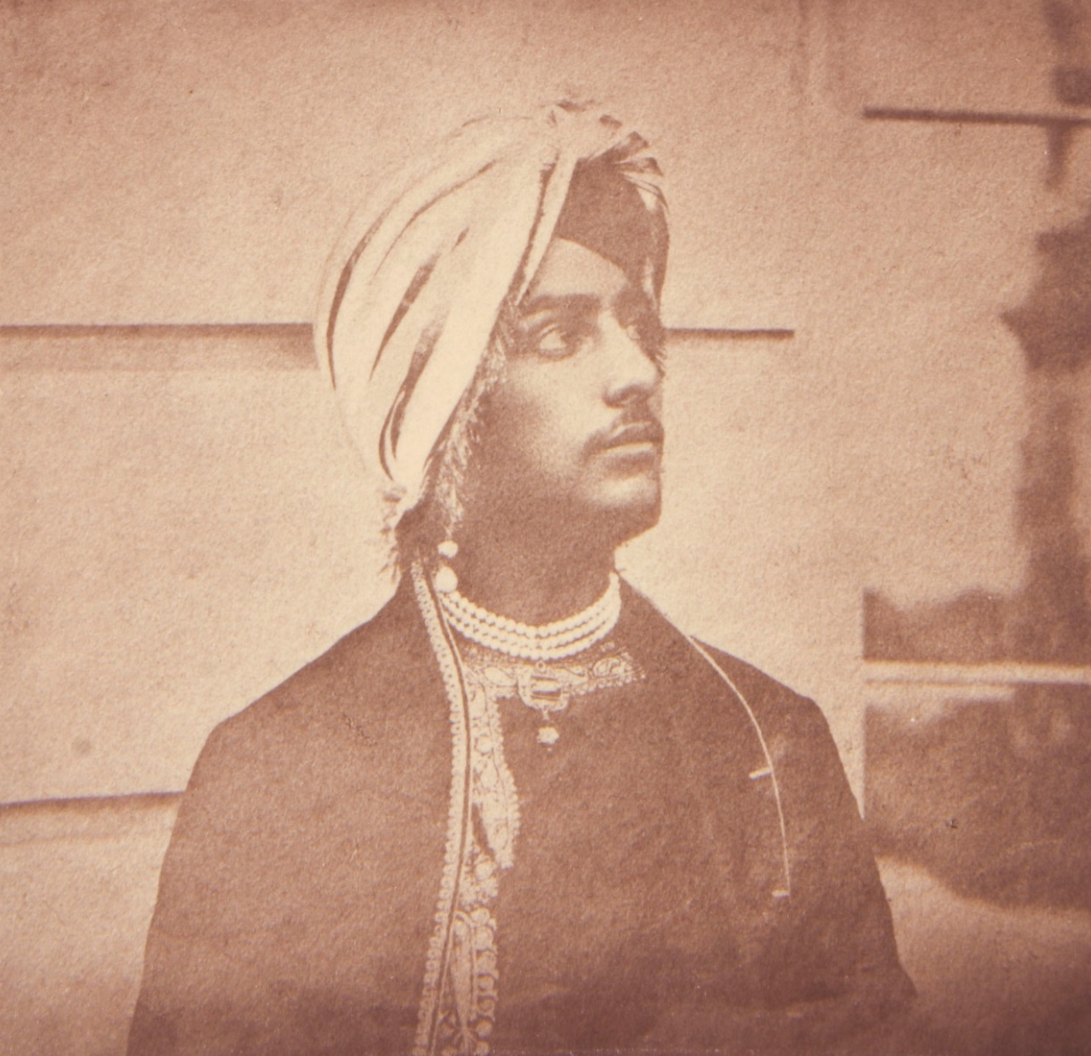
1854: Maharaja Duleep Singh exiled to Britain
LIONS OF THE GREAT WAR LESSON 1: RESOURCE F
Notes:
Slide 5
Maharaja Duleep Singh on the Lower Terrace at Osborne House, Isle of Wight, in August 1854.
Royal Collection Trust/© Her Majesty Queen Elizabeth II 2014

Slide 6
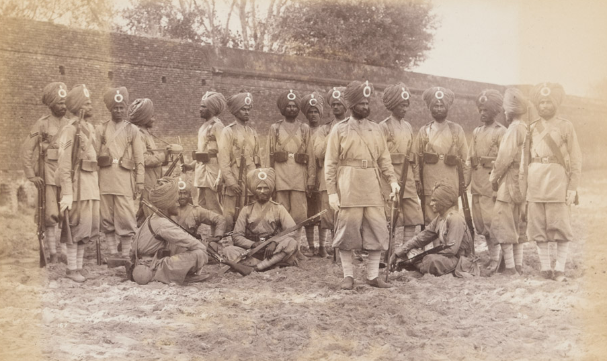
1854-56: Captain Rattray recruited Sikhs
LIONS OF THE GREAT WAR LESSON 1: RESOURCE F
Notes:
Slide 6
Men of the 45th Rattray's Sikhs at the Delhi Camp of Exercise in 1886.
Private collection

Slide 7
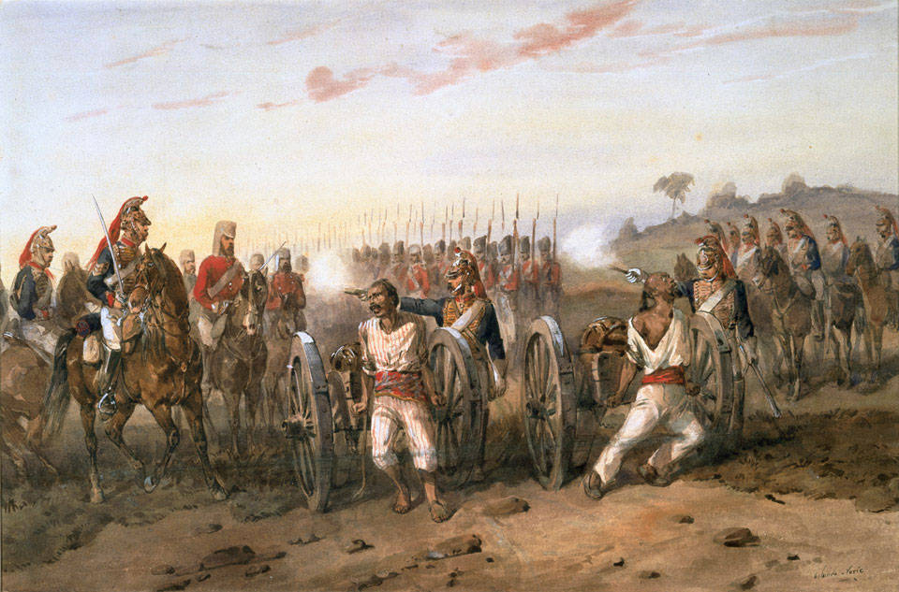
1857-58: The Sepoy Uprising
(the Indian Mutiny)
LIONS OF THE GREAT WAR LESSON 1: RESOURCE F
Notes:
Slide 7
Mutineers about to be blown from guns by the Bengal Horse Artillery, c. 1858.
Courtesy of the Council of the National Army Museum, London (acc. no. 1978-05-55-1)

Slide 8
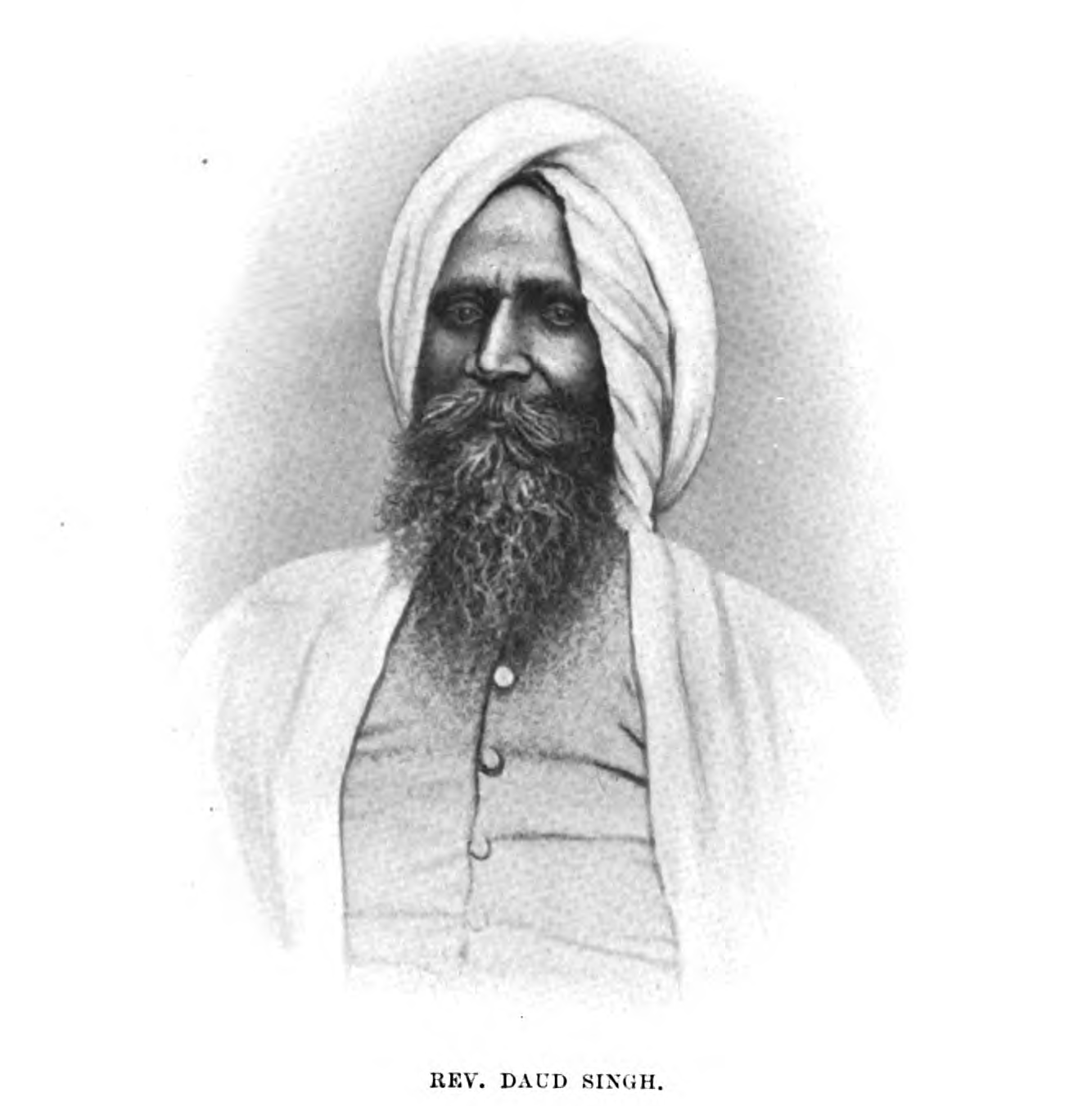
1858: Christian missionaries made a few Sikh converts
LIONS OF THE GREAT WAR LESSON 1: RESOURCE F
Notes:
Slide 8
Reverend Daud Singh was the first Sikh who converted to Christianity and the first ordained clergyman in Punjab.
UKPHA Archive

Slide 9
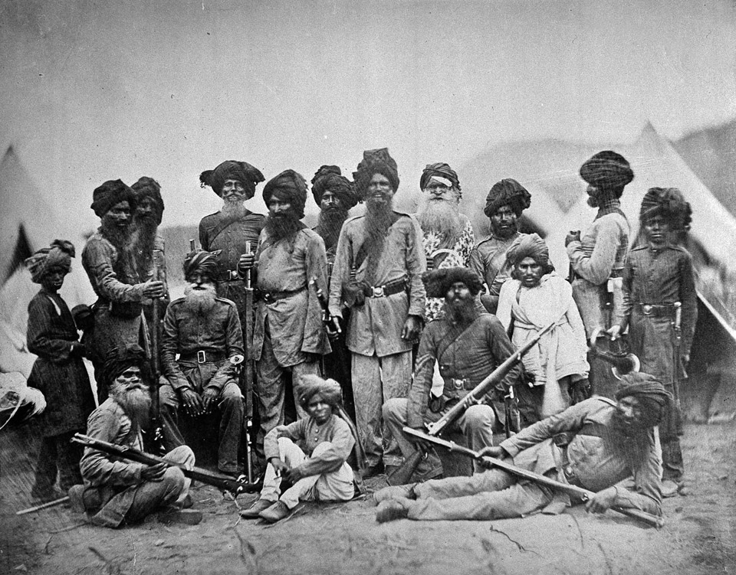
1860: Sikhs served in the Second Opium War against China
LIONS OF THE GREAT WAR LESSON 1: RESOURCE F
Notes:
Slide 9
Men of the 15th Punjab Infantry in China during the Second Opium War.
Toor Collection

Slide 10
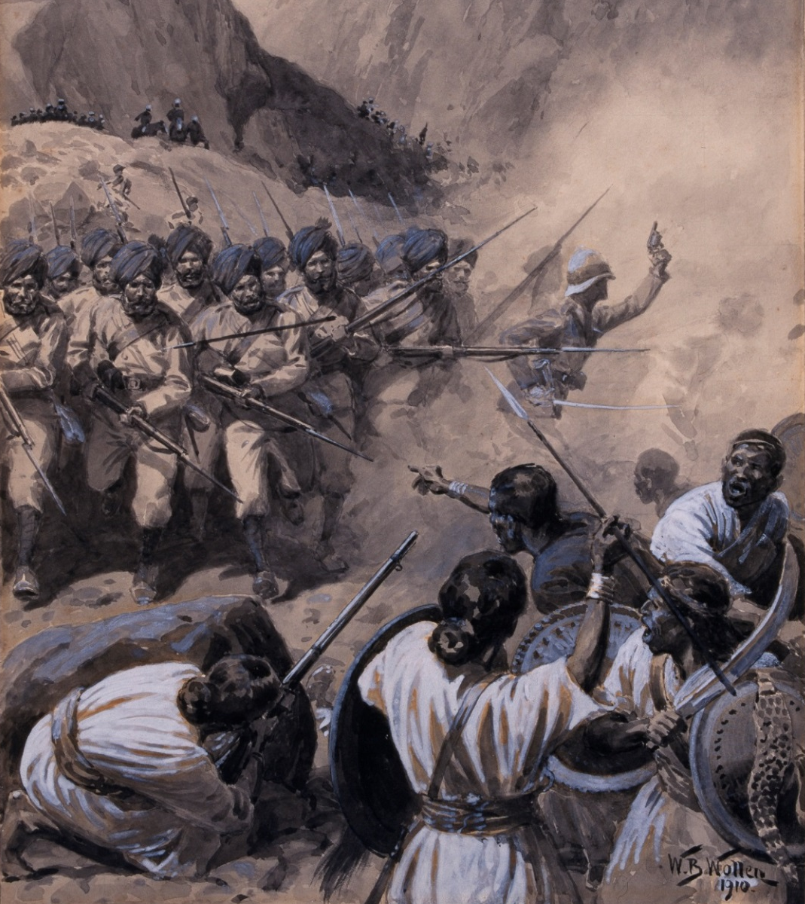
1867-68: Sikhs served in the
Abyssinian Expedition
LIONS OF THE GREAT WAR LESSON 1: RESOURCE F
Notes:
Slide 10
Charge of the 23rd Pioneers at Arrogee, 10 April 1868.
Courtesy of the Council of the National Army Museum, London (acc. no. 1956-02-202)

Slide 11
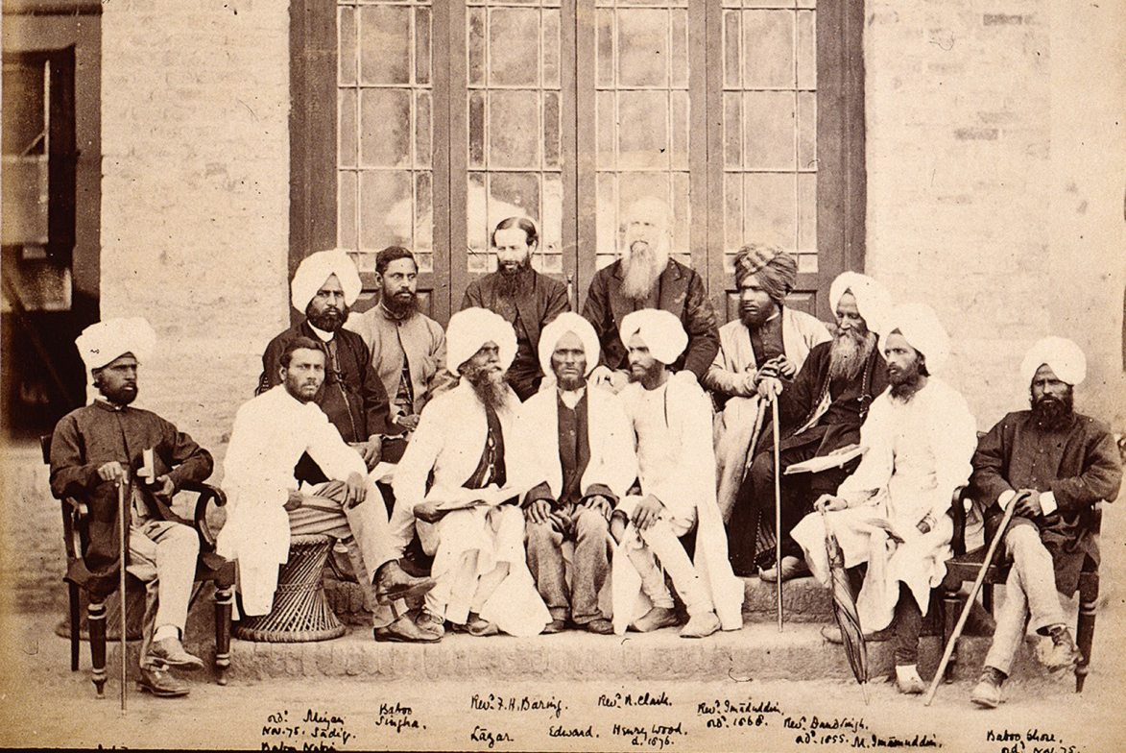
1873: Christian missionary activity provoked Sikhs to organise to protect their religion
LIONS OF THE GREAT WAR LESSON 1: RESOURCE F
Notes:
Slide 11
Agents of the Church Missionary Society (including Hindu, Sikh and Muslim converts) in Amritsar, March 1875.
© The British Library Board. All Rights Reserved (Photo 793/8)

Slide 12
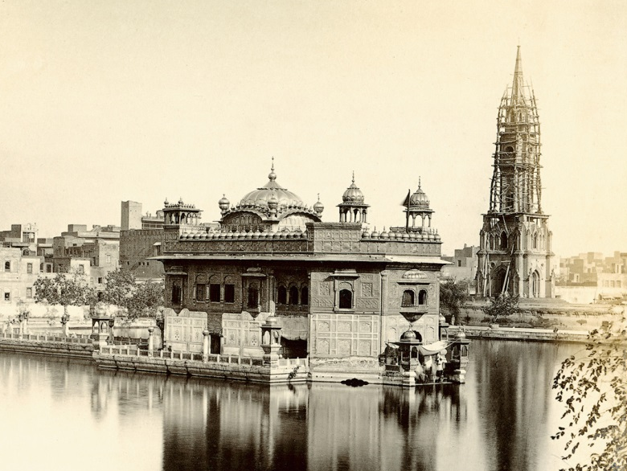
1874: The British build a big clock tower next to the Golden Temple
LIONS OF THE GREAT WAR LESSON 1: RESOURCE F
Notes:
Slide 12
The Golden Temple of Amritsar and an almost-complete clock tower photographed in September 1870.
Private Collection

Slide 13
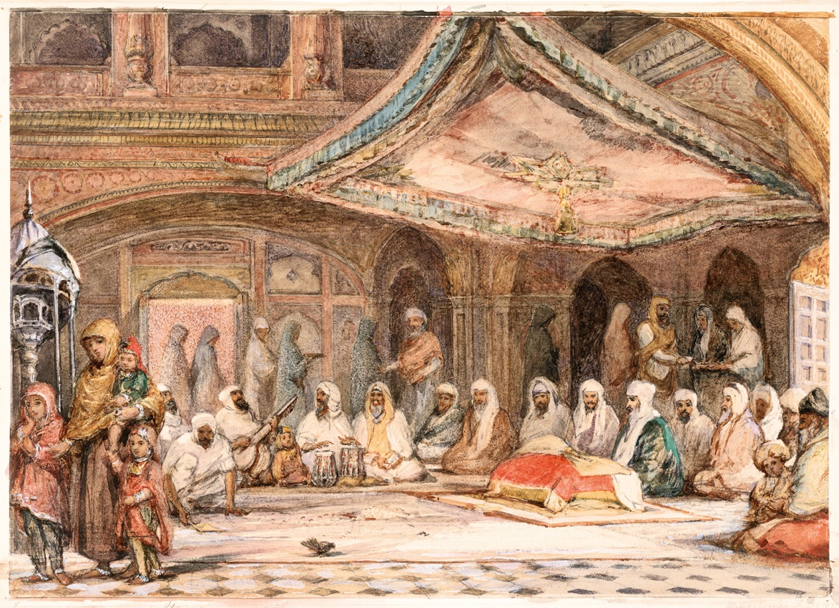
1876: The Prince of Wales visited the Golden Temple
LIONS OF THE GREAT WAR LESSON 1: RESOURCE F
Notes:
Slide 13
Inside the Golden Temple, Amritsar, in 1854.
© Victoria and Albert Museum, London

Slide 14
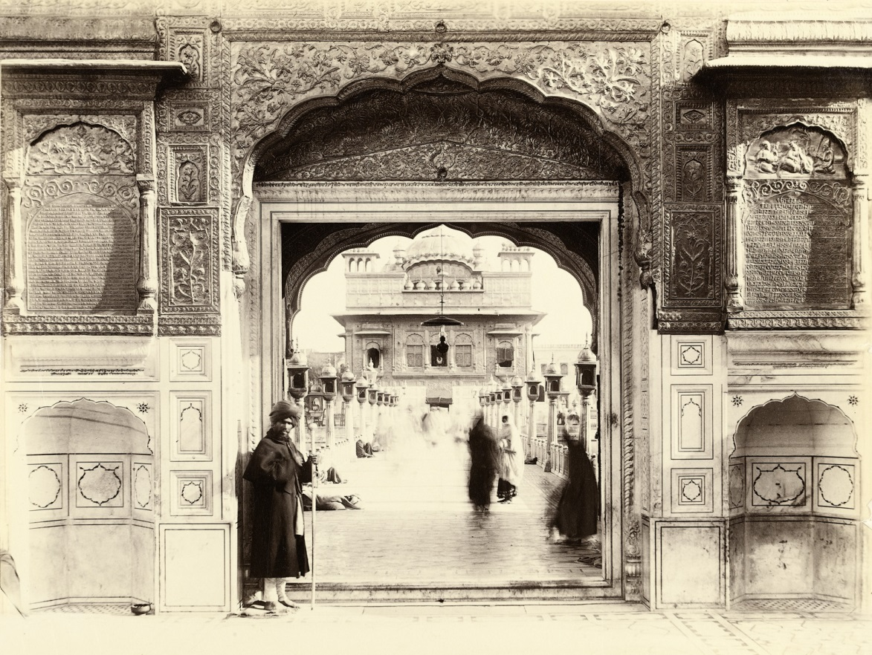
1877: The British nearly sold off the Golden Temple
LIONS OF THE GREAT WAR LESSON 1: RESOURCE F
Notes:
Slide 14
The gateway leading to the Golden Temple of Amritsar. On either side of the entrance are two gold panels in English and Punjabi that describe the ball lightning incident of 1877.
Toor Collection

Slide 15
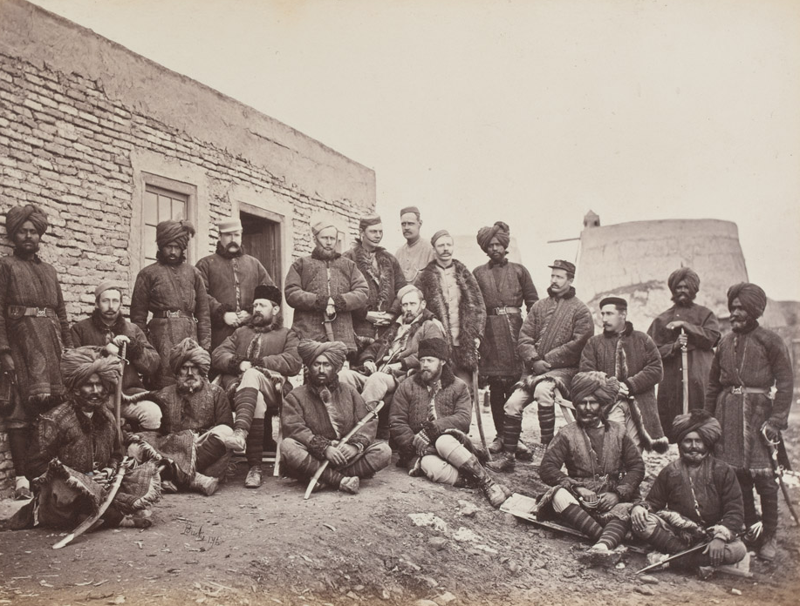
1878-80: Sikhs served in the Second Anglo-Afghan War
LIONS OF THE GREAT WAR LESSON 1: RESOURCE F
Notes:
Slide 15
British and Native Officers of the 3rd Sikh Infantry, part of the Punjab Frontier Force that was raised in Ferozepore, Punjab, in 1847.
Courtesy of the Council of the National Army Museum, London (acc. no. 1955-04-41-39)

Slide 16
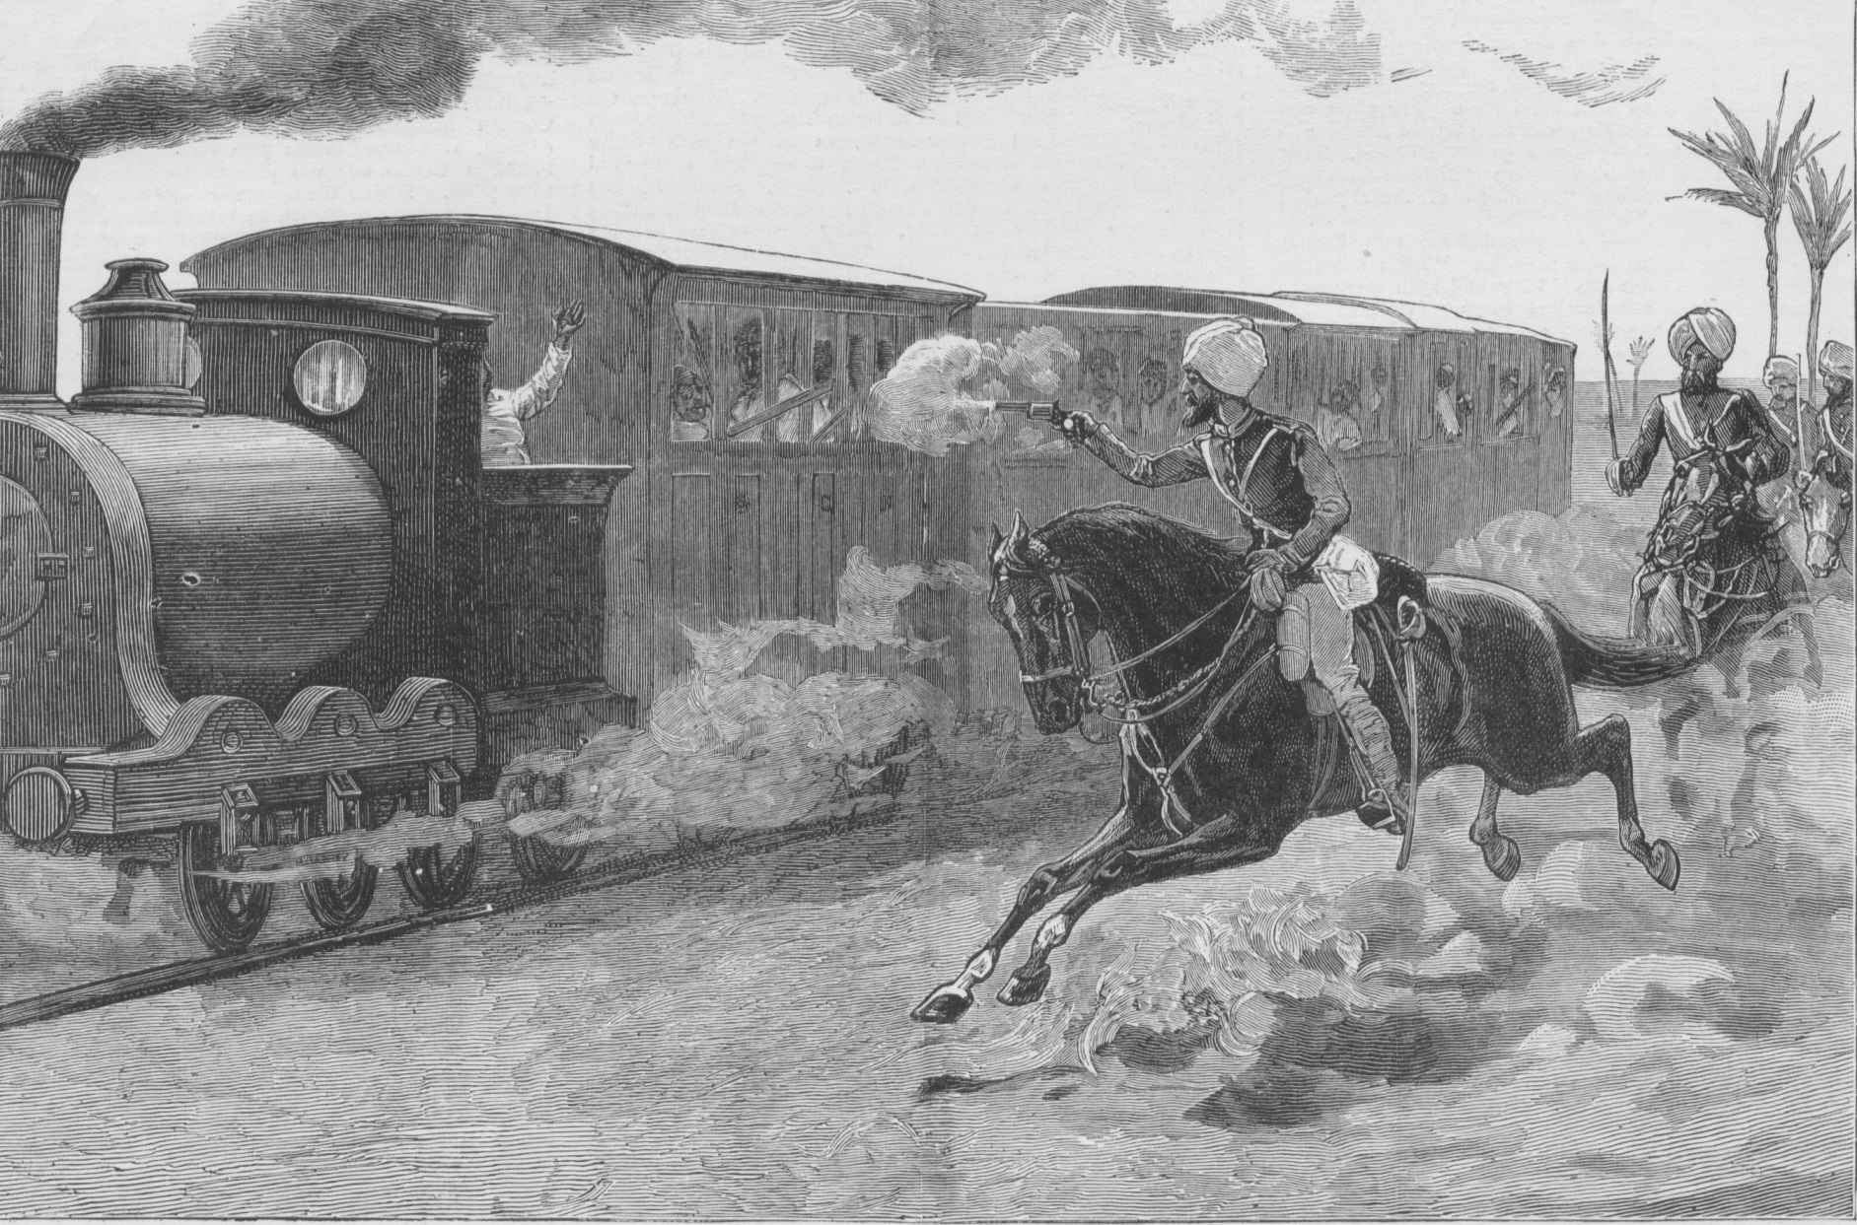
1882: Sikhs served in the
Anglo-Egypt War
LIONS OF THE GREAT WAR LESSON 1: RESOURCE F
Notes:
Slide 16
13th Bengal Lancers in Egypt capturing retreating trains after the Battle of Tel-el-Kebir, on September 13, 1882.
UKPHA Archive

Slide 17
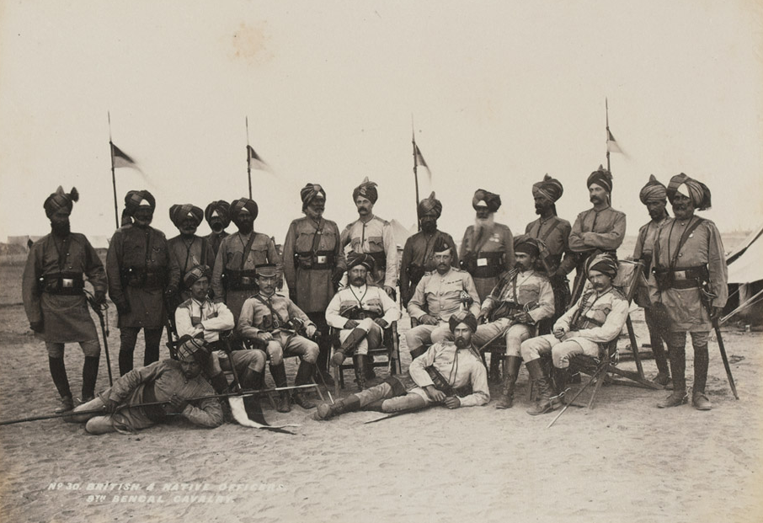
1884: Sikhs served in Suakin, Sudan
LIONS OF THE GREAT WAR LESSON 1: RESOURCE F
Notes:
Slide 17
British and Indian officers of the 9th Bengal Cavalry (also known as Hodson's Horse).
Courtesy of the Council of the National Army Museum, London (acc. no. 1972-11-91-23)

Slide 18
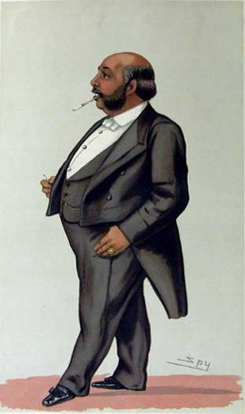
1887: Maharaja Duleep Singh’s anti-British plot failed
LIONS OF THE GREAT WAR LESSON 1: RESOURCE F
Notes:
Slide 18
A drawing of Maharaja Duleep Singh published in Vanity Fair in 1882 with the caption 'the Maharajah'.
Toor Collection

Slide 19
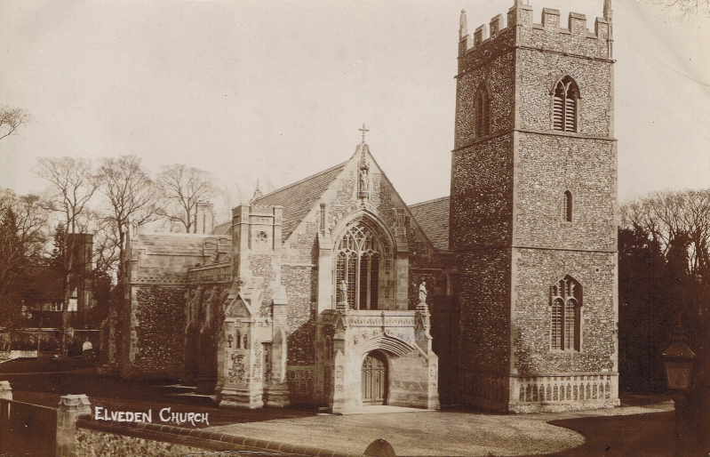
1893: Maharaja Duleep Singh was buried in Elveden Church
LIONS OF THE GREAT WAR LESSON 1: RESOURCE F
Notes:
Slide 19
The village church at Elveden in Norfolk where the last ruler of the Sikh Kingdom, Maharaja Duleep Singh was buried in 1893.
Courtesy of Peter Bance Collection

Slide 20
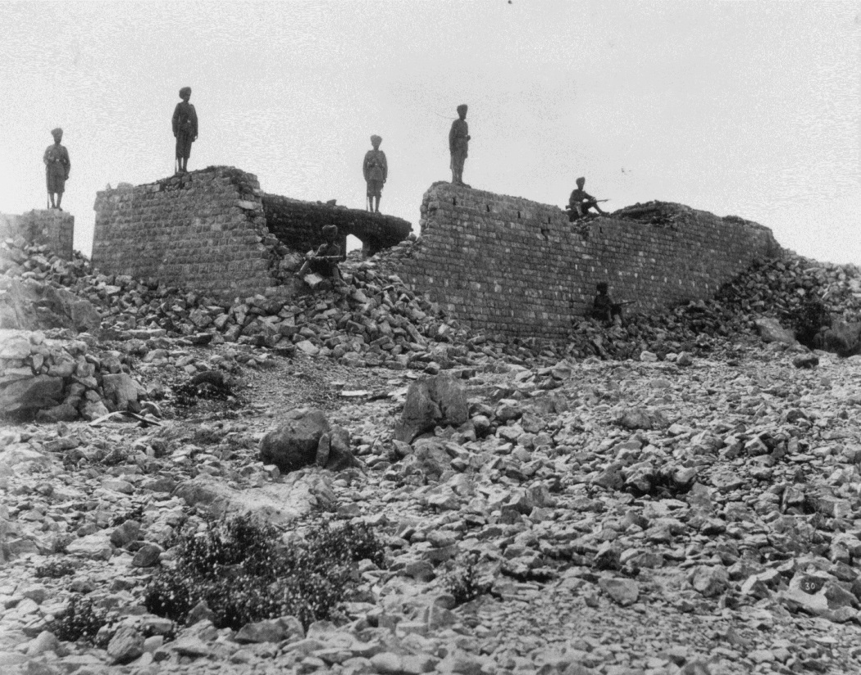
LIONS OF THE GREAT WAR LESSON 1: RESOURCE F
1897: 21 Sikhs died fighting 7,000 enemies on India’s frontier
Notes:
Slide 20
Ruins of Fort Saragarhi in the North-West Frontier Province of India defended by 21 men of the 36th Sikhs.
Private Collection

Slide 21
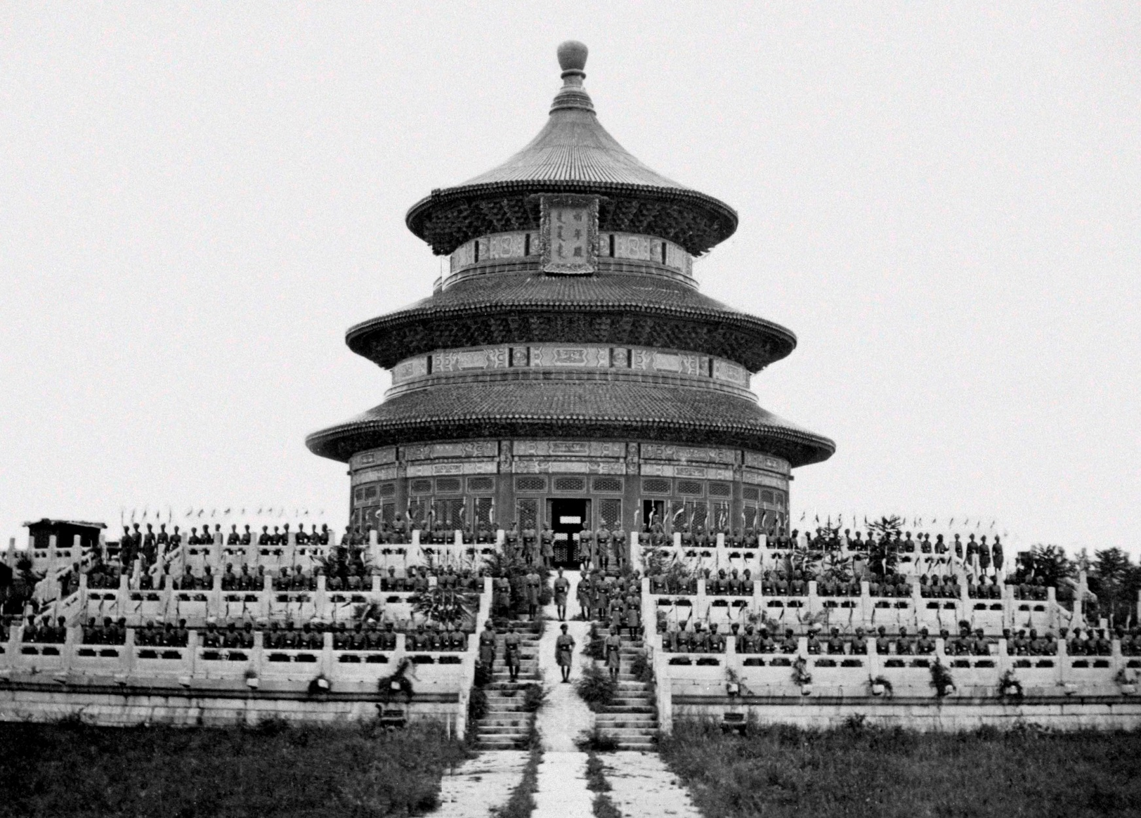
1900: Sikhs served in China during the Boxer Rebellion
LIONS OF THE GREAT WAR LESSON 1: RESOURCE F
Notes:
Slide 21
16th Regiment of Bengal Lancers on the steps of the Temple of Heaven, Beijing, during the Boxer Rebellion.
Courtesy of the Council of the National Army Museum, London (acc. no. 6306-38-135)

Slide 22
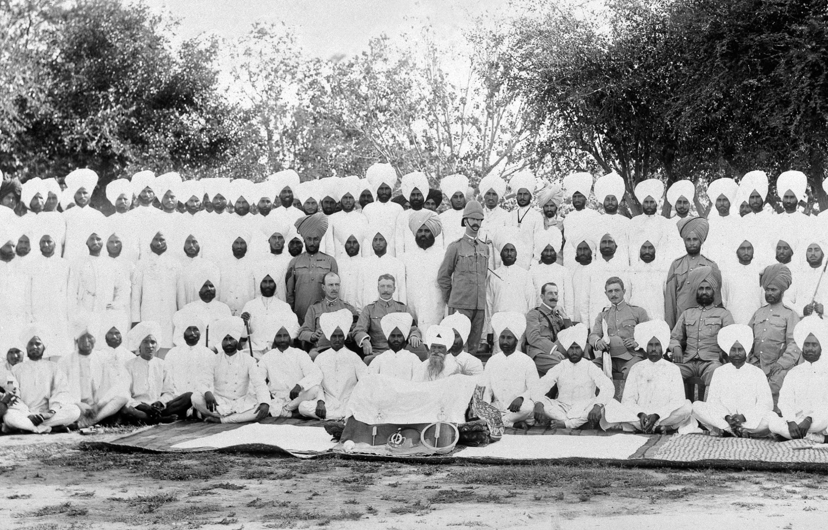
1901: The 47th Sikhs regiment founded
LIONS OF THE GREAT WAR LESSON 1: RESOURCE F
Notes:
Slide 22
Officers and men of the 47th Sikhs in the presence of the Guru Granth Sahib, c. 1902.
Courtesy of the Council of the National Army Museum, London (acc. no. 6406-69-1)

Slide 23
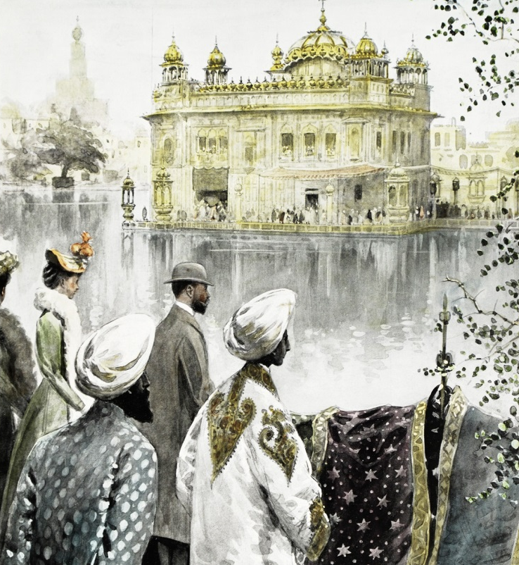
1905: The Prince and Princess of Wales visited the Golden Temple
LIONS OF THE GREAT WAR LESSON 1: RESOURCE F
Notes:
Slide 23
The Prince and Princess of Wales (later King George V and Queen Mary) visit the Golden Temple of Amritsar during their tour of India in 1905.
Toor Collection

Slide 24
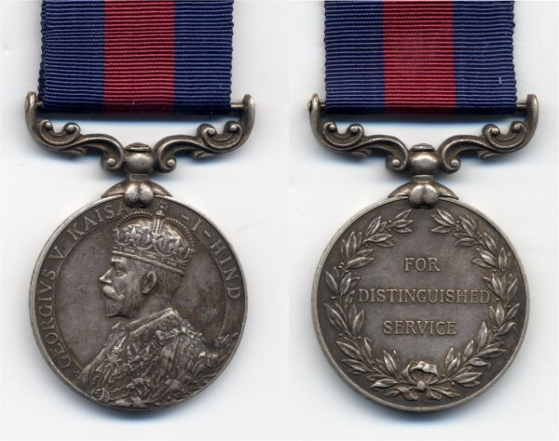
1907: Indian Distinguished Service Medal for Indian soldiers introduced
LIONS OF THE GREAT WAR LESSON 1: RESOURCE F
Notes:
Slide 24
Indian Distinguished Service Medal showing George V. This particular example is named to "3693 Naik Bir Singh 14th K.G.O. Ferozepore Sikhs" and was awarded for an act of gallantry during the Gallipoli campaign in Turkey.
Private collection

Slide 25
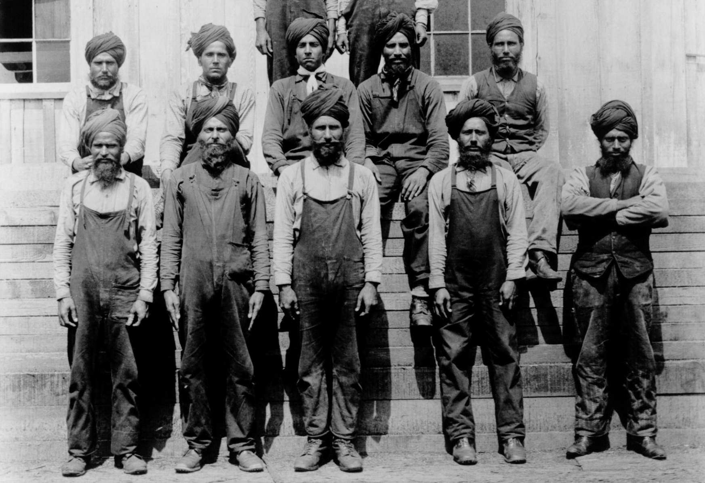
1908: Canada banned most Indian immigration making some Sikhs angry
LIONS OF THE GREAT WAR LESSON 1: RESOURCE F
Notes:
Slide 25
Sikh saw mill workers in British Columbia, Canada, c. 1908.
Courtesy of Sikh Heritage Museum of Canada, source Vancouver Public Library VPL-7641

Slide 26
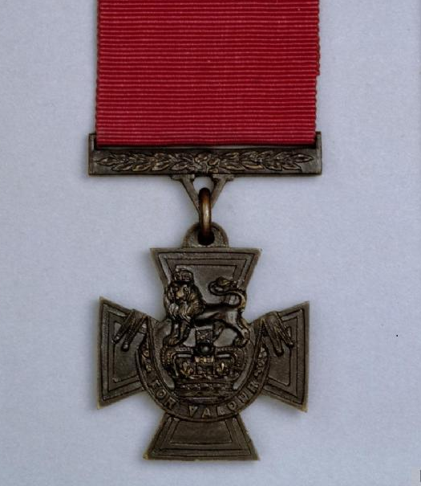
1911: Indian soldiers made eligible for the Victoria Cross
LIONS OF THE GREAT WAR LESSON 1: RESOURCE F
Notes:
Slide 26
The Victoria Cross, the United Kingdom’s highest award for military service.
© IWM (HU 69722)

Slide 27
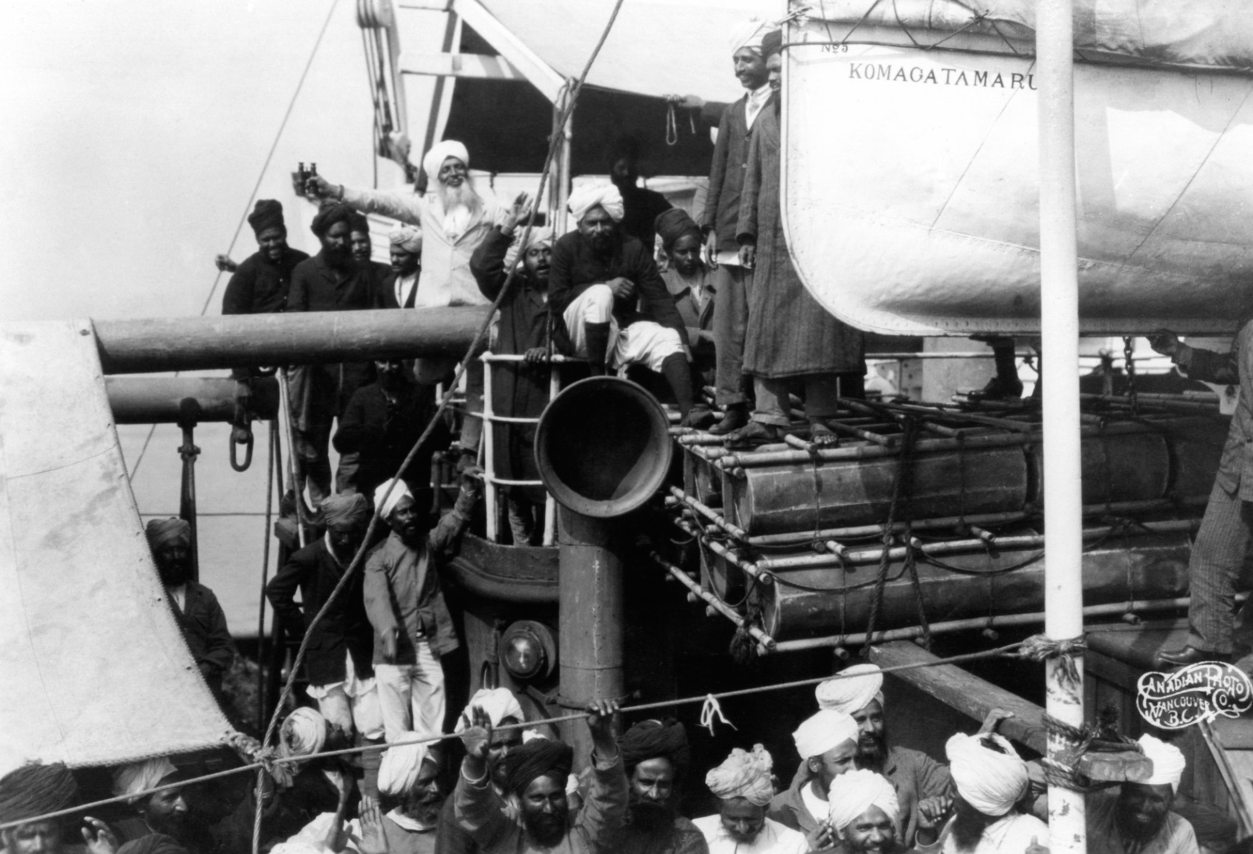
1914: Sikhs on Komagata Maru turned away by Canada, arrested in Calcutta
LIONS OF THE GREAT WAR LESSON 1: RESOURCE F
Notes:
Slide 27
Dressed in a white suit and with binoculars in his right hand, Gurdit Singh, the enterprising Sikh who chartered the Komagata Maru, makes a triumphant gesture in the hope that he and his fellow passengers will be allowed to land in Vancouver.
Courtesy of Sikh Heritage Museum of Canada, source Vancouver Public Library VPL-136

Slide 28
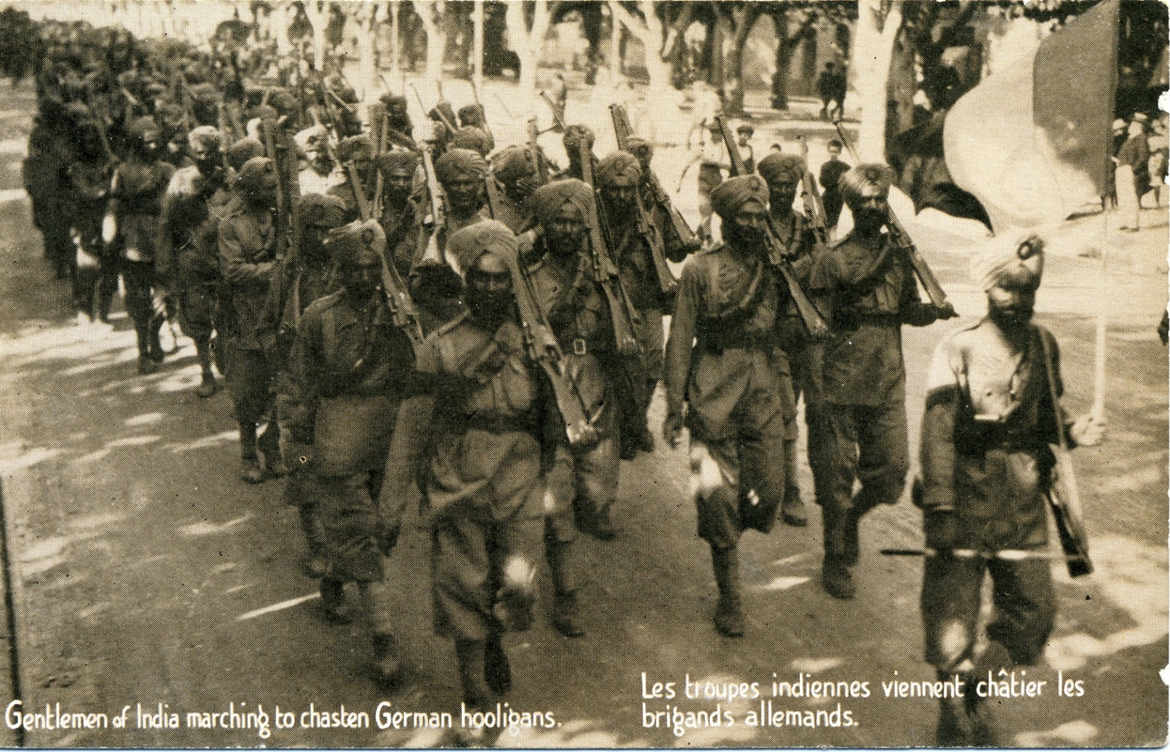
1914: Sikh soldiers of the British Indian Army fought on the Western Front
LIONS OF THE GREAT WAR LESSON 1: RESOURCE F
Notes:
Slide 28
A postcard from 1914 showing Sikh soldiers marching through the streets of the French town of Marseilles. The caption (also translated in French) reads ‘Gentlemen of Indian marching to chasten German hooligans’.
UKPHA Archive

Slide 29
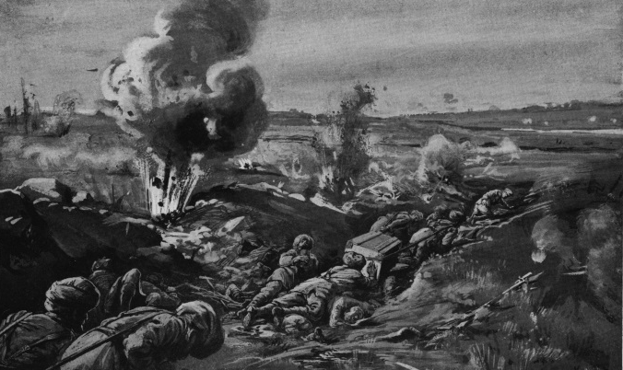
1915: 10 Sikh soldiers volunteer to help Lt. Smyth VC carry bombs on Western Front
LIONS OF THE GREAT WAR LESSON 1: RESOURCE F
Notes:
Slide 29
An engraving published in ‘Deeds That Thrill the Empire’ in 1917 and captioned ‘Lieutenant Smyth and his party of the 15th Sikhs carrying up bombs to the firing trench at the Ferme du Bois.’
Courtesy of Kulwant Singh Bahra Collection

Slide 30
IMAGE CREDITS
LIONS OF THE GREAT WAR LESSON 1: RESOURCE C
Slide 1 3rd King's Own Light Dragoons and the Khalsa Army clash in the Battle of Chillianwalla during the Second Anglo-Sikh War. Courtesy of www.thequeensownhussars.co.uk.
Slide 2 The Koh-i-noor diamond in its original setting. Royal Collection Trust/© Her Majesty Queen Elizabeth II 2014.
Slide 3 Sikh recruits of the 34th Sikh Pioneers taking the Khalsa initiation at the Mian Mir Cantonment, Lahore, in 1906. Courtesy of the Council of the National Army Museum, London (acc. no. 7109-25-2-45).
Slide 4 Prince Albert (1819–1861), the husband of Queen Victoria, had the Koh-i-noor diamond cut in Amsterdam so that it could be set in a brooch for her. Public domain.
Slide 5 Maharaja Duleep Singh on the Lower Terrace at Osborne House, Isle of Wight, in August 1854. Royal Collection Trust/© Her Majesty Queen Elizabeth II 2014.

Slide 31
IMAGE CREDITS (cont)
LIONS OF THE GREAT WAR LESSON 1: RESOURCE C
Slide 6 Men of the 45th Rattray's Sikhs at the Delhi Camp of Exercise in 1886. Private collection.
Slide 7 Mutineers about to be blown from guns by the Bengal Horse Artillery, c. 1858. Courtesy of the Council of the National Army Museum, London (acc. no. 1978-05-55-1).
Slide 8 Reverend Daud Singh was the first Sikh who converted to Christianity and the first ordained clergyman in Punjab. UKPHA Archive.
Slide 9 Men of the 15th Punjab Infantry in China during the Second Opium War. Toor Collection.
Slide 10 Charge of the 23rd Pioneers at Arrogee, 10 April 1868. Courtesy of the Council of the National Army Museum, London (acc. no. 1956-02-202).
Slide 11 Agents of the Church Missionary Society in Amritsar, March 1875. © The British Library Board. All Rights Reserved (Photo 793/8).

Slide 32
IMAGE CREDITS (cont)
LIONS OF THE GREAT WAR LESSON 1: RESOURCE C
Slide 12 The Golden Temple of Amritsar and an almost-complete clock tower photographed in September 1870. Private Collection.
Slide 13 Inside the Golden Temple, Amritsar, in 1854. © Victoria and Albert Museum, London.
Slide 14 The gateway leading to the Golden Temple of Amritsar. Toor Collection.
Slide 15 British and Native Officers of the 3rd Sikh Infantry. Courtesy of the Council of the National Army Museum, London (acc. no. 1955-04-41-39).
Slide 16 13th Bengal Lancers in Egypt capturing retreating trains after the Battle of Tel-el-Kebir, on September 13, 1882. UKPHA Archive.
Slide 17 British and Indian officers of the 9th Bengal Cavalry (also known as Hodson's Horse). Courtesy of the Council of the National Army Museum, London (acc. no. 1972-11-91-23).

Slide 33
IMAGE CREDITS (cont)
LIONS OF THE GREAT WAR LESSON 1: RESOURCE C
Slide 18 A drawing of Maharaja Duleep Singh published in Vanity Fair in 1882 with the caption 'the Maharajah'. Toor Collection.
Slide 19 The village church at Elveden in Norfolk where the last ruler of the Sikh Kingdom, Maharaja Duleep Singh was buried in 1893. Courtesy of Peter Bance Collection.
Slide 20 Ruins of Fort Saragarhi in the North-West Frontier Province of India defended by 21 men of the 36th Sikhs. Private Collection.
Slide 21 16th Regiment of Bengal Lancers on the steps of the Temple of Heaven, Beijing, during the Boxer Rebellion. Courtesy of the Council of the National Army Museum, London (acc. no. 6306-38-135).
Slide 22 Officers and men of the 47th Sikhs in the presence of the Guru Granth Sahib, c. 1902. Courtesy of the Council of the National Army Museum, London (acc. no. 6406-69-1).

Slide 34
IMAGE CREDITS (cont)
LIONS OF THE GREAT WAR LESSON 1: RESOURCE C
Slide 23 The Prince and Princess of Wales (later King George V and Queen Mary) visit the Golden Temple of Amritsar during their tour of India in 1905. Toor Collection.
Slide 24 Indian Distinguished Service Medal showing George V. Private collection.
Slide 25 Sikh saw mill workers in British Columbia, Canada, c. 1908. Courtesy of Sikh Heritage Museum of Canada, source Vancouver Public Library VPL-7641.
Slide 26 The Victoria Cross, the United Kingdom’s highest award for military service. © IWM (HU 69722).
Slide 27 Gurdit Singh, the enterprising Sikh who chartered the Komagata Maru, makes a triumphant gesture. Courtesy of Sikh Heritage Museum of Canada, source Vancouver Public Library VPL-136.

Slide 35
IMAGE CREDITS (cont)
LIONS OF THE GREAT WAR LESSON 1: RESOURCE C
Slide 28 A postcard from 1914 showing Sikh soldiers marching through the streets of the French town of Marseilles. UKPHA Archive.
Slide 29 ‘Lieutenant Smyth and his party of the 15th Sikhs carrying up bombs to the firing trench at the Ferme du Bois.’ Courtesy of Kulwant Singh Bahra Collection.

