Slide 1
LIONS OF THE GREAT WAR LESSON 5: RESOURCE Q
Notes:
Slide 5
A typical Sikh naik (corporal) of the 14th Ferozepore Sikhs, c. 1910.
Courtesy of the Council of the National Army Museum, London (acc. no. 1994-05-50-716)

Slide 2
LIONS OF THE GREAT WAR LESSON 5: RESOURCE Q
Notes:
Slide 2
A rare colour photograph of Indian troops (cavalrymen) on the Western Front on 27 February 1917 (the three soldiers with red showing under their turbans are Sikhs).
© Collection Tournassoud/Docpix.fr

Slide 3
Questions to Sikh veterans in 1972
LIONS OF THE GREAT WAR LESSON 5: RESOURCE Q
Why did you join the British Indian Army?
Why did you stay in the British Indian Army?
How did the British treat you in the British Indian Army?

Slide 4
LIONS OF THE GREAT WAR LESSON 5: RESOURCE Q
What Sikh veterans said in 1972
I liked being a soldier.
The Sikhs are a “martial” people.
The British respected our religion.
We were fed according to our own customs.
We were looked after well if we fell sick or we were wounded.
The British were very well organised.
The British treated us politely, particularly during the First World War.
Sikhs from different castes mixed together.

Slide 5
The historian concluded that:
LIONS OF THE GREAT WAR LESSON 5: RESOURCE Q
British propaganda was successful in making the Sikhs believe that they were a “martial” people
It helped them recruit more Sikh volunteers for the British Indian Army

Slide 6
From the BBC programme do we…
LIONS OF THE GREAT WAR LESSON 5: RESOURCE Q
know more about why Sikhs volunteered for the British Indian Army?
understand more about why Sikhs remained in the British Indian Army?
know more about how Sikh soldiers felt about the British?

Slide 7
What do the letters of Sikh soldiers tell us about how they saw themselves?
LIONS OF THE GREAT WAR LESSON 5: RESOURCE Q
Magnificent
Mysterious
Cruel
Savage
Weak
Powerful
Equal to white Europeans
Handsome
Loyal
Barbaric
Despairing
Disciplined
Frightening
Strong
Fierce
Inferior to white Europeans
Aggressive
Brave
Healthy
Superior to white Europeans
Fearful
Proud

Slide 8
How much can we trust the letters of Sikh soldiers censored by the British?
LIONS OF THE GREAT WAR LESSON 5: RESOURCE Q
Most Sikh soldiers were recruited from poor villages in Punjab.
Most of them could not read or write so they dictated their letters to scribes.
The British read (censored) these letters to check for disloyalty or low morale.
Many soldiers knew that the letters were read by the British.
In some cases letters got past the censor that should not have.
The letters that were censored were mostly those from Britain or the Western Front to India (or from India to Europe).
In some campaigns outside Europe letters were not censored.
Many letters of Sikh soldiers no longer exist because no record of them was kept and the originals were not preserved.

Slide 9
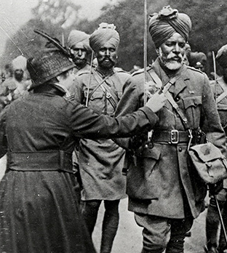
What effect did contact with French people have on Sikh soldiers?
LIONS OF THE GREAT WAR LESSON 5: RESOURCE Q
They liked the boldness of French women.
Some wanted Sikh women to have a European education.
A few married French women.
French people treated them better than the British.
They began to resent the British - why couldn’t Sikhs have the same freedoms as Europeans?
Notes:
Slide 9
A French woman pins flowers onto the tunic of a soldier marching through Paris on Bastille Day, 14 July 1916.
Toor Collection

Slide 10
What effect did fighting in the First World War have on Sikh soldiers?
LIONS OF THE GREAT WAR LESSON 5: RESOURCE Q
Indian soldiers had fought for Britain all over the world, including in Europe.
Indian soldiers had fought bravely against European enemies.
This made them think they were equal to Europeans - the British were not treating them well enough.
After the war Indian soldiers demanded better pay and conditions.
After the war, some Indian soldiers became involved in the Indian independence movement.

Slide 11
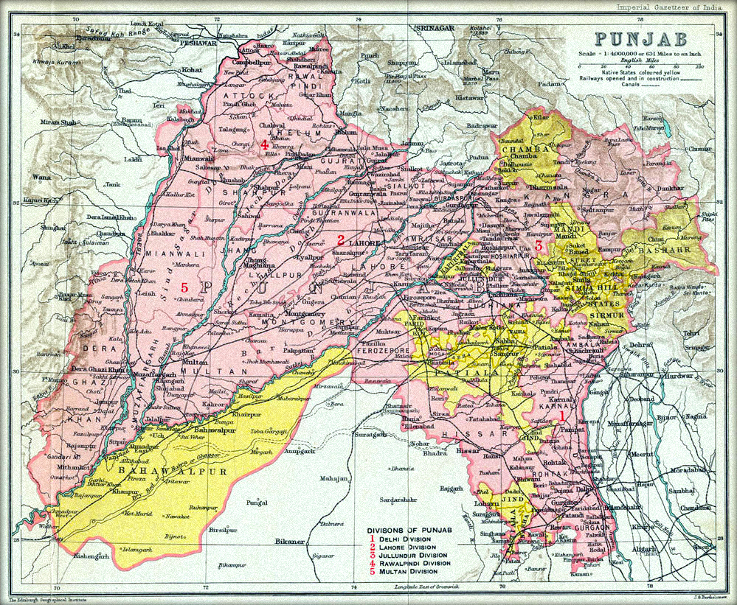
LIONS OF THE GREAT WAR LESSON 5: RESOURCE Q
Notes:
Slide 11
A map of Punjab 1909. After the war in 1919 the British feared a revolt and army mutiny in the north Indian province of Punjab. Military law was imposed banning demonstrations although news of the ban did not reach many Indians.

Slide 12
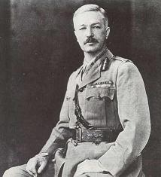
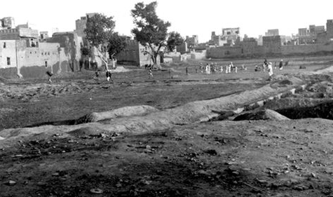
LIONS OF THE GREAT WAR LESSON 5: RESOURCE Q
Notes:
Slide 12
General Dyer and the Jallianwala Bagh in 1919. On 13 April 1919 near the Golden Temple in Amritsar, General Dyer chose to teach Indians a lesson by deciding to fire on an unarmed crowd gathered in an enclosed area called the Jallianwala Bagh.

Slide 13
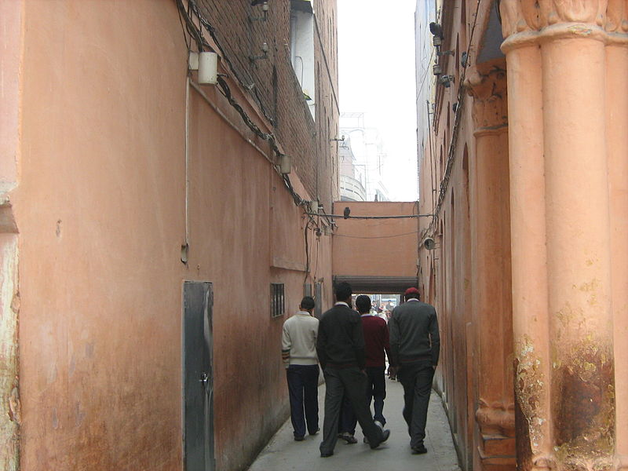
LIONS OF THE GREAT WAR LESSON 5: RESOURCE Q
Notes:
Slide 13
The narrow entrance to the Jallianwala Bagh today. Dyer tried to take machine guns mounted on armoured vehicles into the area but could not fit them through the narrow entrances.

Slide 14
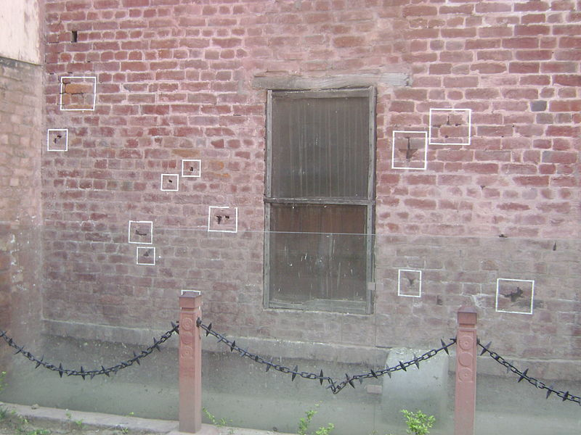
LIONS OF THE GREAT WAR LESSON 5: RESOURCE Q
Notes:
Slide 14
Bullets in a wall at the Jallianwala Bagh. Dyer ordered his Indian troops to fire on the crowd (which included Sikhs) with rifles, killing hundreds of people (the exact figure may have been a thousand).

Slide 15
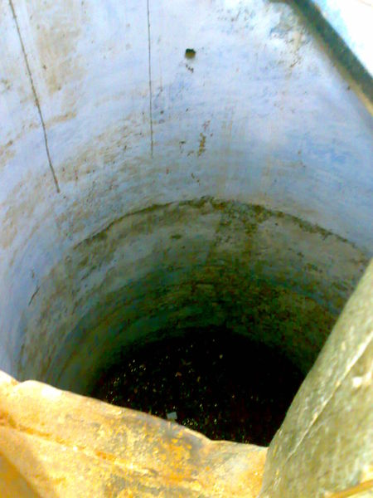
LIONS OF THE GREAT WAR LESSON 5: RESOURCE Q
Notes:
Slide 15
A well in the Jallianwala Bagh. Dyer also ordered his troops to aim their fire at the heaviest part of the crowd where people were trying to escape down the narrow exits or by jumping down a well.

Slide 16
IMAGE CREDITS
LIONS OF THE GREAT WAR LESSON 5: RESOURCE Q
Slide 1 A typical Sikh naik (corporal) of the 14th Ferozepore Sikhs, c. 1910. Courtesy of the Council of the National Army Museum, London (acc. no. 1994-05-50-716).
Slide 2 A rare colour photograph of Indian troops (cavalrymen) on the Western Front on 27 February 1917 (the three soldiers with red showing under their turbans are Sikhs). © Collection Tournassoud/Docpix.fr.
Slide 9 A French woman pins flowers onto the tunic of a soldier marching through Paris on Bastille Day, 14 July 1916. Toor Collection.
Slide 11 A map of Punjab 1909. Public domain.
Slide 12 General Dyer and the Jallianwala Bagh in 1919. Public domain.
Slide 13 The narrow entrance to the Jallianwala Bagh today. Public domain.
Slide 14 Bullets in a wall at the Jallianwala Bagh. Public domain.
Slide 15 A well in the Jallianwala Bagh. Public domain.

