Slide 1
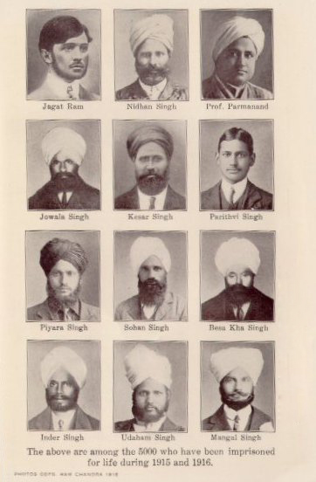
LIONS OF THE GREAT WAR LESSON 6: RESOURCE V
Notes:
Slide 1
Members of the Ghadar Party (including Sikhs) imprisoned by the British.

Slide 2
LIONS OF THE GREAT WAR LESSON 6: RESOURCE V
Notes:
Slide 2
A rare colour photograph of Indian troops (cavalrymen) on the Western Front on 27 February 1917 (the three soldiers with red showing under their turbans are Sikhs).
© Collection Tournassoud/Docpix.fr

Slide 3
What are Interpretations of History?
LIONS OF THE GREAT WAR LESSON 6: RESOURCE V
Interpretations combine:
- fact
- fiction
imagination and
point of view

Slide 4
LIONS OF THE GREAT WAR LESSON 6: RESOURCE V
Fact
Fiction / Imagination
Point of View

Slide 5
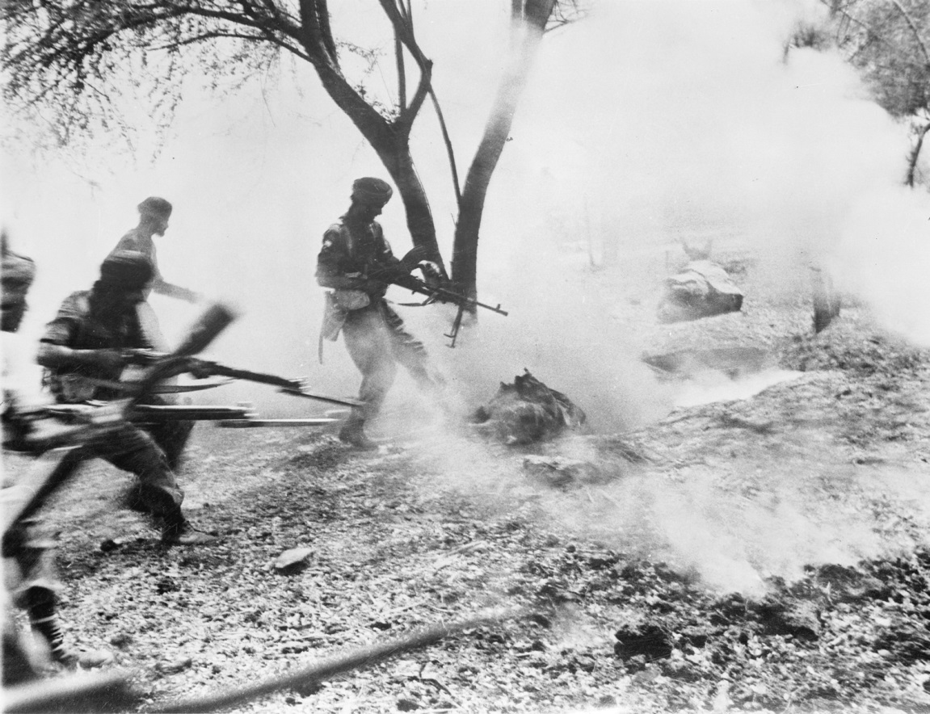
LIONS OF THE GREAT WAR LESSON 6: RESOURCE V
Notes:
Slide 5
Sikh soldiers of the British Indian Army attack an enemy position in Burma during the Second World War (1939-45). Sikh veterans of the First World War helped to recruit 300,000 Sikh soldiers for the over two million troops of the British Indian Army. At this stage India was still not an independent country.
© IWM (IND 4550)

Slide 6
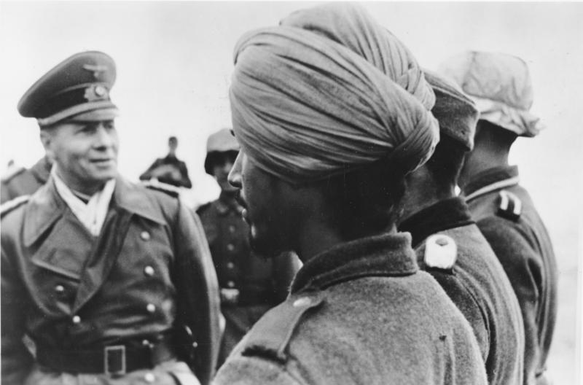
LIONS OF THE GREAT WAR LESSON 6: RESOURCE V
Notes:
Slide 6
A Sikh soldier being inspected by the German general, Rommel. A few Sikhs joined anti-British Indian forces recruited by Nazi Germany and Japan, who promised India her independence.

Slide 7
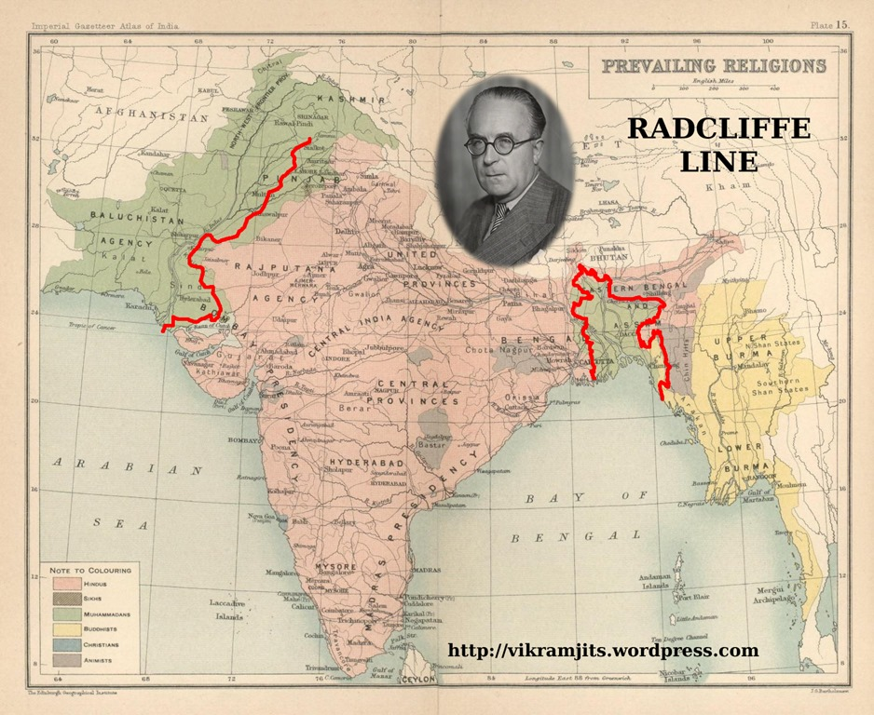
LIONS OF THE GREAT WAR LESSON 6: RESOURCE V
Notes:
Slide 7
A map of the partition boundaries in Punjab (marked in red on the left side of the map) in 1947. When the British left India, two new countries were created: a largely Hindu-dominated modern India (the area to the right of the red line) and a mainly Muslim Pakistan (to the left of the red line).
Courtesy http://vikramjits.wordpress.com

Slide 8
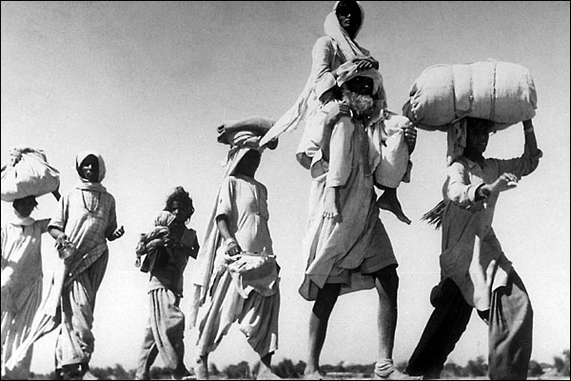
LIONS OF THE GREAT WAR LESSON 6: RESOURCE V
Notes:
Slide 8
An old Sikh man fleeing with his family from the newly created Pakistan. The old Sikh homeland of Punjab was divided between the two countries and millions of people fled their homes either side of the border. There were widespread massacres and thousands of Sikhs died.

Slide 9
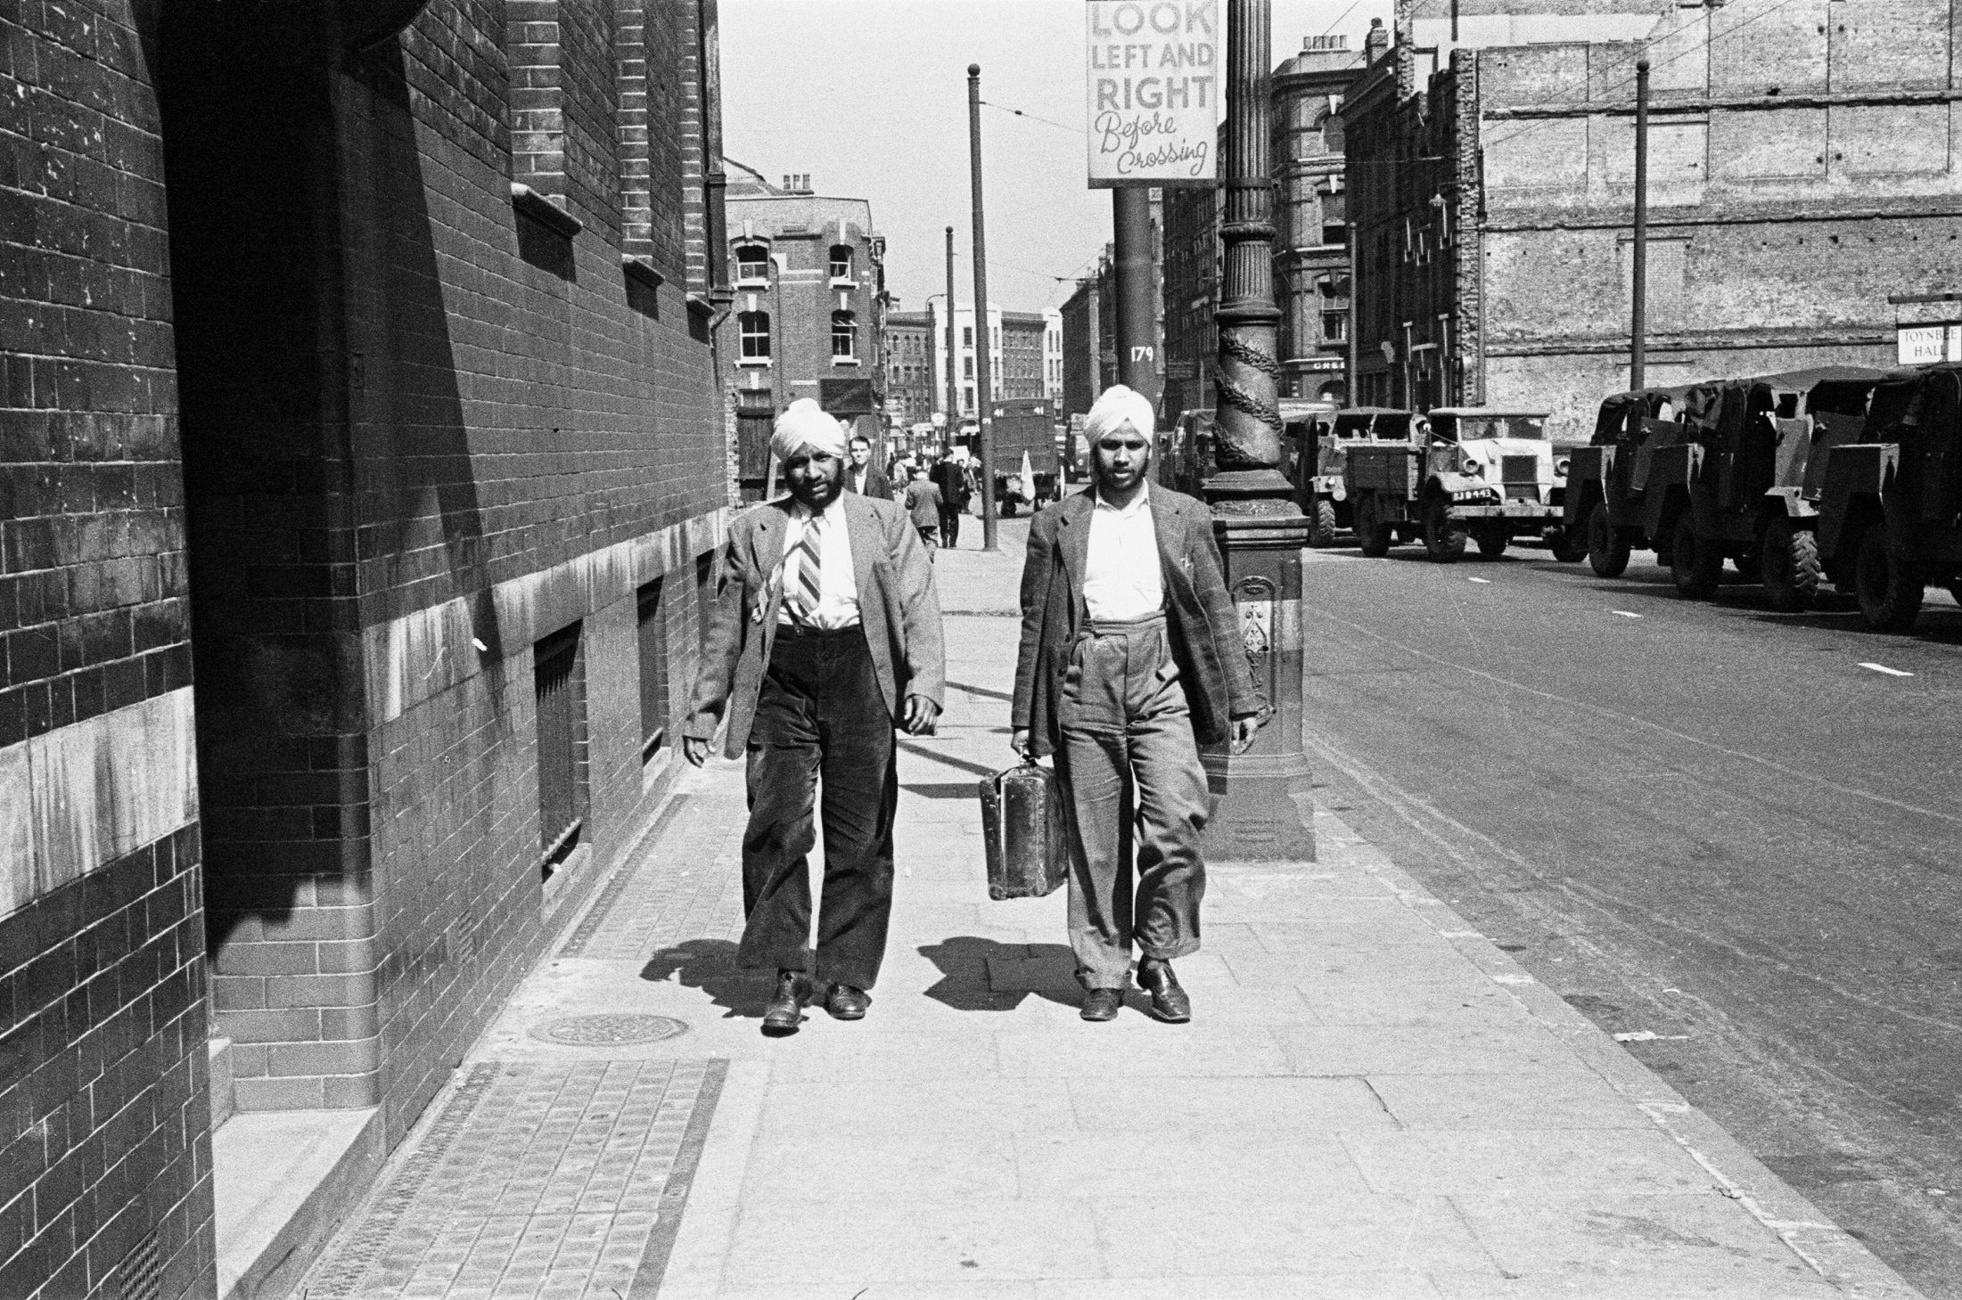
LIONS OF THE GREAT WAR LESSON 6: RESOURCE V
Notes:
Slide 9
Two Sikh migrants in Britain in 1947. Sikhs started to settle here in larger numbers after India gained her independence.
Mirrorpix

Slide 10
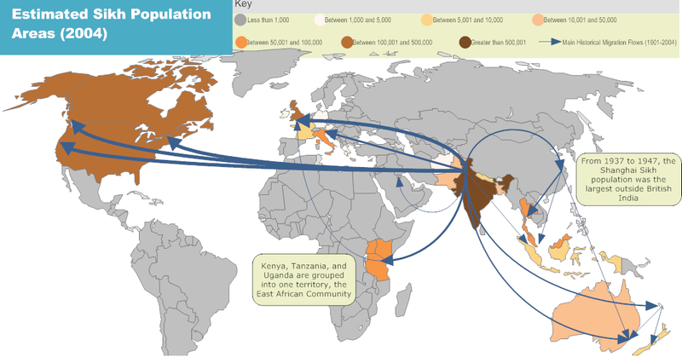
LIONS OF THE GREAT WAR LESSON 6: RESOURCE V
Notes:
Slide 10
Some of the population movements of the Sikh community. This was part of an historic movement of Sikhs over decades from India to other countries.

Slide 11
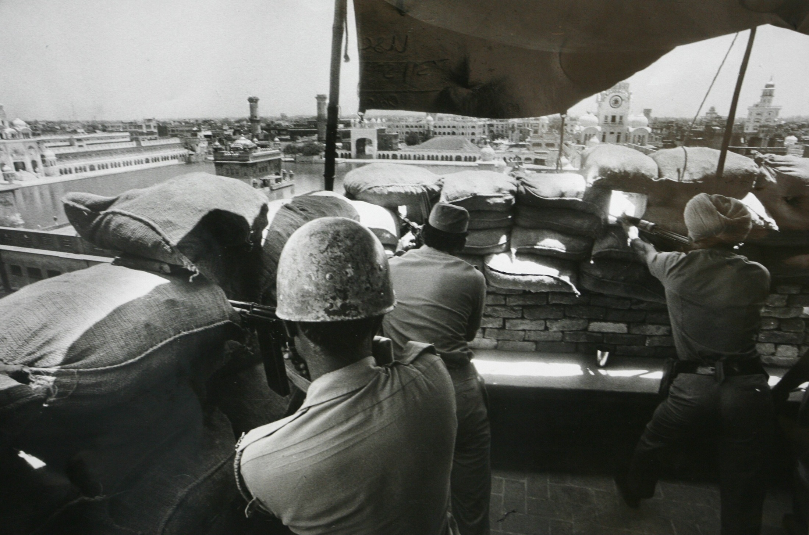
LIONS OF THE GREAT WAR LESSON 6: RESOURCE V
Notes:
Slide 11
Men of the Indian Army take positions in the Golden Temple complex in Amritsar in 1984, which was occupied by a group of Sikhs who demanded greater rights from the Indian government. Indian Prime Minister, Indira Gandhi, ordered the Indian Army to storm the complex, killing many innocent people. Two of her Sikh bodyguards later shot dead Indira Gandhi in revenge. These events caused great bitterness between many Sikhs and the Indian government.
Photo by INDIA TODAY/India Today Group/Getty Images

Slide 12
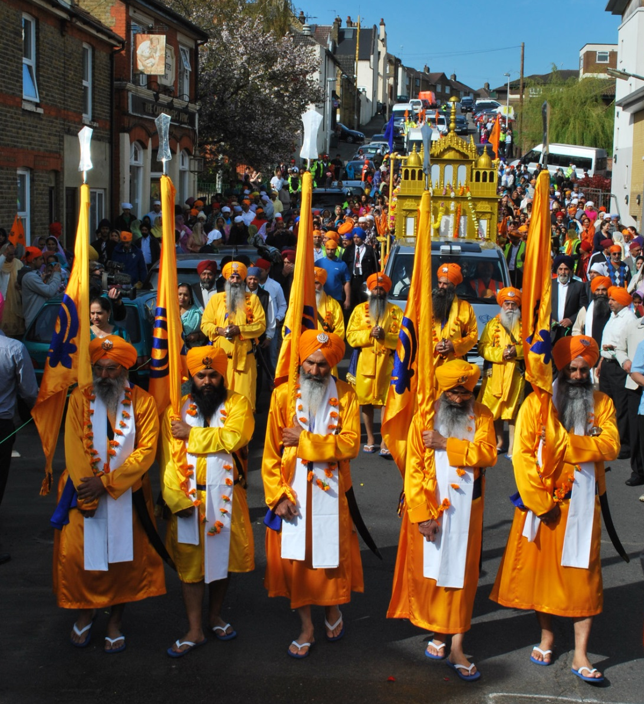
LIONS OF THE GREAT WAR LESSON 6: RESOURCE V
Notes:
Slide 12
Sikhs living in Britain. Today there are over 400,000 Sikhs settled in the UK.
Courtesy of Taran Singh Padam

Slide 13
LIONS OF THE GREAT WAR LESSON 6: RESOURCE V
Notes:
Slide 13
The Sepoy Mohan Singh Trophy, showing the Sikh soldier preparing to throw a grenade during the First World War. It was created by British officers of a Sikh Indian regiment of the British Indian Army (14th King George’s Own Ferozepore Sikhs), which took part in a battle of the Gallipoli campaign against Turkish forces.
Courtesy of the Council of the National Army Museum, London (acc. no. 1951-07-23-1)

Slide 14
IMAGE CREDITS
LIONS OF THE GREAT WAR LESSON 6: RESOURCE V
Slide 1 Members of the Ghadar Party (including Sikhs) imprisoned by the British. Public domain.
Slide 2 A rare colour photograph of Indian troops (cavalrymen) on the Western Front on 27 February 1917 (the three soldiers with red showing under their turbans are Sikhs). © Collection Tournassoud/Docpix.fr.
Slide 5 Sikh soldiers of the British Indian Army attack an enemy position in Burma during the Second World War (1939-45). © IWM (IND 4550).
Slide 6 A Sikh soldier being inspected by the German general, Rommel. Public domain.
Slide 7 A map of the partition boundaries in Punjab (marked in red on the left side of the map) in 1947. Courtesy http://vikramjits.wordpress.com.
Slide 8 An old Sikh man fleeing with his family from the newly created Pakistan. Public domain.

Slide 15
IMAGE CREDITS (cont)
LIONS OF THE GREAT WAR LESSON 6: RESOURCE V
Slide 9 Two Sikh migrants in Britain in 1947. Mirrorpix.
Slide 10 Some of the population movements of the Sikh community. Public domain.
Slide 11 Men of the Indian Army take positions in the Golden Temple complex in Amritsar in 1984, which was occupied by a group of Sikhs who demanded greater rights from the Indian government. Photo by INDIA TODAY/India Today Group/Getty Images.
Slide 12 Sikhs living in Britain. Courtesy of Taran Singh Padam.
Slide 13 The Sepoy Mohan Singh Trophy, showing the Sikh soldier preparing to throw a grenade during the First World War. Courtesy of the Council of the National Army Museum, London (acc. no. 1951-07-23-1).

