Slide 1
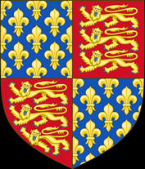

K
1337: King Philip VI of France supported Scotland against England. As overlord, he also declared that he would take over the part of Aquitaine still controlled by the English. As a result, King Edward III of England claimed to be king of France too and made war. He changed the royal shield of England to include the lillies of France. The Hundred Years War started.

Slide 2

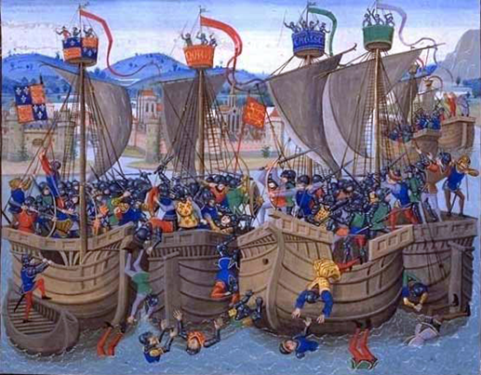
1340: In June, King Edward’s navy defeated the French navy at the Battle of Sluys in the English Channel, preventing King Philip from invading England. Both sides agreed a temporary truce.

Slide 3
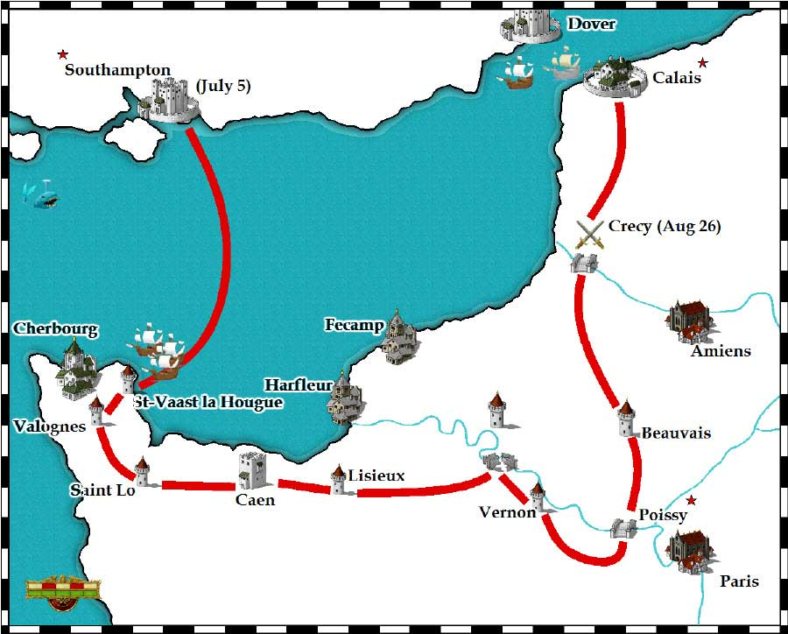
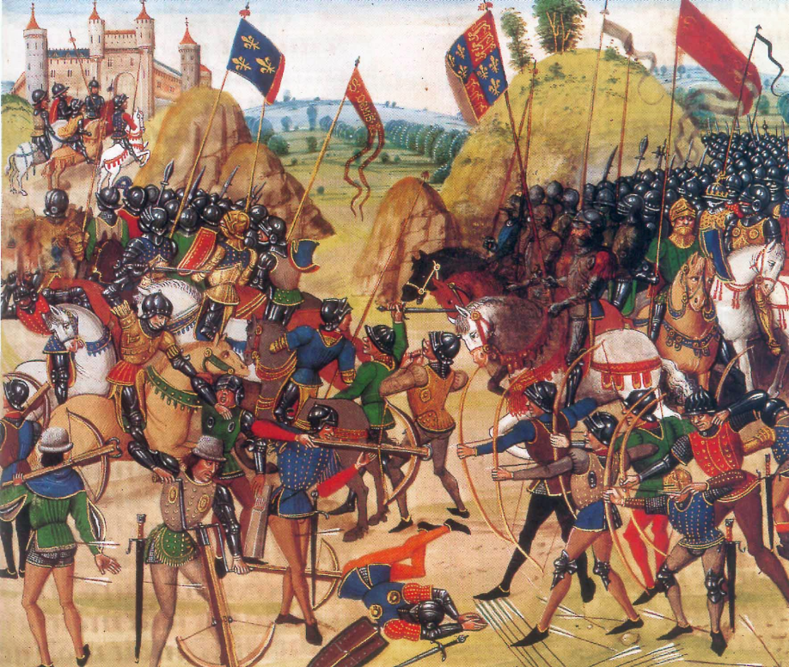
1346: Edward III invaded Normandy with an army of 15,000 men. He completely defeated a large French army at the Battle of Crecy. Edward continued his march through France and laid siege to the town of Calais on the French coast.

Slide 4
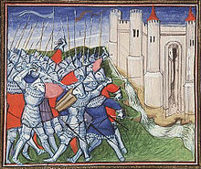
1347: Calais surrendered to English control and Edward filled it with English immigrants.

Slide 5
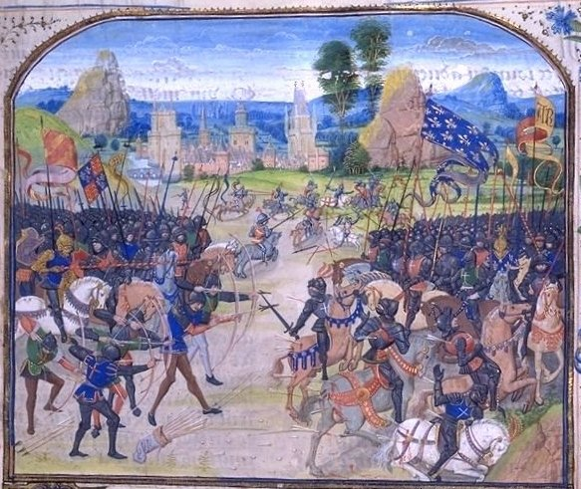
1356: Prince Edward, King Edward’s son, later known as the Black Prince because of his black armour, led an army into France, plundering and looting as he went. He defeated a larger French army at Poitiers, led by King John of France, and captured the French king himself. John was sent as a prisoner to the Tower of London.

Slide 6
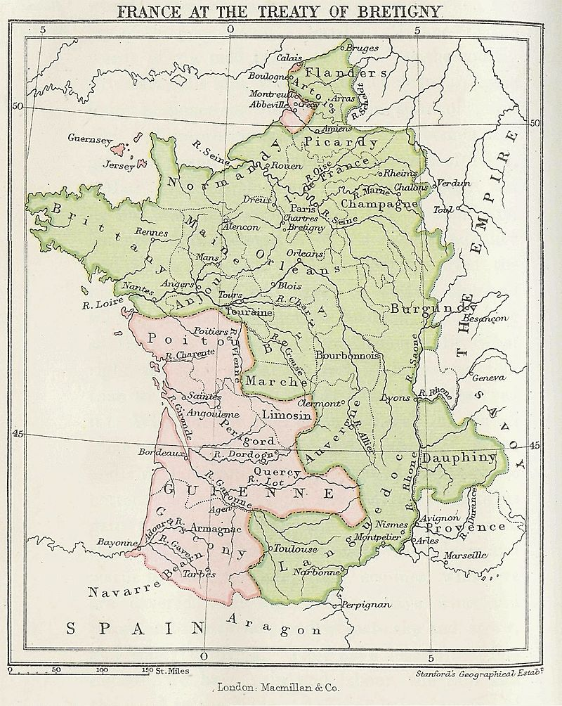
1360: The French agreed to the Treaty of Brétigny. This gave lots of land in Aquitaine to King Edward, as well as Calais. In return, Edward gave up his claim to be king of France and sent King John back to Paris in exchange for a huge ransom payment.

Slide 7
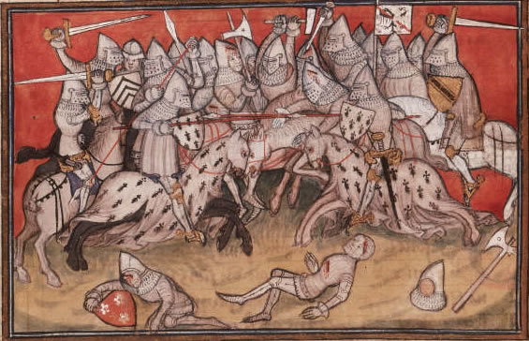
1369: War broke out again between England and France and the French began attacking Aquitaine successfully.

Slide 8
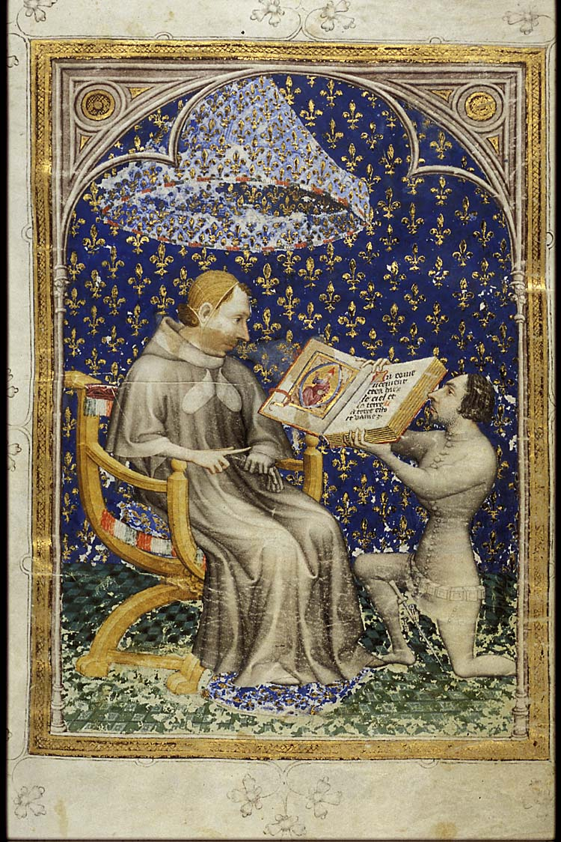
1375: The English only controlled a small strip of Aquitaine, along the French coast, and Calais.
King Charles V of France

Slide 9
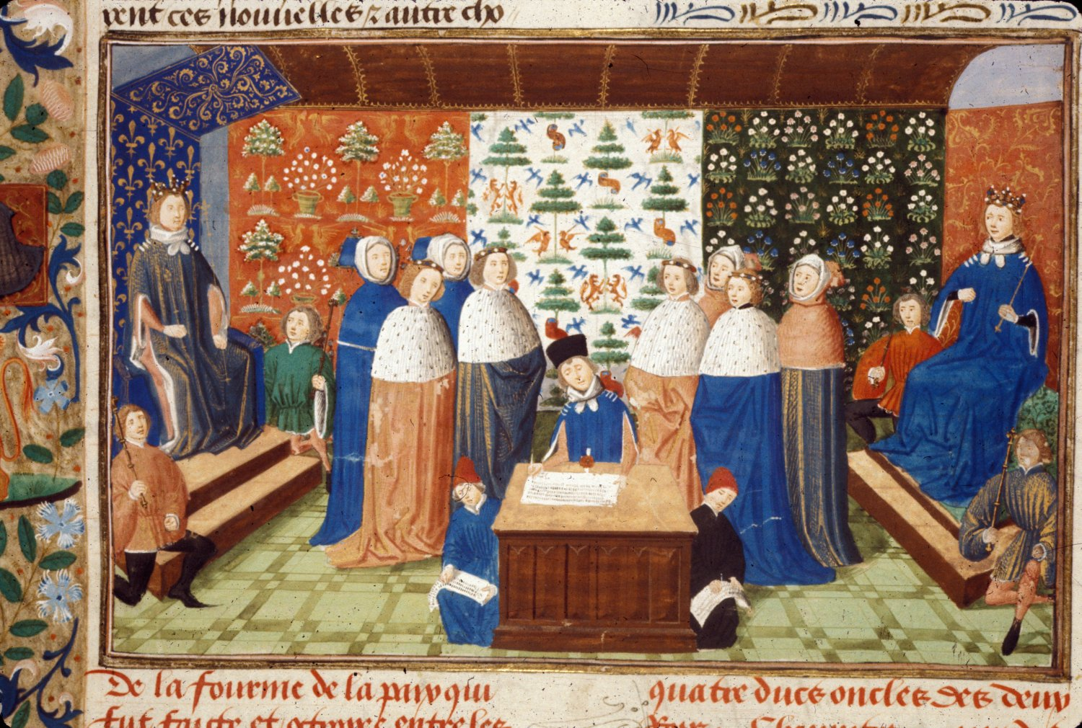
1389: The English and French kings agreed a temporary truce at Leulinghem.

Slide 10
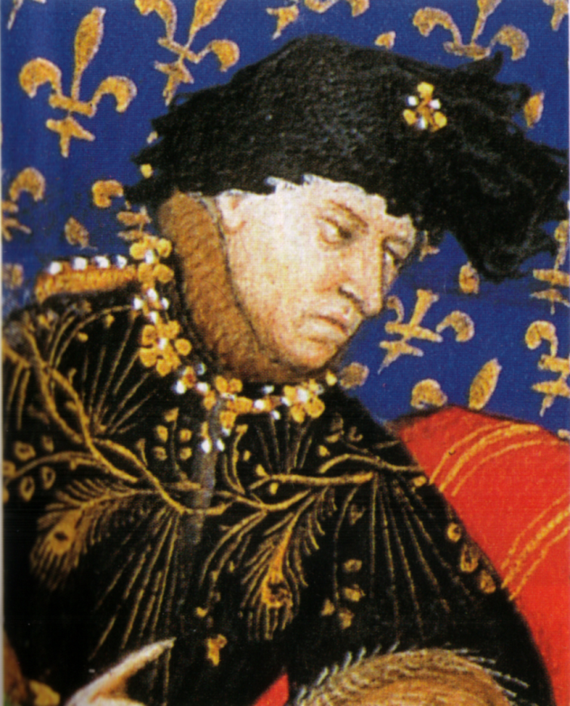
1407: England and France had mostly been at peace for many years. King Charles VI of France became mad and a bitter civil war for control began between the Duke of Burgundy and rival lords known as the Armagnacs.
King Charles VI

Slide 11
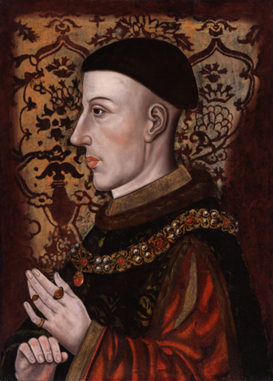
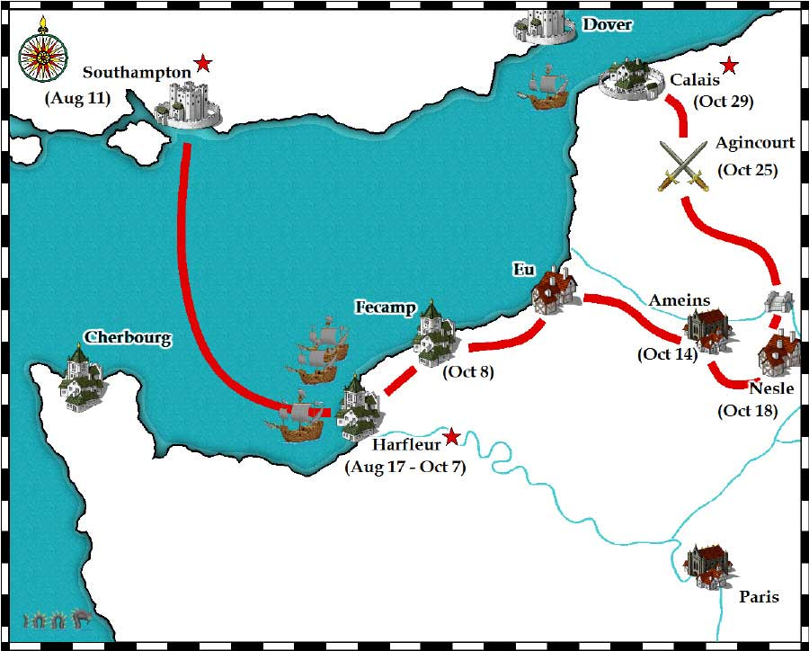
1415: King Henry V of England claimed the French throne for himself. He seized the French port of Harfleur in Normandy and marched towards Calais, completely defeating a French army at Agincourt on the way.

Slide 12
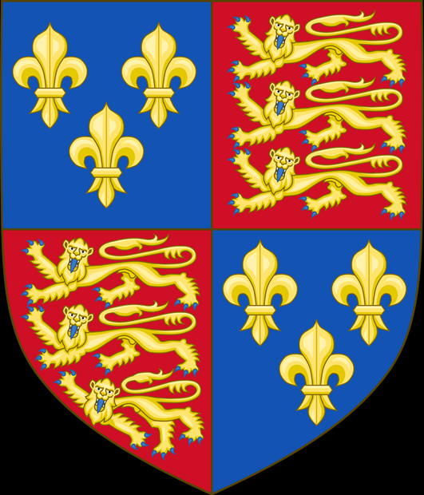

1417: King Henry began to conquer Normandy while the French lords fought among themselves.
The royal shield of Henry V

Slide 13
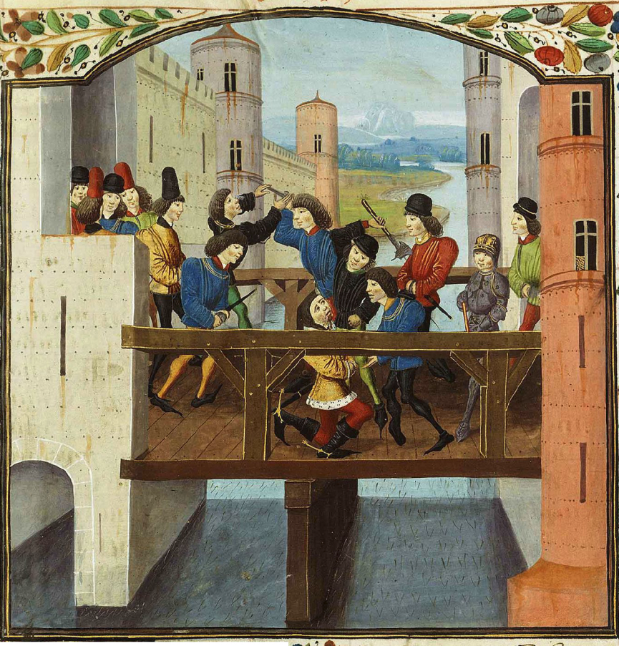
1419: King Henry completed his conquest of Normandy and the Armagnac lords murdered the Duke of Burgundy. In revenge, his son, the new Duke of Burgundy, became an English ally.

Slide 14
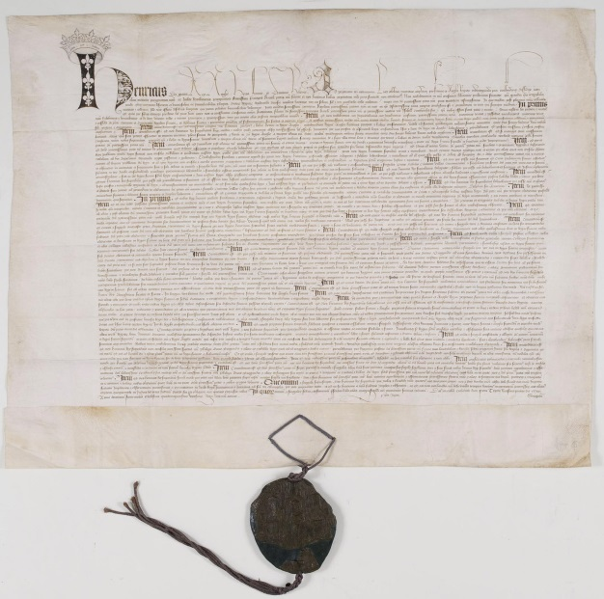
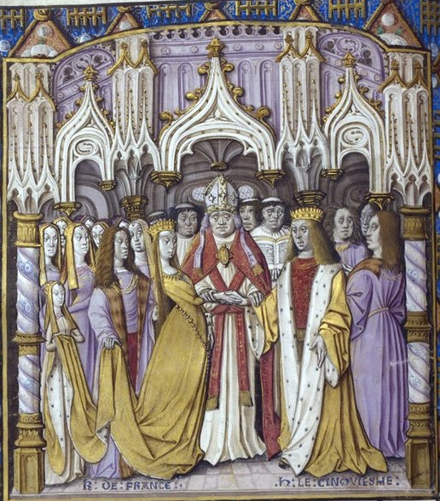
1420: The French agreed to the Treaty of Troyes. King Henry gave up his claim to the French throne but, in return, married the daughter of the French king, Princess Catherine, and would become king of France when her father died. The French king’s son continued the fight against the English invaders but the powerful Duke of Burgundy remained an English ally.

Slide 15
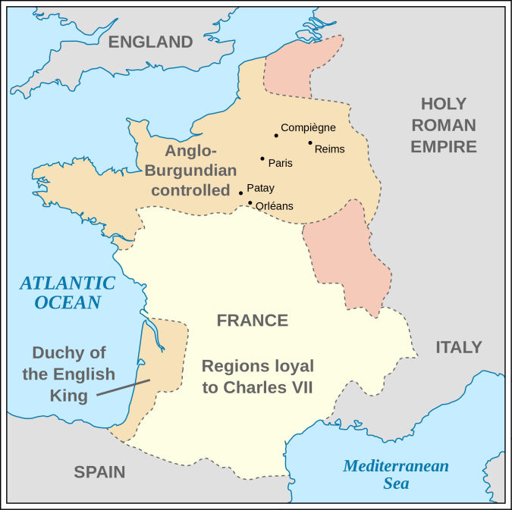
1422: Both King Charles VI of France and King Henry V of England died. Henry’s baby son, King Henry VI, was crowned king of France in Paris by the English and the supporters of the Duke of Burgundy. The French supporters of the old French king’s son, the Dauphin (known to the French as Charles VII), continued to support him.

Slide 16
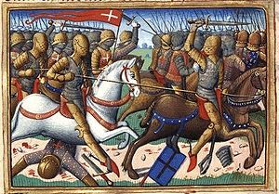
1424: The English defeated the Dauphin’s army at Verneuil.

Slide 17
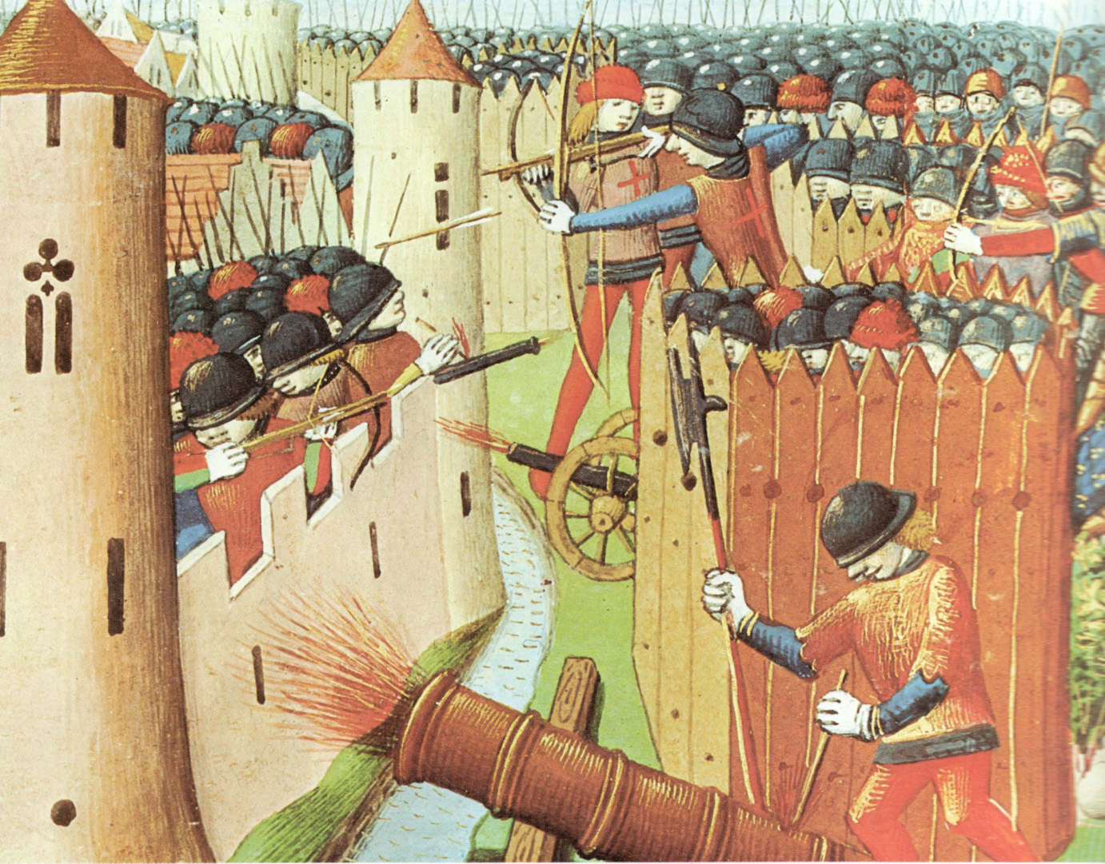
1428: The English laid siege to the city of Orleans, south of Paris.

Slide 18
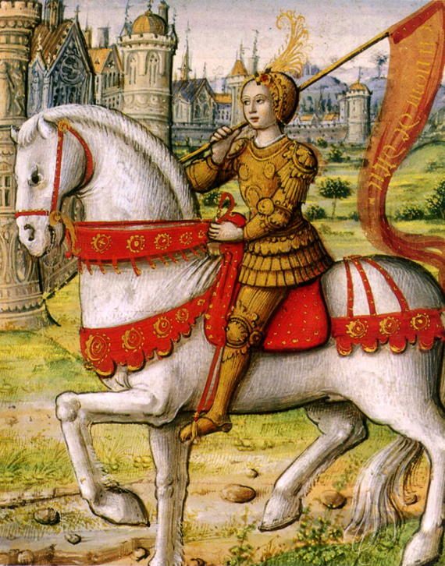

1429: A 17-year-old French girl called Joan of Arc, claiming to be inspired by God, helped the French army to drive the English away from Orleans and defeat them in two battles at Jargeau and Patay. The Dauphin was crowned King Charles VII of France at Rheims cathedral.

Slide 19
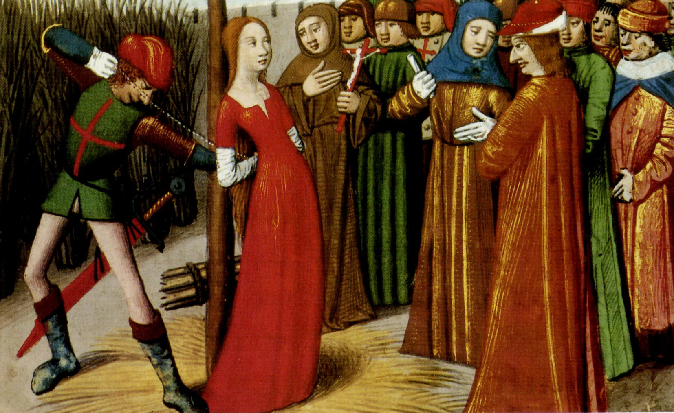
1431: The Burgundians had captured Joan of Arc in 1430. After a trial, the English burned her at the stake.

Slide 20
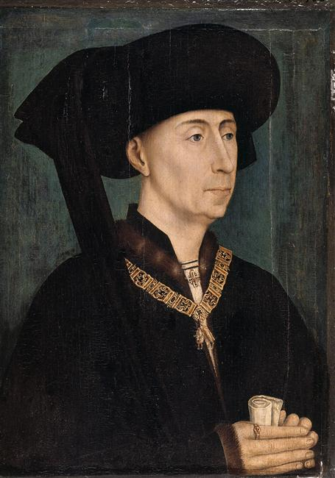
1435: The Duke of Burgundy broke away from the English and allied with King Charles VII of France.

Slide 21
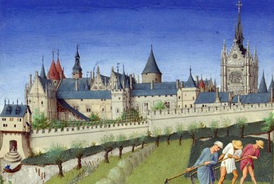
1436: The French retook Paris from the English.
Paris 1410

Slide 22
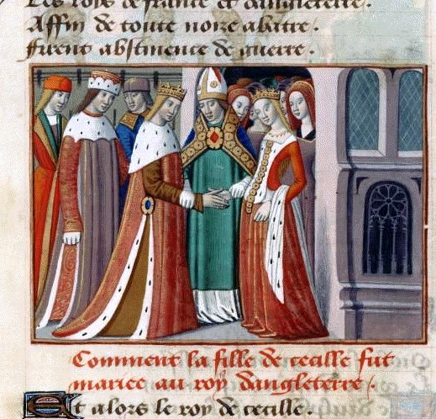
1444: King Henry VI married a French princess, gave up an area of land in France called Maine to the French and agreed to a truce. The French king used the truce to reorganise his army.

Slide 23
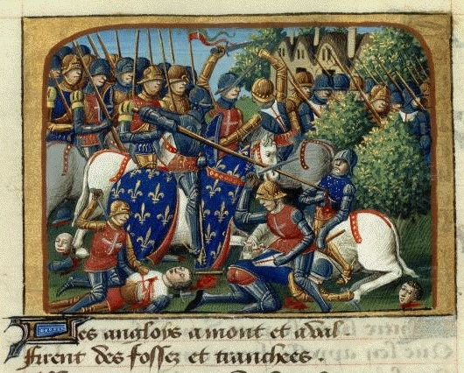
1450: The French successfully conquered Normandy, defeating the English at the Battle of Formigny.

Slide 24
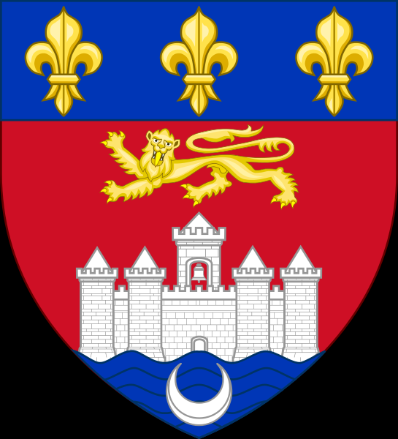
1451: The French captured Bordeaux and the rest of Aquitaine.

Slide 25
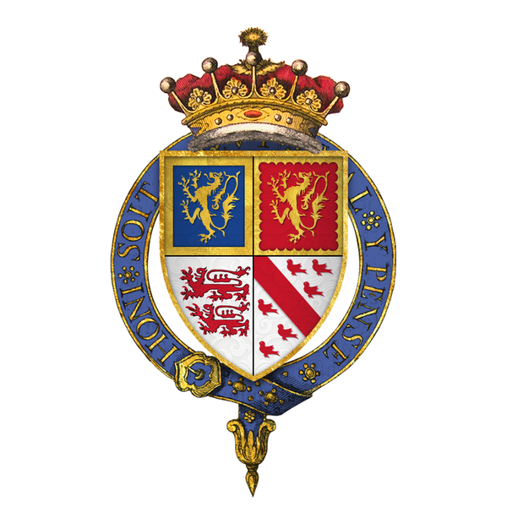
1452: The English Earl of Shrewsbury landed in Aquitaine with an English army and retook Bordeaux.

Slide 26

1453: The French defeated and killed Shrewsbury at the Battle of Castillon. They also recaptured Bordeaux. The only English territory left on the French mainland was Calais. The Hundred Years War was over.
The oriflamme, the traditional battle standard of France

