Slide 1
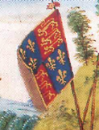
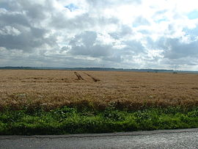
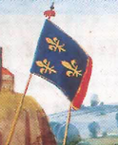
How do we know what happened at the Battle of Agincourt in 1415?

Slide 2
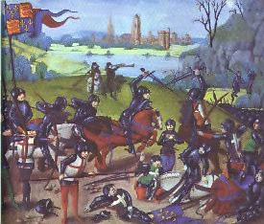
Which source of evidence is more useful for telling us about the Battle of Agincourt ?

Slide 3
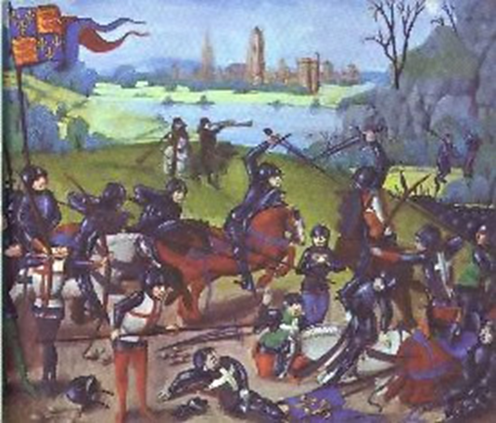
This painting was created in 1450, 35 years after the battle. The background is imaginary. The soldiers wear armour of 1450 not 1415. It is very unlikely that the artist saw the battlefield or witnessed the battle itself. The English are shown defeating the French. It was probably made for a rich English family.

Slide 4
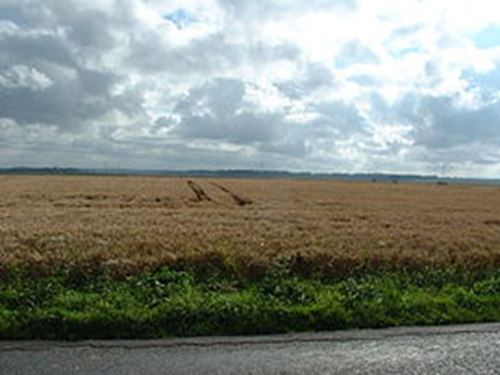
The battlefield at Agincourt is still farmland and the slopes of the land have not changed. The amount of woodland on it has changed. Very little evidence has so far been found on the battlefield, such as arrowheads, swords or graves where many people may have been buried. Historians cannot agree exactly where events took place on the battlefield.

Slide 5
Reliable sources of evidence for the Battle of Agincourt?
Eyewitness accounts
Accounts (chronicles) written close to the time in England and France
Records of numbers of soldiers, numbers of dead, cost of supplies, etc.
Pictures created near the time in England and France
Armour and weapons actually used in the battle
Armour and weapons like those used in the battle
The battlefield itself
Experiments with armour and weapon like those used in the battle
The expert opinions of historians who have thought long and hard about the battle

Slide 6
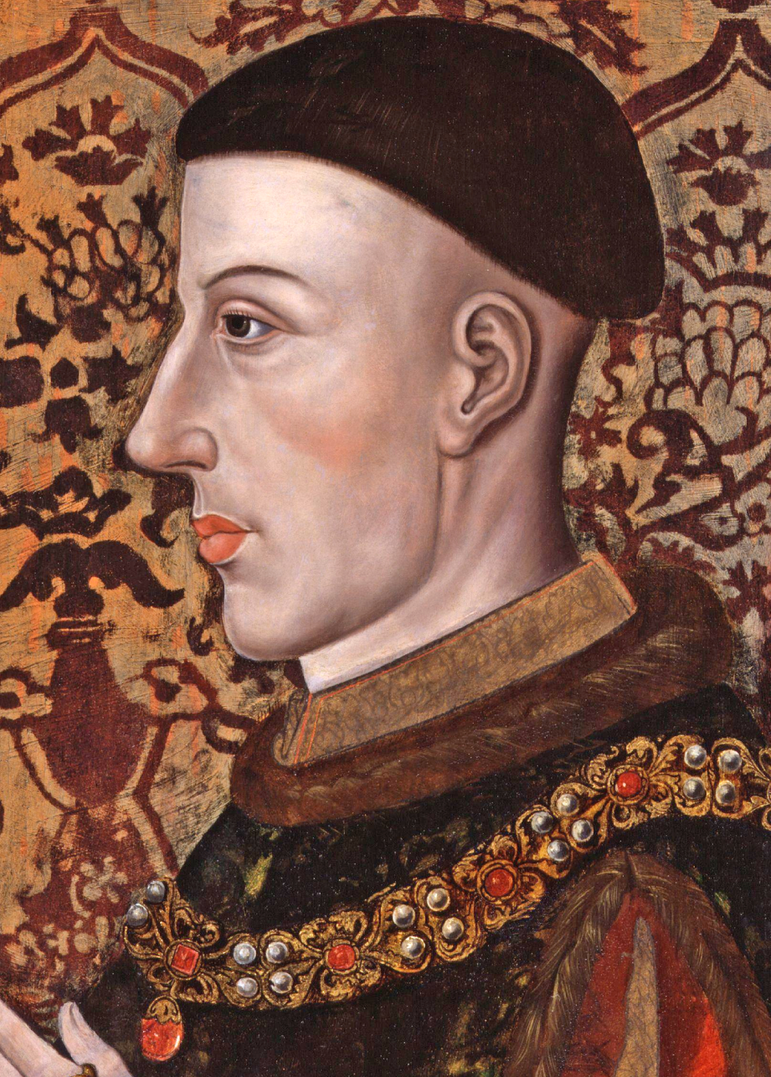

Slide 7
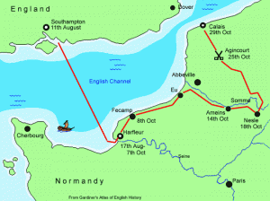
Henry V’s march to Agincourt 1415

Slide 8
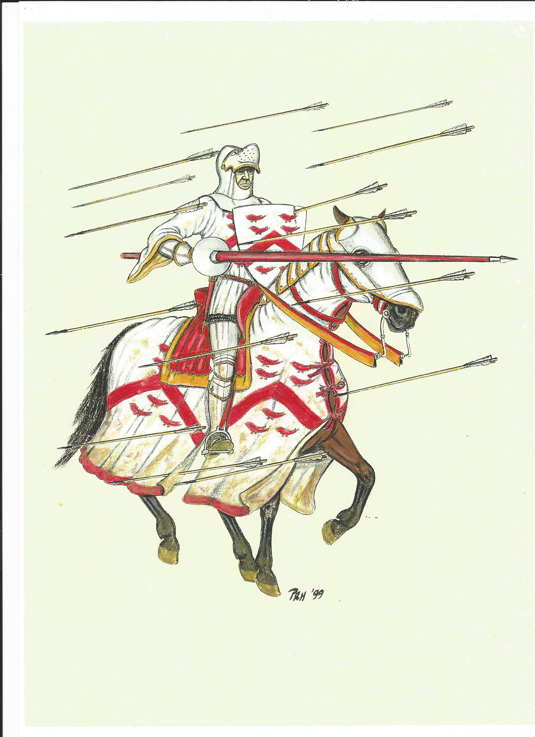
Paul Hitchen

Slide 9
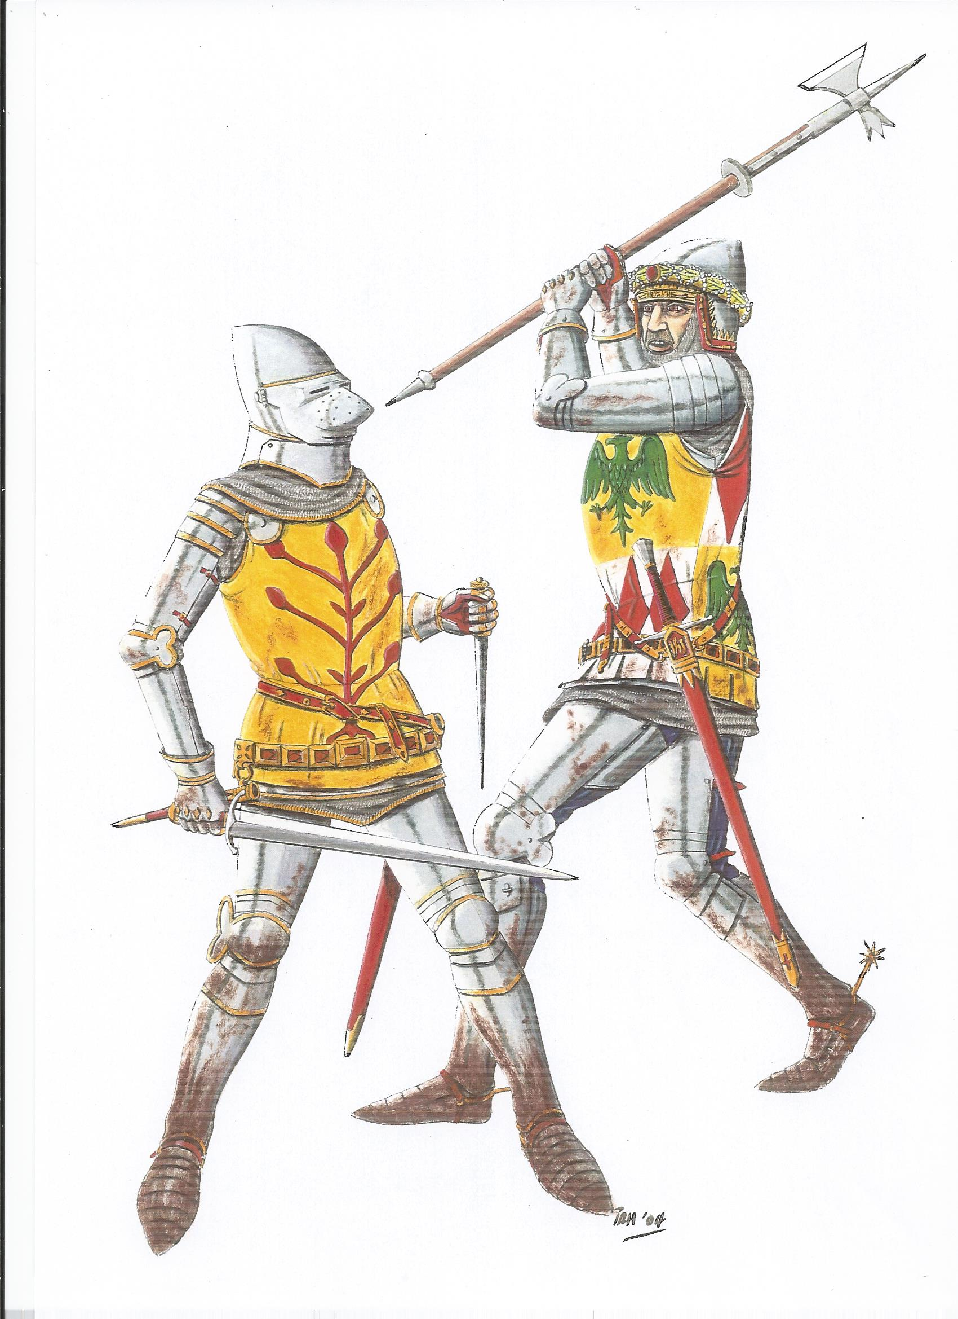
Paul Hitchen

Slide 10
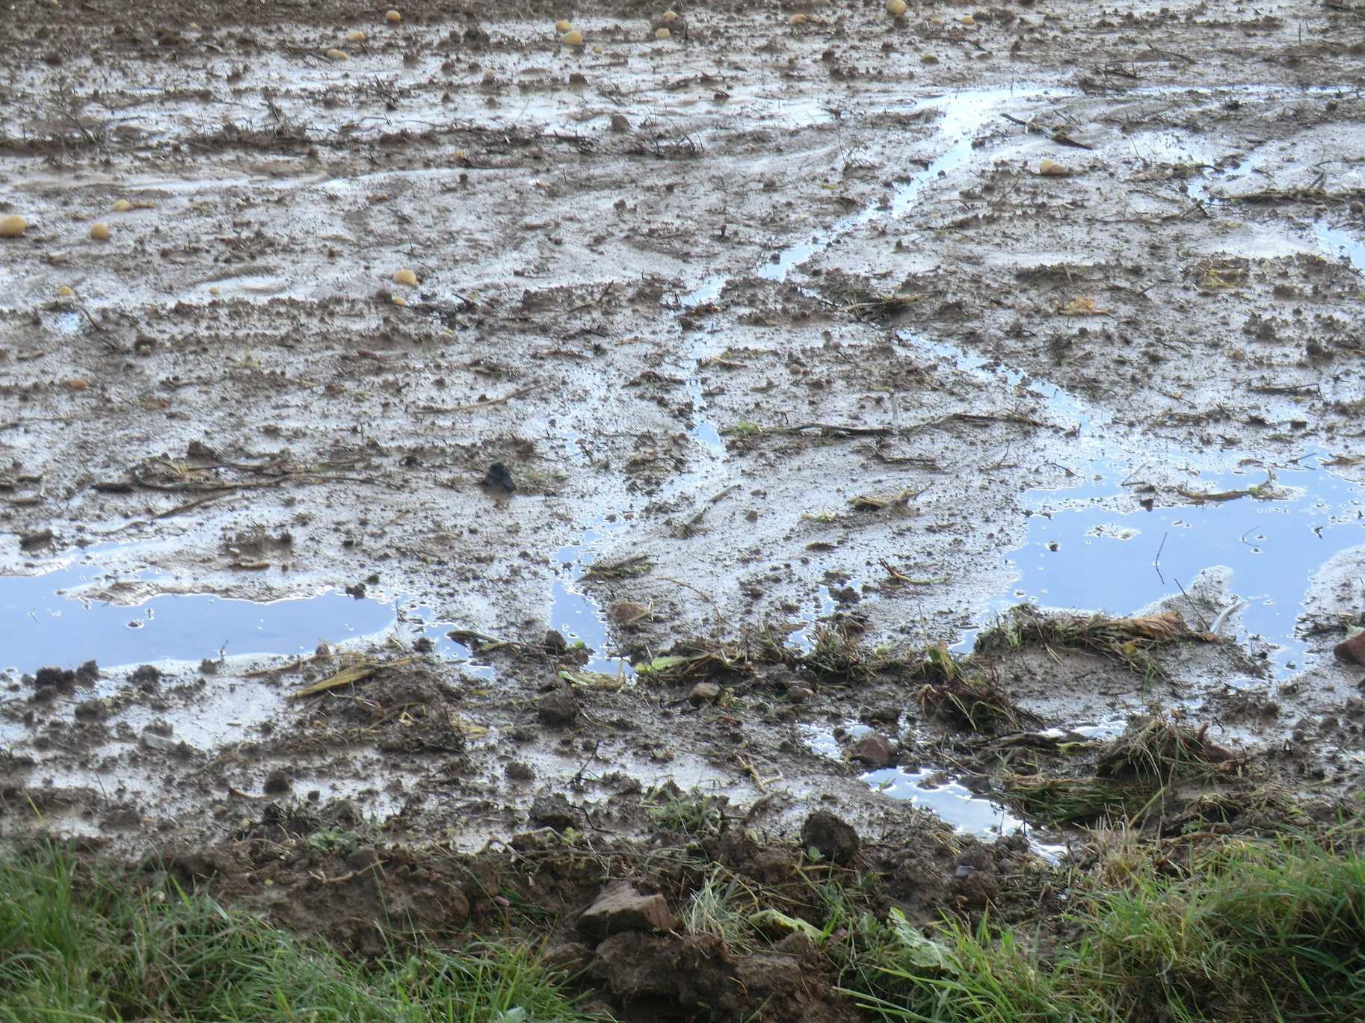
Peter Hoskins

Slide 11
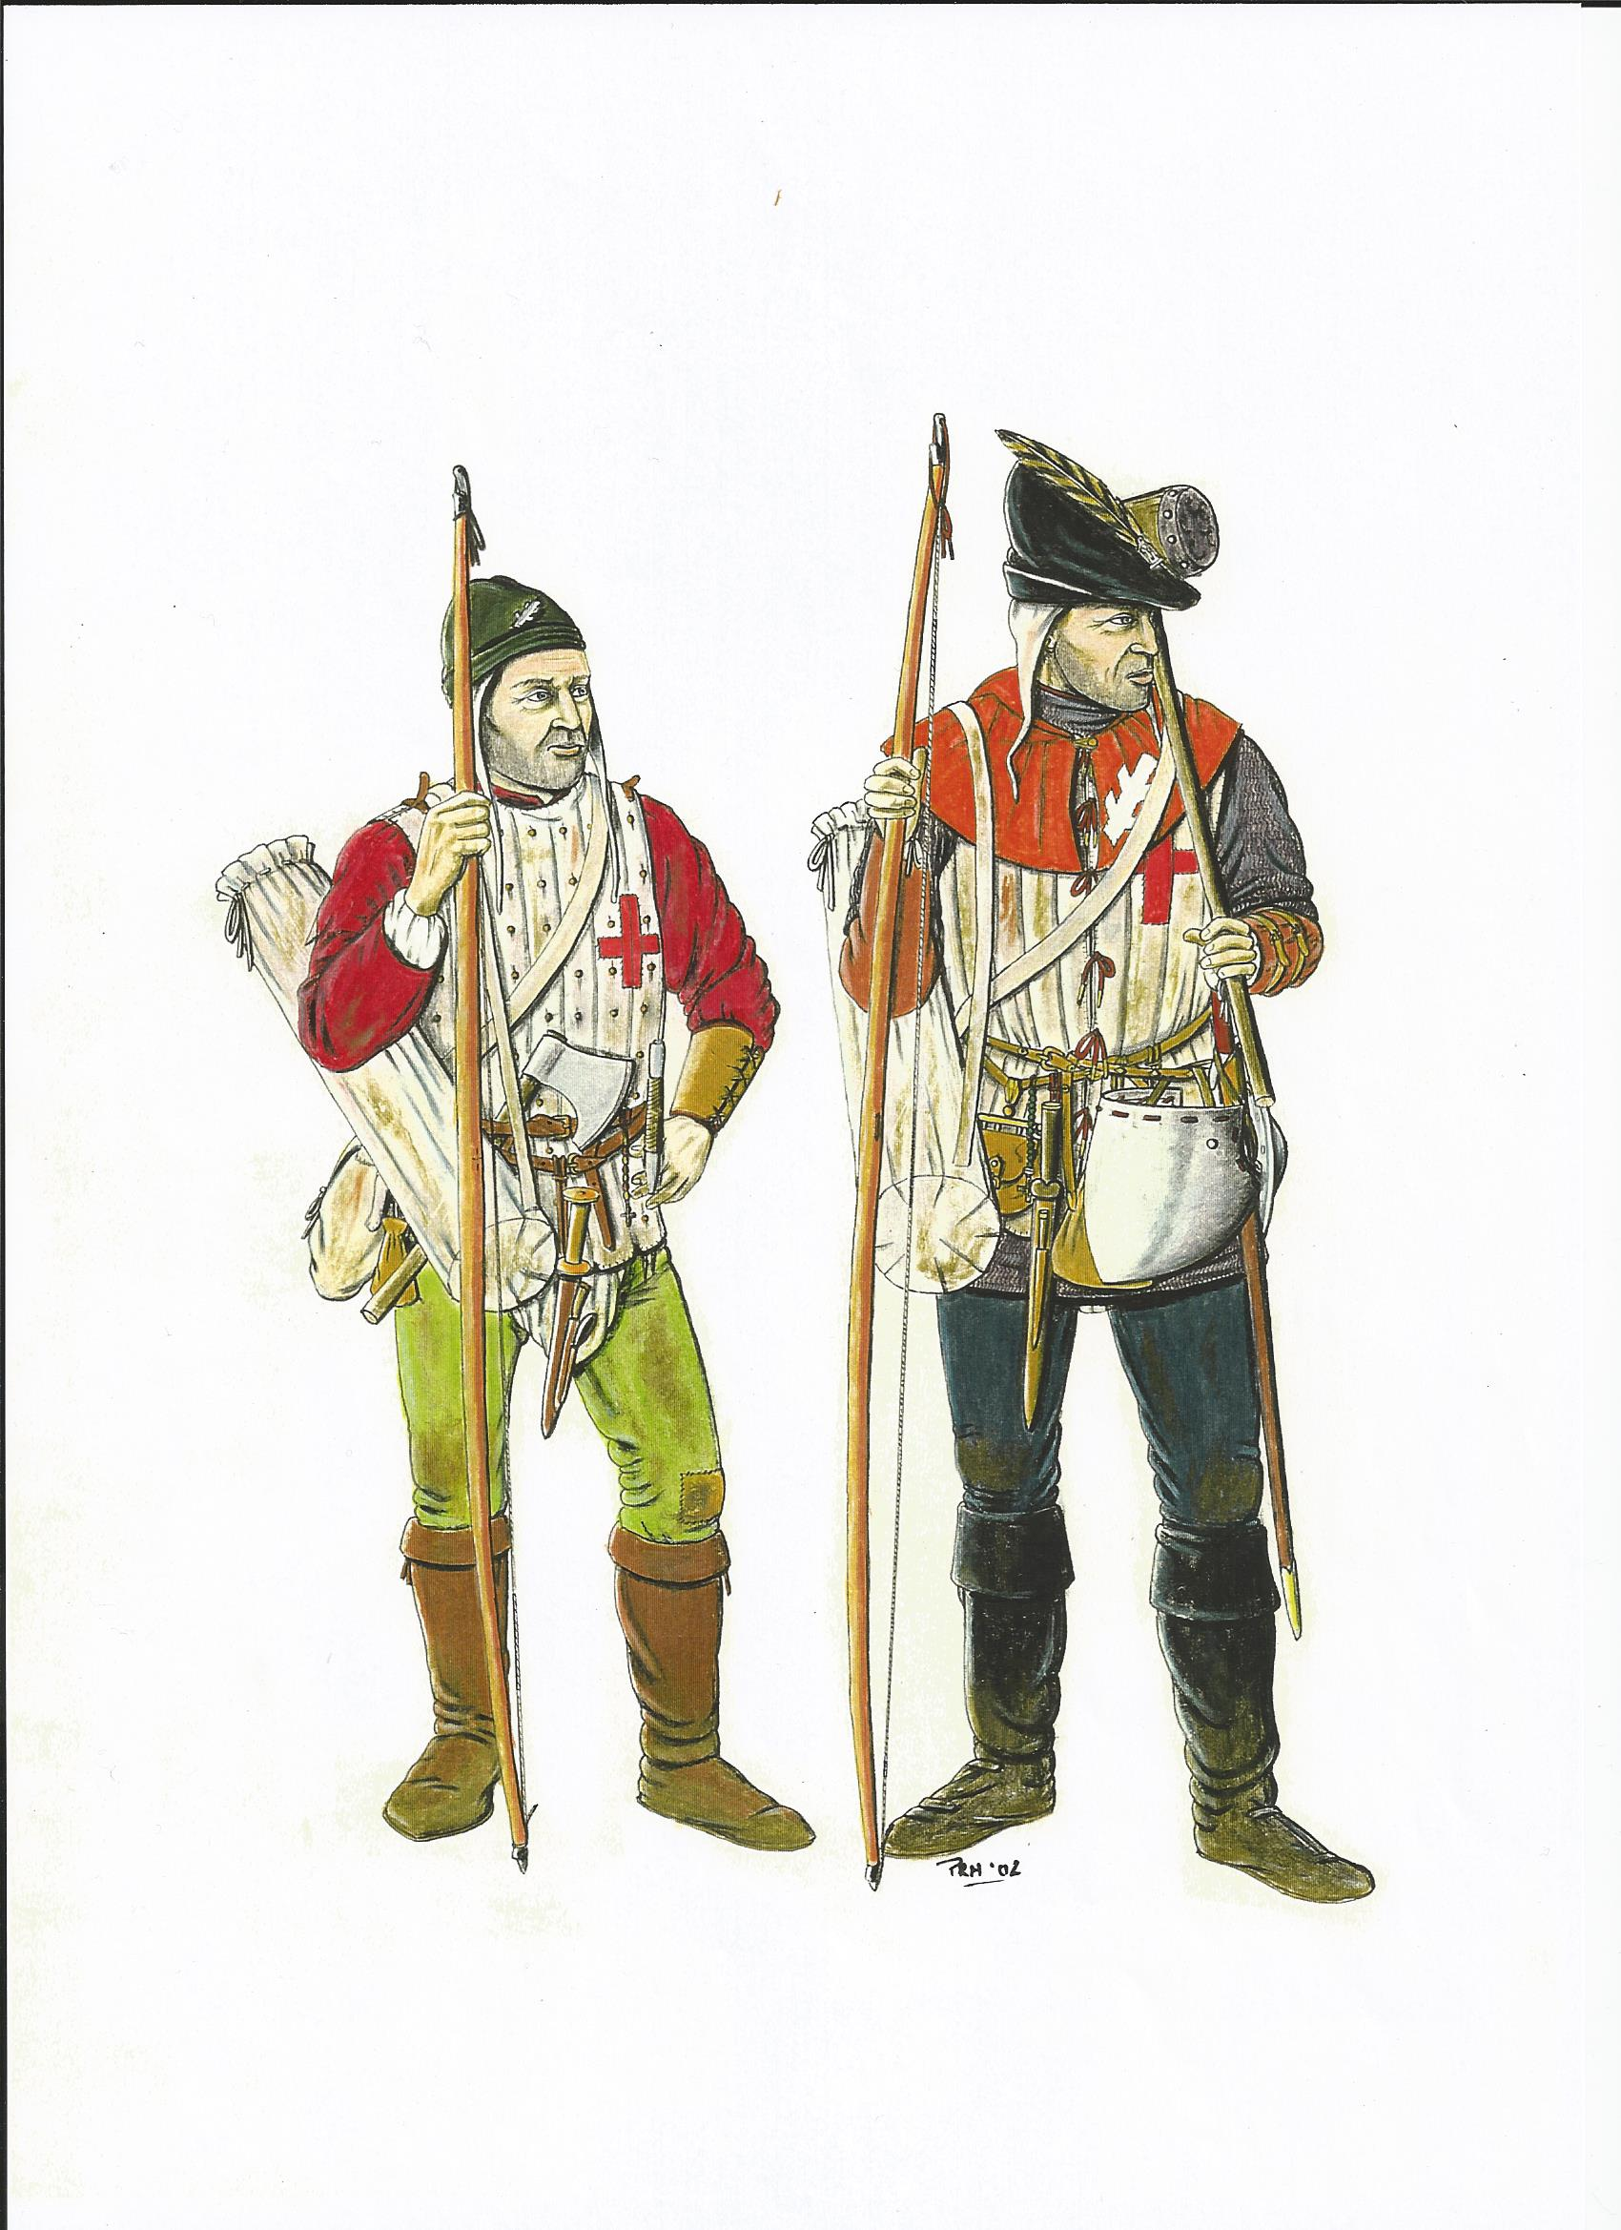
Paul Hitchen

Slide 12
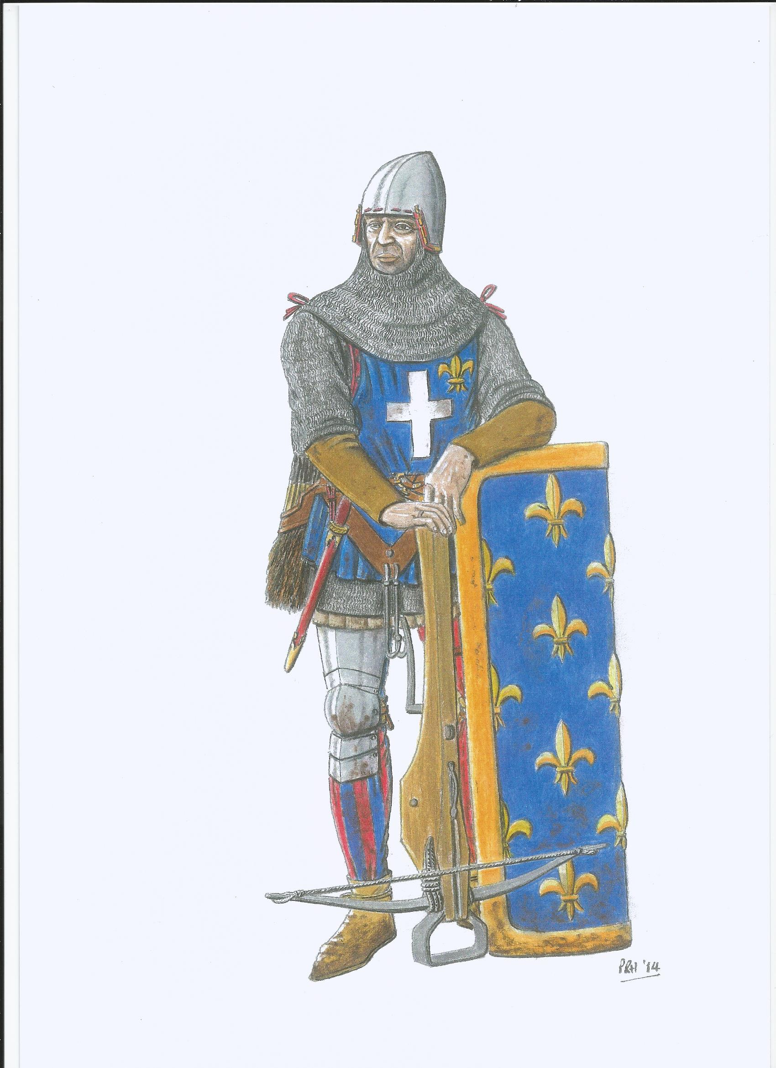
Paul Hitchen

Slide 13
Why did the English win the Battle of Agincourt?
The ground was muddy and churned up.
King Henry V was a strong leader.
English archers were fast and accurate.
French soldiers were too tightly packed together.
King Henry deliberately trapped the French army in a narrow field between two bits of woodland.
The cavalry charge of French knights failed.
The French had few archers and relied on crossbow men.

