Slide 1
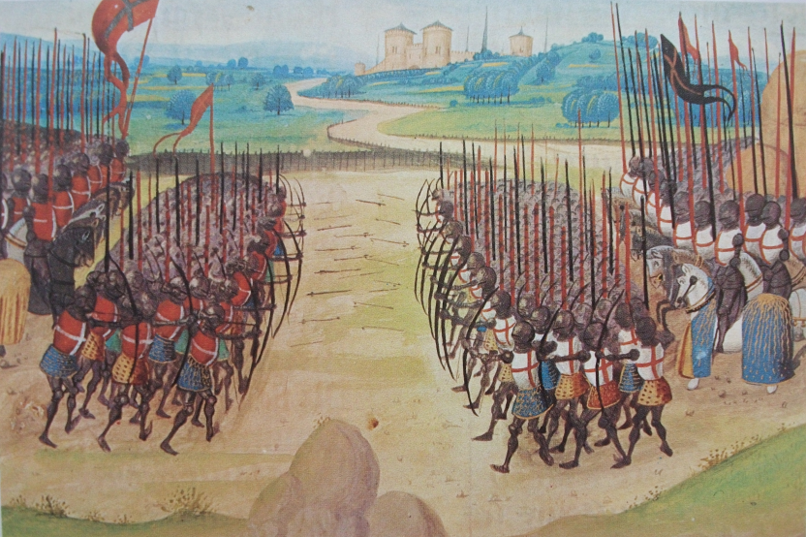

How did William Shakespeare want to make his audiences feel about the Battle of Agincourt?

Slide 2
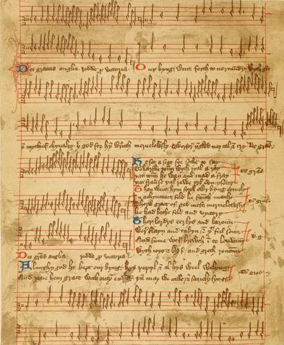
The Agincourt Carol 1415

Slide 3
What does the Agincourt Carol tell us?
Brave
Loyal
Clever
Proud
Handsome
Foolish
Evil
Violent
Good
Adventurous
Loving
Fun-loving
Determined
Just
Ruthless
Merciful
Greedy

Slide 4
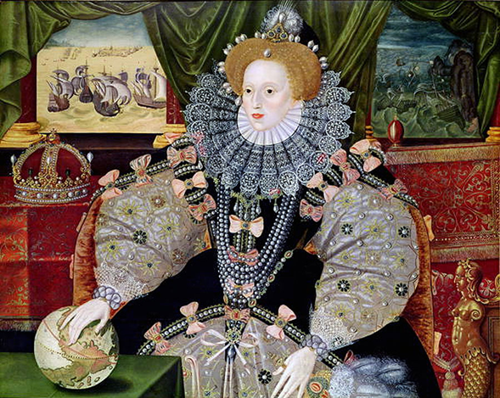
Queen Elizabeth I was queen of England and Ireland between 1558 and 1603. She never married or had children. While she lived, she never said who would be the next king or queen. By 1599, the Queen was old and could die at any time.

Slide 5
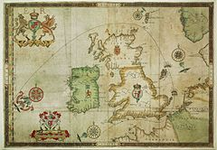
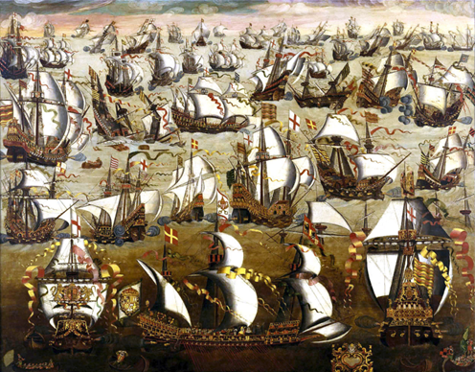
In 1588, Spain (not France), the most powerful country in Europe, sent a large fleet of ships to invade England. The English helped to defeat the Armada. England was still fighting Spain in 1599. The war had dragged on for more than eleven years. It was expensive.

Slide 6
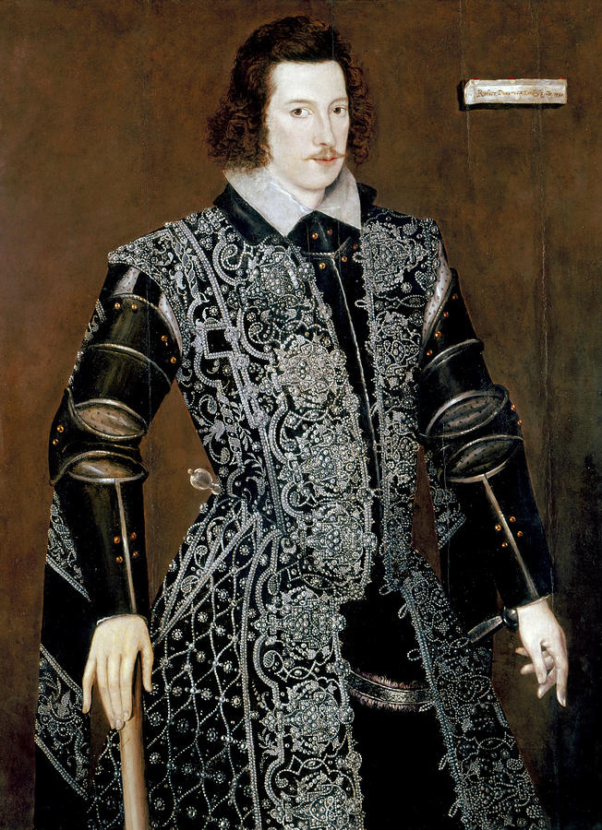

The handsome and popular Earl of Essex was sent by the Queen to Ireland. His job was to defeat Irish rebels there, backed by Spain.

Slide 7
What might English people have been feeling in 1599?
Proud
Hopeful
Fearful
Weary
Joyful

Slide 8

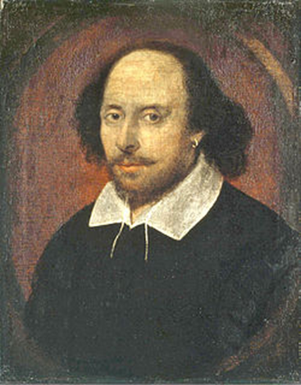

Slide 9
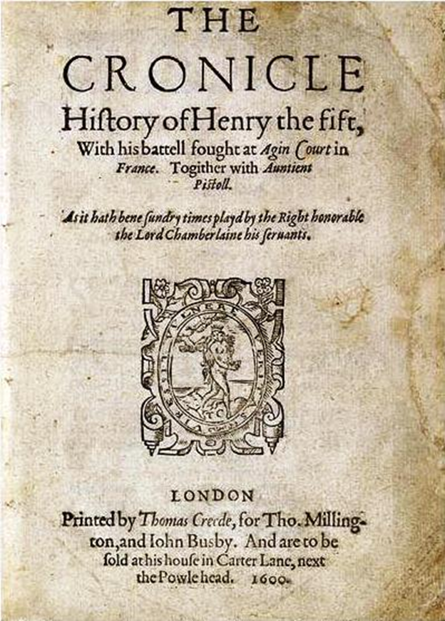
William Shakespeare’s play King Henry V, 1599

Slide 10
How did William Shakespeare want to make his audiences feel about the Battle of Agincourt?
It was a great victory.
The battle shows that England can defeat its enemies under great leadership (with some help from peoples around it, like the Welsh, the Scots and the Irish).
The battle shows that England can defeat its enemies even when the enemy seems more powerful or has larger armies.
The battle shows that England’s enemies are proud, foolish and brutal.
The battle shows that England can still defeat its enemies in 1599 (whether it’s the Spanish or Irish rebels).

