Slide 1
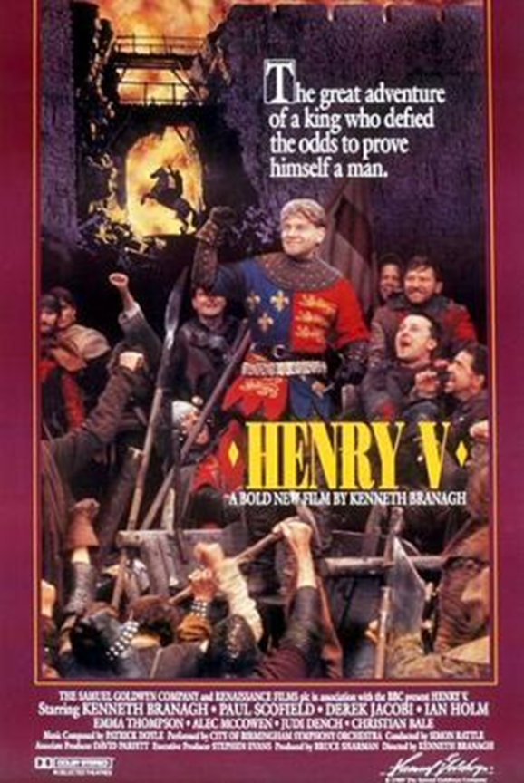
How did Laurence Olivier and Kenneth Branagh want their audiences to feel about the Battle of Agincourt?

Slide 2
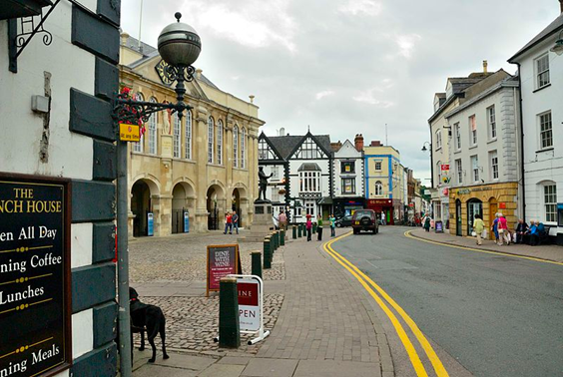
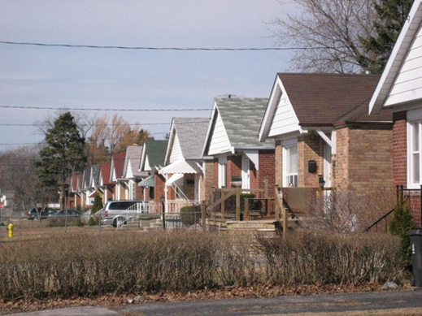
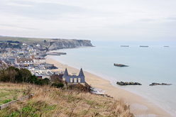
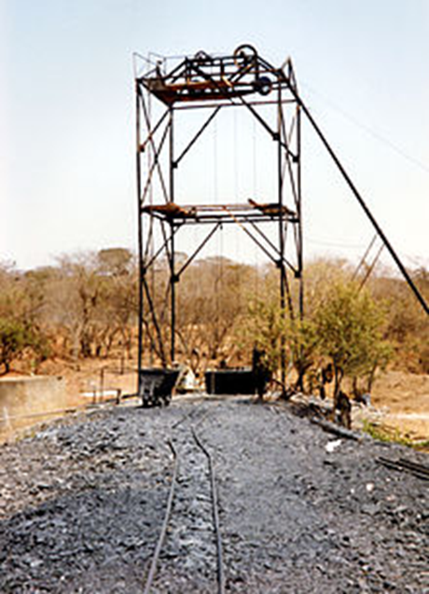

Slide 3
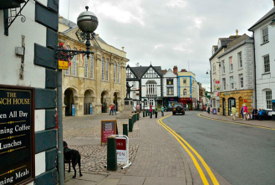
What’s in a name?
Agincourt Square, Monmouth, Wales, United Kingdom
Agincourt, Ontario Province, Canada
Agincourt Reef, Queensland, Australia
Agincourt, Mpumalanga Province, South Africa

Slide 4
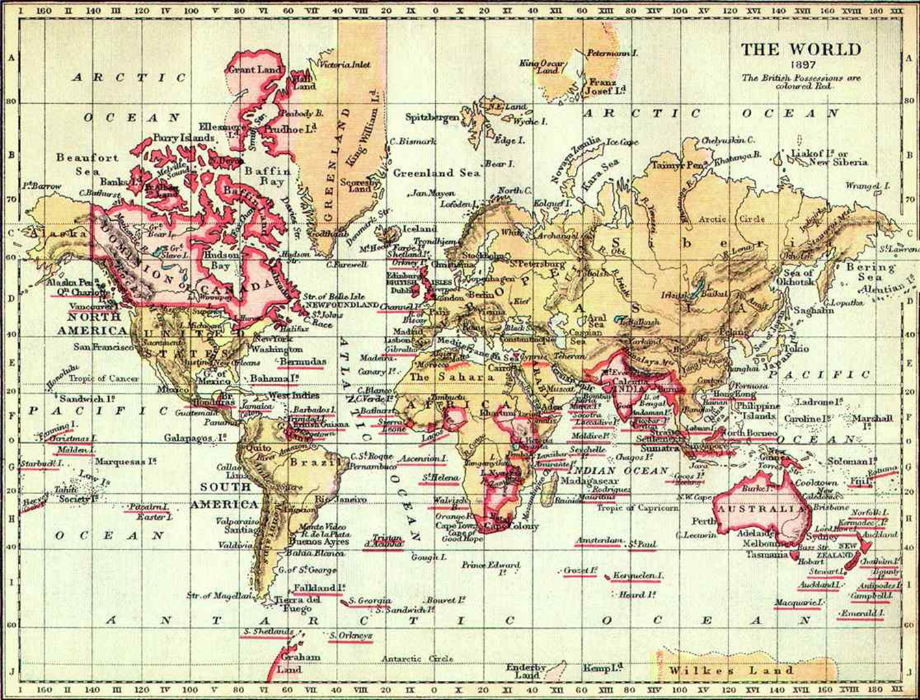
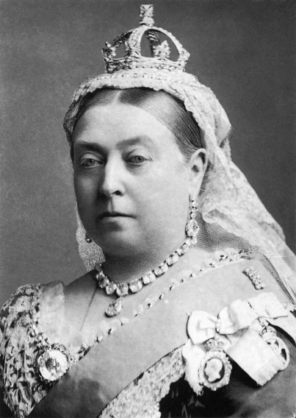

Slide 5
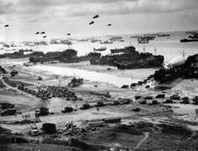
On 6th June 1944, during the Second World War, the British took part in a massive invasion with their allies to free France from Nazi Germany.

Slide 6
What was life like for ordinary British people during the Second World War up to 1944?
Britain was nearly invaded in 1940.
People had to carry gas masks, windows had to be blacked out at night, most cars were stored and road signs taken down.
Cities were bombed, people were killed, injured and made homeless.
Men and women went to war and some were killed and injured.
Rationing meant people were short of food.
Children from cities were evacuated to the countryside.
Britain had been fighting for four long years, experiencing victory and defeat.

Slide 7
“
‘Dedicated to the
Commandos and Airborne Troops of Great Britain, the spirit of whose ancestors it has been humbly attempted to recapture.’

Slide 8
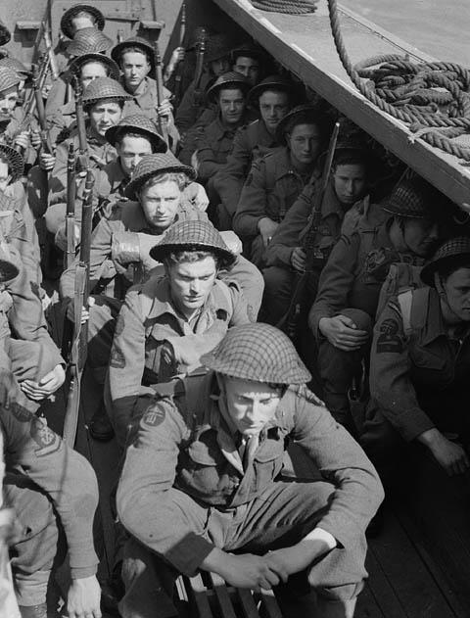
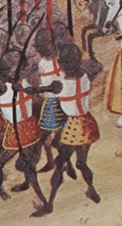
‘Made especially for the British Commandos [specially trained foot soldiers] and soldiers dropped by parachute from aeroplanes. It [the film] has been made to try and recreate the courage and fighting spirit of the soldiers who fought at Agincourt. Soldiers fighting today are descended from those soldiers at Agincourt.’

Slide 9
Similarities and differences between 1415 and 1944
1415 Henry V’s soldiers
1944 British soldiers on D-Day
Invaded Normandy
Fought in northern France
Came from England and Wales
Fought on foot and horseback
Defeated the French and helped to conquer France for their king
Invaded Normandy
Fought in northern France
Came from England, Wales, Scotland and Ireland
Fought on foot and in vehicles
Defeated the Germans
Were allies of the French and helped to free France from German rule
Were part of a large allied force including the Americans

Slide 10
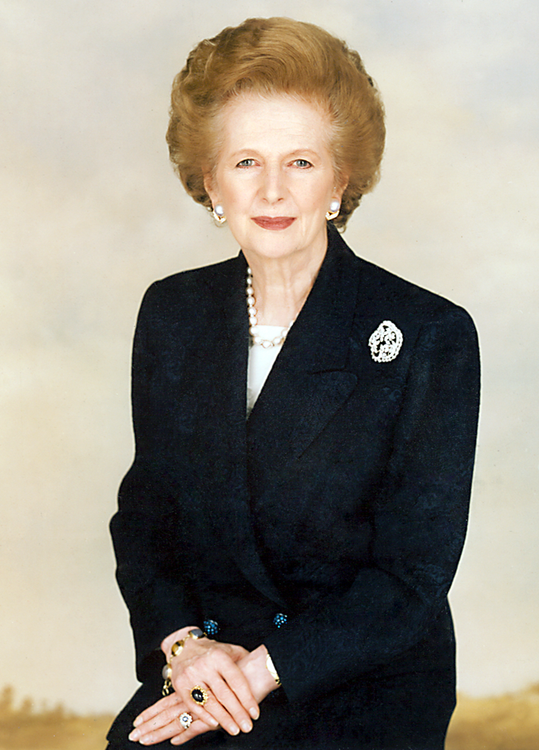

Slide 12
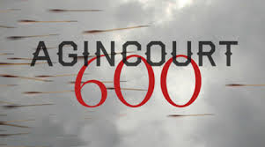
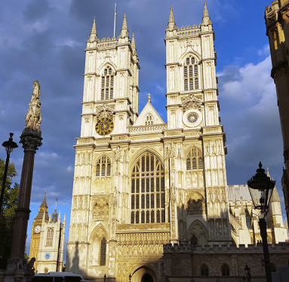
Planning the service
What kind of music should be included?
Should just English and Welsh people be invited or Scottish and Irish people too?
Should Henry’s sword and helmet be on display; if so, where?
Should there be anything read from Shakespeare’s play?
Should the Queen be invited?
Should French people be invited?
Should people from families of soldiers who fought at Agincourt be invited?
When should the service be held?

Slide 13
Agincourt 600 service
The service was held on Thursday Oct 29th 2015. In the same month, the battle was fought but not on the same date.
Henry’s sword was carried into the church and, with his helmet, placed on the altar (one of the most important parts of the church).
An actor from the Royal Shakespeare Company dressed as Henry V read one of Shakespeare’s famous speeches from the play.
The music included the Agincourt Carol
Anyone from the whole United Kingdom (including Scotland and Northern Ireland) could apply for tickets to go to the service.
Members of the British Royal Family attended but not the Queen.
A French leader from the area of France where Agincourt was fought read about how the British and French remembered the battle together in 1915 when they were allies during the First World War.

