Slide 1
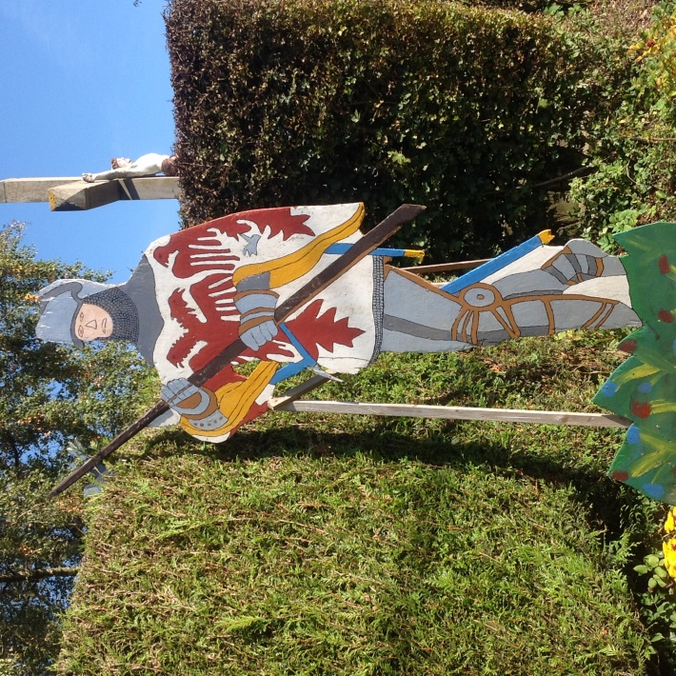
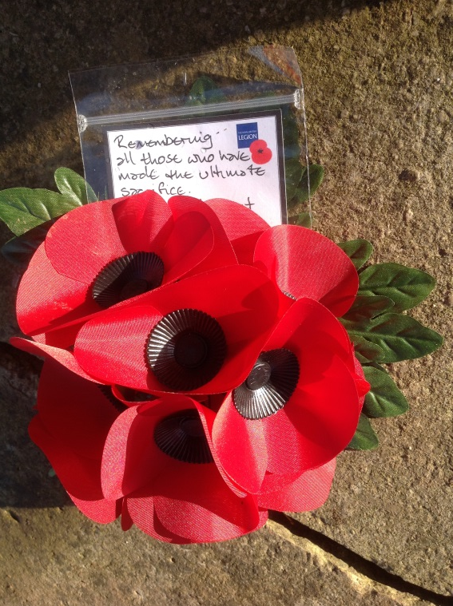
How should the battle of Agincourt be remembered today?

Slide 4
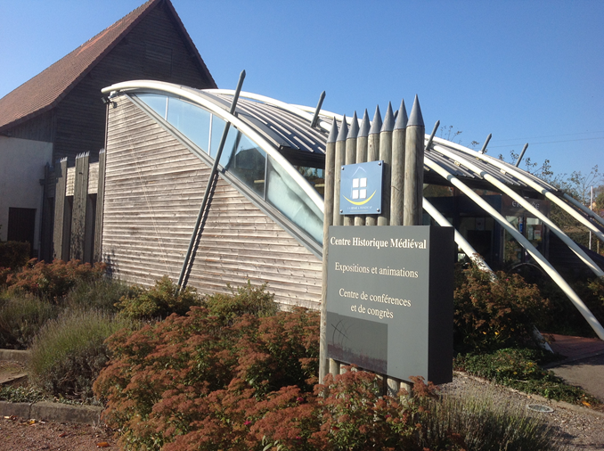

Slide 6
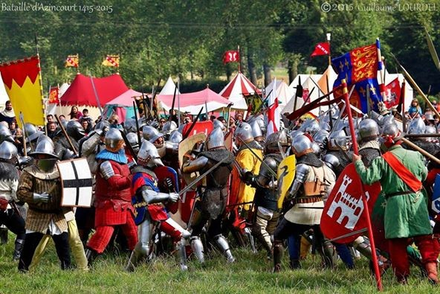
Battle scene

Slide 7
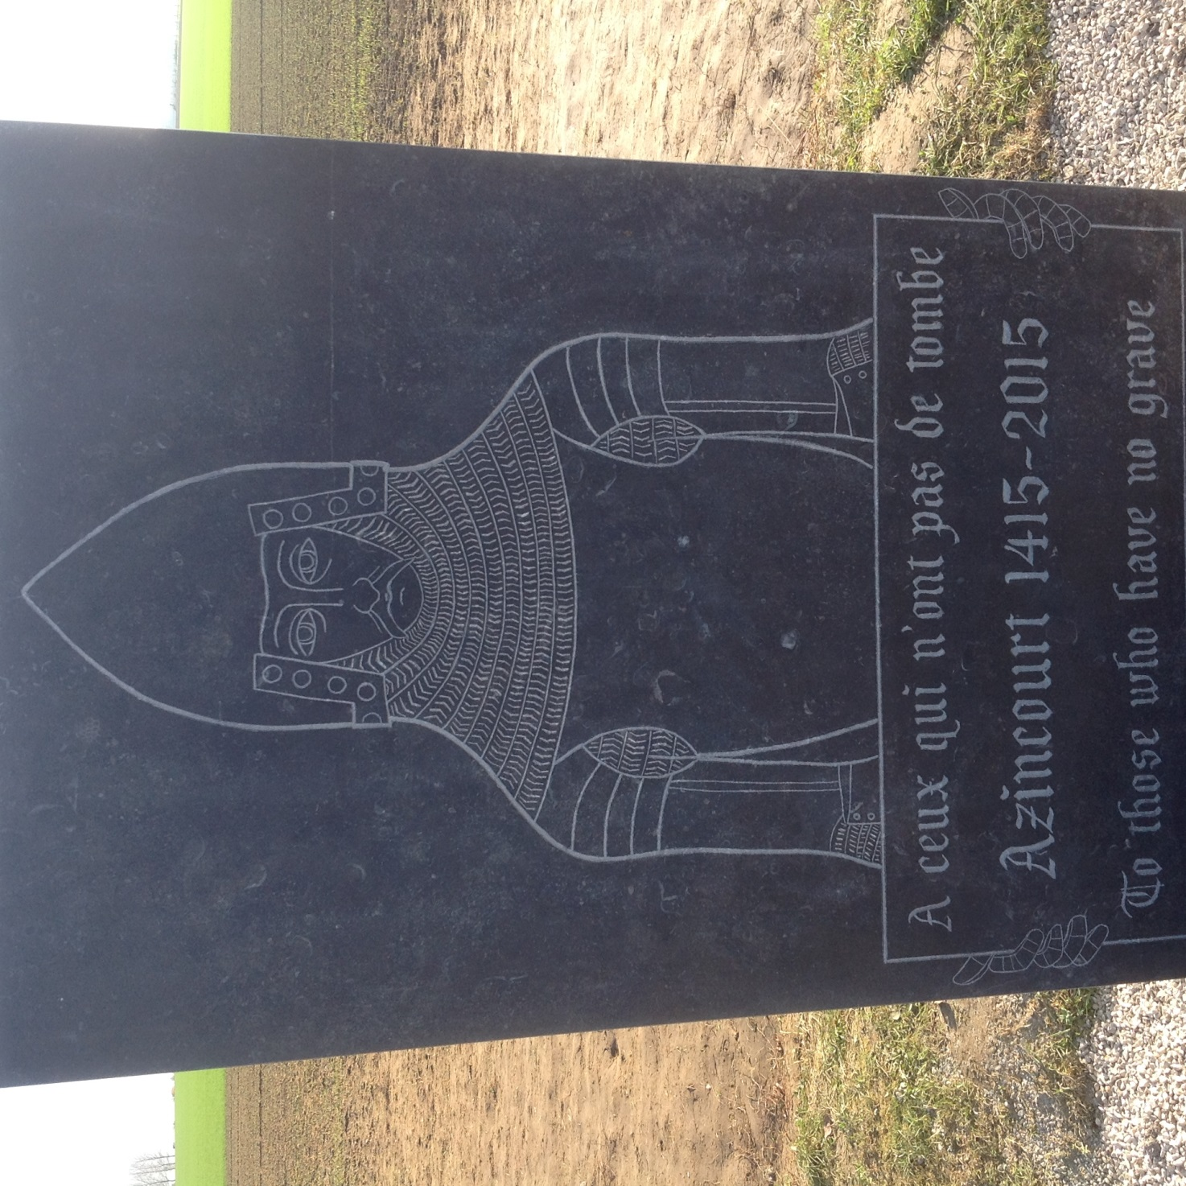

Slide 8
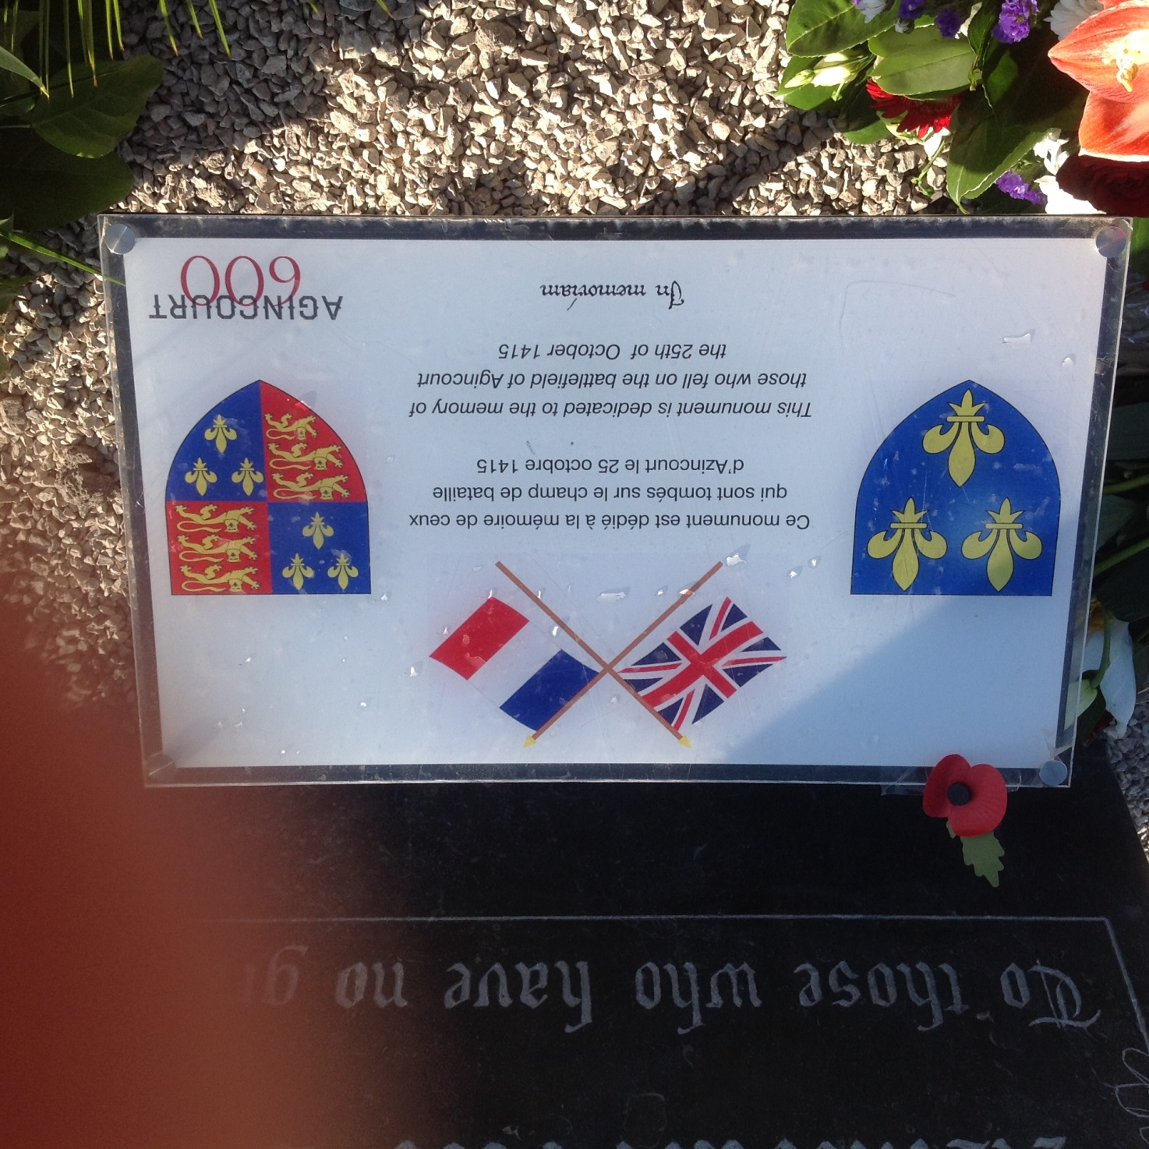

Slide 9
Interpretations of the Battle of Agincourt
The Battle of Agincourt was a great English victory which English (and all British) people can still take pride in
The Battle of Agincourt was a great Welsh as well as a great English victory which all Welsh people can still take pride in
The Battle of Agincourt is not worth remembering today because it was only an English victory not a British one (for example, why should Scottish or Northern Irish people remember it at all?)
The Battle of Azincourt was a terrible and shameful French defeat which is best forgotten
The Battle of Azincourt was a terrible French defeat but French people should remember the bravery of French soldiers who defended their country
The battle was important for different reasons but we must also remember the dead of both sides with sadness (we do not even know where they are buried on the battlefield). This shared sadness can unite Britain and France as friends and allies today.

