Slide 1
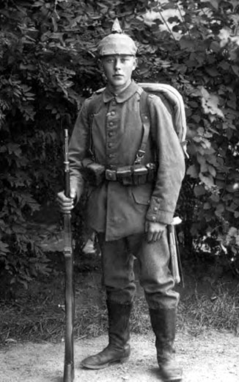
LIONS OF THE GREAT WAR (PRIMARY) LESSON 3: RESOURCE K
Notes:
Slide 1
A blood thirsty depiction of a Sikh soldier from a German children's picture book of 1914 entitled “Our Enemies”.
Courtesy of Robin Schäfer, Military Historian, Dinslaken, Germany

Slide 2
What did Germans fear about Sikhs?
LIONS OF THE GREAT WAR (PRIMARY) LESSON 3: RESOURCE K
“Brown fellows wearing tall turbans. We were all sure that things would become even more dangerous from now on as they would probably sneak over to us at night time to murder our pickets (sentries) using their long knives.”
German infantry officer

Slide 3
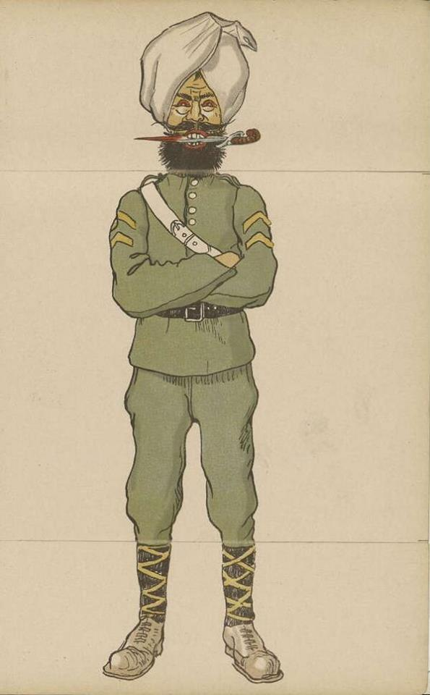
LIONS OF THE GREAT WAR (PRIMARY) LESSON 3: RESOURCE K
Notes:
Slide 1
A blood thirsty depiction of a Sikh soldier from a German children's picture book of 1914 entitled “Our Enemies”.
Courtesy of Robin Schäfer, Military Historian, Dinslaken, Germany

Slide 4
LIONS OF THE GREAT WAR (PRIMARY) LESSON 3: RESOURCE K
Magnificent
Mysterious
Cruel
Savage
Weak
Powerful
Equal to white Europeans
Handsome
Better than white Europeans
Disciplined
Frightening
Strong
Fierce
Not as good as white Europeans
Aggressive
Brave
Healthy
Loyal

Slide 5
LIONS OF THE GREAT WAR (PRIMARY) LESSON 3: RESOURCE K
Notes:
Slide 4
A German postcard from early on in the war with an image of a German soldier holding a captured Indian soldier. The phrase “Der Gefangene Inder” translates as “The Captured Indian”.
By kind permission of Timothy Moore

Slide 6
LIONS OF THE GREAT WAR (PRIMARY) LESSON 3: RESOURCE K
Notes:
Slide 5
A typical Sikh naik (corporal) of the 14th Ferozepore Sikhs, c. 1910.
Courtesy of the Council of the National Army Museum, London (acc. no. 1994-05-50-716)

Slide 7
LIONS OF THE GREAT WAR (PRIMARY) LESSON 2: RESOURCE G
Magnificent
Mysterious
Cruel
Savage
Weak
Powerful
Equal to white Europeans
Handsome
Better than white Europeans
Disciplined
Frightening
Strong
Fierce
Not as good as white Europeans
Aggressive
Brave
Healthy
Loyal

Slide 8
LIONS OF THE GREAT WAR (PRIMARY) LESSON 3: RESOURCE K
Notes:
Slide 6
The commandant of the prison camp at Wunsdorf speaks with a group of British Indian prisoners (including Sikhs) in the prison compound.
UKPHA Archive

Slide 9
How did Germans change their minds about Sikh soldiers?
LIONS OF THE GREAT WAR (PRIMARY) LESSON 3: RESOURCE K
By the end of the First World War in 1918 Germans who had fought against them or met them thought that:
Sikhs were brave fighters
Sikhs were loyal
Sikhs were not cruel and cared for prisoners
Sikhs were not equal to Europeans
Notes:
Slide 6
The commandant of the prison camp at Wunsdorf speaks with a group of British Indian prisoners (including Sikhs) in the prison compound.
UKPHA Archive

Slide 10
IMAGE CREDITS
LIONS OF THE GREAT WAR (PRIMARY) LESSON 3: RESOURCE K
Slide 1 Photograph of a German soldier of the First World War. From “The Heritage of the Great War” (www.greatwar.nl).
Slide 3 A blood thirsty depiction of a Sikh soldier from a German children's picture book of 1914 entitled “Our Enemies”. Courtesy of Robin Schäfer, Military Historian, Dinslaken, Germany.
Slide 5 A German postcard from early on in the war with an image of a German soldier holding a captured Indian soldier. By kind permission of Timothy Moore.
Slide 6 A typical Sikh naik (corporal) of the 14th Ferozepore Sikhs, c. 1910. Courtesy of the Council of the National Army Museum, London (acc. no. 1994-05-50-716).
Slide 8 The commandant of the prison camp at Wunsdorf speaks with a group of British Indian prisoners (including Sikhs) in the prison compound. UKPHA Archive.

