Slide 1
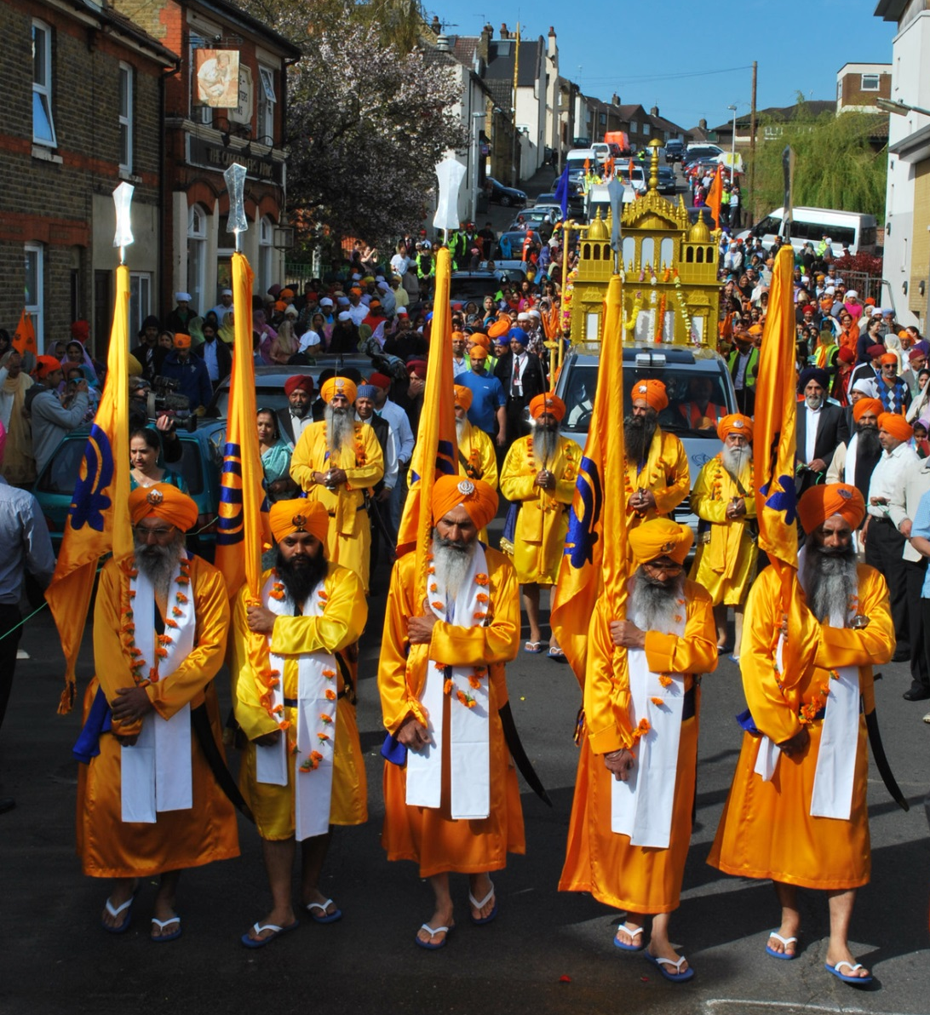
LIONS OF THE GREAT WAR (PRIMARY) LESSON 5: RESOURCE S

Slide 2
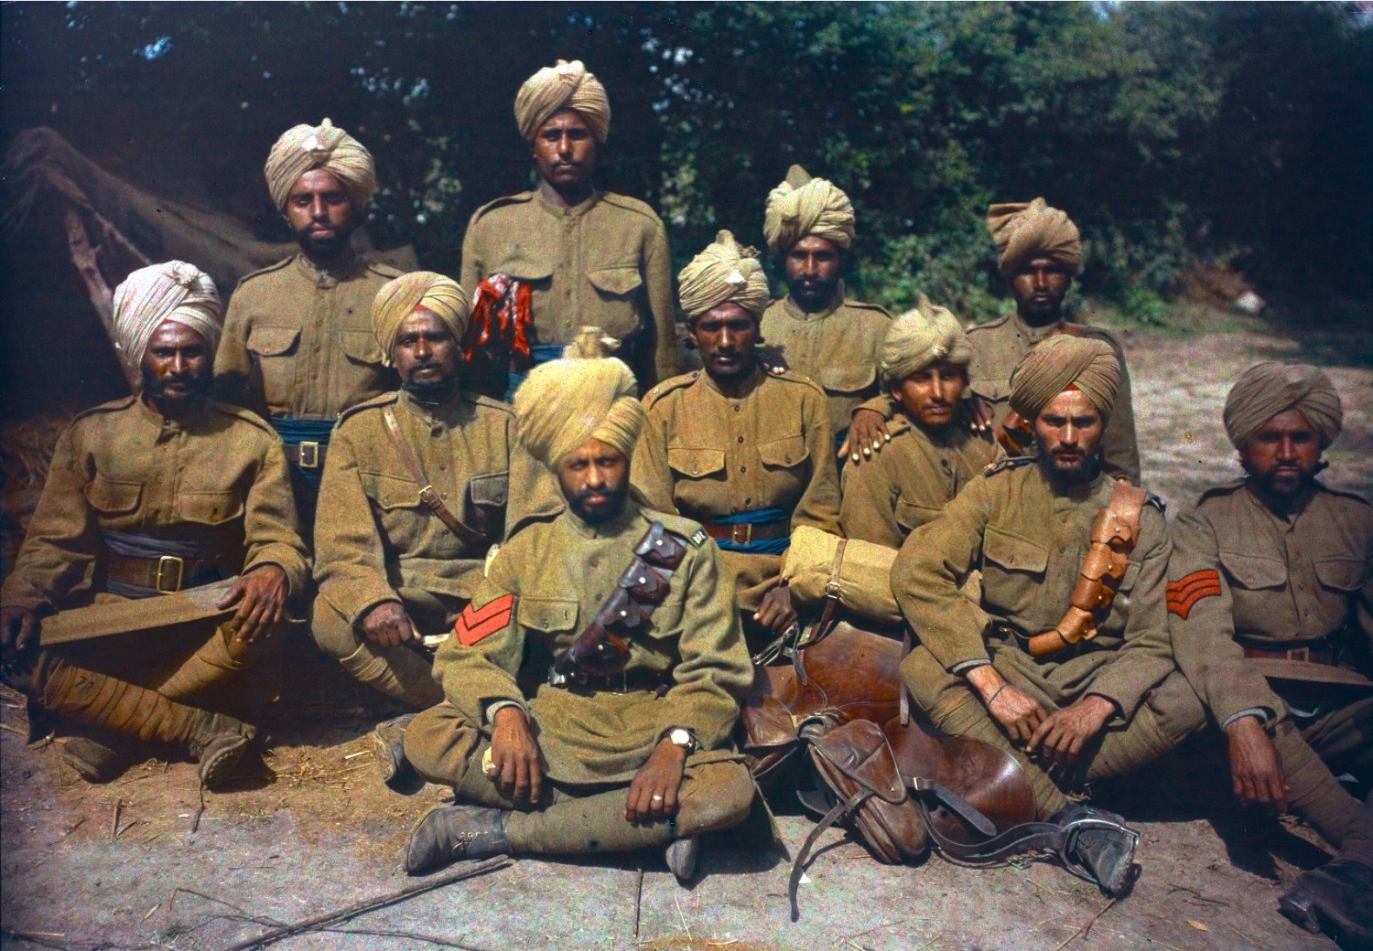
LIONS OF THE GREAT WAR (PRIMARY) LESSON 5: RESOURCE S

Slide 3
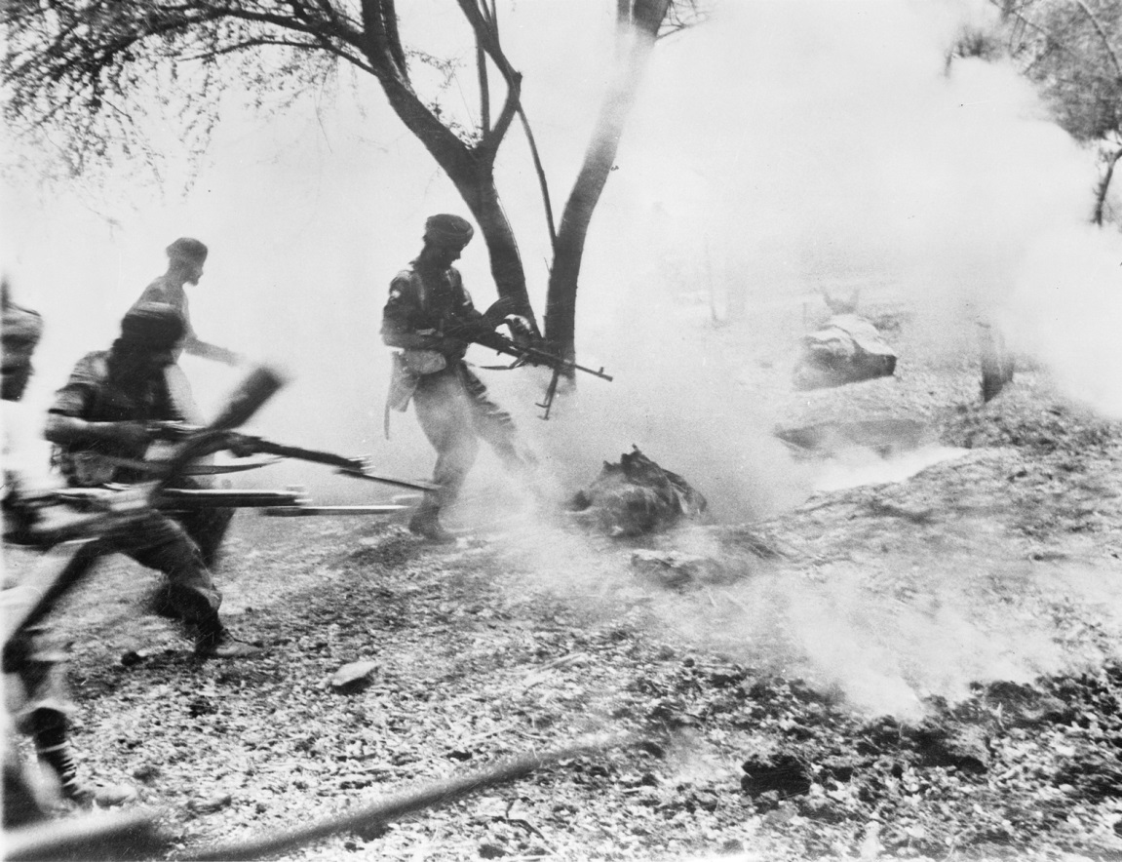
LIONS OF THE GREAT WAR (PRIMARY) LESSON 5: RESOURCE S

Slide 4
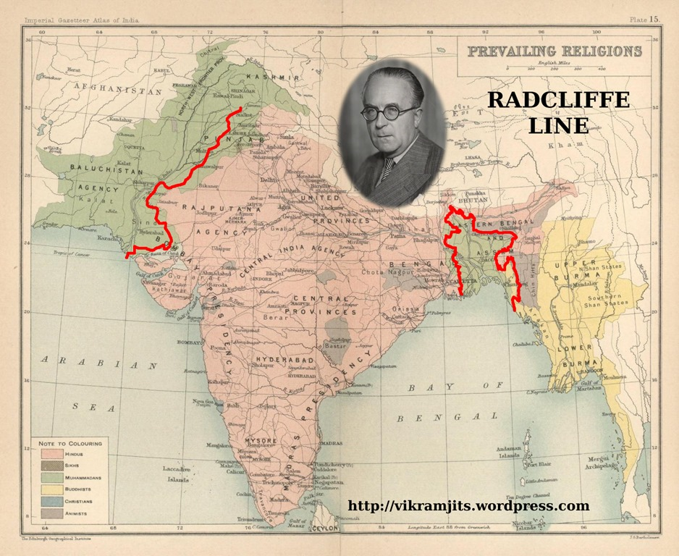
LIONS OF THE GREAT WAR (PRIMARY) LESSON 5: RESOURCE S

Slide 5
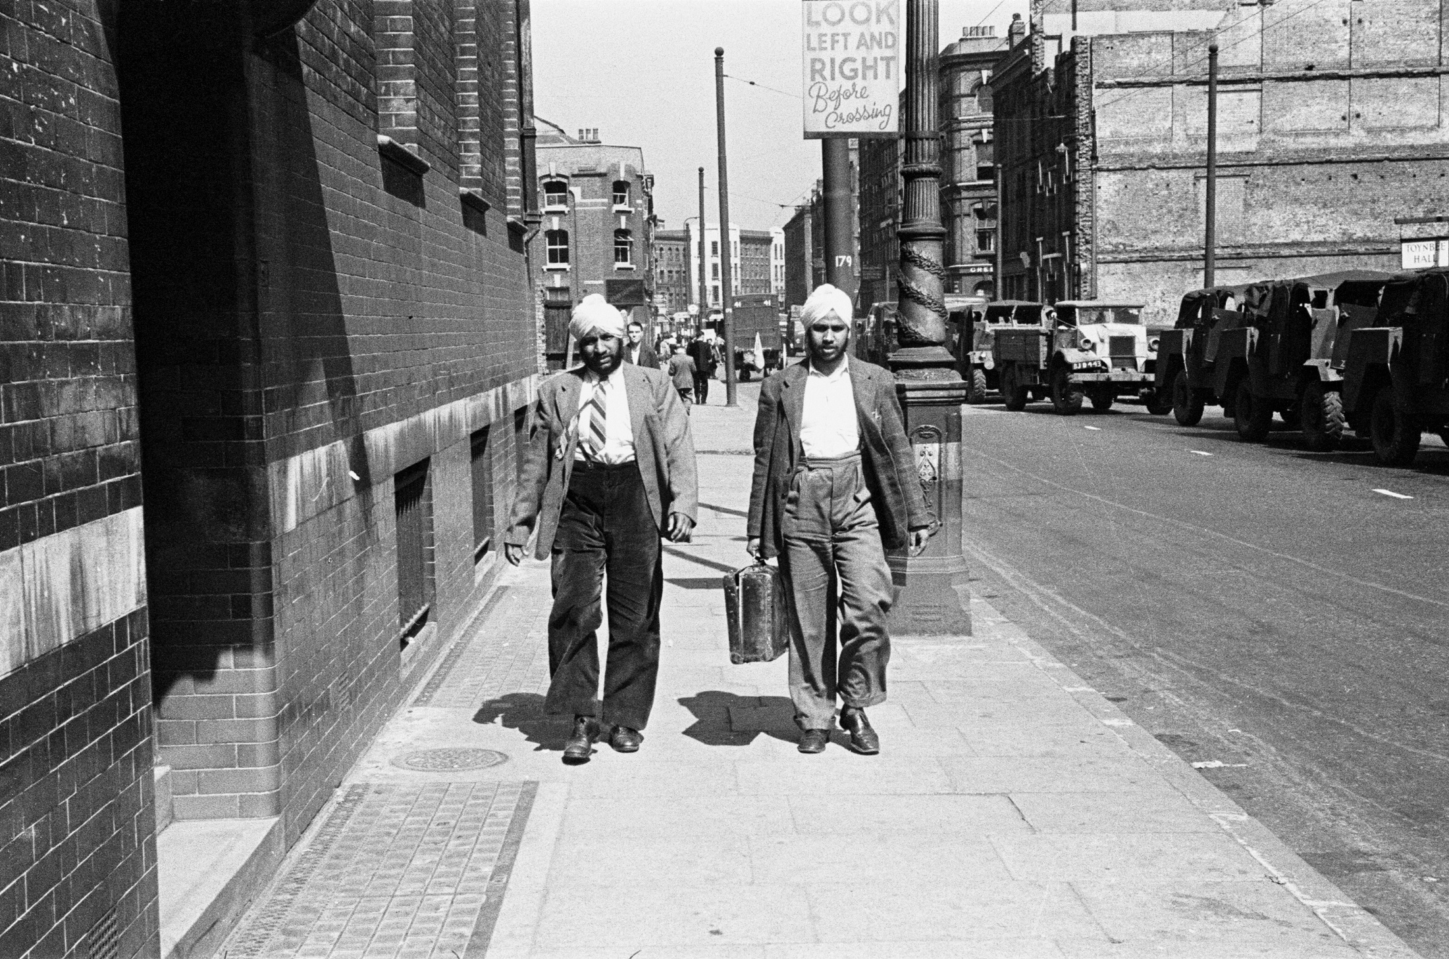
LIONS OF THE GREAT WAR (PRIMARY) LESSON 5: RESOURCE S

Slide 6
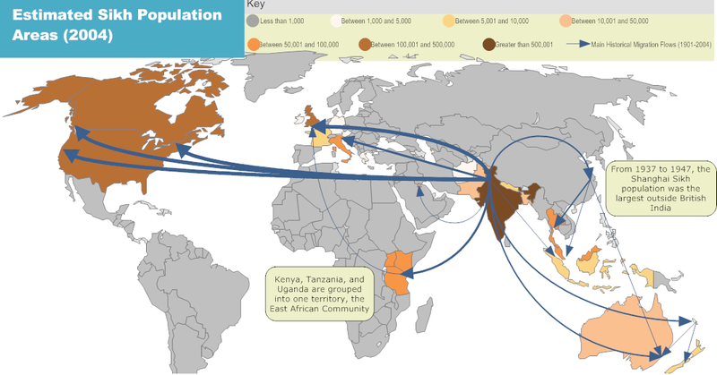
LIONS OF THE GREAT WAR (PRIMARY) LESSON 5: RESOURCE S

Slide 7
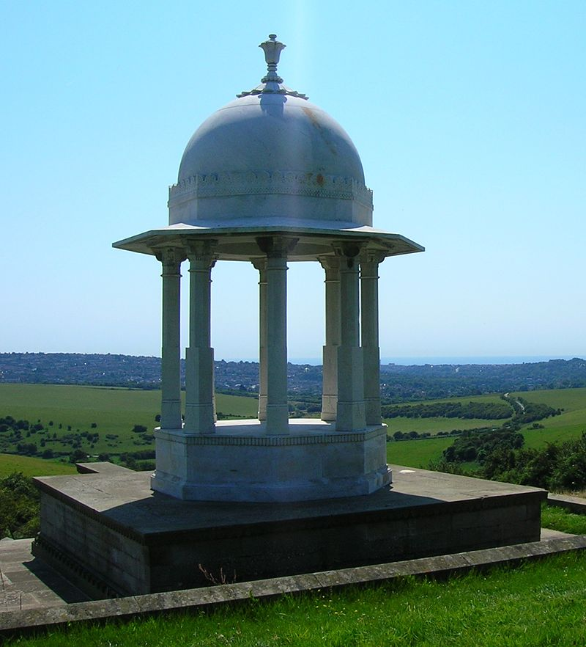
The Chattri Memorial, Brighton
LIONS OF THE GREAT WAR (PRIMARY) LESSON 5: RESOURCE S

Slide 8
LIONS OF THE GREAT WAR (PRIMARY) LESSON 5: RESOURCE S
To the memory of all Indian soldiers who gave their lives for the King-Emperor in the Great War, this monument, erected on the site of the funeral pyre (fire) where Hindus and Sikhs who died in hospital at Brighton passed through the fire, is in grateful admiration and brotherly love dedicated

Slide 9
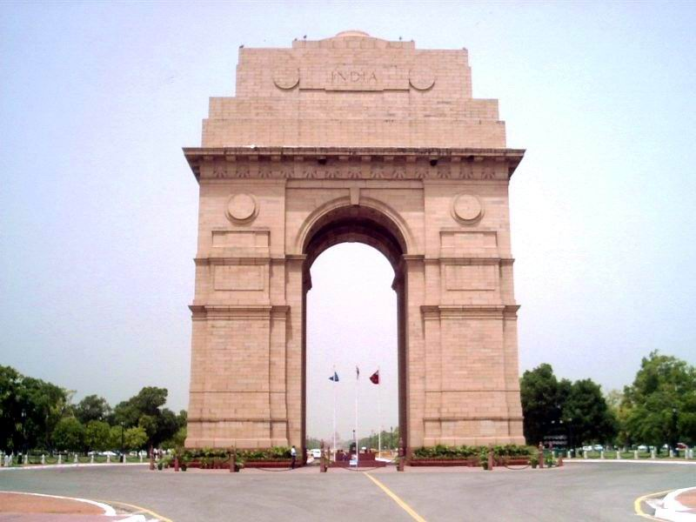
India Gate, Delhi, India
LIONS OF THE GREAT WAR (PRIMARY) LESSON 5: RESOURCE S

Slide 10
INDIA MCMXIV (1914) (to) MCMXIX (1919)
LIONS OF THE GREAT WAR (PRIMARY) LESSON 5: RESOURCE S
TO THE DEAD OF THE INDIAN ARMIES WHO FELL HONOURED IN FRANCE AND FLANDERS MESOPOTAMIA AND PERSIA EAST AFRICA GALLIPOLI AND ELSEWHERE IN THE NEAR AND THE FAR-EAST AND IN SACRED MEMORY ALSO OF THOSE WHOSE NAMES ARE RECORDED AND WHO FELL IN INDIA OR THE NORTH-WEST FRONTIER AND DURING THE THIRD AFGHAN WAR

Slide 11
Sikhs at War Memorial
LIONS OF THE GREAT WAR (PRIMARY) LESSON 5: RESOURCE S
Their service
Their sacrifice
For our freedom…………
will never be forgotten

Slide 12
IMAGE CREDITS
LIONS OF THE GREAT WAR (PRIMARY) LESSON 5: RESOURCE S
Slide 1 Sikhs living in Britain. Courtesy of Taran Singh Padam.
Slide 2 A rare colour photograph of Indian troops (cavalrymen) on the Western Front on 27 February 1917 (the three soldiers with red showing under their turbans are Sikhs). © Collection Tournassoud/Docpix.fr.
Slide 3 Sikh soldiers of the British Indian Army attack an enemy position in Burma during the Second World War (1939-45). © IWM (IND 4550).
Slide 4 A map of the partition boundaries in Punjab (marked in red on the left side of the map) in 1947. Courtesy http://vikramjits.wordpress.com.
Slide 5 Two Sikh migrants in Britain in 1947. Mirrorpix.
Slide 6 Some of the population movements of the Sikh community (public domain).

Slide 13
IMAGE CREDITS
LIONS OF THE GREAT WAR (PRIMARY) LESSON 5: RESOURCE S
Slide 8 The Chattri Memorial, Brighton (public domain).
Slide 9 India Gate Delhi, India (public domain).

