Slide 1
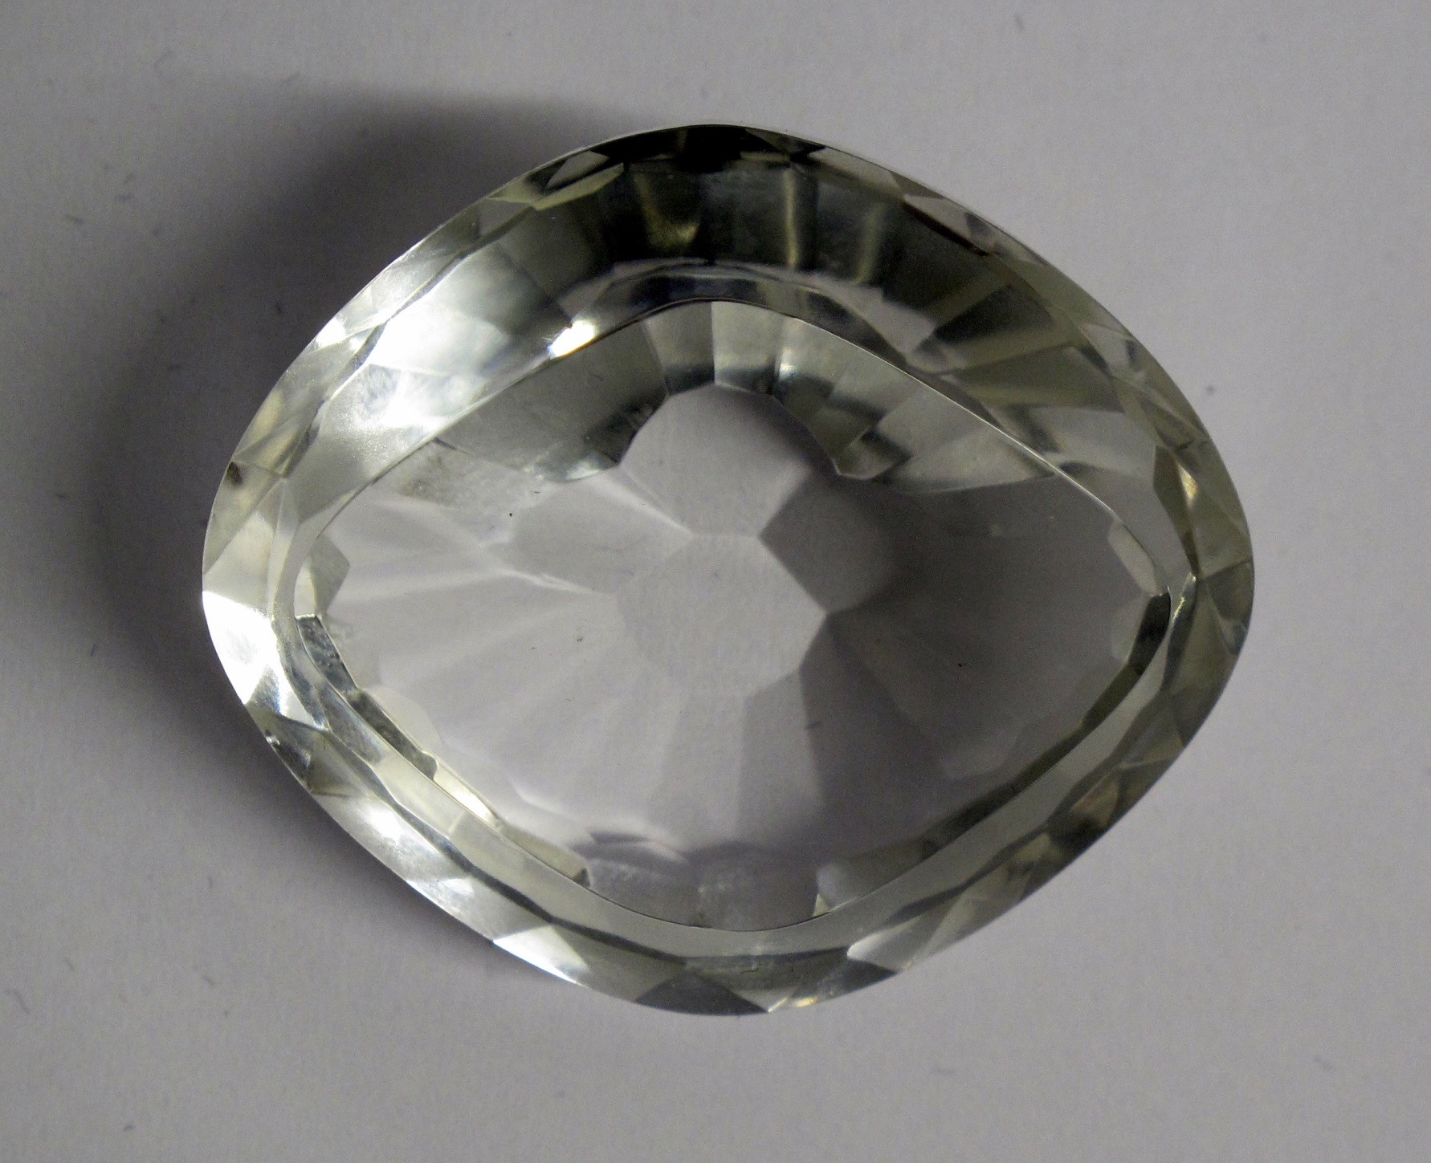
LIONS OF THE GREAT WAR (PRIMARY) LESSON 1: RESOURCE A
Notes:
Slide 5
Maharaja Ranjit Singh with his favourite, Raja Heera Singh, c. 1835-38.
Toor Collection.

Slide 2
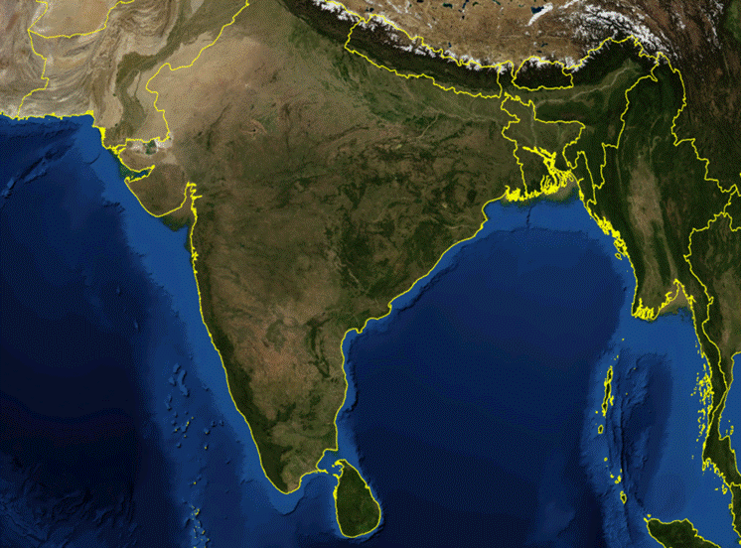
LIONS OF THE GREAT WAR (PRIMARY) LESSON 1: RESOURCE A
Notes:
Slide 1
The Koh-i-noor (Persian for ‘Mountain of Light’) diamond in its original setting. It was confiscated from the Sikh State by the British East India Company after the Second Anglo-Sikh War in 1849 and subsequently presented to Queen Victoria. In England, it was cut down to almost half its original size in an attempt to make it more attractive to European eyes.
Royal Collection Trust/© Her Majesty Queen Elizabeth II 2014

Slide 3
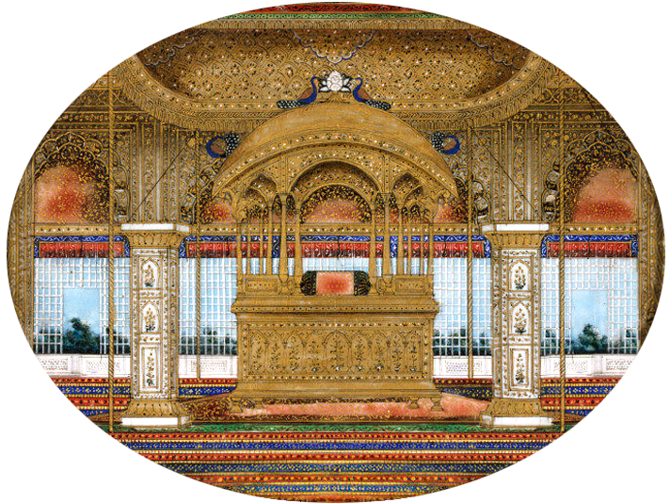
LIONS OF THE GREAT WAR (PRIMARY) LESSON 1: RESOURCE A
Notes:
Slide 1
The Koh-i-noor (Persian for ‘Mountain of Light’) diamond in its original setting. It was confiscated from the Sikh State by the British East India Company after the Second Anglo-Sikh War in 1849 and subsequently presented to Queen Victoria. In England, it was cut down to almost half its original size in an attempt to make it more attractive to European eyes.
Royal Collection Trust/© Her Majesty Queen Elizabeth II 2014

Slide 4
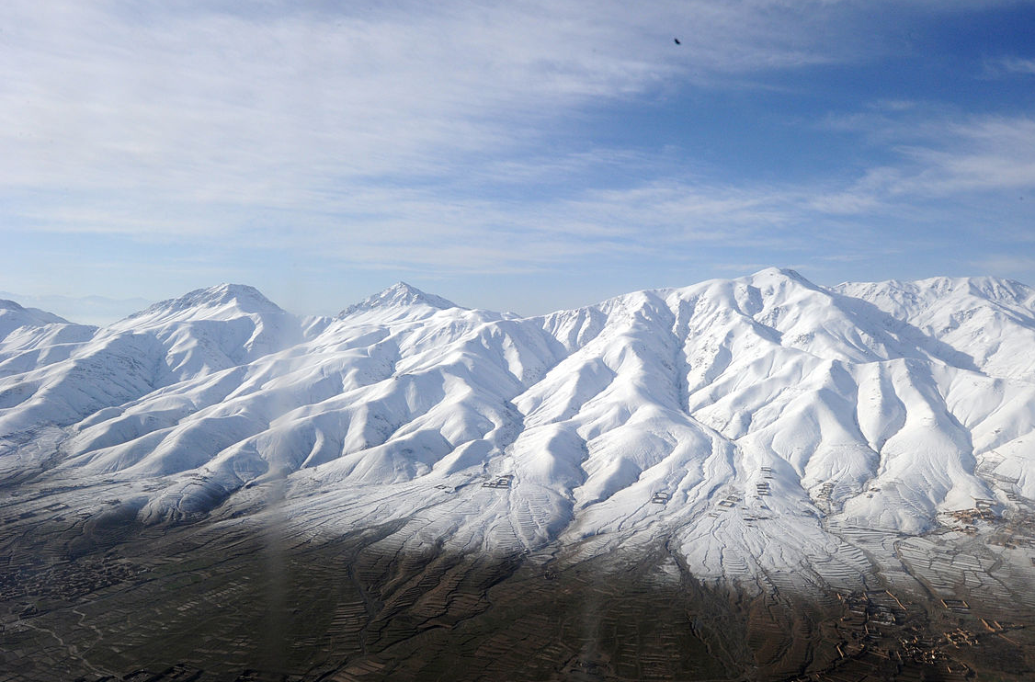
LIONS OF THE GREAT WAR (PRIMARY) LESSON 1: RESOURCE A
Notes:
Slide 1
The Koh-i-noor (Persian for ‘Mountain of Light’) diamond in its original setting. It was confiscated from the Sikh State by the British East India Company after the Second Anglo-Sikh War in 1849 and subsequently presented to Queen Victoria. In England, it was cut down to almost half its original size in an attempt to make it more attractive to European eyes.
Royal Collection Trust/© Her Majesty Queen Elizabeth II 2014

Slide 5
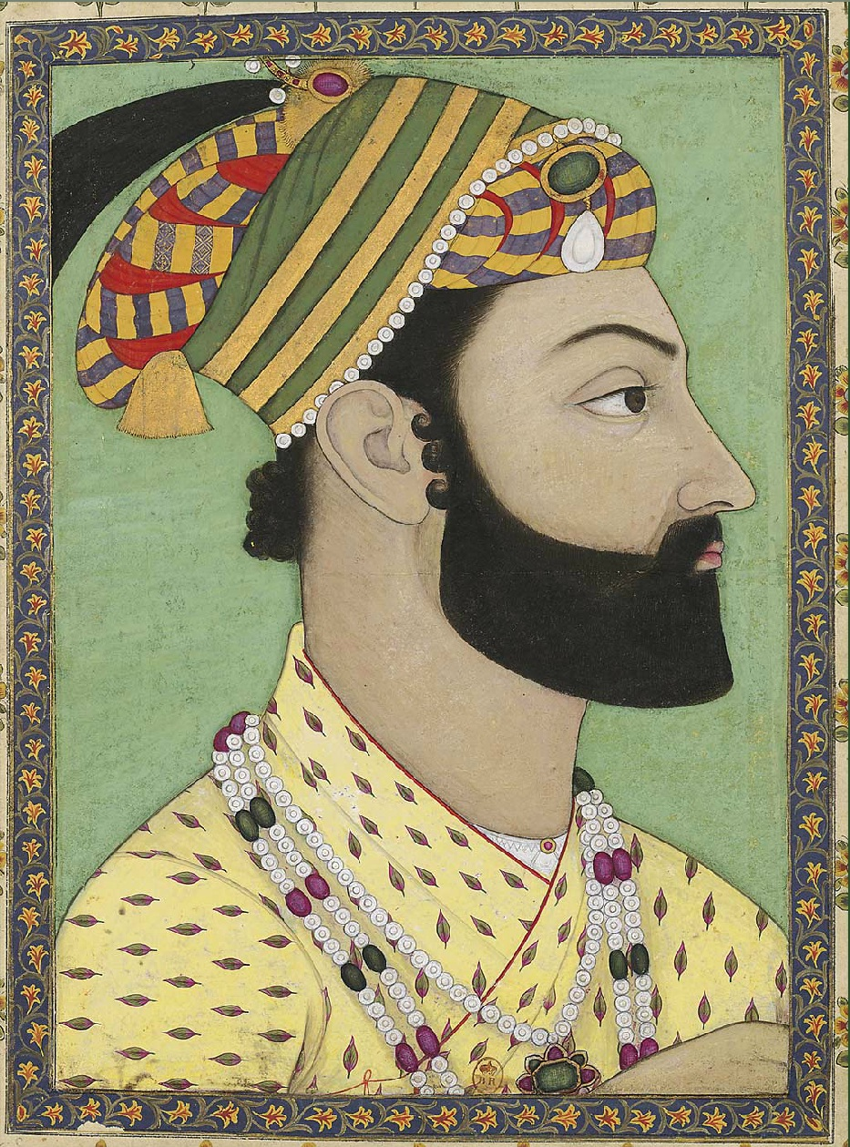
LIONS OF THE GREAT WAR (PRIMARY) LESSON 1: RESOURCE A
Notes:
Slide 1
The Koh-i-noor (Persian for ‘Mountain of Light’) diamond in its original setting. It was confiscated from the Sikh State by the British East India Company after the Second Anglo-Sikh War in 1849 and subsequently presented to Queen Victoria. In England, it was cut down to almost half its original size in an attempt to make it more attractive to European eyes.
Royal Collection Trust/© Her Majesty Queen Elizabeth II 2014

Slide 6
LIONS OF THE GREAT WAR (PRIMARY) LESSON 1: RESOURCE A
Notes:
Slide 2
Map of the Sikh Empire in 1839.
Designed by Jugasingh.com/Grfik.com.

Slide 7
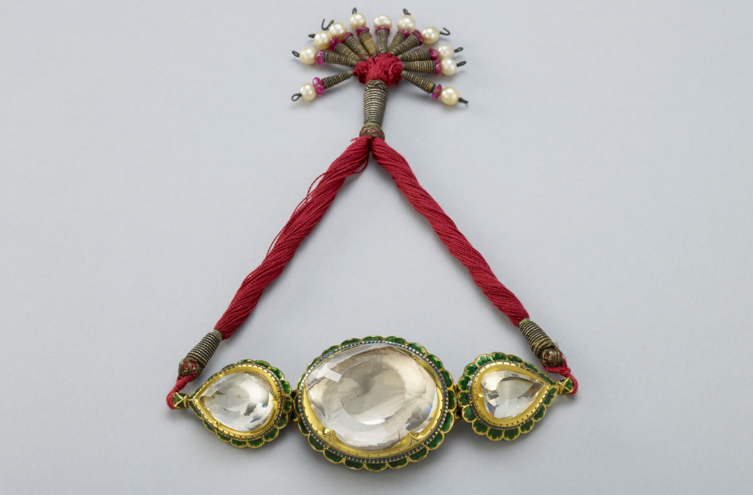
LIONS OF THE GREAT WAR (PRIMARY) LESSON 1: RESOURCE A
Notes:
Slide 1
The Koh-i-noor (Persian for ‘Mountain of Light’) diamond in its original setting. It was confiscated from the Sikh State by the British East India Company after the Second Anglo-Sikh War in 1849 and subsequently presented to Queen Victoria. In England, it was cut down to almost half its original size in an attempt to make it more attractive to European eyes.
Royal Collection Trust/© Her Majesty Queen Elizabeth II 2014

Slide 8
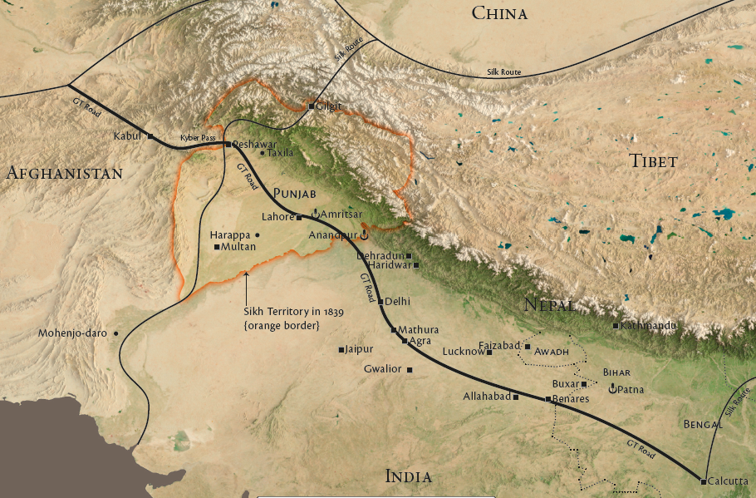
LIONS OF THE GREAT WAR (PRIMARY) LESSON 1: RESOURCE A
Notes:
Slide 1
The Koh-i-noor (Persian for ‘Mountain of Light’) diamond in its original setting. It was confiscated from the Sikh State by the British East India Company after the Second Anglo-Sikh War in 1849 and subsequently presented to Queen Victoria. In England, it was cut down to almost half its original size in an attempt to make it more attractive to European eyes.
Royal Collection Trust/© Her Majesty Queen Elizabeth II 2014

Slide 9
LIONS OF THE GREAT WAR (PRIMARY) LESSON 1: RESOURCE A
Notes:
Slide 3
A Sikh warrior bathes in the pool around the Golden Temple of Amritsar.
Courtesy of Taran Singh Padam.

Slide 10
LIONS OF THE GREAT WAR (PRIMARY) LESSON 1: RESOURCE A
Notes:
Slide 1
The Koh-i-noor (Persian for ‘Mountain of Light’) diamond in its original setting. It was confiscated from the Sikh State by the British East India Company after the Second Anglo-Sikh War in 1849 and subsequently presented to Queen Victoria. In England, it was cut down to almost half its original size in an attempt to make it more attractive to European eyes.
Royal Collection Trust/© Her Majesty Queen Elizabeth II 2014

Slide 11
LIONS OF THE GREAT WAR (PRIMARY) LESSON 1: RESOURCE A
Notes:
Slide 3
A Sikh warrior bathes in the pool around the Golden Temple of Amritsar.
Courtesy of Taran Singh Padam.

Slide 12
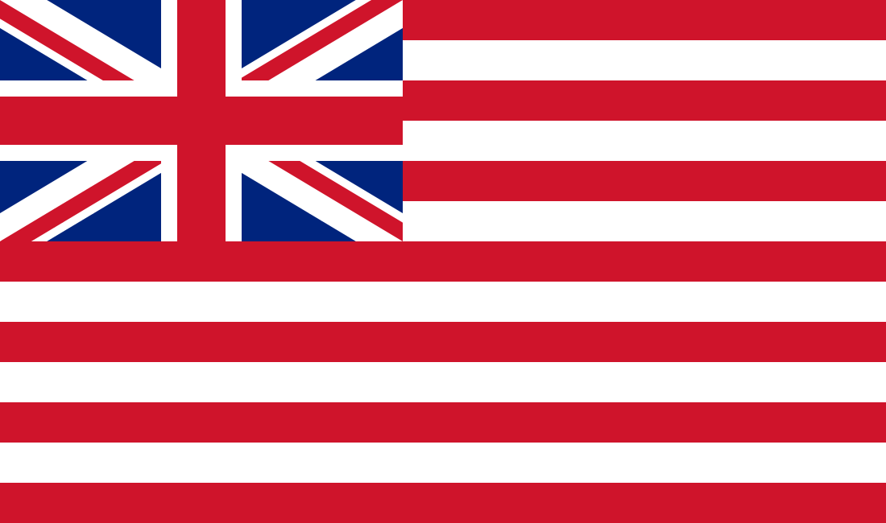
LIONS OF THE GREAT WAR (PRIMARY) LESSON 1: RESOURCE A
Notes:
Slide 1
The Koh-i-noor (Persian for ‘Mountain of Light’) diamond in its original setting. It was confiscated from the Sikh State by the British East India Company after the Second Anglo-Sikh War in 1849 and subsequently presented to Queen Victoria. In England, it was cut down to almost half its original size in an attempt to make it more attractive to European eyes.
Royal Collection Trust/© Her Majesty Queen Elizabeth II 2014

Slide 13
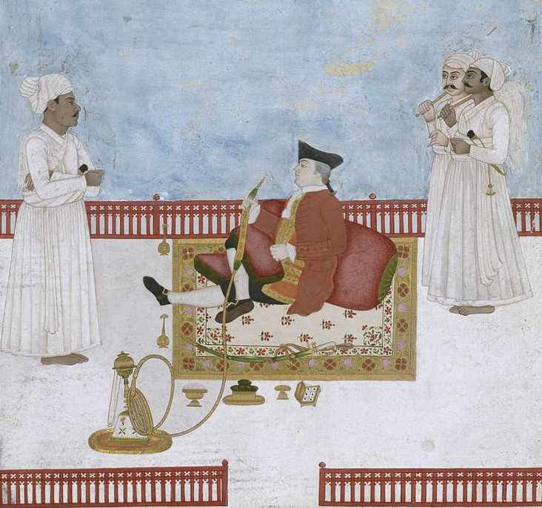
LIONS OF THE GREAT WAR (PRIMARY) LESSON 1: RESOURCE A
Notes:
Slide 3
A Sikh warrior bathes in the pool around the Golden Temple of Amritsar.
Courtesy of Taran Singh Padam.

Slide 14
LIONS OF THE GREAT WAR (PRIMARY) LESSON 1: RESOURCE A
Notes:
Slide 3
A Sikh warrior bathes in the pool around the Golden Temple of Amritsar.
Courtesy of Taran Singh Padam.

Slide 15
LIONS OF THE GREAT WAR (PRIMARY) LESSON 1: RESOURCE A
Notes:
Slide 1
The Koh-i-noor (Persian for ‘Mountain of Light’) diamond in its original setting. It was confiscated from the Sikh State by the British East India Company after the Second Anglo-Sikh War in 1849 and subsequently presented to Queen Victoria. In England, it was cut down to almost half its original size in an attempt to make it more attractive to European eyes.
Royal Collection Trust/© Her Majesty Queen Elizabeth II 2014

Slide 16
LIONS OF THE GREAT WAR (PRIMARY) LESSON 1: RESOURCE A
Notes:
Slide 3
A Sikh warrior bathes in the pool around the Golden Temple of Amritsar.
Courtesy of Taran Singh Padam.

Slide 17
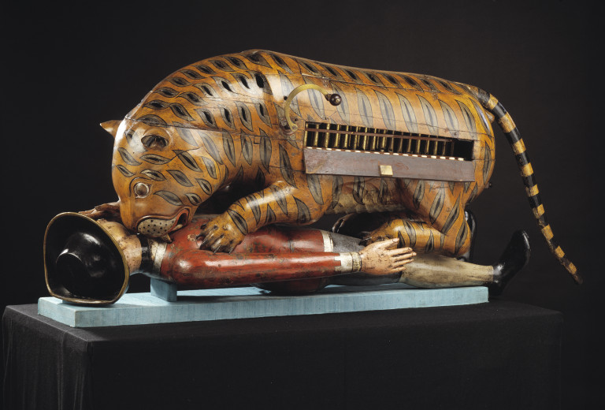
LIONS OF THE GREAT WAR (PRIMARY) LESSON 1: RESOURCE A
Notes:
Slide 1
The Koh-i-noor (Persian for ‘Mountain of Light’) diamond in its original setting. It was confiscated from the Sikh State by the British East India Company after the Second Anglo-Sikh War in 1849 and subsequently presented to Queen Victoria. In England, it was cut down to almost half its original size in an attempt to make it more attractive to European eyes.
Royal Collection Trust/© Her Majesty Queen Elizabeth II 2014

Slide 18
LIONS OF THE GREAT WAR (PRIMARY) LESSON 1: RESOURCE A
Notes:
Slide 2
Map of the Sikh Empire in 1839.
Designed by Jugasingh.com/Grfik.com.

Slide 19
LIONS OF THE GREAT WAR (PRIMARY) LESSON 1: RESOURCE A
Notes:
Slide 1
3rd King's Own Light Dragoons and the Khalsa Army clash in the Battle of Chillianwalla during the Second Anglo-Sikh War.
Courtesy of www.thequeensownhussars.co.uk

Slide 20
LIONS OF THE GREAT WAR (PRIMARY) LESSON 1: RESOURCE A
Notes:
Slide 6
A British Victorian print showing Sir Henry Hardinge, British Governor-General of India and his officers surveying the battlefield at Ferozeshah (a village in Punjab, North India) on the first night of this crucial battle during the first Anglo-Sikh War in December 1845 when British forces faced defeat. The images show exhausted British soldiers sleeping amid the British dead.
Courtesy of the Council of the National Army Museum, London (acc. no. 1971-02-33-165)

Slide 21
LIONS OF THE GREAT WAR (PRIMARY) LESSON 1: RESOURCE A
Notes:
Slide 5
Maharaja Duleep Singh on the Lower Terrace at Osborne House, Isle of Wight, in August 1854.
Royal Collection Trust/© Her Majesty Queen Elizabeth II 2014

Slide 22
LIONS OF THE GREAT WAR (PRIMARY) LESSON 1: RESOURCE A
Notes:
Slide 3
Sikh recruits of the 34th Sikh Pioneers taking the Khalsa initiation at the Mian Mir Cantonment, Lahore, in 1906.
Courtesy of the Council of the National Army Museum, London (acc. no. 7109-25-2-45)

Slide 23
LIONS OF THE GREAT WAR (PRIMARY) LESSON 1: RESOURCE A
Notes:
Slide 2
The Koh-i-noor (Persian for ‘Mountain of Light’) diamond in its original setting.
Royal Collection Trust/© Her Majesty Queen Elizabeth II 2014

Slide 24
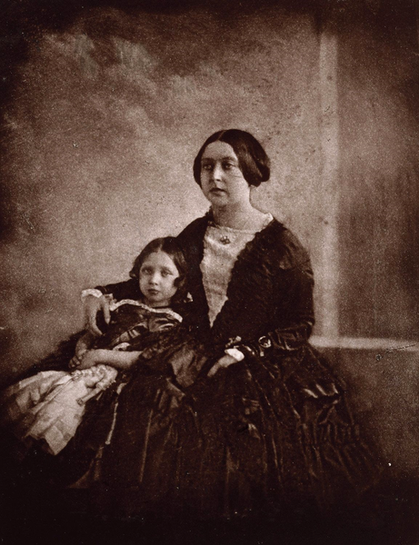
LIONS OF THE GREAT WAR (PRIMARY) LESSON 1: RESOURCE A
Notes:
Slide 1
3rd King's Own Light Dragoons and the Khalsa Army clash in the Battle of Chillianwalla during the Second Anglo-Sikh War.
Courtesy of www.thequeensownhussars.co.uk

Slide 25
LIONS OF THE GREAT WAR (PRIMARY) LESSON 1: RESOURCE A
Notes:
Slide 2
The Koh-i-noor (Persian for ‘Mountain of Light’) diamond in its original setting.
Royal Collection Trust/© Her Majesty Queen Elizabeth II 2014

Slide 26
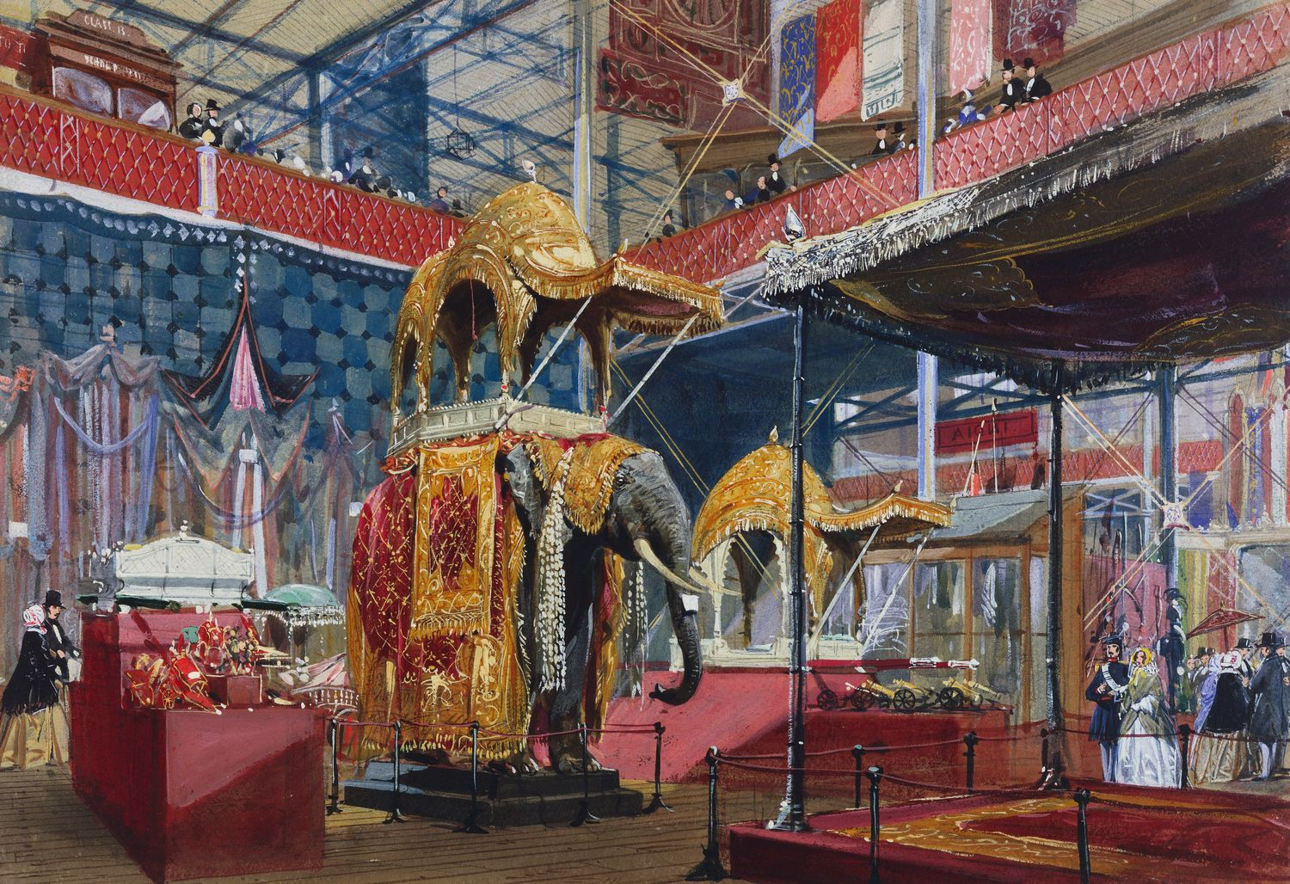
LIONS OF THE GREAT WAR (PRIMARY) LESSON 1: RESOURCE A
Notes:
Slide 2
The Koh-i-noor (Persian for ‘Mountain of Light’) diamond in its original setting.
Royal Collection Trust/© Her Majesty Queen Elizabeth II 2014

Slide 27
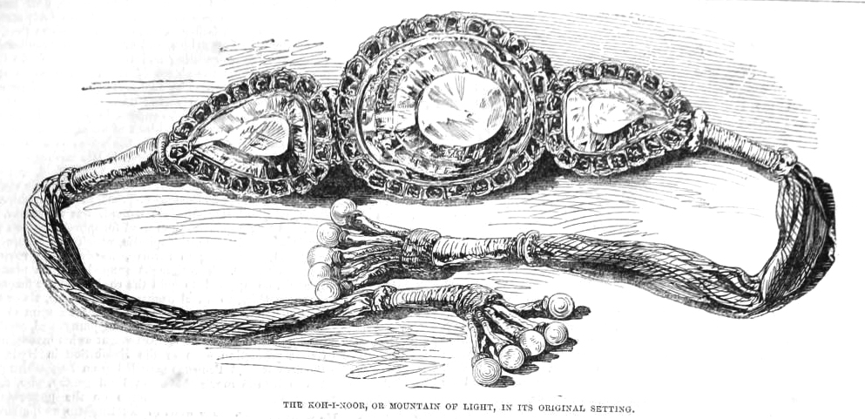
LIONS OF THE GREAT WAR (PRIMARY) LESSON 1: RESOURCE A
Notes:
Slide 1
3rd King's Own Light Dragoons and the Khalsa Army clash in the Battle of Chillianwalla during the Second Anglo-Sikh War.
Courtesy of www.thequeensownhussars.co.uk

Slide 28
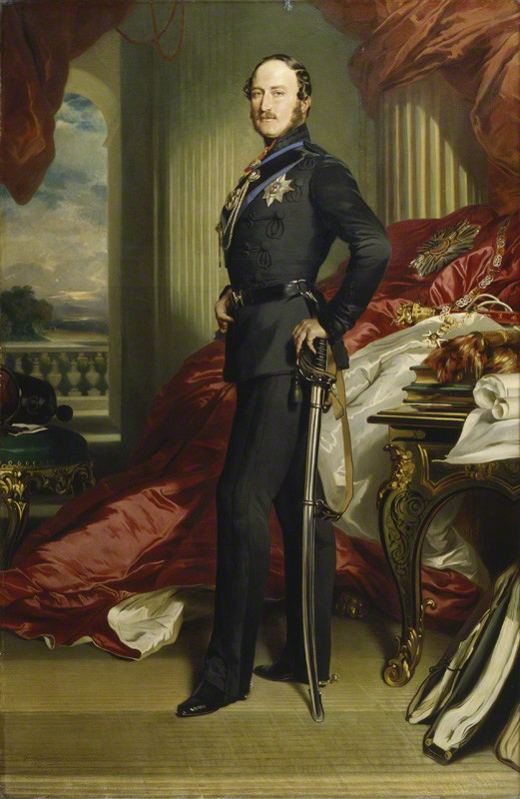
LIONS OF THE GREAT WAR (PRIMARY) LESSON 1: RESOURCE A
Notes:
Slide 4
Prince Albert (1819–1861), the husband of Queen Victoria, had the Koh-i-noor diamond cut in Amsterdam so that it could be set in a brooch for her.

Slide 29
LIONS OF THE GREAT WAR (PRIMARY) LESSON 1: RESOURCE A
Notes:
Slide 2
The Koh-i-noor (Persian for ‘Mountain of Light’) diamond in its original setting.
Royal Collection Trust/© Her Majesty Queen Elizabeth II 2014

Slide 30
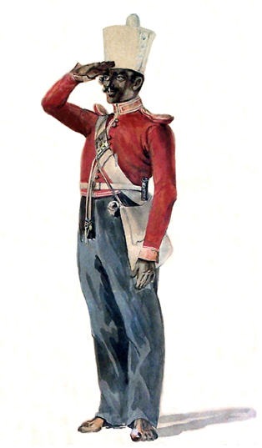
LIONS OF THE GREAT WAR (PRIMARY) LESSON 1: RESOURCE A
Notes:
Slide 2
The Koh-i-noor (Persian for ‘Mountain of Light’) diamond in its original setting.
Royal Collection Trust/© Her Majesty Queen Elizabeth II 2014

Slide 31
LIONS OF THE GREAT WAR (PRIMARY) LESSON 1: RESOURCE A
Notes:
Slide 6
Men of the 45th Rattray's Sikhs at the Delhi Camp of Exercise in 1886.
Private collection

Slide 32
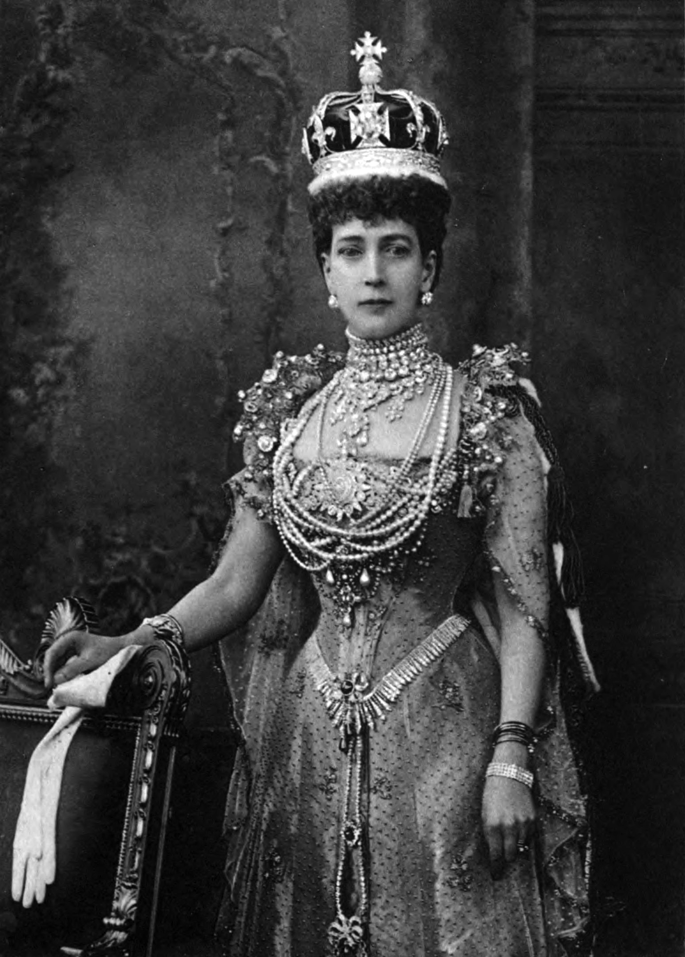
LIONS OF THE GREAT WAR (PRIMARY) LESSON 1: RESOURCE A
Notes:
Slide 1
3rd King's Own Light Dragoons and the Khalsa Army clash in the Battle of Chillianwalla during the Second Anglo-Sikh War.
Courtesy of www.thequeensownhussars.co.uk

Slide 33
LIONS OF THE GREAT WAR (PRIMARY) LESSON 1: RESOURCE A
Notes:
Slide 9
Men of the 15th Punjab Infantry in China during the Second Opium War.
Toor Collection

Slide 34
LIONS OF THE GREAT WAR (PRIMARY) LESSON 1: RESOURCE A
Notes:
Slide 10
Charge of the 23rd Pioneers at Arrogee, 10 April 1868.
Courtesy of the Council of the National Army Museum, London (acc. no. 1956-02-202)

Slide 35
LIONS OF THE GREAT WAR (PRIMARY) LESSON 1: RESOURCE A
Notes:
Slide 15
British and Native Officers of the 3rd Sikh Infantry, part of the Punjab Frontier Force that was raised in Ferozepore, Punjab, in 1847.
Courtesy of the Council of the National Army Museum, London (acc. no. 1955-04-41-39)

Slide 36
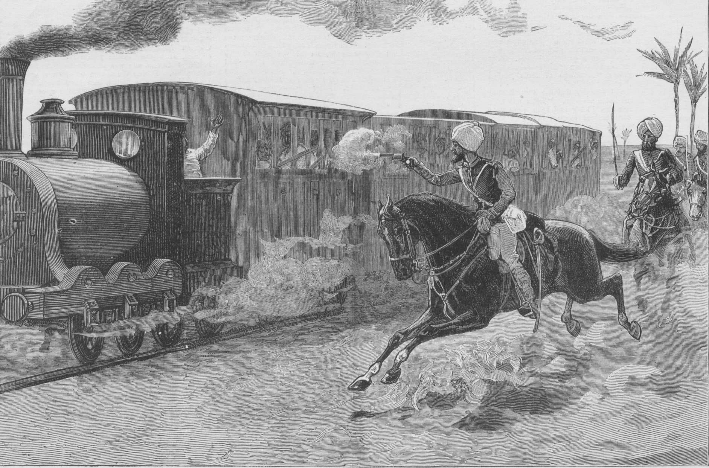
LIONS OF THE GREAT WAR (PRIMARY) LESSON 1: RESOURCE A
Notes:
Slide 2
The Koh-i-noor (Persian for ‘Mountain of Light’) diamond in its original setting.
Royal Collection Trust/© Her Majesty Queen Elizabeth II 2014

Slide 37
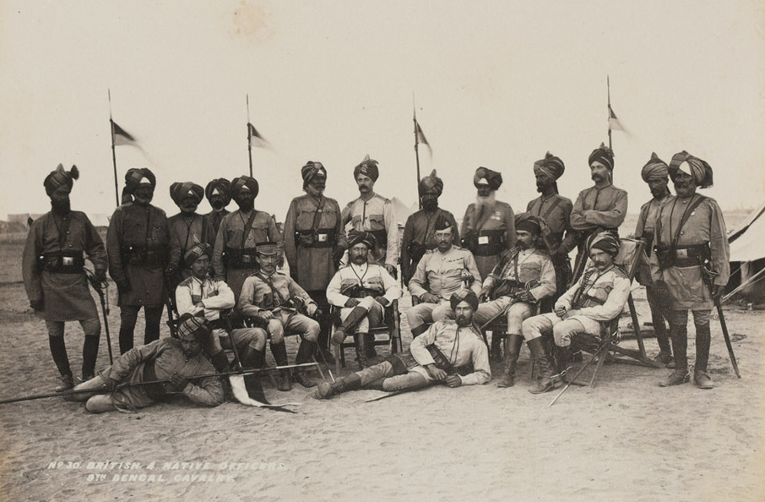
LIONS OF THE GREAT WAR (PRIMARY) LESSON 1: RESOURCE A
Notes:
Slide 2
The Koh-i-noor (Persian for ‘Mountain of Light’) diamond in its original setting.
Royal Collection Trust/© Her Majesty Queen Elizabeth II 2014

Slide 38
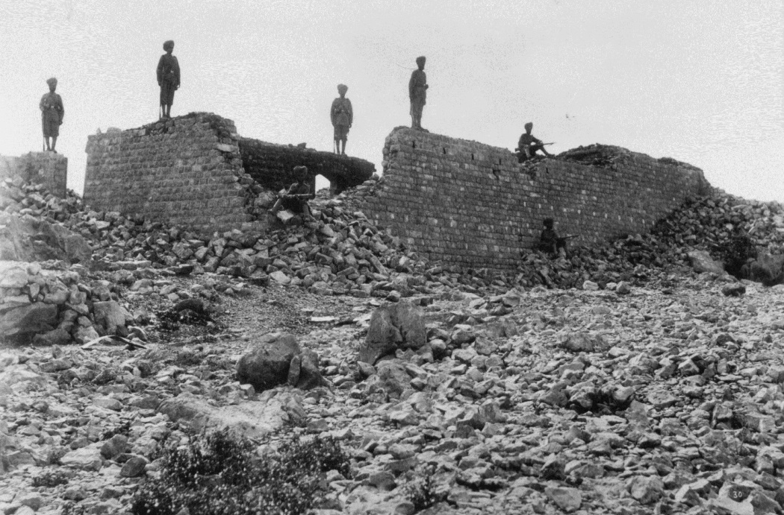
LIONS OF THE GREAT WAR (PRIMARY) LESSON 1: RESOURCE A
Notes:
Slide 2
The Koh-i-noor (Persian for ‘Mountain of Light’) diamond in its original setting.
Royal Collection Trust/© Her Majesty Queen Elizabeth II 2014

Slide 39
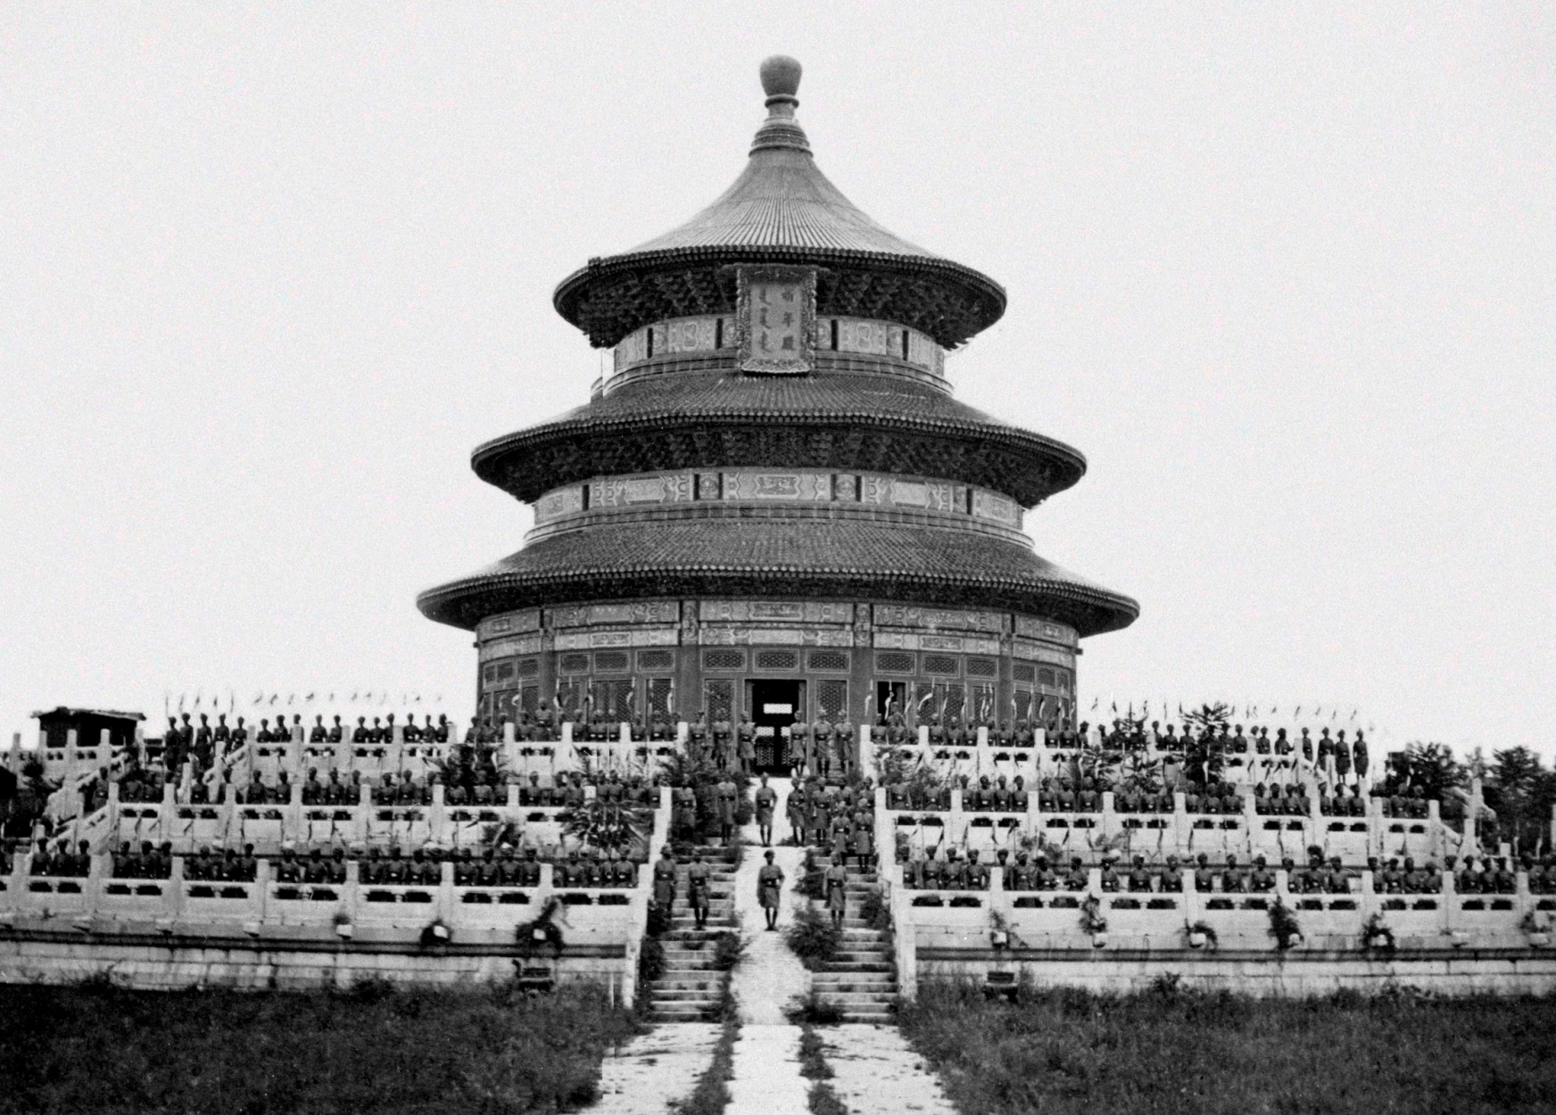
LIONS OF THE GREAT WAR (PRIMARY) LESSON 1: RESOURCE A
Notes:
Slide 2
The Koh-i-noor (Persian for ‘Mountain of Light’) diamond in its original setting.
Royal Collection Trust/© Her Majesty Queen Elizabeth II 2014

Slide 40
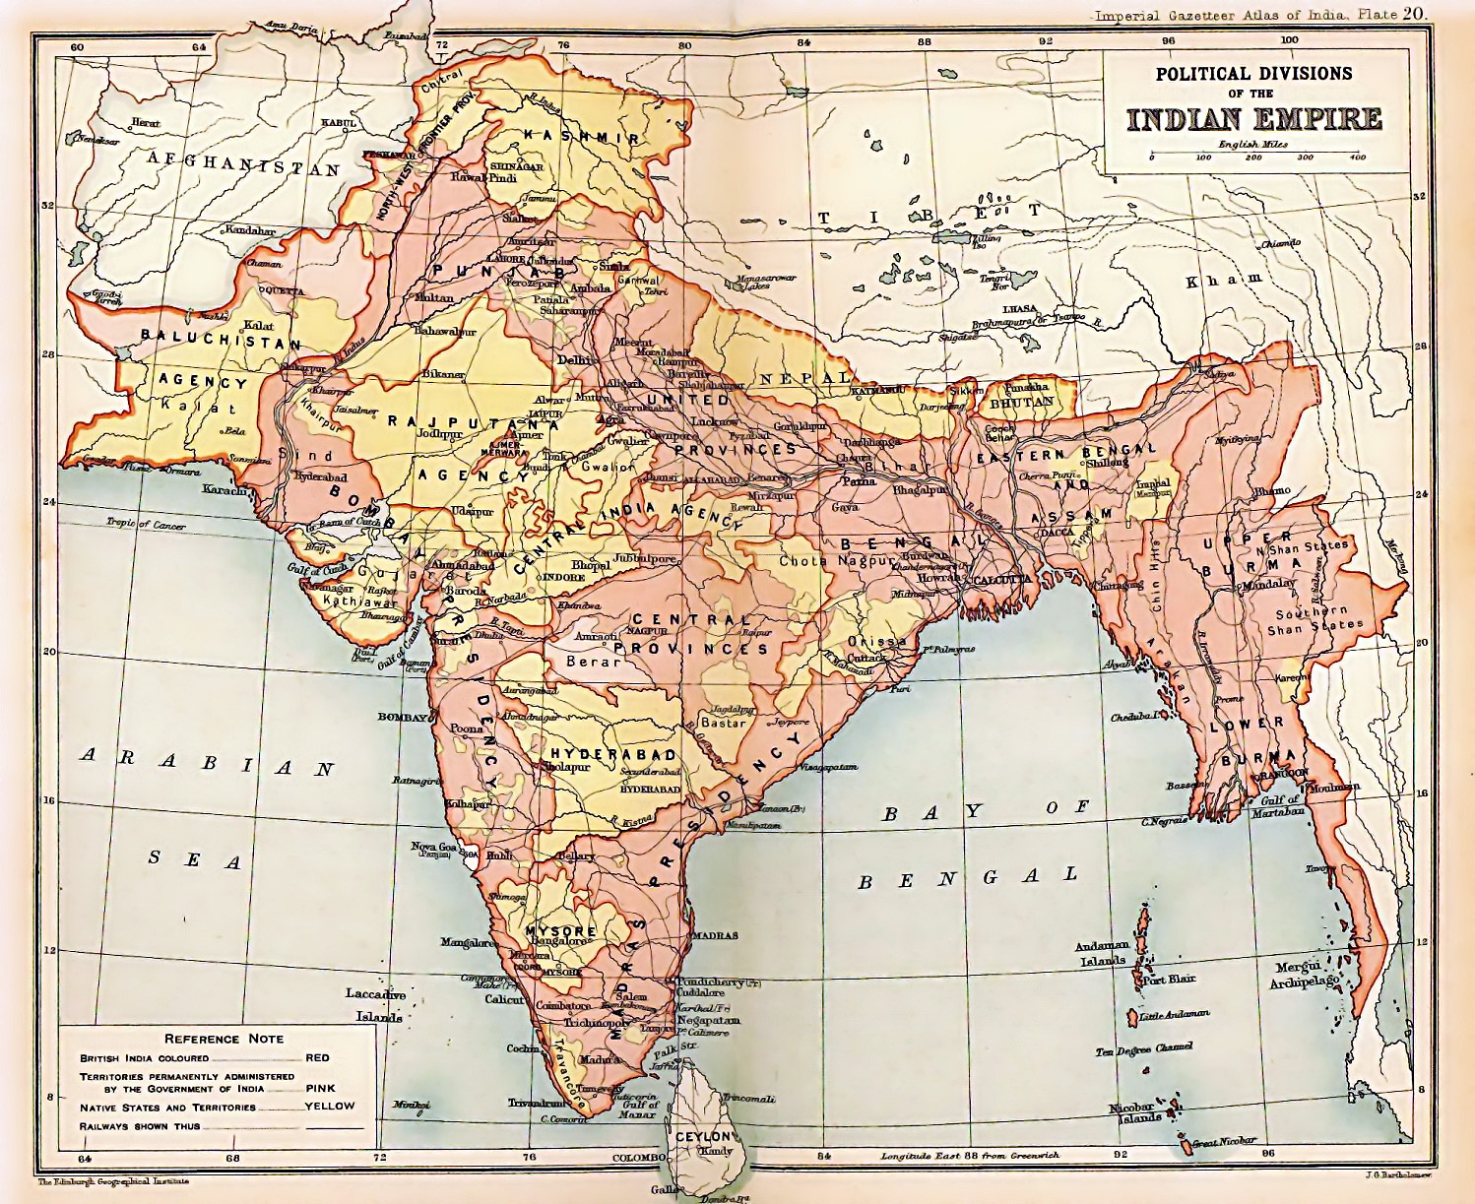
LIONS OF THE GREAT WAR (PRIMARY) LESSON 1: RESOURCE A
Notes:
Slide 2
The Koh-i-noor (Persian for ‘Mountain of Light’) diamond in its original setting.
Royal Collection Trust/© Her Majesty Queen Elizabeth II 2014

Slide 41
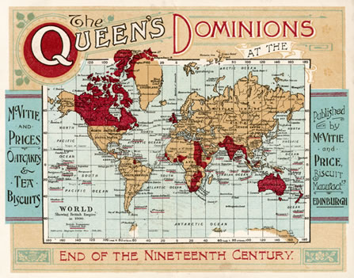
LIONS OF THE GREAT WAR (PRIMARY) LESSON 1: RESOURCE A
Notes:
Slide 2
The Koh-i-noor (Persian for ‘Mountain of Light’) diamond in its original setting.
Royal Collection Trust/© Her Majesty Queen Elizabeth II 2014

Slide 42
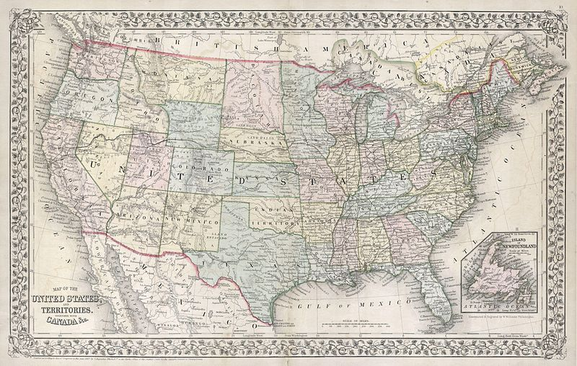
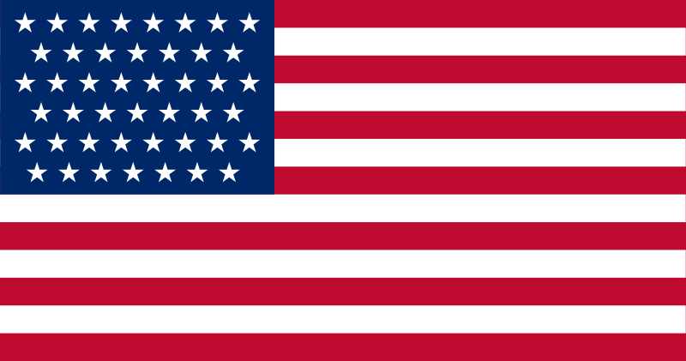
LIONS OF THE GREAT WAR (PRIMARY) LESSON 1: RESOURCE A
Notes:
Slide 2
The Koh-i-noor (Persian for ‘Mountain of Light’) diamond in its original setting.
Royal Collection Trust/© Her Majesty Queen Elizabeth II 2014

Slide 43
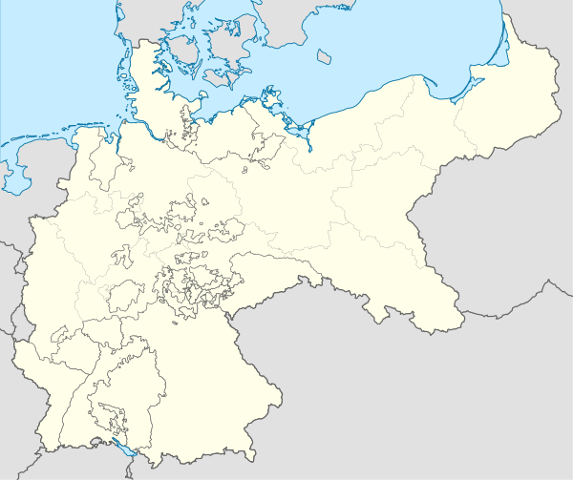
LIONS OF THE GREAT WAR (PRIMARY) LESSON 1: RESOURCE A
Notes:
Slide 2
The Koh-i-noor (Persian for ‘Mountain of Light’) diamond in its original setting.
Royal Collection Trust/© Her Majesty Queen Elizabeth II 2014

Slide 44
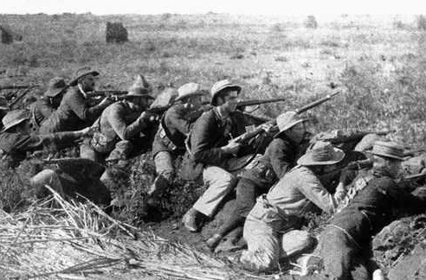
LIONS OF THE GREAT WAR (PRIMARY) LESSON 1: RESOURCE A
Notes:
Slide 2
The Koh-i-noor (Persian for ‘Mountain of Light’) diamond in its original setting.
Royal Collection Trust/© Her Majesty Queen Elizabeth II 2014

Slide 45
LIONS OF THE GREAT WAR (PRIMARY) LESSON 1: RESOURCE A
Notes:
Slide 6
A replica of the crown of the late Queen Mother, with the Koh-i-noor diamond set within it. The historic Koh-i-noor diamond was one of the most precious treasures of the Sikh Kingdom, which was taken over by the British East India Company following two battles in 1846 and 1849. From the time of its gift to Queen Victoria it has formed part of the British Crown Jewels and by tradition is only worn by women.
Royal Collection Trust/© Her Majesty Queen Elizabeth II 2014

Slide 46
IMAGE CREDITS
LIONS OF THE GREAT WAR (PRIMARY) LESSON 1: RESOURCE A
Slide 1 Photograph of a glass replica of the Koh-i-noor diamond in its original cut. Toor Collection.
Slide 2 Satellite image of India and surrounding regions. NASA (public domain).
Slide 3 Painting of the Peacock Throne at the Red Fort in Dehli, 1879. Victoria & Albert Museum (public domain).
Slide 4 Snow covered mountains in Ghansi province, Afghanistan. US Embassy in Kabul, Afghanistan (public domain).
Slide 5 King Ahmed Shah Durrani, emir of Afghanistan, c. 1757. Bibliothèque Nationale de France (public domain).
Slide 6 Maharaja Ranjit Singh with his favourite, Raja Heera Singh. Toor Collection.
Slide 7 The Koh-i-noor diamond in its original setting. Royal Collection Trust/copyright Her Majesty Queen Elizabeth II 2014.

Slide 47
IMAGE CREDITS
LIONS OF THE GREAT WAR (PRIMARY) LESSON 1: RESOURCE A
Slide 8 Map of the Sikh Empire in 1839. Designed by Juga Singh (jugasingh.com / grfik.com).
Slide 9 A Sikh warrior bathes in the pool around the Golden Temple of Amritsar. Courtesy of Taran Singh Padam.
Slide 10 A sword (talwar) and scabbard typical of the kind used by Sikhs during the Anglo-Sikh Wars. Royal Collection Trust/copyright Her Majesty Queen Elizabeth II 2014.
Slide 11 Elevation drawing of a captured Sikh cannon from the First Anglo-Sikh War. Courtesy of the Council of the National Army Museum, Museum (acc.no. 1958-07-75-1).
Slide 12 Flag of the British East India Company 1801-1858. Public domain.
Slide 13 Portrait of East India Company merchant c. 1760. Public domain.
Notes:
Slide 1
The Koh-i-noor (Persian for ‘Mountain of Light’) diamond in its original setting. It was confiscated from the Sikh State by the British East India Company after the Second Anglo-Sikh War in 1849 and subsequently presented to Queen Victoria. In England, it was cut down to almost half its original size in an attempt to make it more attractive to European eyes.
Royal Collection Trust/© Her Majesty Queen Elizabeth II 2014

Slide 48
IMAGE CREDITS
LIONS OF THE GREAT WAR (PRIMARY) LESSON 1: RESOURCE A
Slide 14 Map of India under the British East India Company in 1765. Published in ‘The Imperial Gazetteer of India’, Oxford University Press, 1909 (public domain).
Slide 15 & 16 As above for 1805 and 1837 respectively.
Slide 17 Tipoo’s Tiger. Victoria & Albert Museum (public domain).
Slide 18 Maharaja Ranjit Singh with his favourite, Raja Heera Singh. Toor Collection.
Slide 19 3rd King's Own Light Dragoons and the Khalsa Army clash in the Battle of Chillianwalla during the Second Anglo-Sikh War. Courtesy of www.thequeensownhussars.co.uk.
Slide 20 Engraving of the battlefield at Ferozeshah in December 1845. Courtesy of the Council of the National Army Museum, London (acc. no. 1971-02-33-165).

Slide 49
IMAGE CREDITS
LIONS OF THE GREAT WAR (PRIMARY) LESSON 1: RESOURCE A
Slide 21 Maharaja Duleep Singh on the Lower Terrace at Osborne House, Isle of Wight, in August 1854. Royal Collection Trust/© Her Majesty Queen Elizabeth II 2014.
Slide 22 Sikh recruits of the 34th Sikh Pioneers taking the Khalsa initiation at the Mian Mir Cantonment, Lahore, in 1906. Courtesy of the Council of the National Army Museum, London (acc. no. 7109-25-2-45).
Slide 23 The Koh-i-noor diamond in its original setting. Royal Collection Trust/© Her Majesty Queen Elizabeth II 2014.
Slide 24 Photograph of Queen Victoria in 1845. Victoria and Albert Museum (public domain).
Slide 25 Map of India under the British East India Company in 1857. Published in ‘The Imperial Gazetteer of India’, Oxford University Press, 1909 (public domain).
Notes:
Slide 1
The Koh-i-noor (Persian for ‘Mountain of Light’) diamond in its original setting. It was confiscated from the Sikh State by the British East India Company after the Second Anglo-Sikh War in 1849 and subsequently presented to Queen Victoria. In England, it was cut down to almost half its original size in an attempt to make it more attractive to European eyes.
Royal Collection Trust/© Her Majesty Queen Elizabeth II 2014

Slide 50
IMAGE CREDITS
LIONS OF THE GREAT WAR (PRIMARY) LESSON 1: RESOURCE A
Slide 26 Painting of the opening of the Great Exhibition in 1851. Royal Collection Trust/© Her Majesty Queen Elizabeth II 2014.
Slide 27 A drawing of the Koh-i-noor diamond in its original setting at the Great Exhibition. Published in ‘An Illustrated Cyclopaedia of the Great Exhibition of Industry of All Nations 1851’, W.M. Clark, 1852 (public domain).
Slide 28 Prince Albert (1819–1861), the husband of Queen Victoria, had the Koh-i-noor diamond cut by diamond cutters from Amsterdam so that it could be set in a brooch for his wife. Public domain.
Slide 29 Map of India under the British East India Company in 1857. Published in ‘The Imperial Gazetteer of India’, Oxford University Press, 1909 (public domain).
Slide 30 Watercolour by Alex Hunter of a sepoy of the 29th Madras Native Infantry (Baloch 1), 1845. Public domain.
Notes:
Slide 1
The Koh-i-noor (Persian for ‘Mountain of Light’) diamond in its original setting. It was confiscated from the Sikh State by the British East India Company after the Second Anglo-Sikh War in 1849 and subsequently presented to Queen Victoria. In England, it was cut down to almost half its original size in an attempt to make it more attractive to European eyes.
Royal Collection Trust/© Her Majesty Queen Elizabeth II 2014

Slide 51
IMAGE CREDITS
LIONS OF THE GREAT WAR (PRIMARY) LESSON 1: RESOURCE A
Slide 31 Men of the 45th Rattray's Sikhs at the Delhi Camp of Exercise in 1886. Private collection.
Slide 32 Queen Alexandra wearing the Koh-i-noor in her coronation crown. Photographed by W. and D. Downey on 9 August 1902. Published in Sir Charles Lawson, ‘Memories of Madras’, S. Sonnenschein, 1905 (public domain).
Slide 33 Men of the 15th Punjab Infantry in China during the Second Opium War. Photographed by Felice Beato. Toor Collection.
Slide 34 Charge of the 23rd Pioneers at Arrogee, 10 April 1868, as part of the British expedition against Abyssinia (modern Ethiopia). Courtesy of the Council of the National Army Museum, London (acc. no. 1956-02-202).
Notes:
Slide 1
The Koh-i-noor (Persian for ‘Mountain of Light’) diamond in its original setting. It was confiscated from the Sikh State by the British East India Company after the Second Anglo-Sikh War in 1849 and subsequently presented to Queen Victoria. In England, it was cut down to almost half its original size in an attempt to make it more attractive to European eyes.
Royal Collection Trust/© Her Majesty Queen Elizabeth II 2014

Slide 52
IMAGE CREDITS
LIONS OF THE GREAT WAR (PRIMARY) LESSON 1: RESOURCE A
Slide 35 British and Indian officers of the 3rd Sikh Infantry serving in the Second Anglo-Afghan War (1878-80). Courtesy of the Council of the National Army Museum, London (acc. no. 1955-04-41-39).
Slide 36 13th Bengal Lancers in Egypt capturing retreating trains after the Battle of Tel-el-Kebir on 13 September 1882. UKPHA Archive.
Slide 37 British and Indian officers of the 9th Bengal Cavalry (also known as Hodson's Horse) in service in Sudan in 1884. Courtesy of the Council of the National Army Museum, London (acc. no. 1972-11-91-23).
Slide 38 Ruins of Fort Saragarhi in the North-West Frontier Province of India defended by 21 men of the 36th Sikhs. Private collection.
Notes:
Slide 1
The Koh-i-noor (Persian for ‘Mountain of Light’) diamond in its original setting. It was confiscated from the Sikh State by the British East India Company after the Second Anglo-Sikh War in 1849 and subsequently presented to Queen Victoria. In England, it was cut down to almost half its original size in an attempt to make it more attractive to European eyes.
Royal Collection Trust/© Her Majesty Queen Elizabeth II 2014

Slide 53
IMAGE CREDITS
LIONS OF THE GREAT WAR (PRIMARY) LESSON 1: RESOURCE A
Slide 39 16th Regiment of Bengal Lancers on the steps of the Temple of Heaven, Beijing, during the Boxer Rebellion. Courtesy of the Council of the National Army Museum, London (acc. no. 6306-38-135).
Slide 40 Map of the British Indian Empire. Published in ‘The Imperial Gazetteer of India’, Oxford University Press, 1909 (public domain).
Slide 41 World map of the Queen`s Dominions at the end of the ninteenth century 1898 McVitie and Price. Canada War Museum. Ottawa, Public domain
Slide 42 (i) 1867 Mitchell map of the USA. Geographicus (public domain); (ii) US flag 45 stars. Public domain.
Slide 43 (i) Map of the German Empire up to 1914 (public domain); (ii) German flag before and during the First World War (public domain).
Notes:
Slide 1
The Koh-i-noor (Persian for ‘Mountain of Light’) diamond in its original setting. It was confiscated from the Sikh State by the British East India Company after the Second Anglo-Sikh War in 1849 and subsequently presented to Queen Victoria. In England, it was cut down to almost half its original size in an attempt to make it more attractive to European eyes.
Royal Collection Trust/© Her Majesty Queen Elizabeth II 2014

Slide 54
IMAGE CREDITS
LIONS OF THE GREAT WAR (PRIMARY) LESSON 1: RESOURCE A
Slide 44 Boer soldiers in South Africa who fought to preserve their independence from the British Empire between 1899 and 1902. Imperial War Museum (Q 101768) (public domain).
Slide 45 A replica of the crown of the late Queen Mother, with the cut Koh-i-noor diamond set within it. Royal Collection Trust/© Her Majesty Queen Elizabeth II 2014.
Notes:
Slide 1
The Koh-i-noor (Persian for ‘Mountain of Light’) diamond in its original setting. It was confiscated from the Sikh State by the British East India Company after the Second Anglo-Sikh War in 1849 and subsequently presented to Queen Victoria. In England, it was cut down to almost half its original size in an attempt to make it more attractive to European eyes.
Royal Collection Trust/© Her Majesty Queen Elizabeth II 2014

