Slide 1
Arts Festival Project: How did Henry V win the Battle of Agincourt?
July 2016

Slide 2
Setting the scene

Slide 3
Student Research

Slide 4
Making the soldiers

Slide 5
Making the model

Slide 6
Researching the tactics

Slide 7
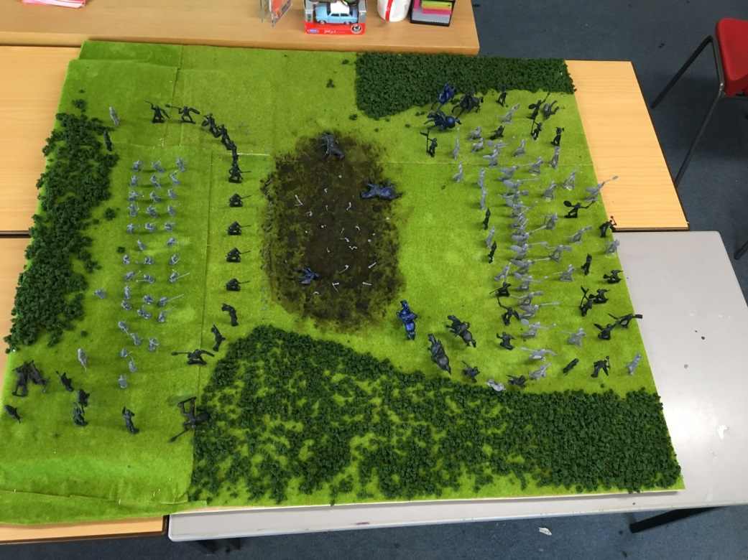
The finished model!

Slide 8
The Re-enactment

Slide 9
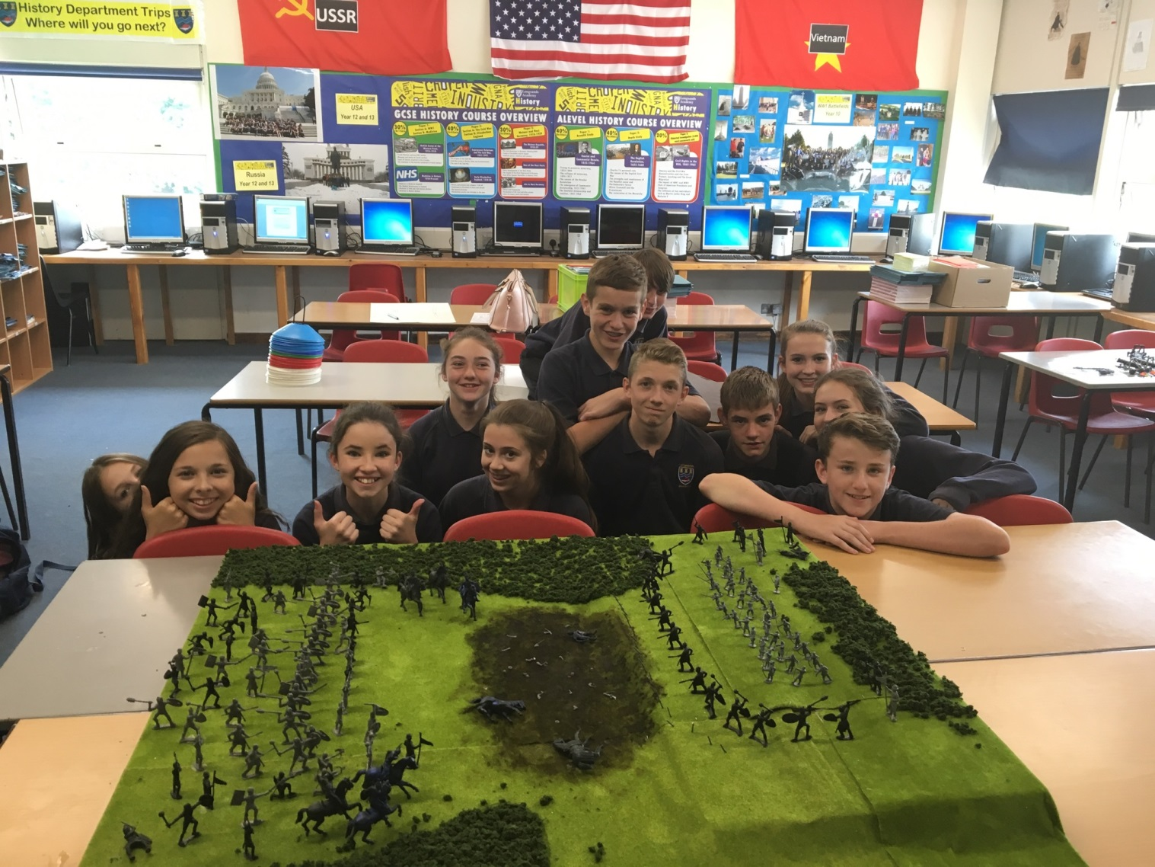
The end of the day

