Slide 1
Was Margery Spuret married to Thomas Hornby? (Or was Thomas married to Beatrix de Gillyng instead?!)
A medieval soap opera

Slide 2
Slide 1: Medieval Marriage: the rules
For a marriage to be valid and lawful a couple had to:
be free to marry (not married to anyone else);
agree that they wanted to get married;
exchange properly-worded vows stating that they were now married.
The problems:
The church encouraged couples to have witnesses and to exchange vows in front of a priest, but did not think this was essential.
There was no real agreement about how to word vows properly.

Slide 3
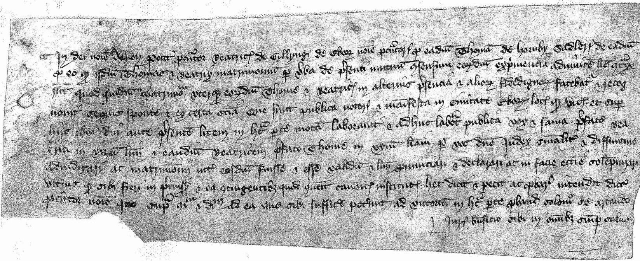
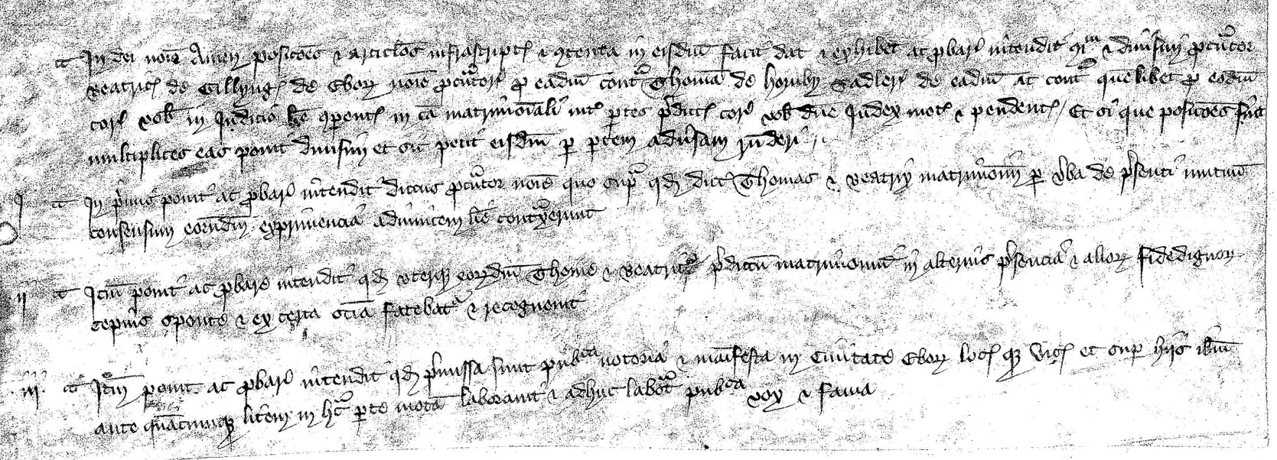
Slide 2: The documents

Slide 4
Slide 3: The complaints
Beatrix de Gillyng alleges:
She exchanged vows of marriage with Thomas Hornby in 1393.
Margery Spuret alleges:
She exchanged vows of marriage with Thomas Hornby in 1389.
Thomas Hornby alleges:
This is all news to him!

Slide 5
Slide 4: The witnesses
Isabel Spuret
Juliana del Grene
Thomas Hornby (senior)
Margaret Esyngwald
Thomas Gasegill
John Wyresdall
John de Akom
Thomas Menston

Slide 6
Slide 5: Additional witnesses
Katharine Sadler
Walter de Mellerby
Robert Polayn
Richard Wyresdall
Alice Menston

Slide 7
Slide 6: The verdict
After nearly two years of discussions, witness interviews and hearings, the church court ruled that:
Thomas Hornby was married to Beatrix de Gillyng
Margery Spuret was told she had not proved her case sufficiently to establish that a marriage had properly taken place.

Slide 8
Was Margery Spuret married to Thomas Hornby? (Or was Thomas married to Beatrix de Gillyng instead?!)
A medieval soap opera
(end)

