Slide 1
What were the foundations of the Cold War?
LO: To analyse what helped to create the conditions of the Cold War.

Slide 2
Today’s purpose
We are going to identify the foundations of the Cold War: the key factors that helped to underpin the Cold War and kept it going for so long.
These are going to help us understand what caused the Cold War, how and why it changed over time, and what brought it to an end.

Slide 3
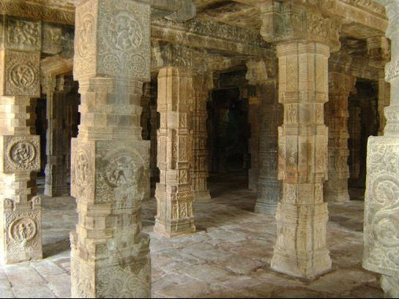
What are foundations?
Notes:
Photo attribution: https://en.wikipedia.org/wiki/File:Aira_Pillars.jpg

Slide 4
What are the foundations of a school?

Slide 5
What are the foundations of a school?
What would be the effect if some of the foundations were weakened or removed?
What does this tell us about which are most important?
Head teacher
Site staff
Teachers
Students

Slide 6
Identifying our foundations
To help us identify our foundations, we are going to read the stories of some key figures who were involved in the Cold War.
These will give us clues as to what created the Cold War and kept it going.

Slide 7
Key individuals and your groups
Joseph McCarthy
Dean Acheson
Andrei Sakharov
Vyacheslav Molotov
Rudi Dutschke

Slide 8
As you read, underline information relevant to your number:
Money, jobs or trade
International political power – being the most powerful country
Fear and paranoia
Differences in ideology (capitalism/communism)
Weapons or their development

Slide 9
Now re-read the information you’ve underlined
Does it help to explain why the Cold War started or why it carried on?
If not then cross it out.

Slide 10
Which foundation matches your work?
Economic factors
Mutual fear
Desire for supremacy
Ideology
The arms race
Money, jobs or trade
Fear and paranoia
International political power – being the most powerful country
Differences in ideology (capitalism/communism)
Weapons or their development
Now rank these foundations in order of importance in your group.
Which were most important in creating and sustaining the Cold War?
Write one sentence explaining your ranking.

Slide 11
Plenary
Be ready to share which foundation your group thinks is most important and give evidence to justify why.

