Slide 1
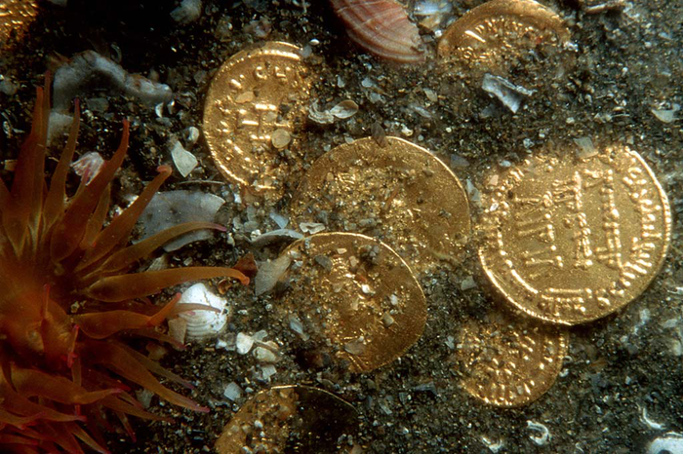
How did Franck Goddio rescue hidden treasures from the sea?
Photo credit; Christoph Gerigk/Franck Goddio

Slide 2
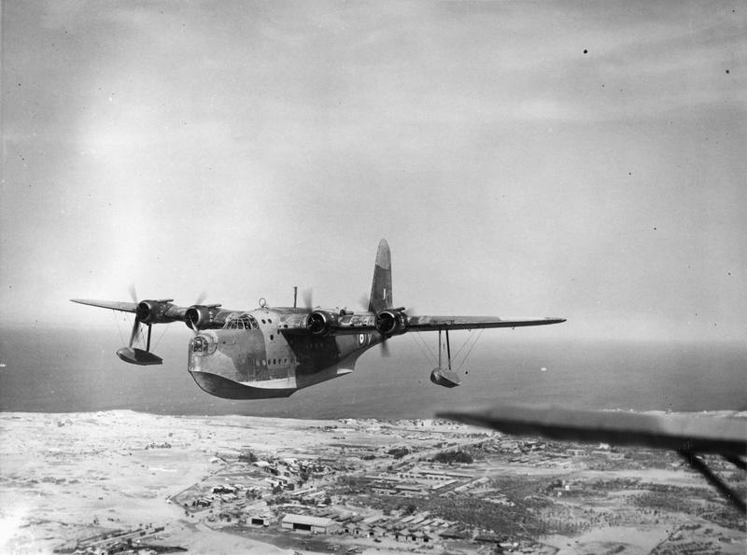
RAF plane over Aboukir Bay, Egypt, 1940`s

Slide 3
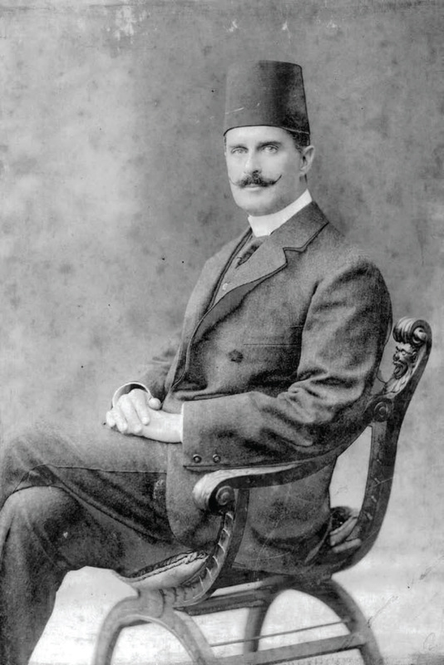
Prince Omar Tousson of Egypt (1872-1944)
Photo Credit; In Magazine Alexandria Center

Slide 4
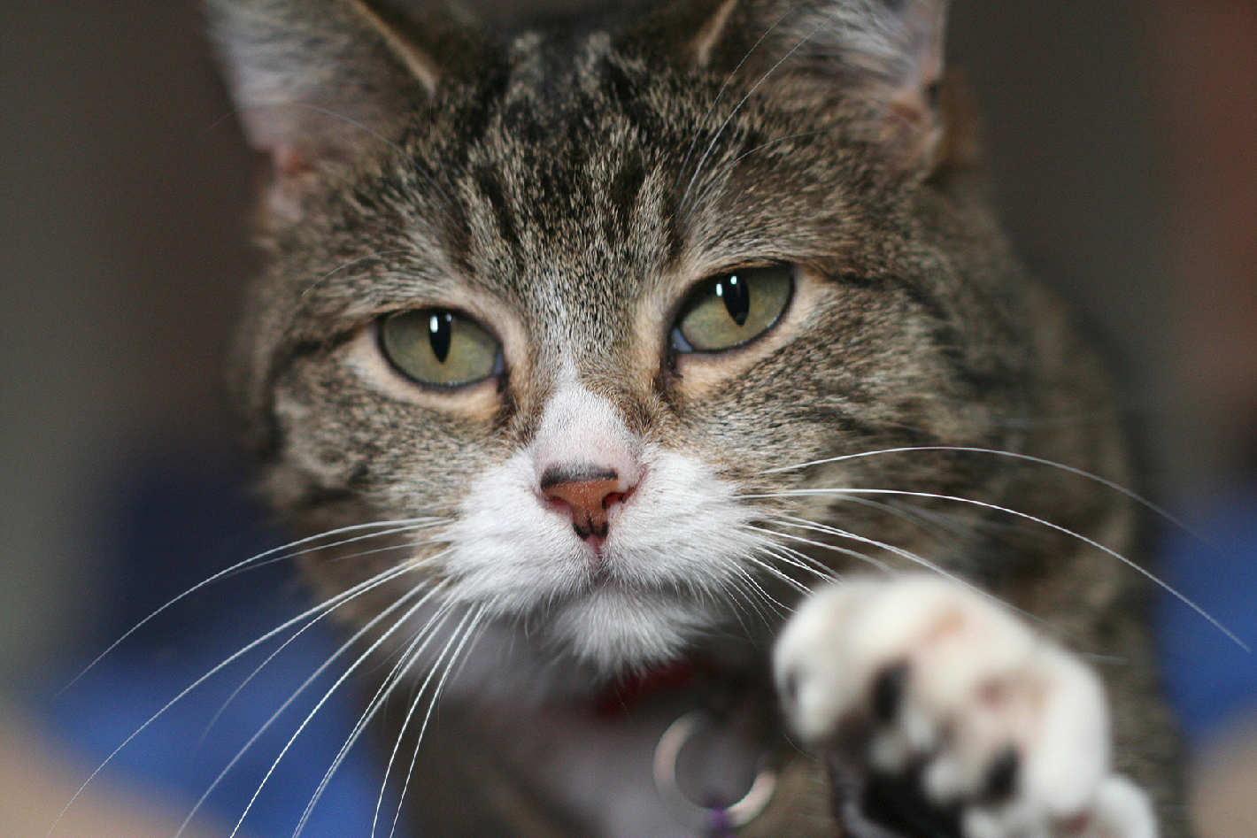
Photo Credit; David Corby

Slide 5
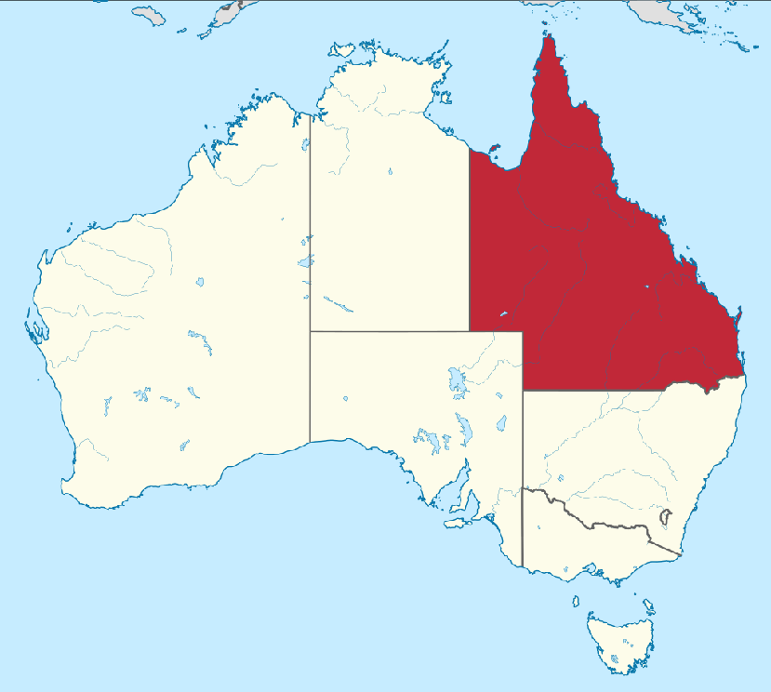
Map of Queensland, Australia
Photo Credit; TUBS

Slide 6
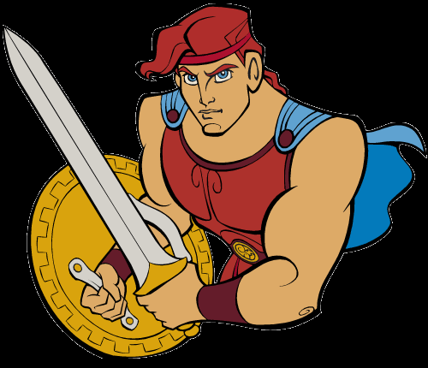
Ancient Greek Hero Hercules
Photo Credit; Clipartpanda

Slide 7
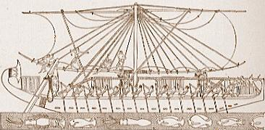
Ancient Egyptian ship
Photo Credit: 83d40m

Slide 8
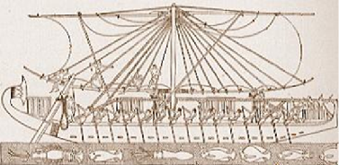
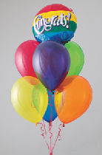
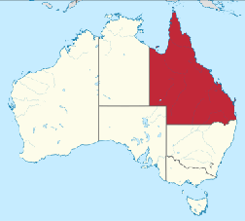
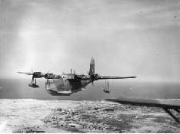
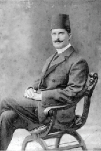
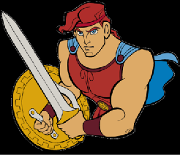
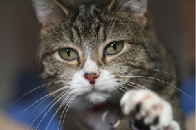

Slide 9
DROWNED CITY NEAR MOUTHS OF NILE
DROWNED CITY
Vigilance (alertness) of a Royal Air Force pilot at Alexandria (a city on the coast of Egypt) is responsible for what is hailed (announced) as one of the most important archaeological discoveries in recent years. While flying over the sea near Nelson Island, Group-Captain John T. Cull, who commands the aircraft depot at Aboukir, looked down into the clear blue Mediterranean and saw something in the shape of a large horseshoe beneath the sea. He informed Prince Omar Toussoun, the eminent (important) Egyptian archaeologist, who sent a diver down at the spot indicated and has now ascertained (decided) that the 'horseshoe' is made up of columns of marble and red granite and the foundations of ancient buildings.
Among the relics brought up by the diver is the head of a white marble
statue. Now cleaned, it reveals the features of Alexander the Great (a Greek conqueror). Experts believe that the ruins may indicate the exact site of Canopus (an ancient lost city).

Slide 10
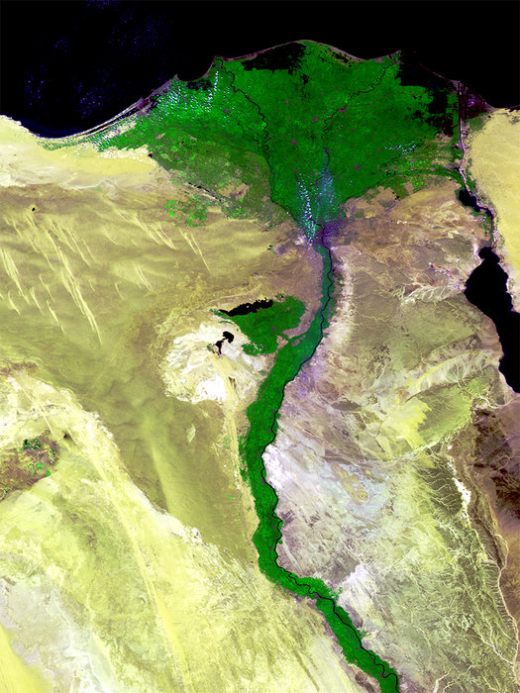

Slide 11
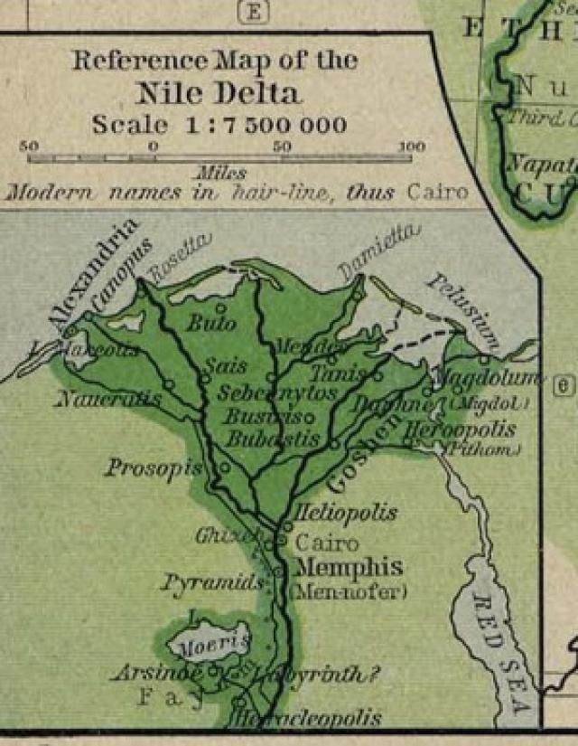

Slide 12
Photo Credit ; Christoph Gerigk; © Franck Goddio /Hilti Foundation

Slide 13
Factor | Obstacle | Solution?
Ancient writings don't give detailed descriptions about where the cities exactly were
Ancient writings are sometimes inaccurate
The area of the seabed where the cities were buried covers over 68 square miles (110 kilometres)
The Water of the River Nile contains lots of floating dust and soil (sediment)
A layer of sand covers the whole seabed

Slide 14
Factor | Obstacle | Solution?
Ancient writings don't give detailed descriptions about where the cities exactly were | Ancient writings are not much use for finding out where the cities exactly were
Ancient writings are sometimes inaccurate | Archaeologists cannot always trust clues in ancient writings
The area of the seabed where the cities were buried covers over 68 square miles (110 kilometres) | The area of the seabed is just too vast to explore
The Water of the River Nile contains lots of floating dust and soil (sediment) | Floating sediment in the river water makes it very murky and difficult to see through
A layer of sand covers the whole seabed | Ruins of buildings and artefacts cannot usually be seen because they are covered in sand and river sediment

Slide 15
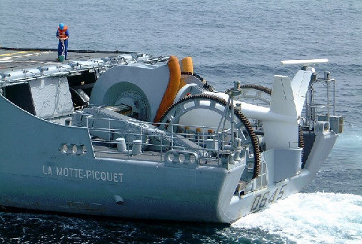
B – Nuclear Magnetic Resonance Magnetometer (NMRM)
Equipment which discovers places under the seabed with a strong magnetic pull. These usually come from faults in the earth under the seabed.
A - Side Scan Sonar
Photo Credit: Jean Michelle Roche
Equipment towed under a boat sends invisible sound waves (sonar) in to the water which bounce off the seabed. Echoes on an electronic screen showing the ups and downs of the surface.

Slide 16
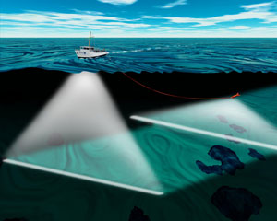
Side scan Sonar can show mounds where ruined buildings might be and dips where river and canal channels once flowed

Slide 17
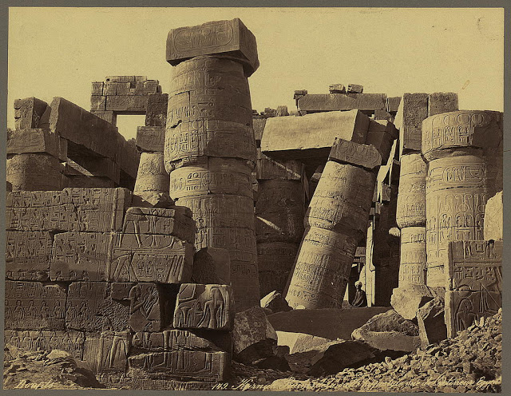
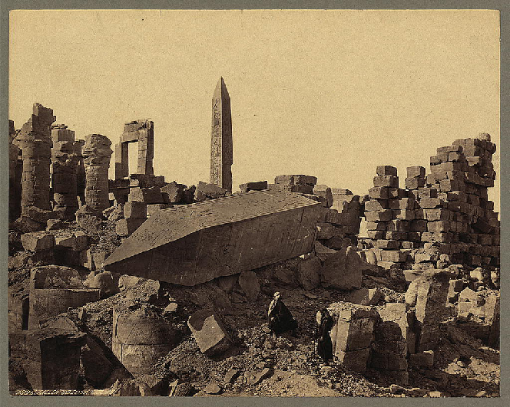
NMRM reveals where the weight of heavy buildings may have collapsed, cracking the earth beneath them and causing a fault

Slide 18
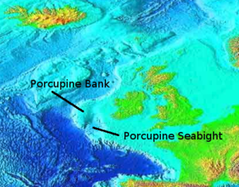
Bathymetric map of the ocean bed off Britain

Slide 19
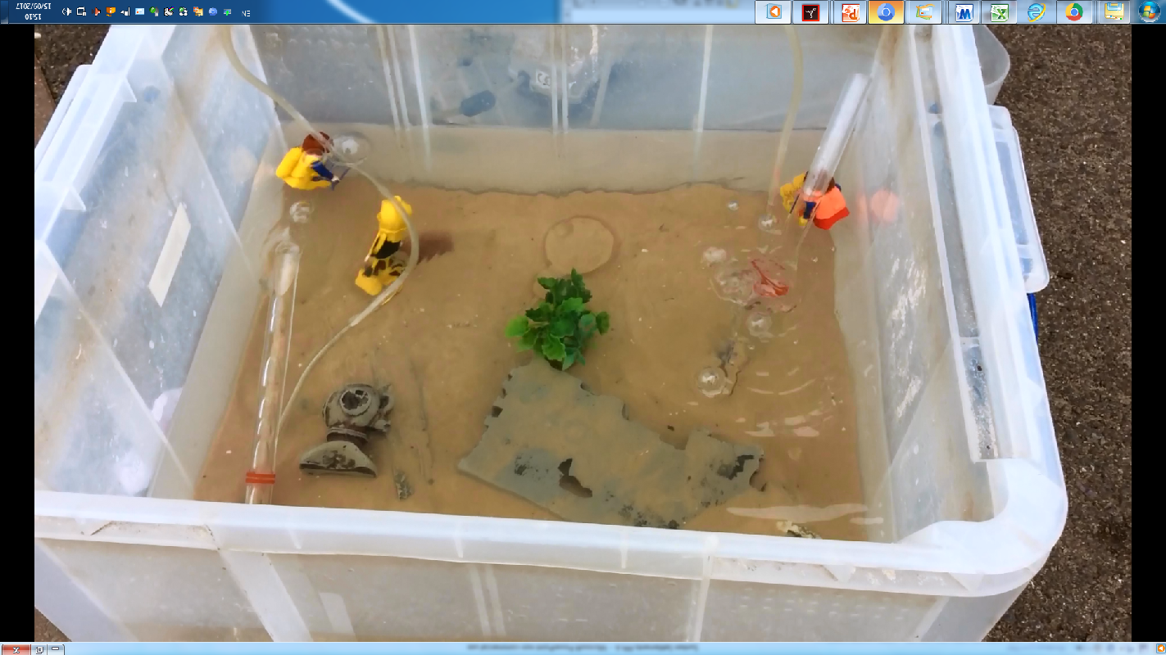

Slide 20
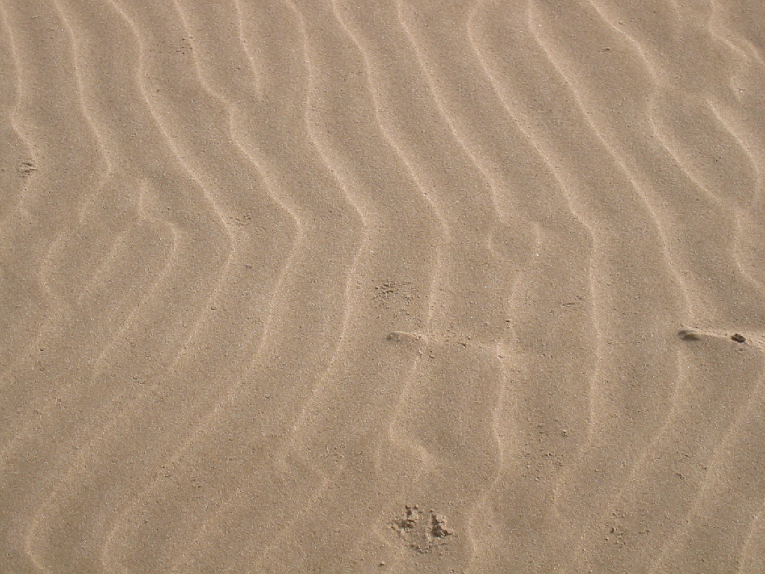
How do you get sand off a heavy artefact underwater?

Slide 21
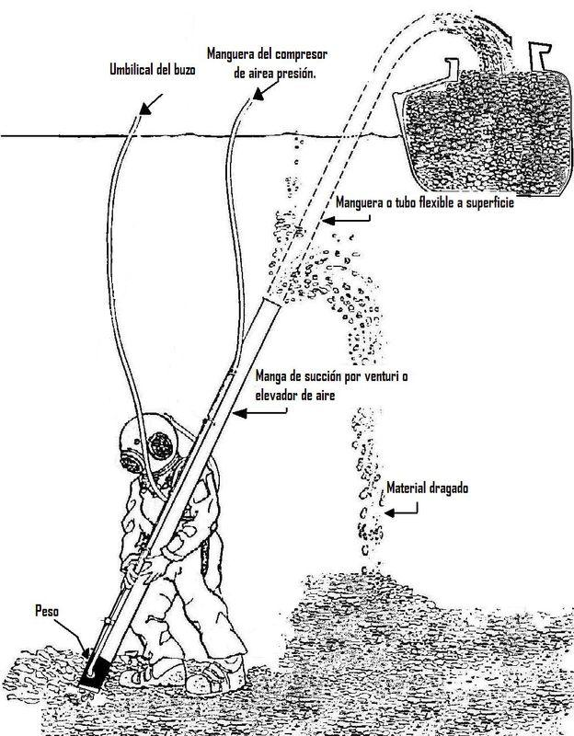
Suck the sand off with an Airlift or Water Dredge

Slide 22
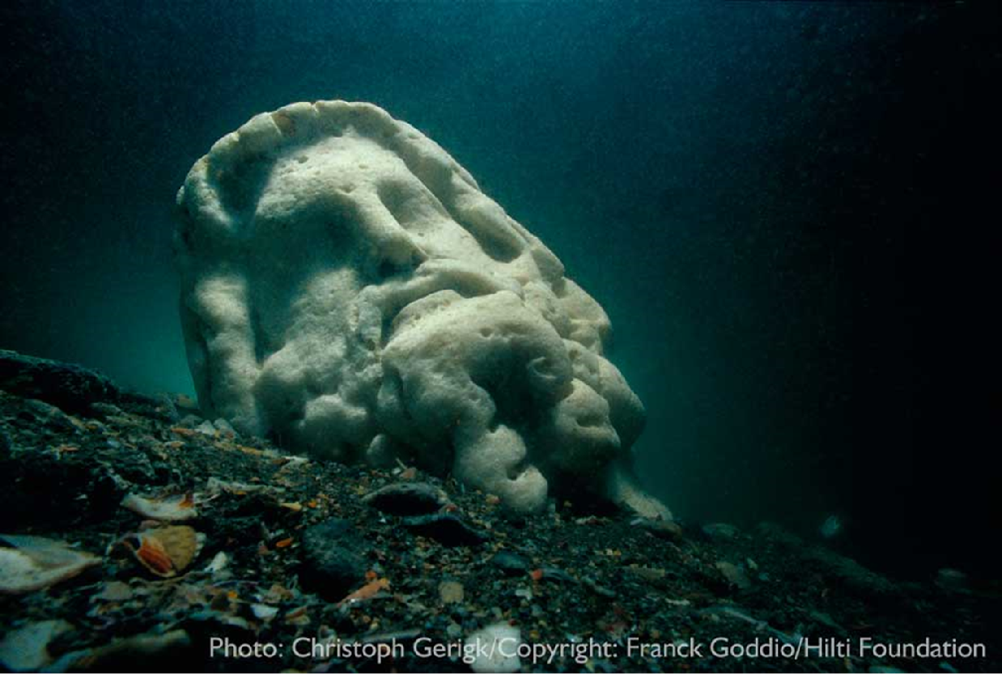
How do you take artefacts from the seabed to the surface?

Slide 23
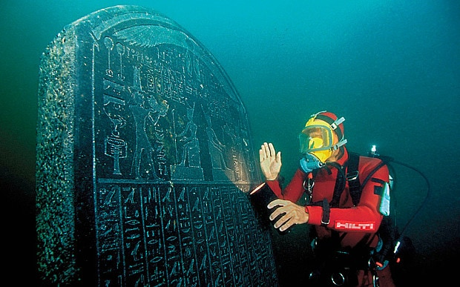
Photo credit;;Christoph Gerigk; © Franck Goddio /Hilti Foundation

Slide 24
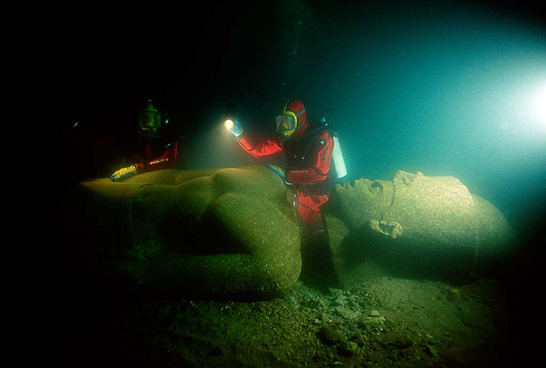
Photo credit;Christoph Gerigk;© Franck Goddio /Hilti Foundation

Slide 25
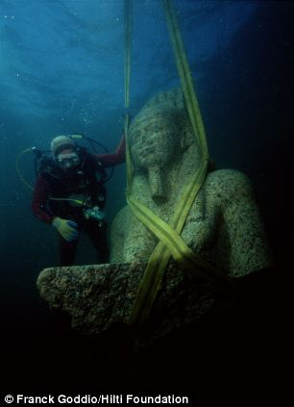
By hoisting artefacts by ropes or straps with a crane

Slide 26
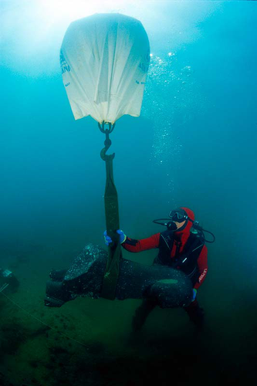
By hooking artefacts to a buoyant airlift (like a balloon)
Photo credit;;Christoph Gerigk; © Franck Goddio /Hilti Foundation

Slide 27
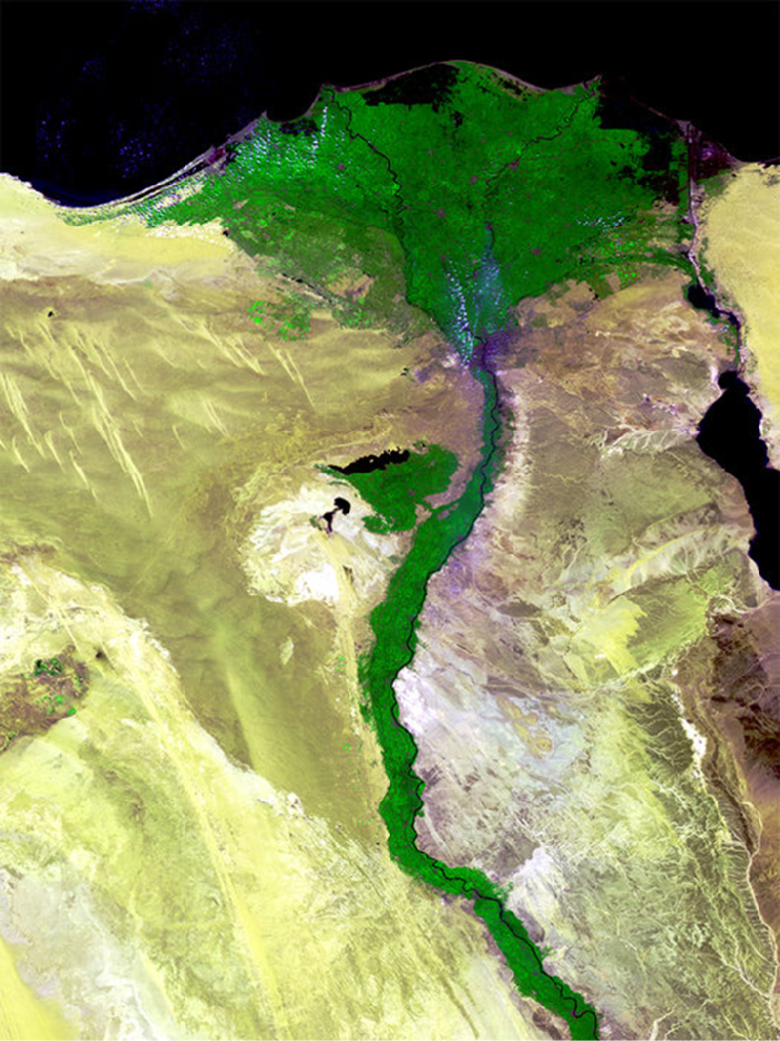

Slide 28
