Slide 1
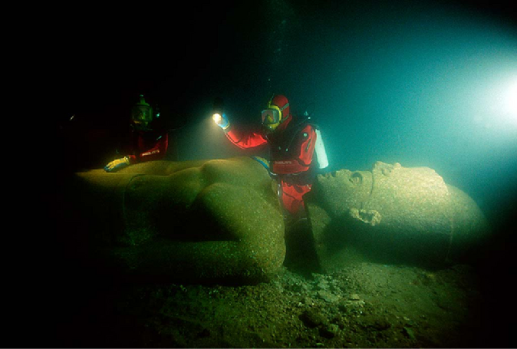
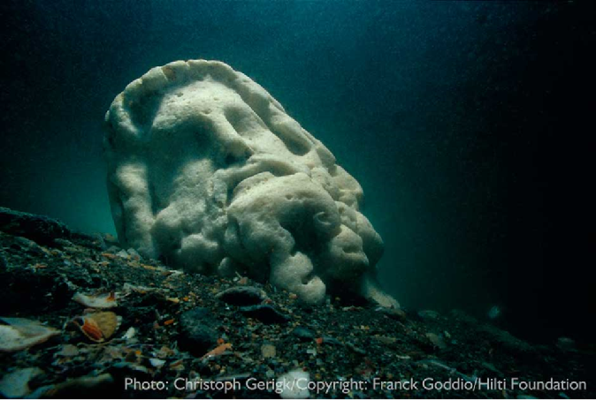
How Egyptian were the lost cities of Thonis-Heracleion and Canopus?
Photo credit;;Christoph Gerigk; © Franck Goddio /Hilti Foundation

Slide 2
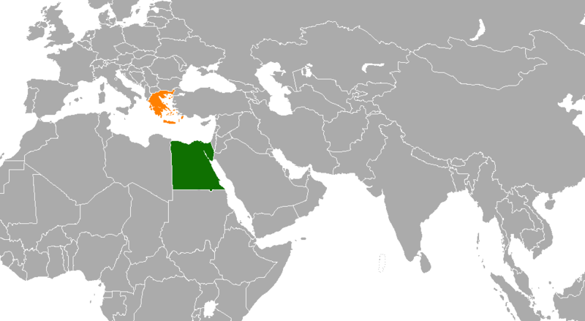
Photo Credit; Groubani

Slide 3
Buildings.
Art
Statues (Sculpture)
Type of writing
Religious beliefs
Coins
Pottery
Burial of the dead

Slide 4
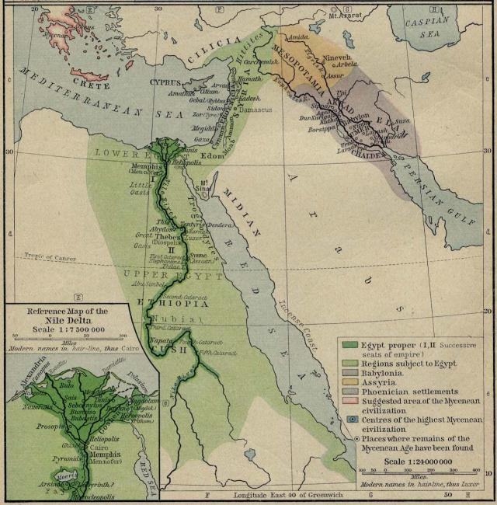
Around 3100 BC King Narmer united Egypt for the first time

Slide 5
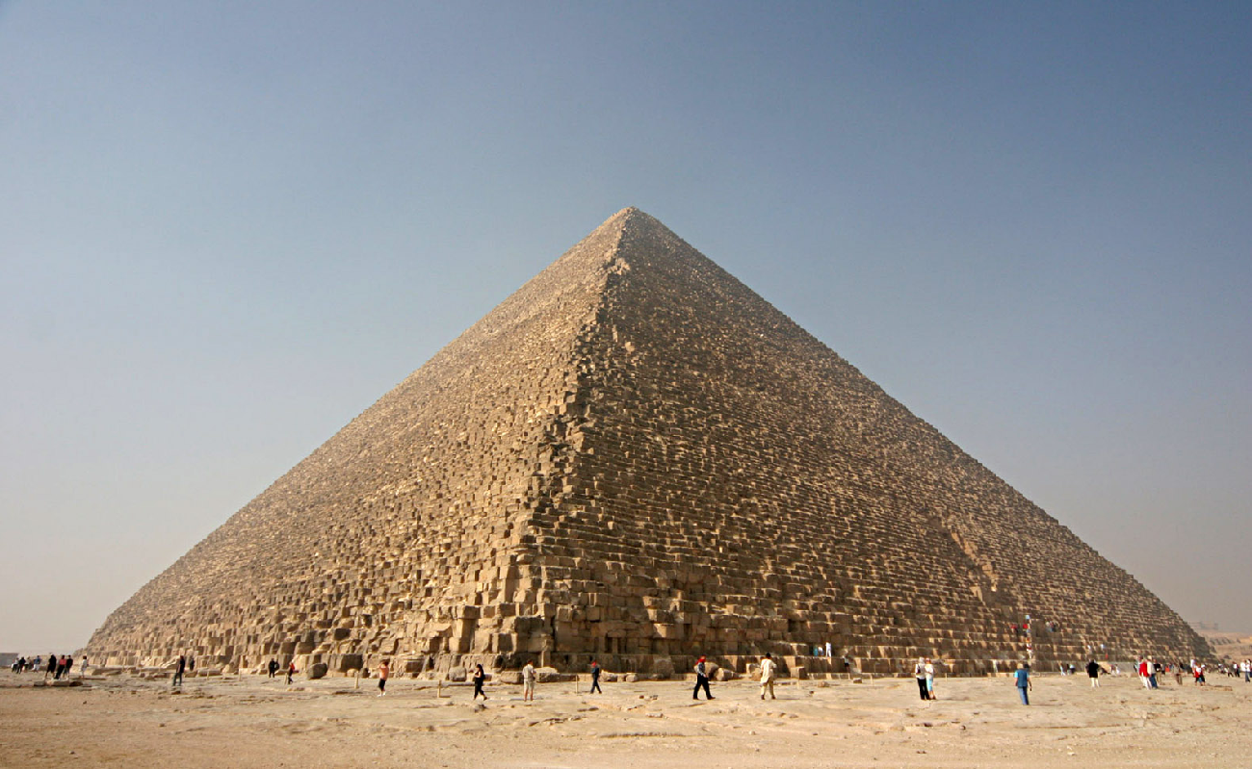
Around 2500 BC the Egyptians built the Great Pyramid at Giza
Photo Credit; Nina Aldin Thune

Slide 6
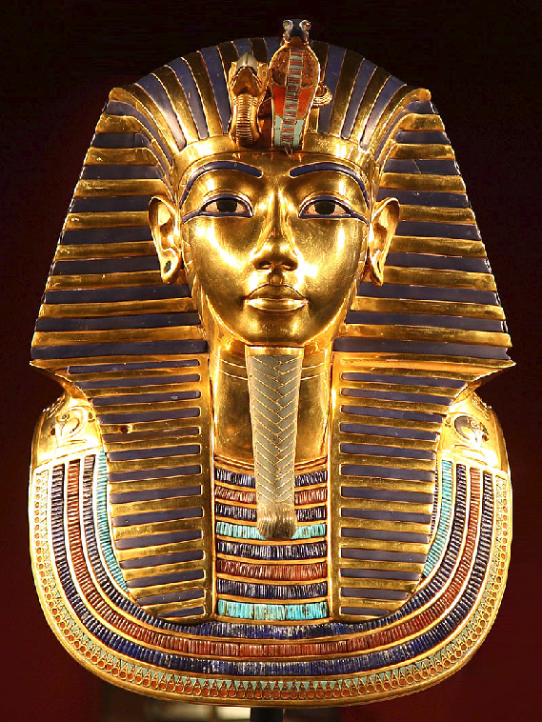
Around 1325 BC Tutankhamun was buried in the Valley of the Kings
Photo Credit; Karsten Frenzl

Slide 7
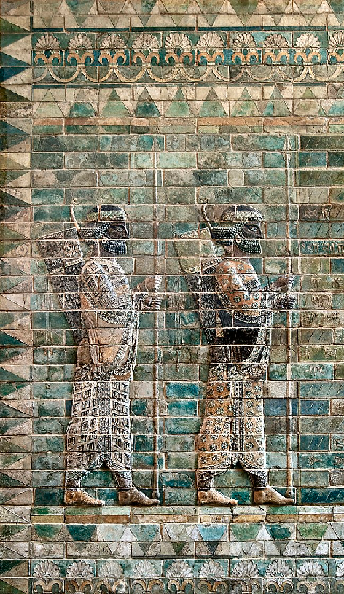
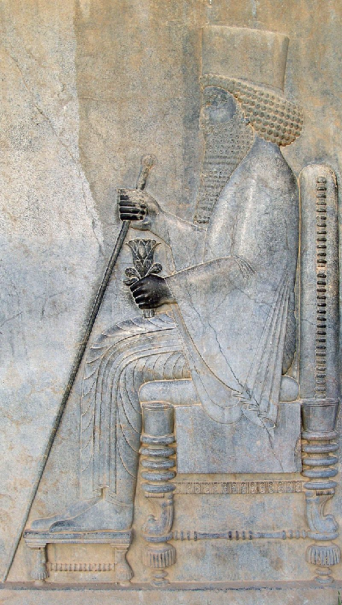
Between 525–399 and 342–332 BC the hated Persians ruled Egypt

Slide 8
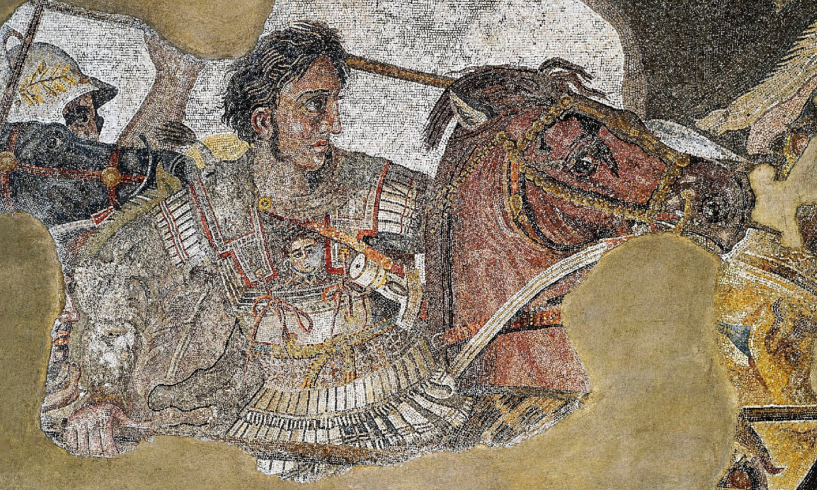
In 332 BC popular Greek conqueror Alexander the Great took over Egypt

Slide 9
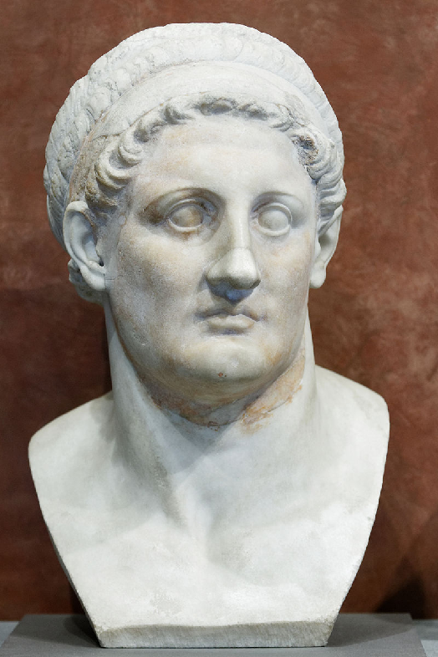
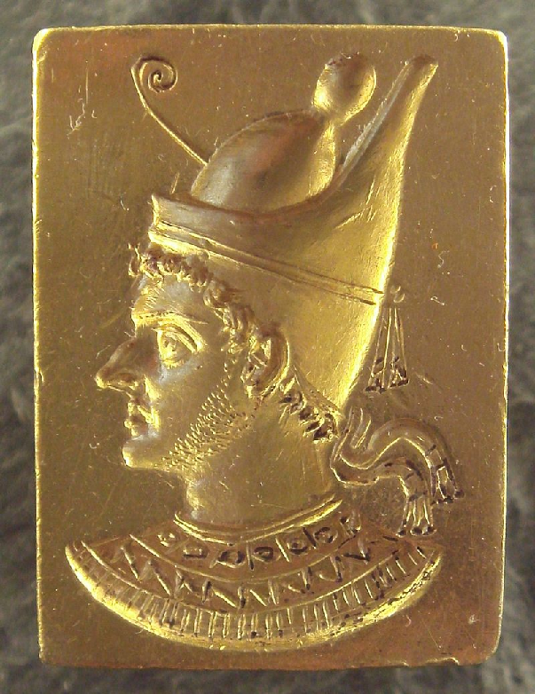
The Ptolemy family from Greece ruled Egypt like old fashioned Pharoahs 310-30 BC

Slide 10
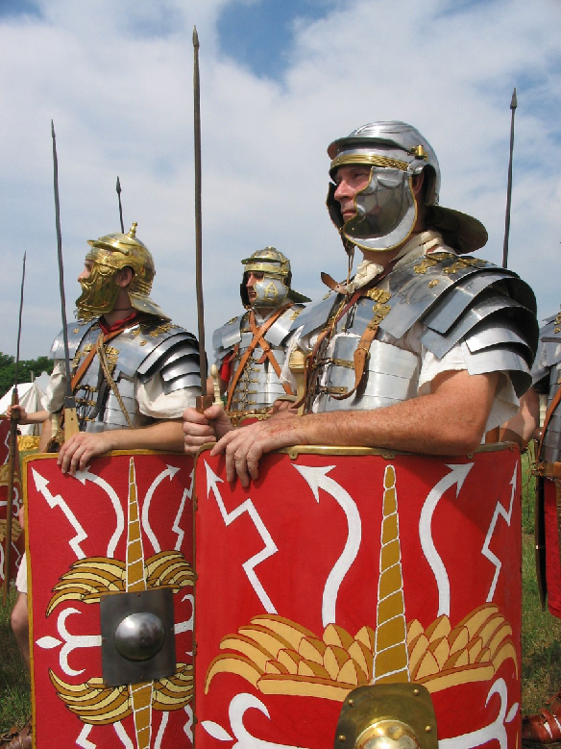
The Romans conquered Egypt 30 BC
Photo Credit; Caliga 10

Slide 11
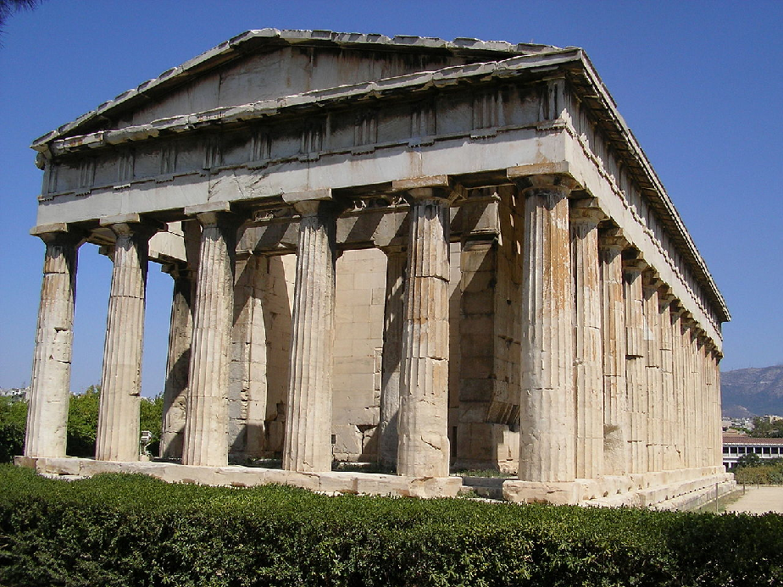
Between 620 and 525 BC Greek traders were allowed to build their own temples to Greek gods in Thonis-Heracleion. It became an important trading port
Photo Credit; Tommi Nikkilä

Slide 12
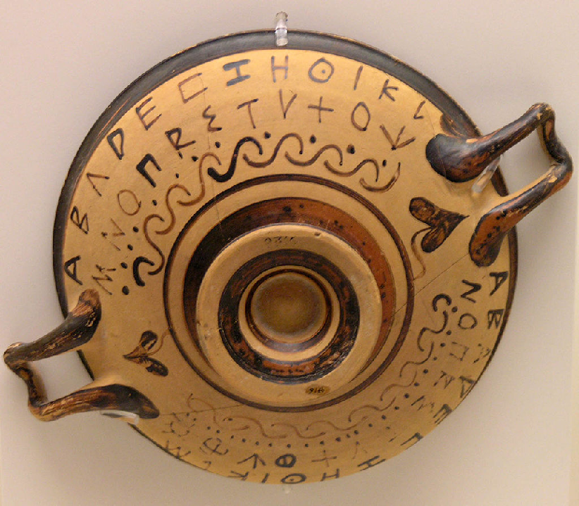
In 300 BC Greek became the official language in Egypt including in Thion-Heraklion and Canopus
Photo Credit; Marsyas

Slide 13
By 700 AD Thonis- Heraclion and Canopus were submerged by the sea
Photo Credit; pdppics.com

Slide 14
How Egyptian were the lost cities of Thonis-Heracleion and Canopus?
Photo credit;;Christoph Gerigk; © Franck Goddio /Hilti Foundation

Slide 15
Glossary for Map of Thion-Heracleion
Amulet = an object with magical or religious powers of protection
Cartouche = oval with a royal Egyptian name in it in hieroglyphics
Collosii = larger than life statues
Collosal = massive, like larger than life statues
Cult = religion
Frit = ingredients for glassmaking
Eroded = worn away
Frit = ingredients for glassmaking
Germinated = started to grow
Ibis = a type of bird common in Egypt
Pagan = can mean a belief in many gods
Monolithic = huge or made from one block of stone
Naos = a hidden or box-like religious shrine
Nautical = something to do with the sea
Pagan = can mean a belief in many gods
Papyrus = Egyptian paper made from reeds
Papyrus bundle = rolls of papyrus bundled together, sometimes Egyptian stone columns were carved to look like a bundle of papyrus
Recuperation = getting something which replaces something you once had
Priestly revenues = money paid to priests
Revered = worshipped

Slide 16
Sanctuary = the holiest part of a temple, where only priests may be allowed
Sarcophagus = a stone coffin
Wadjet = an Egyptian god
Uraie = a sacred snake or serpent, a symbol showing great power, found on the head dresses of Egyptian queens

Slide 17
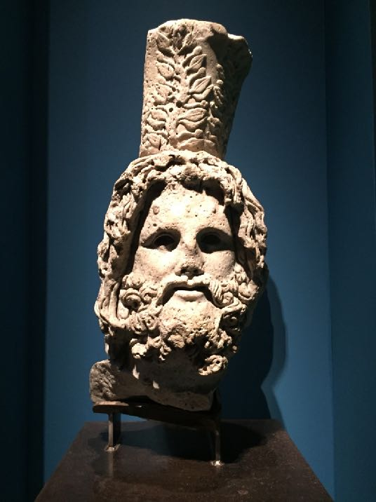
Head from a 12 foot statue of the Egyptian god Serapis carved to look like the Greek god Zeus
Photo Credit; John Kannenberg

Slide 18
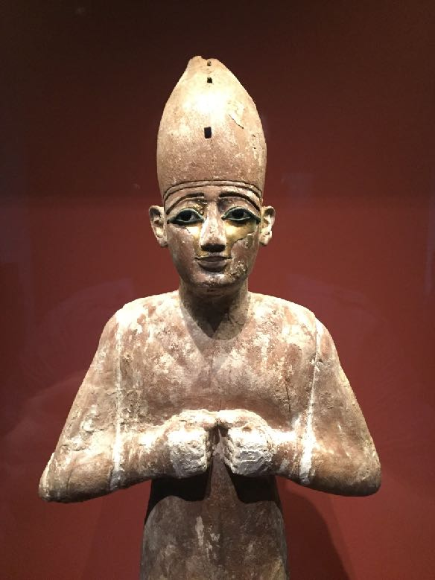
bronze statuettes of the Egyptian god Osiris were found (this wooden one is from elsewhere in Egypt)
Photo Credit; John Kannenberg

Slide 19
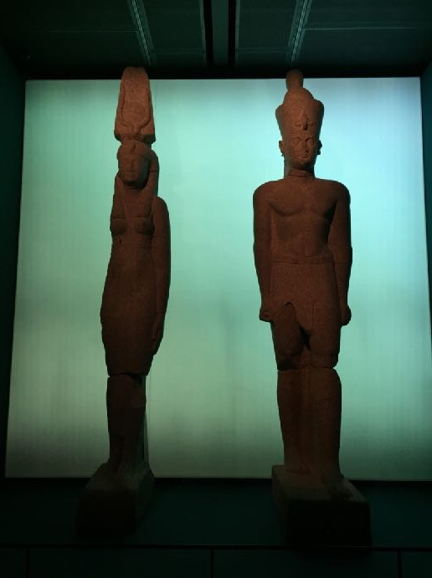
Huge red granite statues of a king and queen dressed in Egyptian clothes but members of the ruling Greek royal family (246-222 BC)
Photo Credit; John Kannenberg

Slide 20
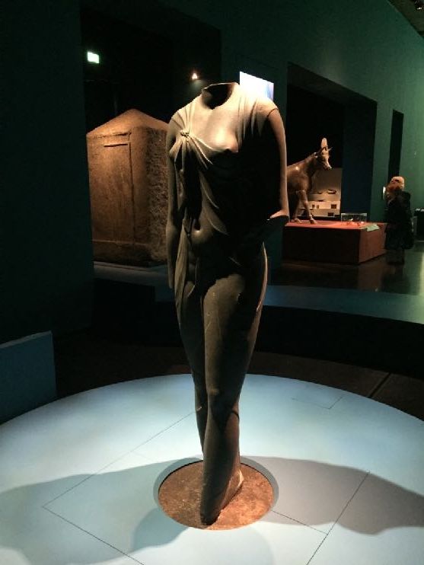
Black stone statue of the Egyptian Queen Arsinoe the Second dressed as Aphrodite, the Greek goddess of love. The queen was part of the ruling Greek royal family (3rd century BC)
Photo Credit; John Kannenberg

Slide 21
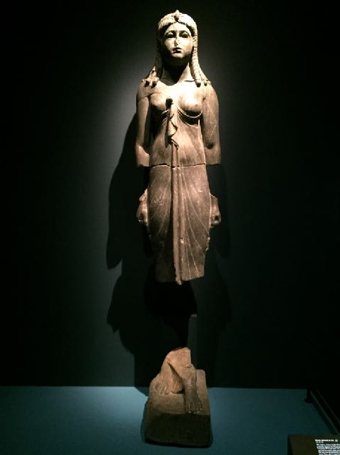
A stone statue of an Egyptian queen from the ruling Greek royal family (possibly Cleopatra the Third) dressed as the Egyptian goddess Isis (2nd Century BC)
Photo Credit; John Kannenberg

Slide 22
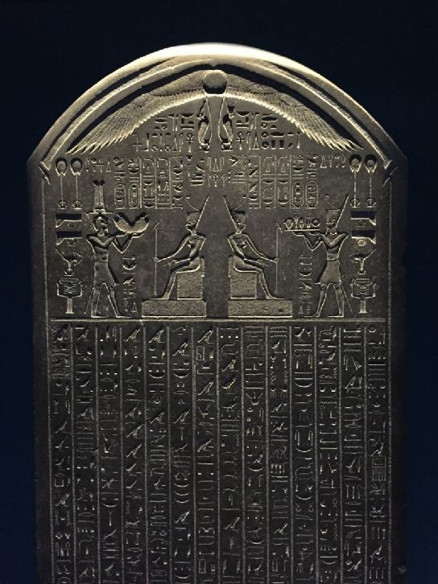
The Decree (law) of Sais written in Egyptian hieroglyphics on black stone (380 BC)
Photo Credit; John Kannenberg

Slide 23
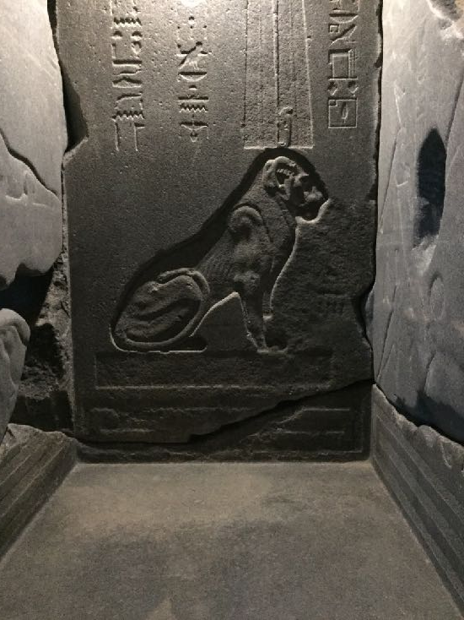
Part of a shrine to the Egyptian god Shu made from black granite (380-362 BC)
Photo Credit; John Kannenberg

Slide 24
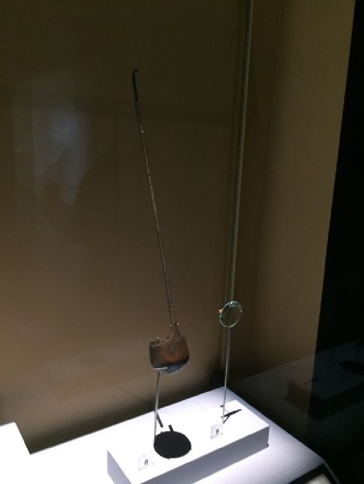
A bronze ladle (kind of spoon) used in Egyptian religious ceremonies (6th to 2nd centuries BC). Over a hundred had been found thrown in to waterways after use
Photo Credit; John Kannenberg

Slide 25
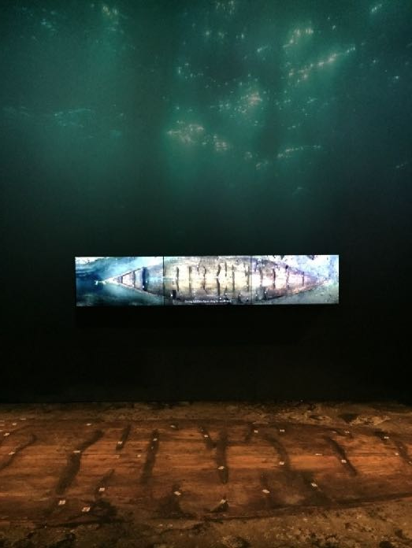
A barge made from sycamore wood used in important Egyptian religious ceremonies
Photo Credit; John Kannenberg

Slide 26
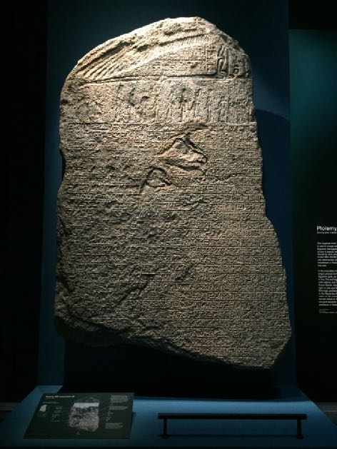
A stele (stone slab) written by order of Egyptian king Ptolemy the Eighth shortly after 118 BC. The royal family were Greeks. The slab is written in both Egyptian hieroglyphics and Greek letters.
Photo Credit; John Kannenberg

Slide 27
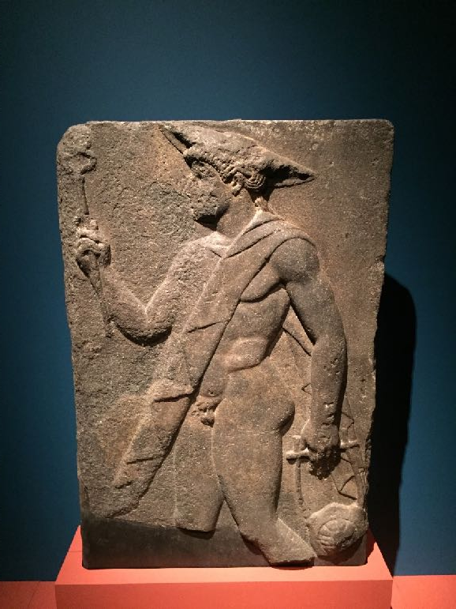
Stone carving of the Greek messenger god Hermes (1st Century BC)
Photo Credit; John Kannenberg

Slide 28
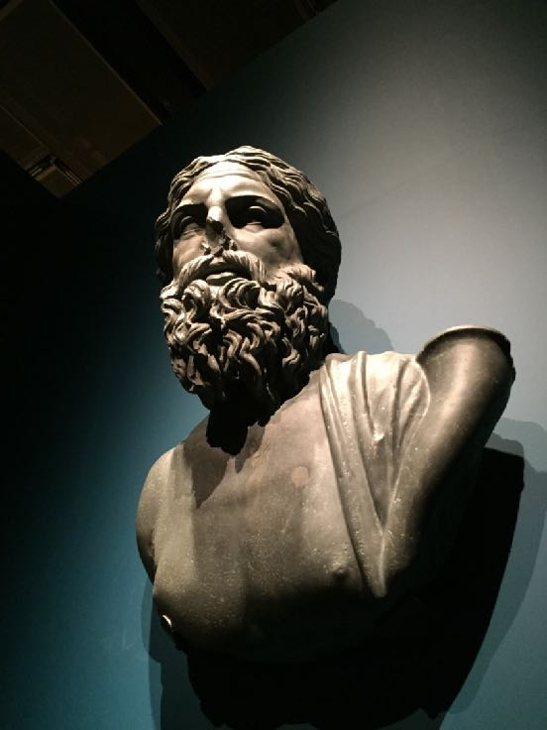
Stone head of Neilos, god of the River Nile (2nd Century AD)
Photo Credit; John Kannenberg

Slide 29
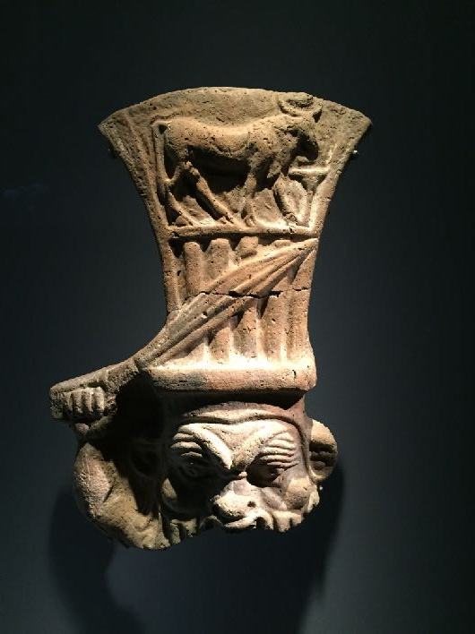
Clay Figure of the Egyptian god Bes (3rd to 2nd century BC)
Photo Credit; John Kannenberg

Slide 30
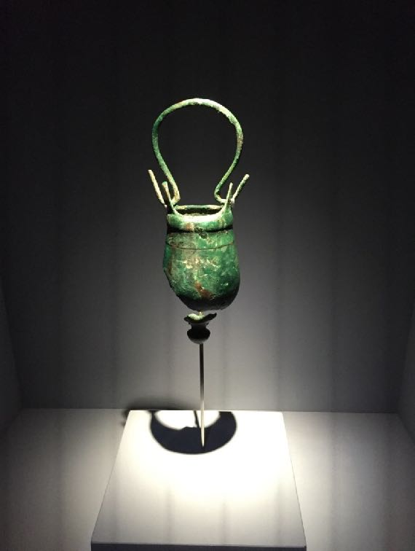
Bronze pail (bucket) used in Egyptian religious ceremonies
Photo Credit; John Kannenberg

Slide 31
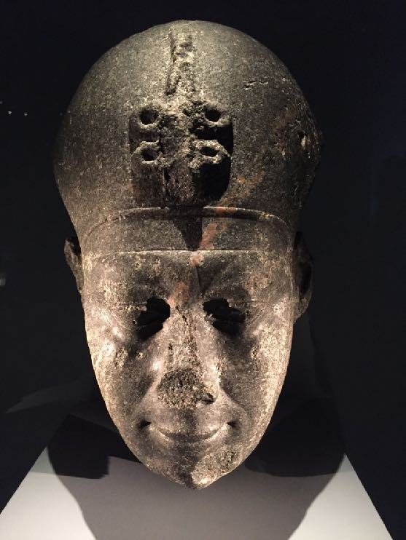
Stone head of Egyptian pharoah Nectonebo the Second
Photo Credit; John Kannenberg

Slide 32
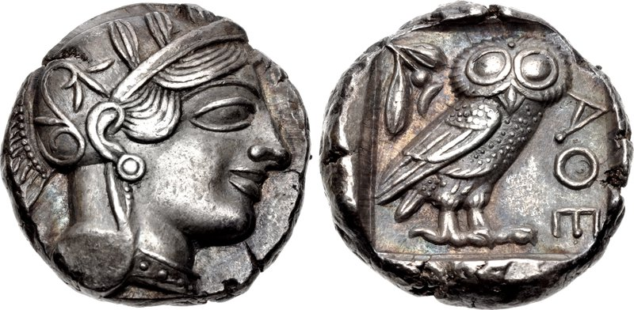
Many Greek coins like this were found from the city of Athens
Photo Credit; Classical Numismatic Group, Inc

Slide 33
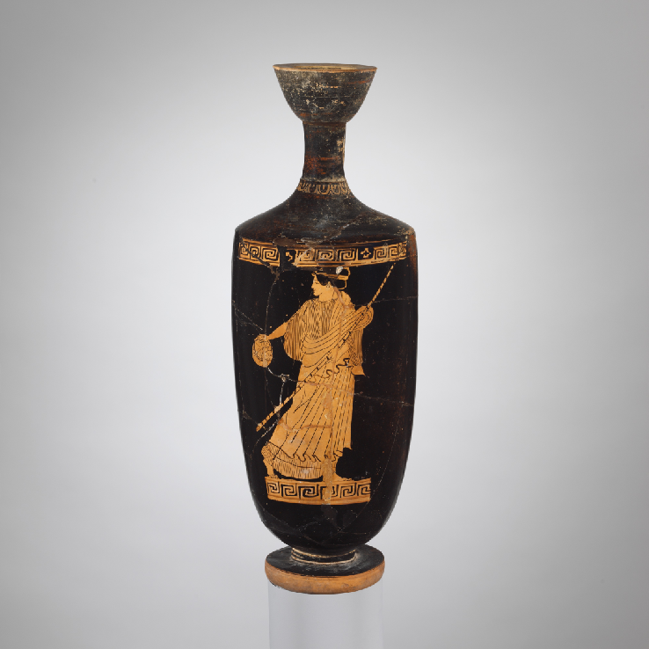
A tiny clay perfume bottle made in Athens with a pattern like this was found

Slide 34
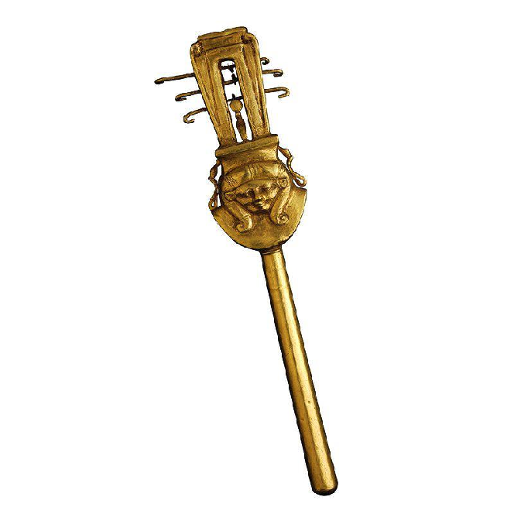
Egyptian musical instruments like this sistrum, used in religious ceremonies were found thrown in waterways
Photo credit; Egyptian Museum

Slide 35
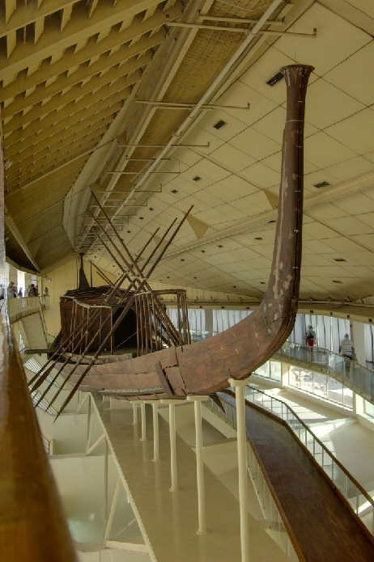
Small lead models in the shape of Egyptian barges used in religious ceremonies were found at the bottom of waterways. They may have been offerings to the Egyptian gods
Photo Credit; Berthold Werner

Slide 36
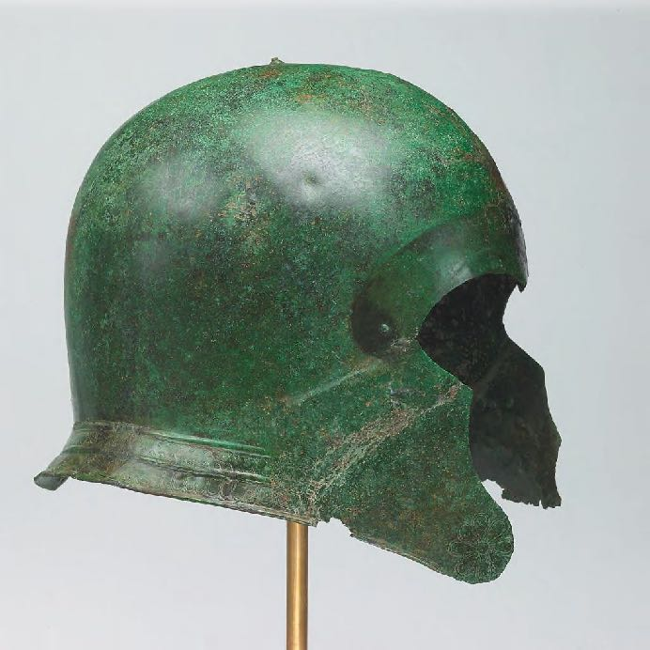
A bronze Greek helmet like this one was found (4th or 5TH Centuries BC). Greek soldiers were hired to fight in Egyptian armies
Photo Credit: Harvard Art Museums/Arthur M. Sackler Museum, Gift of the Schimmel Foundation, Inc.

Slide 37
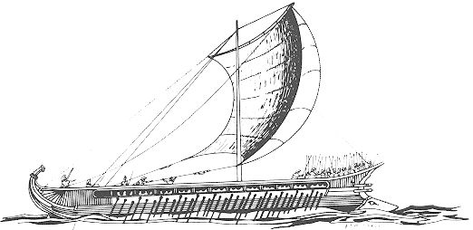
The remains of may anchors from Greek ships have been found (lengths of wood inserted with heavy lead)

Slide 38
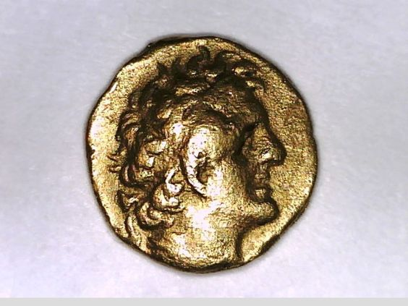
Five gold coins of the Egyptian king Ptolomy the First (305-247) were found in a temple. The other side has wording in Greek. The Ptolomy royal family were Greeks

Slide 39
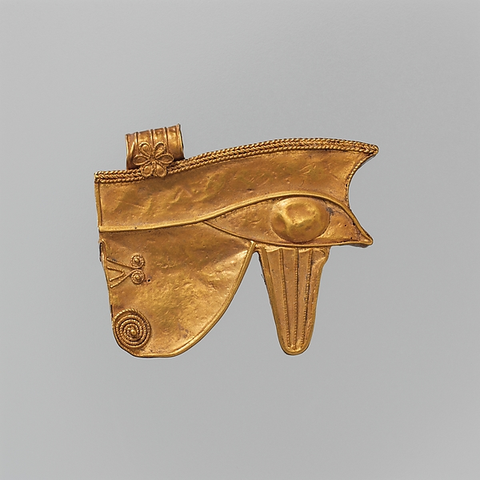
A tiny gold bead was found like this one showing the eye of the Egyptian god Horus

Slide 40
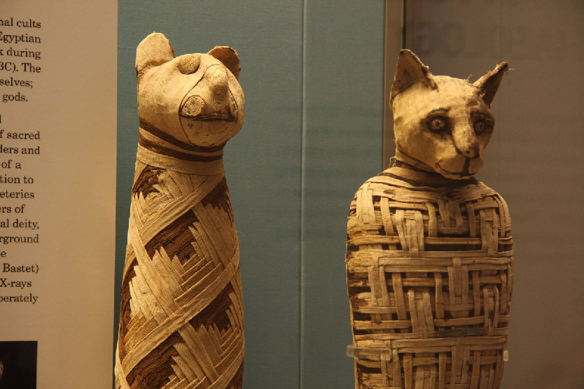
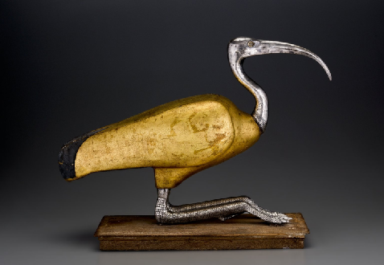
Sarcophagi (stone coffins) were found in which animal mummies had been buried. Egyptians mummified animals they worshipped such as cats and ibis birds.
Photo Credit; Mario Sanchez, Brooklyn Museum, Steve Garvie

