Slide 1
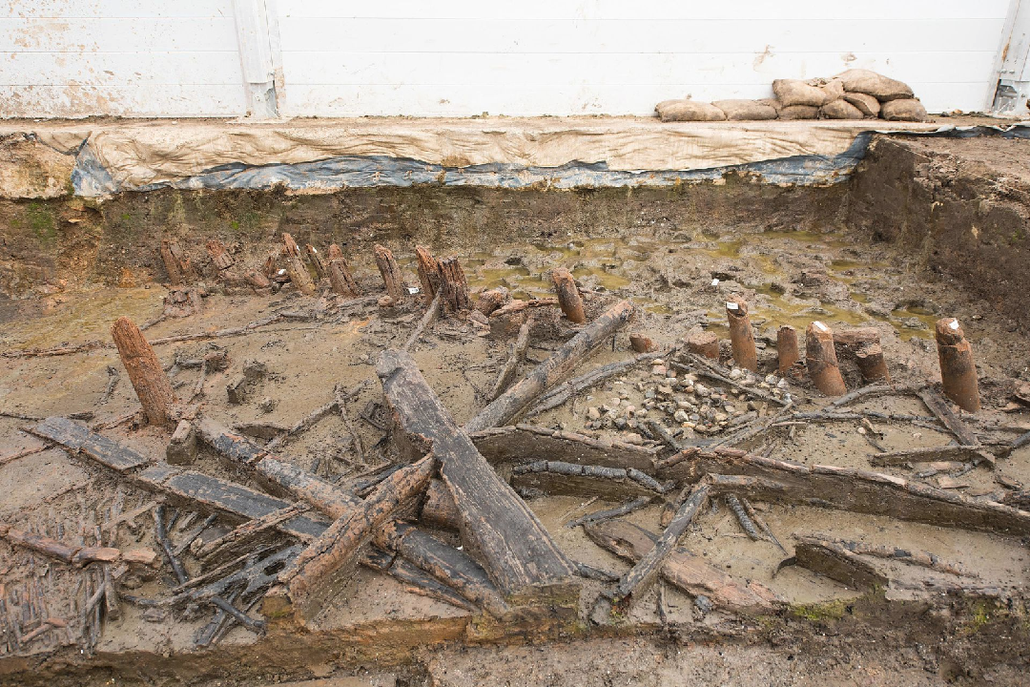
How did archaeologists lift artefacts from the mud at Must Farm?
Photo Credit; Dr Coleen Morgan

Slide 2
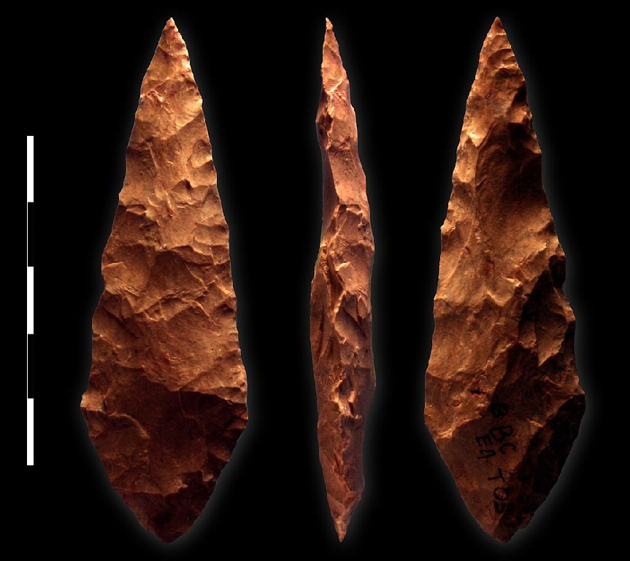
Late Stone Age (Neolithic) 4,000 -2,500 BC
Photo Credit; Vincent Mourre/Inrap

Slide 3
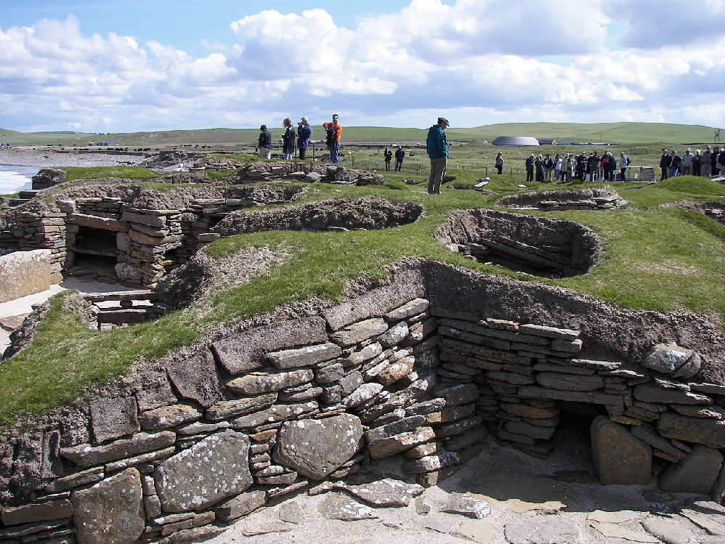
Stone houses at Skara Brae, Scotland 3,180-2,500 BC
Photo Credit; Wknight94

Slide 4
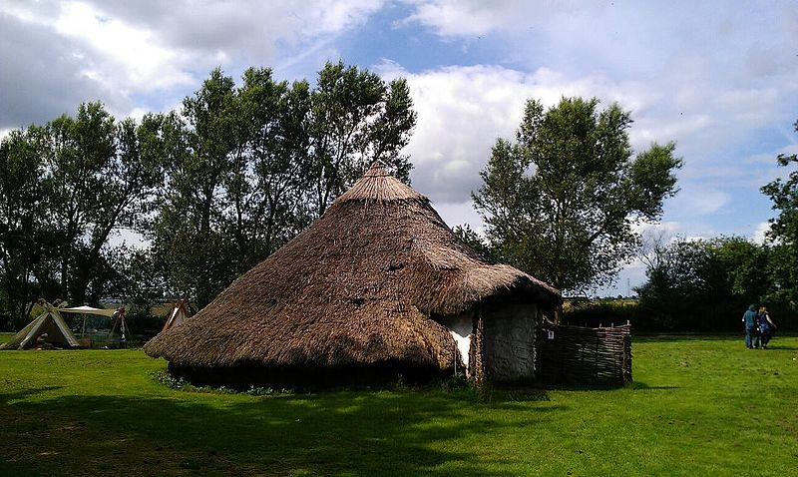
Bronze Age 2,500-800 BC
Photo Credit ;midnightblueowl

Slide 5

StoneHenge 2,500 BC
Photo Credit; Simon Wakefield

Slide 6
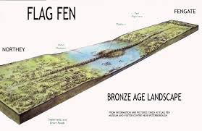
Flag Fen Causeway 1300 BC
Photo Credit; Vivacity

Slide 7
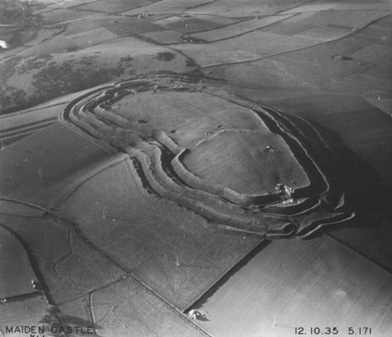
Iron Age 800 BC- 43 AD

Slide 8
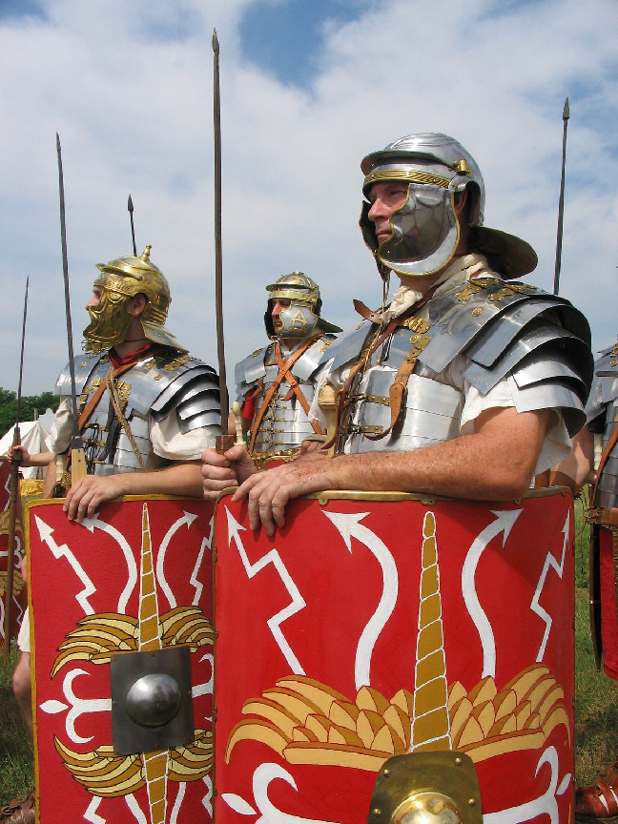
Roman Invasion 43 AD
Photo Credit; Caliga10

Slide 9
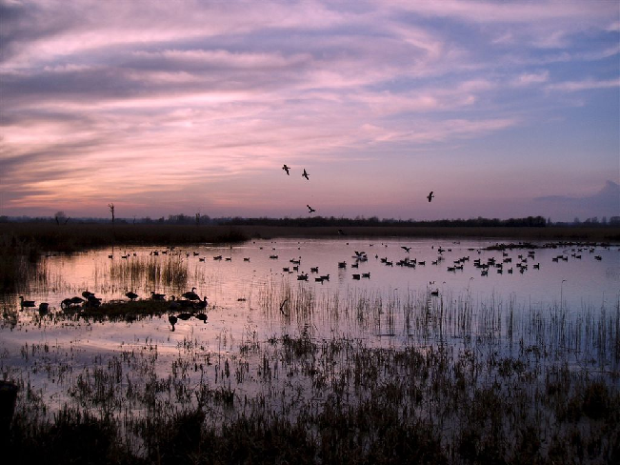
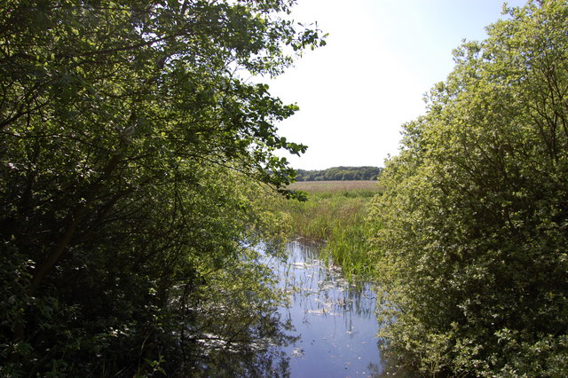
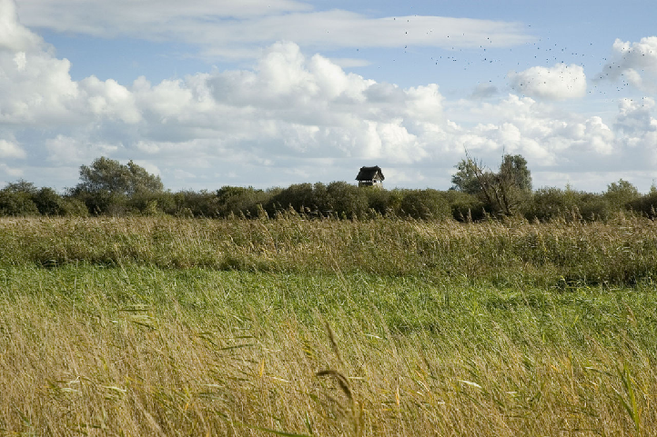
Photo Credits; Littlehow, J Myers, Dr Border

Slide 10
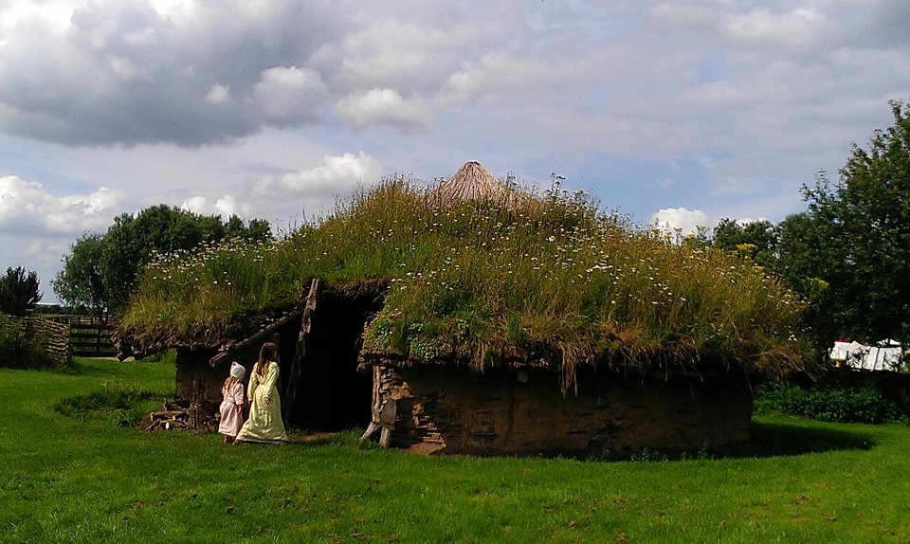
Photo Credit; midnightblueowl

Slide 11
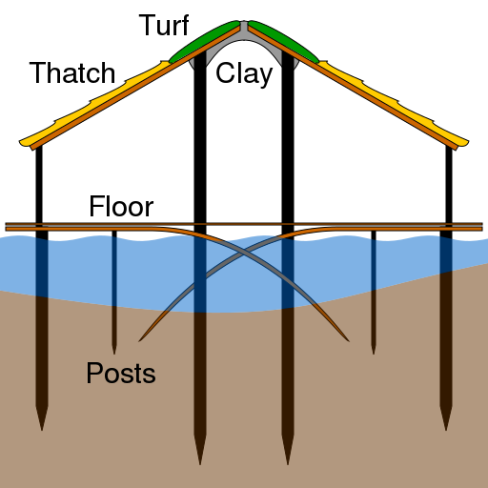
Photo Credit; cmglee

Slide 12


Slide 13
Stage One

Slide 14
Stage Two

Slide 15
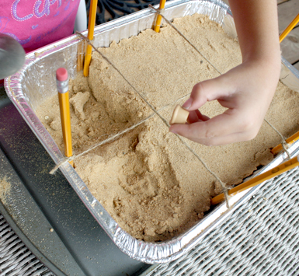

Slide 16
Sunken Settlements Bronze Age Artefact Box One
Reproduction of a gold Bronze Age composite ring of the type found threaded onto flange twisted gold torcs. It dates circa 1200 to 1000 BC
Replica miniature socketed axe or chisel produced in the Bronze Age. Original found in North Yorkshire. May have been used as a votive offering e.g. for throwing in to water as an offering to gods, spirits or the dead.
Late Bronze Age Barbed and Tanged arrowhead from the Urnfield culture of East Germany dating to 1200 BC. As the arrowhead has not been sharpened it may have been made as a votive offerings or it may have been awaiting to be sharpened among others.
Modern Amber bead
Slightly burnt fragment of Willow wattle fence
Fragments of cloth
Replica Bronze Age sickle

Slide 17
Sunken Settlements Bronze Age Artefact Box Two
Reproduction of a gold Bronze Age composite ring of the type found threaded onto flange twisted gold torcs. It dates circa 1200 to 1000 BC
Replica miniature socketed axe or chisel produced in the Bronze Age. Original found in North Yorkshire. May have been used as a votive offering e.g. for throwing in to water as an offering to gods, spirits or the dead.
Late Bronze Age Barbed and Tagned arrowhead from the Urnfield culture of East Germany dating to 1200 BC. As the arrowhead has not been sharpened it may have been made as a votive offerings or it may have been awaiting to be sharpened among others.
Modern Amber bead
Slightly burnt fragment of Willow wattle fence
Fragments of cloth
Bronze Age Scythe, Central Germany, 2nd Millenium BC

Slide 18
Sunken Settlements Bronze Age Artefact Box Three
Reproduction of a gold Bronze Age composite ring of the type found threaded onto flange twisted gold torcs. It dates circa 1200 to 1000 BC
Replica miniature socketed axe or chisel produced in the Bronze Age. Original found in North Yorkshire. May have been used as a votive offering e.g. for throwing in to water as an offering to gods, spirits or the dead.
Replica bronze age pot
Replica bronze age spearhead
Modern Amber bead
Slightly burnt fragment of Willow wattle fence
Fragments of cloth
Bronze Age replica sickle

Slide 19
Sunken Settlements Bronze Age Artefact Box Four
Reproduction of a gold Bronze Age composite ring of the type found threaded onto flange twisted gold torcs. It dates circa 1200 to 1000 BC
Replica miniature socketed axe or chisel produced in the Bronze Age. Original found in North Yorkshire. May have been used as a votive offering e.g. for throwing in to water as an offering to gods, spirits or the dead.
Replica Bronze Age pot
Modern Amber bead
Slightly burnt fragment of Willow wattle fence
Fragments of cloth
Bronze Age replica sickle
Reproduction Bronze Age spearhead

Slide 20
Sunken Settlements Bronze Age Artefact Box Five
Reproduction of a gold Bronze Age composite ring of the type found threaded onto flange twisted gold torcs. It dates circa 1200 to 1000 BC
Replica miniature socketed axe or chisel produced in the Bronze Age. Original found in North Yorkshire. May have been used as a votive offering e.g. for throwing in to water as an offering to gods, spirits or the dead.
Replica Bronze Age pot
Modern Amber bead
Slightly burnt fragment of Willow wattle fence
Fragments of cloth
Bronze Age scythe, Central Germany, 2ND Millenium BC
Reproduction Bronze Age spearhead 2000-1400 BC

Slide 21
What can we infer from the artefacts?
Gold ring – Bronze Age people could make gold jewelry – the metal could be mined.
Miniature axe or chisel – evidence of craftsmanship and religious beliefs
Bronze Arrowhead and Spearhead – evidence of warfare or hunting and that bronze artefacts could be made or traded-
Amber – Evidence of jewelry and that amber reached Britain from the Baltic
Clay pot – evidence of pot making techniques , that pottery was used and of styles of pottery
Bronze scyhths and sickles – evidence of farming
Burnt willow wattle – evidence of local building materials, evidence of the fire which burned down the hut
Cloth – evidence of ability to make cloth

