Slide 1
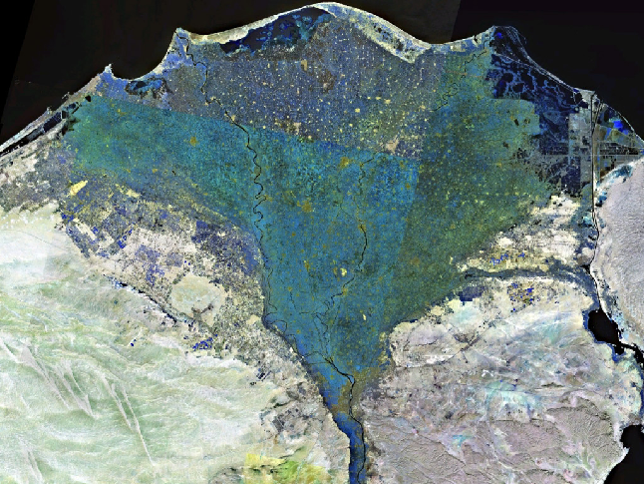
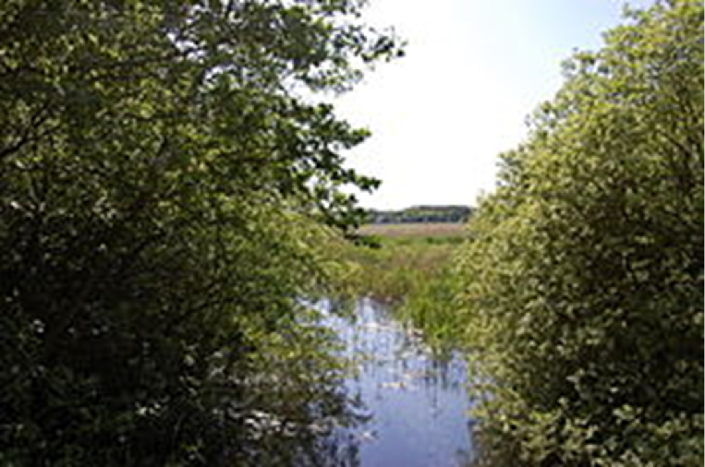
How similar and different was life in Thonis-Heracleion and Canopus compared to Must Farm?

Slide 2
This artefact is…… | It suggests that………………..

Slide 3
Must Farm Egypt

Slide 4
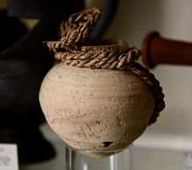
Egyptian and Greek people in Thion-Heracleion and Canopus used clay pots.

Slide 5
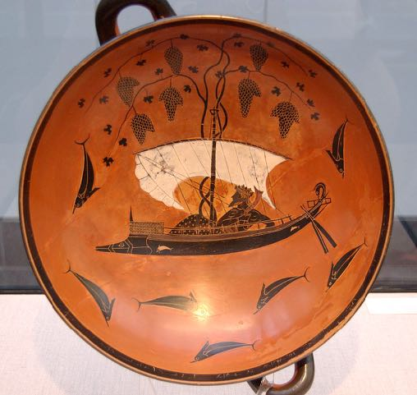
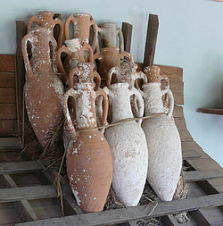
Egyptian and Greek people in Thion-Heracleion and Canopus traded goods with other countries e.g. buying wine from Greek ships.

Slide 6
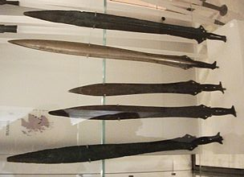
Must Farm people must have traded their goods for goods from further away e.g. jet beads from Yorkshire and amber from the Baltic, bronze swords from somewhere in Britain or from Europe,glass beads from Syria.

Slide 7
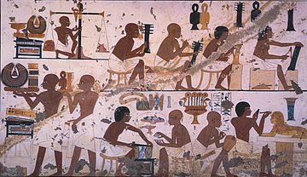
Egyptian and Greek people in Thion-Heracleion and Canopus were rich enough to buy food. They earned money from working in a range of jobs e.g. as craftsman, traders, priests etc.

Slide 8
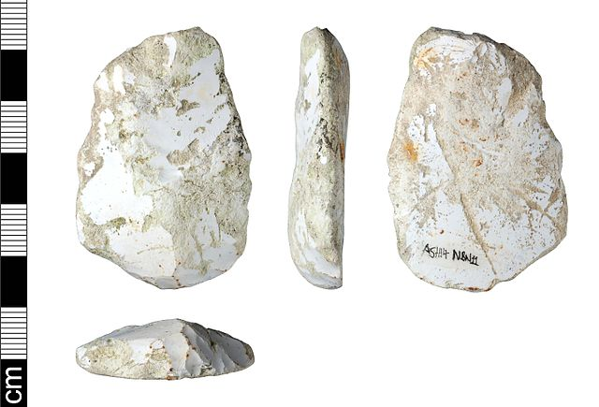
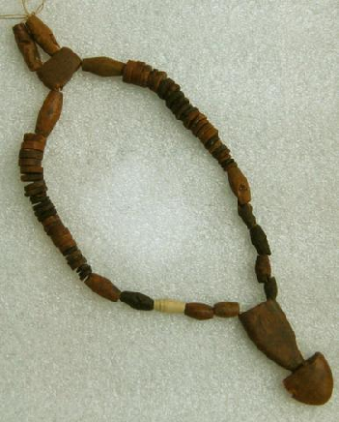
Must Farm people produced enough food to feed themselves. They could use food and cloth they wove to trade or exchange for goods which they did not have but still needed e. g. flints, Amber and jet beads, bronze swords etc.

Slide 9
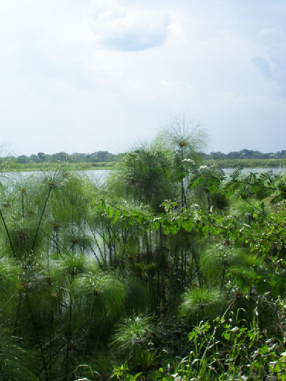
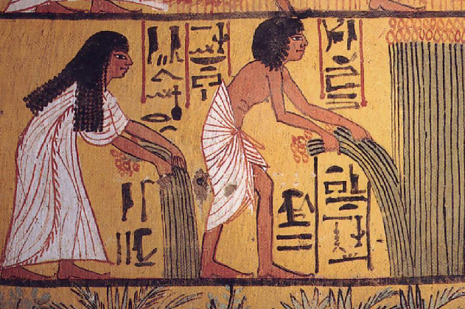
Egyptian and Greek people in Thion-Heraklion and Canopus used materials from the local environment to help them lead their lives e. g. reeds, wood.

Slide 10
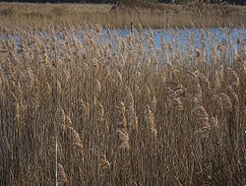
Must Farm people used materials from the local environment to help them lead their lives e.g. reeds, wood.

Slide 11
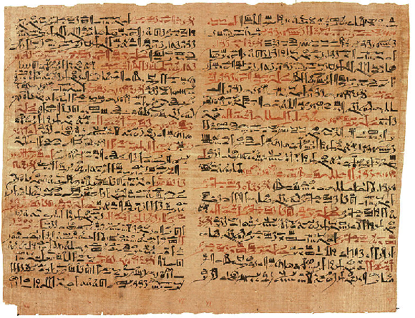
Some Egyptian and Greek People in Thion-Heraklion and Canopus wrote on papyrus (paper) made from local reeds.

Slide 12
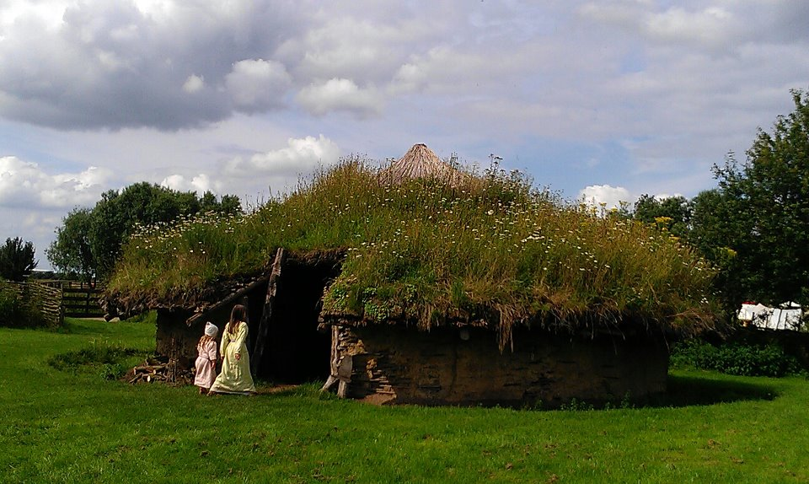
Must Farm people harvested reeds to thatch their round houses.

Slide 13
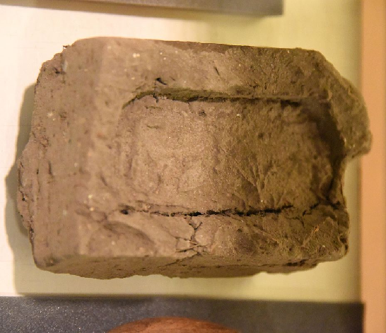
Egyptian and Greek people in Thion-Heracleion and Canopus mostly lived in houses made of mud bricks.

Slide 14
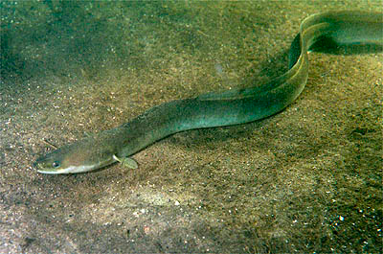
Must Farm people trapped and ate fish and eels as part of their diet.

Slide 15
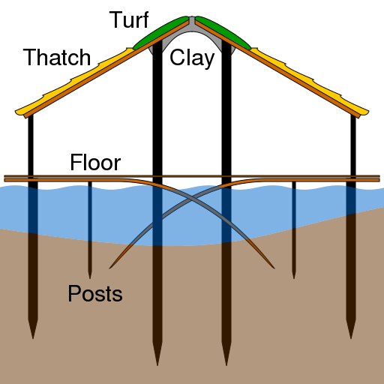
Must Farm families lived in wooden round houses built on wooden stilts over water and driven into a river bed.

Slide 16
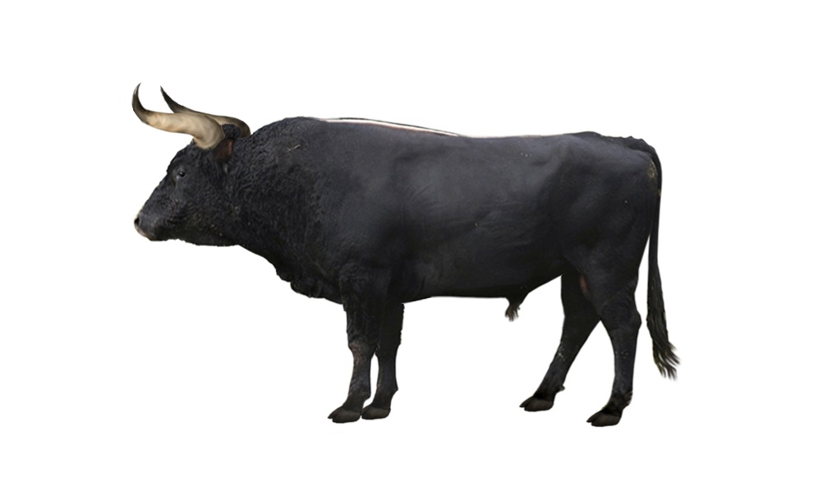
Must Farm people probably hunted wild animals such as birds and wild aurochs (a type of wild cattle).

Slide 17
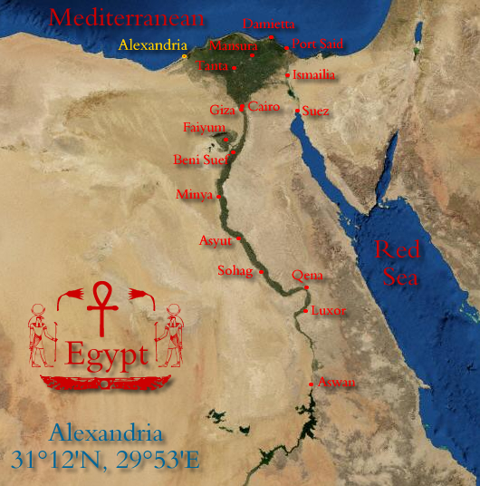
From about 620 BC to around the first century AD Egypt was mostly at peace.

Slide 18
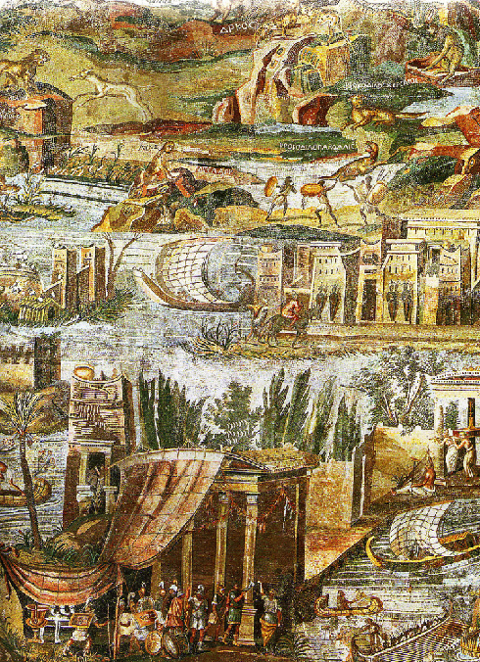
There were no walls around Thion-Heracleion and Canopus to protect their peoples from attack.

Slide 19
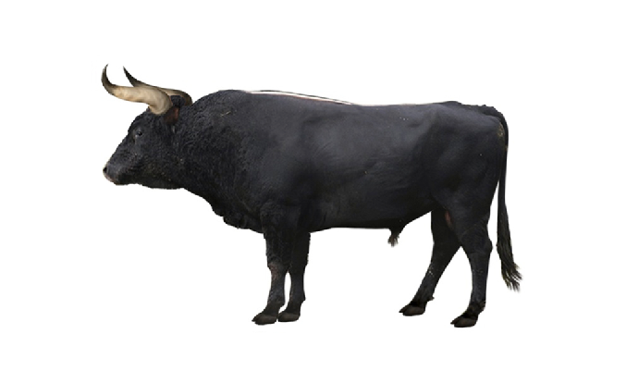
Must Farm people drove sharp, wooden stakes into the ground around the village. This stockade may have been to protect the village from human attackers, keep out wild animals or farmed animals (like sheep) in. Perhaps it was for all three.

Slide 20
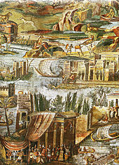
Egyptian and Greek people in Thion-Heracleion and Canopus travelled by boats, ships, carts and chariots.

Slide 21
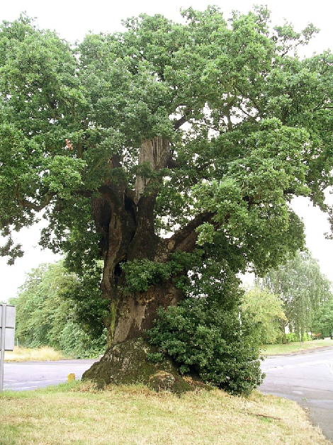
Must Farm people travelled in log boats on the water and could travel by wheeled carts on land.

Slide 22
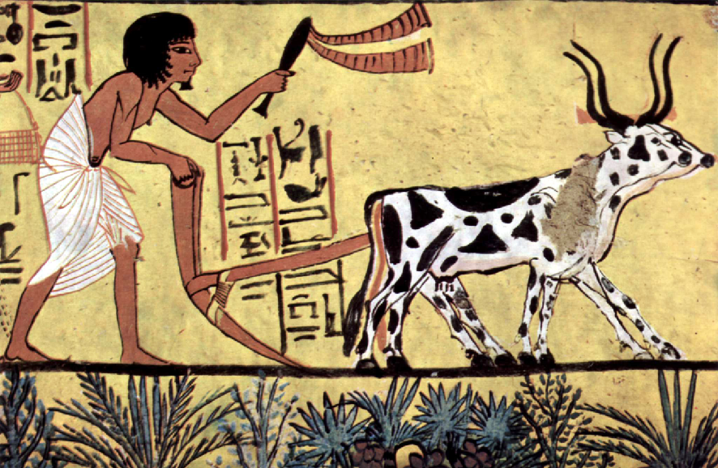
Egyptian farmers grew crops and kept animals outside Thion-Heraklion and Canopus.

Slide 23
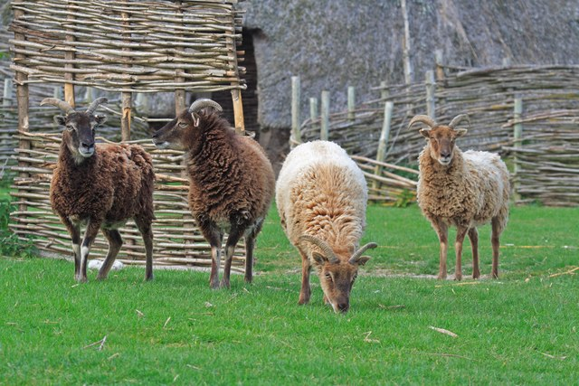
Must Farm people kept animals like sheep on solid land near to their homes. They ate lambs but did not make woolen clothes to wear or trade.

Slide 24
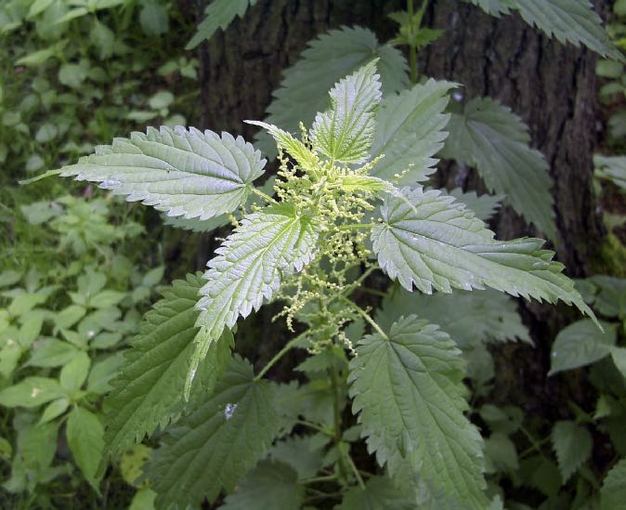
Must Farm people probably harvested some crops like nettles.

Slide 25
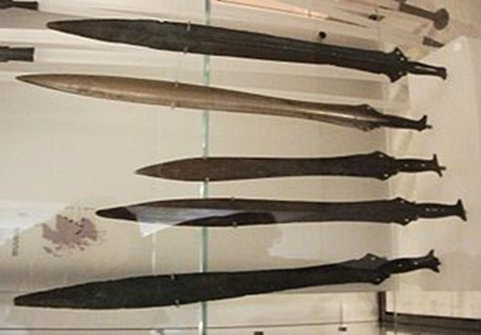
Must Farm people did not use money for trading.

Slide 26
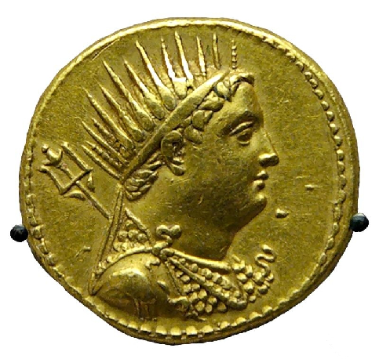
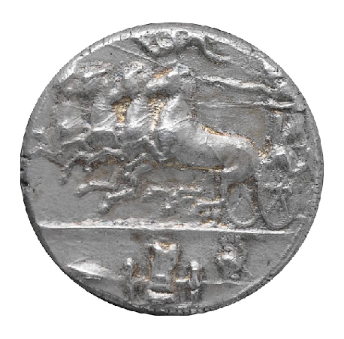
Egyptian and Greek people in Thion-Heracleion and Canopus paid for things with Egyptian and Greek money.

Slide 27
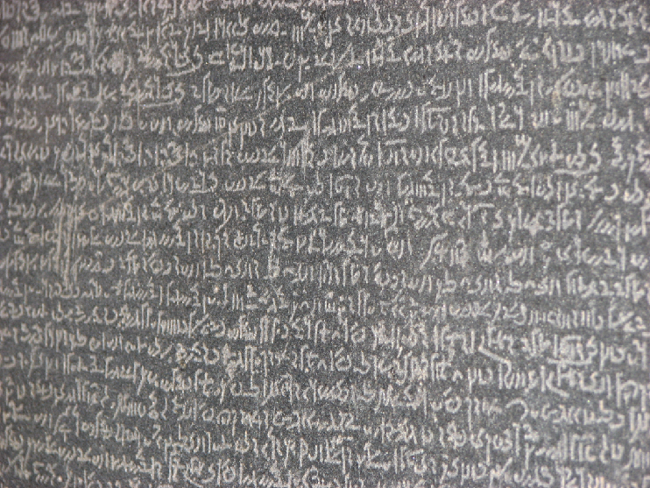
Some people in Thion-Heracleion and Canopus could write Egyptian hieroglyphics, every day Egyptian and in Greek.

Slide 28
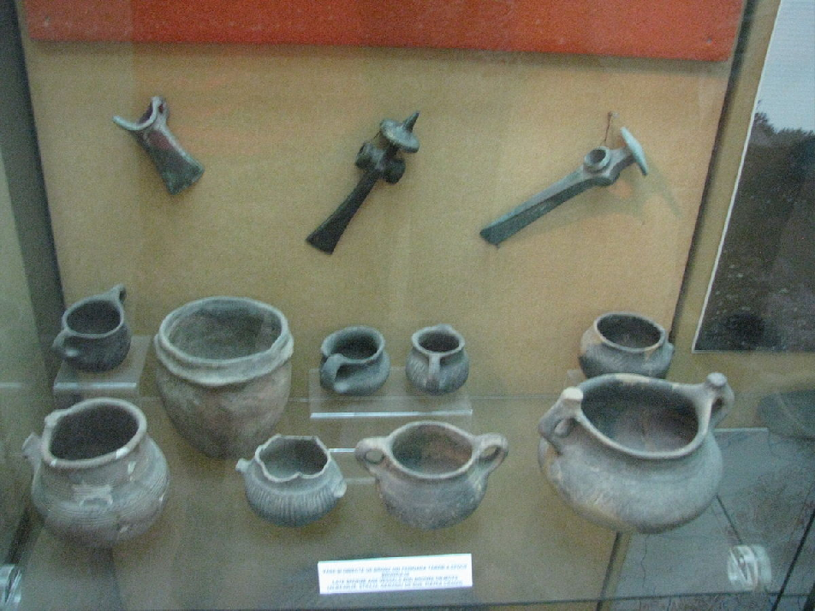
Must Farm people could not read or write.

Slide 29
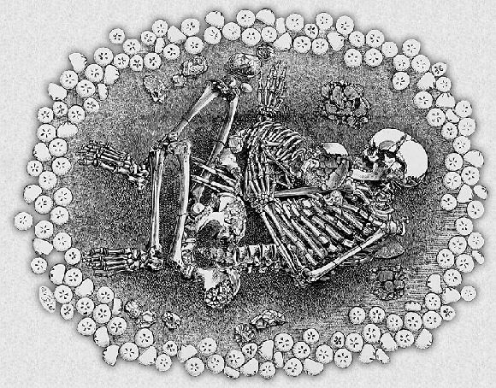
We cannot be sure how Must Farm people (or others in Bronze Age Britain) treated their dead. In some cases people were probably cremated (bodies were burned) and in other cases they appear to have been smoked over a fire to preserve them (a form of mummification) and then buried in a bog. Some were buried in simple graves.

Slide 30
Must Farm people used clay pots.

Slide 31
Must Farm people used a range of metals such as bronze. They may have seen or heard of gold. They did not have iron.

Slide 32
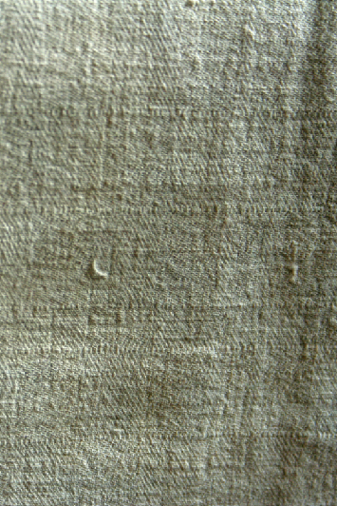
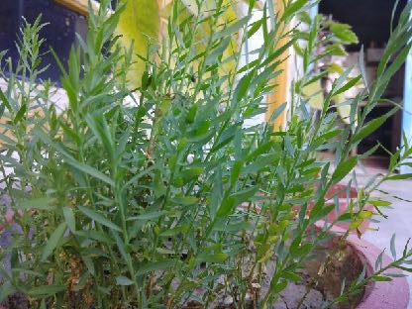
Egyptian and Greek people in Thion-Heracleion and Canopus largely wore clothes woven from linen which comes from flax plants farmers grew outside the cities..

Slide 33
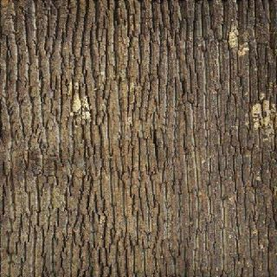
Must Farm people made and traded clothes woven from plant materials like fibres from the inside of poplar tree bark.

Slide 34
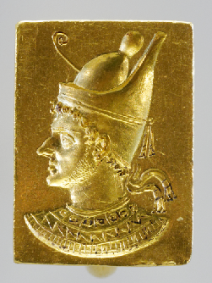
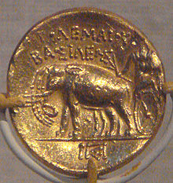
Egyptian and Greek people in Thion-Heracleion and Canopus used a range of objects made from iron, lead, bronze and tin. Valuable coins and special objects were made from gold.

Slide 35
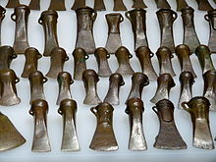
Must Farm people probably left certain objects in the reeds near their village or in the wooden causeway at Flag Fen. These may have been offerings to gods, spirits or the dead.

Slide 36
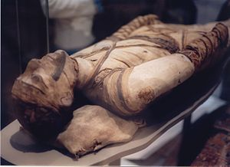
Egyptian people in Thion-Heracleion and Canopus mummified their dead.

Slide 37
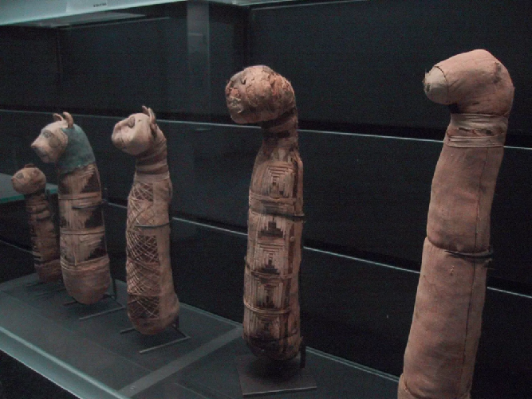
Egyptian and Greek people in Thion-Heracleion and Canopus mummified millions of sacred animals such as Ibis birds, cats, hawks, bulls etc and buried them in special cemeteries.

Slide 38
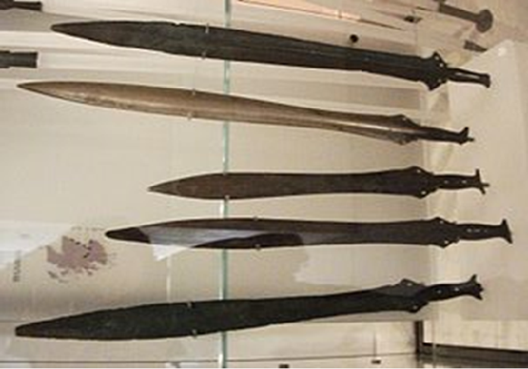
We do not know how the Must Farm people were ruled.

Slide 39
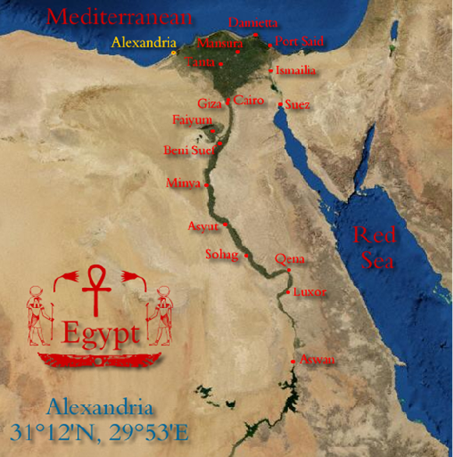
Thion-Heracleion and Cano- pus were part of the kingdom of Egypt.

Slide 40
Wild animals such as aurochs (wild cattle) roamed the Must Farm area.

Slide 41
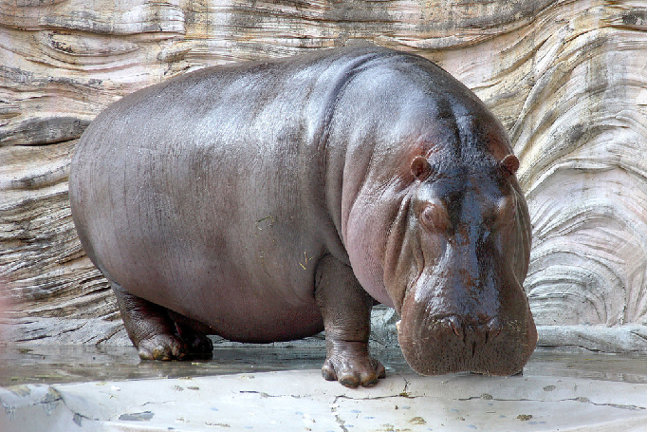
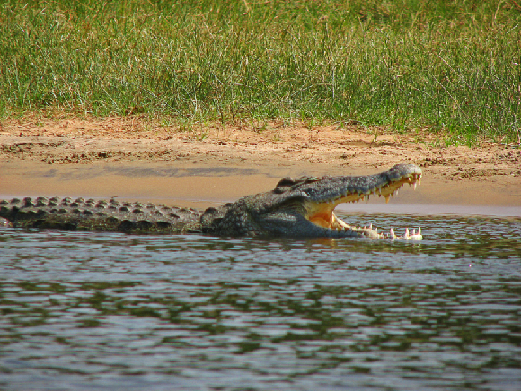
Wild animals like hippos and crocodiles roamed around the Thion-Heracleion and Canopus area.

Slide 42
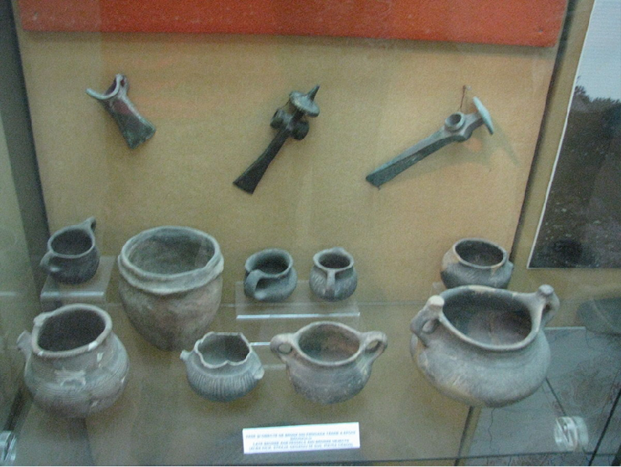
We do not know exactly how Must Farm people worshipped or what they believed in. There is no written record.

Slide 43
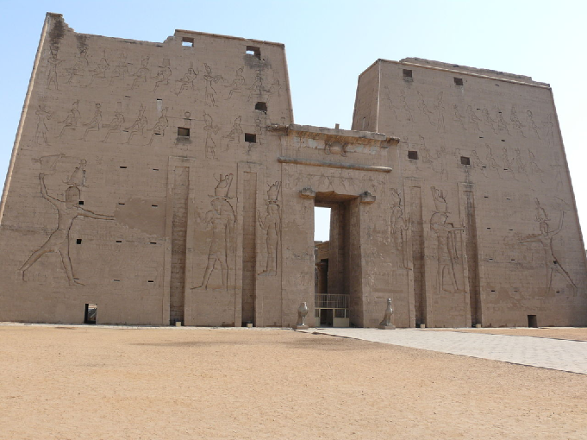
Egyptian and Greek people in Thion-Heracleion and Canopus worshipped in temples and made offerings to their gods. Sometimes they threw offerings in to rivers and waterways.

Slide 44
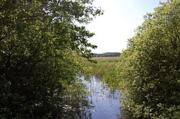
Must Farm people lived in a flat, watery landscape

Slide 45
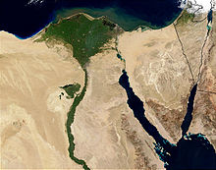
Egyptian and Greek people in Thion-Heraklion and Canopus lived in a flat, watery landscape (on the delta of the River Nile).

Slide 46
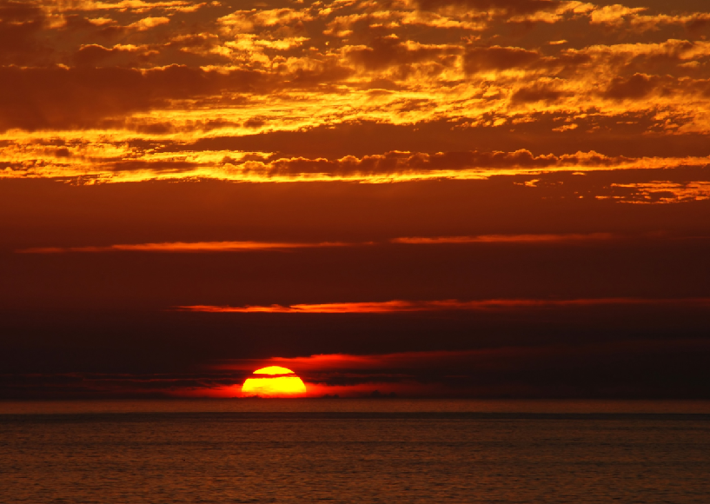
Egyptian and Greek people in Thion-Heracleion and Canopus lived in a hot, dry climate with little rain.

Slide 47
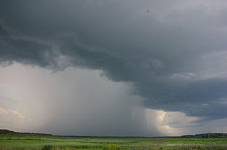
Must Farm people lived in a wet, cool climate with plenty of rain and harsh winters.

