Slide 1
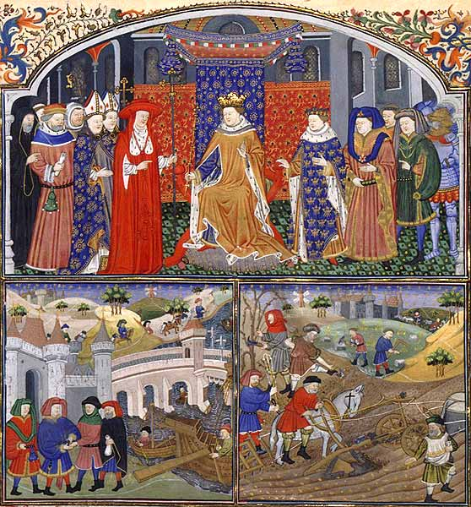
Les Regimes des Princes (Gilles de Rome)

Slide 3
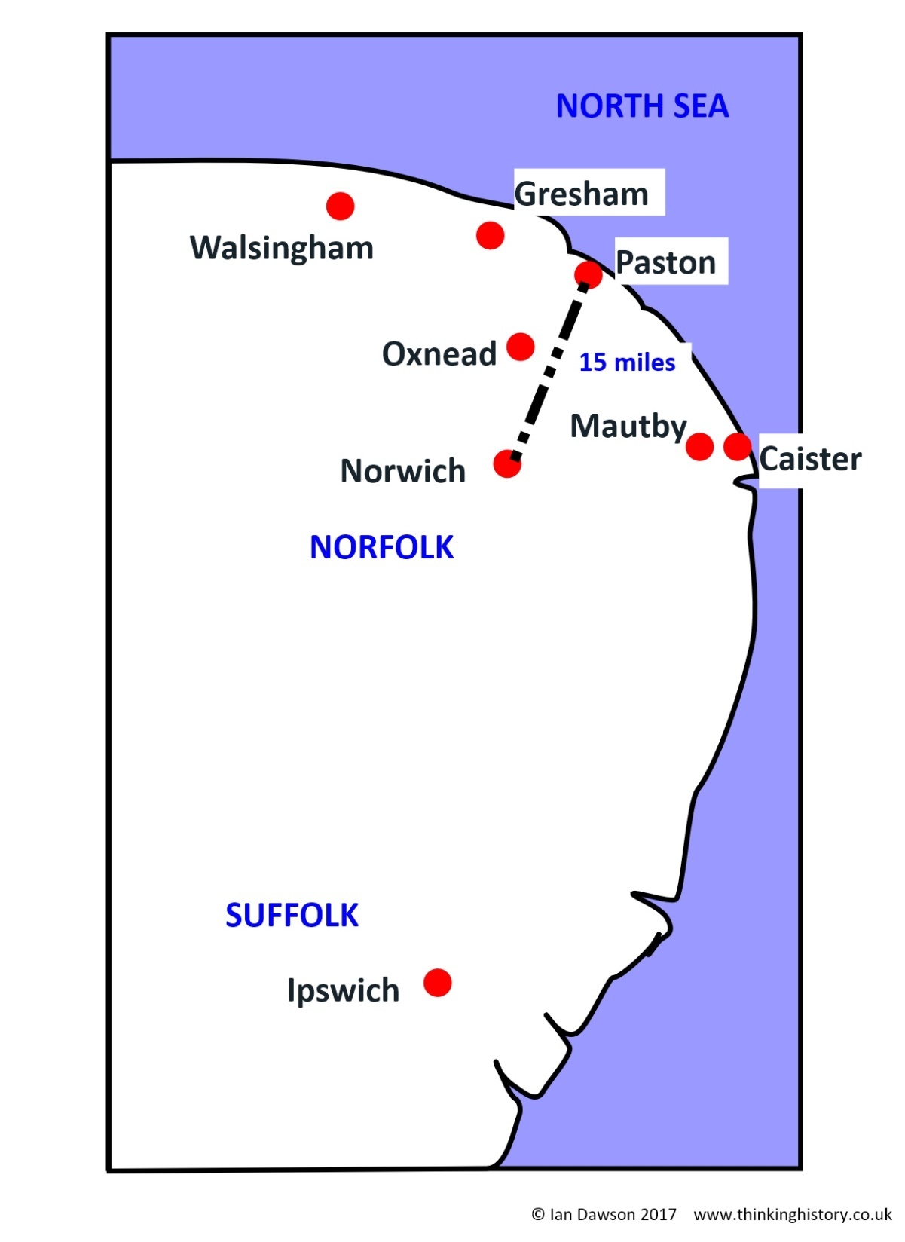
Norfolk and Suffolk

Slide 4
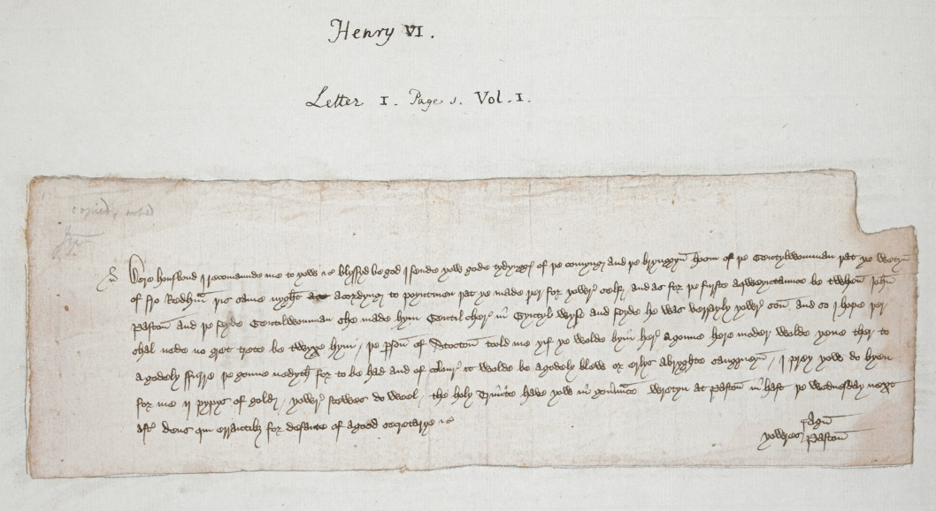
Agnes’ letter

