Slide 1
The Cold War
Notes:
http://hyperallergic.com/wp-content/uploads/2012/08/cold-war-graphics-640.jpg Due to copyright restrictions, the initial stimulus material has been removed. If you would like to include this, the cartoon can be found at the above address.

Slide 2
The Cold War
Welcome to this review lesson on the Cold War.
You have been placed in groups to work.
You will be given different cards during the lesson, which you will need to make a timeline.
Activity 1: Your first cards are the names of events. There are 26 events to place in the order in which they took place.
Notes:
The ‘aims’ column on the left has been left blank to suit your needs or match your school format. An idea for possible objectives has been included in the Teacher guidance notes. Include content as desired. The class should be separated into groups of four to six. It would be advisable to have mixed ability groups. Desks should be in long rows or have blank areas of the wall designated for students to use. They will need Blu tack if the wall is being used. Instructions for the students are on the PowerPoint. Teacher notes are on each slide and in the teacher notes.

Slide 3
The Cold War
Activity 2: The next set of cards are 26 dates to match the events you have already placed in chronological order.
You can reorder the events and dates at any time with the agreement of your group.

Slide 4
The Cold War
Activity 3: Your next set of cards are definitions to match the events and dates you have already placed in chronological order.
You can reorder the dates, events and definitions at any time with the agreement of your group.
Notes:
Individual dates or decades are provided, depending on the teacher’s judgement. The decades cards could be used before individual dates, or the decades cards could be a less intimidating activity.

Slide 5
The Cold War
You should now review the timeline. You can reorder the dates, events and definitions with the agreement of your group.
Activity 4: You have a created a timeline of events that were preselected for you. Your group task is to use the blank cards to write down three more events, with dates and brief definitions, that your group think should be included on a timeline of the Cold War.
Notes:
You may change the three events to any number you wish. Alternatively, to differentiate between groups, they can be given different numbers of events to add. On the blank cards, they should write the name and a description of the event. Once completed, each group should tell the class one event they have added and why they thought it should be on the timeline. More able students may be given a target, such as to include an event that did not directly involve the USA or USSR or an extra economic or social event.

Slide 6
The Cold War
Timeline checker
The following slides are for you to check the timeline content.
Notes:
This can be run through quickly, with students correcting if necessary. Their own choices are obviously not included and so will be the teacher’s own knowledge. There is a teacher’s timeline sheet to help, which does have more events on.

Slide 7
YALTA CONFERENCE, 1945
The ‘Big Three’ met to sort out what would happen to Europe after the end of WWII. Problems arose immediately about the control of Eastern Europe. Stalin did eventually agree to the principle of ‘free elections’ in Eastern Europe. Agreements were also made that divided Germany and Berlin into four sectors owned jointly by the major powers, Britain, France, the USA and the USSR.
Notes:
The slides can be used to simply check the order, or questioning on detail or significance can take place. There are 26 events so questioning on each slide is not recommended to keep the pace of the lesson moving and maintain student interest. Image ref: http://cdn.history.com/sites/2/2014/01/yalta_conference-A.jpeg

Slide 8
POTSDAM CONFERENCE, 1945
Roosevelt had died before this meeting and was replaced with Truman, and Churchill lost the election during this meeting and was replaced with Attlee. Stalin began to feel that he was not being shown the respect he deserved, especially by Truman, who attempted to intimidate Stalin with the news of the successful atomic bomb test in the USA.
Notes:
Compare the Yalta and Potsdam conference photos to show the different characters present. Image ref: https://upload.wikimedia.org/wikipedia/commons/thumb/a/af/Potsdam_conference_1945-8.jpg/220px-Potsdam_conference_1945-8.jpg

Slide 9
FIRST USE OF ATOMIC BOMBS, 1945
‘Little Boy’ bomb, dropped on Hiroshima on 6 August 1945, had a capacity of 12,500 tons of TNT – it killed 70,000 people within two seconds.
‘Fat Man’ bomb, dropped on Nagasaki on 9 August 1945, had a capacity of 25,000 tons of TNT – it killed 50,000 people within two seconds. Japan unconditionally surrendered on 14 August 1945.
Notes:
A link could be made to the Potsdam Conference. Image ref: http://historyconflicts.com/wp-content/uploads/2017/04/hiroshima-bombing-article-about-atomic-bomb.jpg

Slide 10
COMMUNIST CONTROL OF EASTERN EUROPE GROWS
1945–49
Albania (1945); Bulgaria (1945); Poland (1947); Hungary (1947); Romania (1945–1947); Czechoslovakia (1945–48); East Germany (1949) – Russia turned their zone of Germany into the German Democratic Republic in 1949.
Notes:
Image ref: https://cdn.thinglink.me/api/image/781948380866674690/1240/10/scaletowidth

Slide 11
KENNAN’S LONG TELEGRAM, 1946
An analysis of the foreign policy of the USSR and its possible future actions stated that the Soviet leadership were suspicious and aggressive and that there must be no compromises with the USSR. Only a hard-line approach would be effective in containing Communism. The analysis proved to be the basis for the Truman Doctrine.

Slide 12
TRUMAN DOCTRINE, 1947
The USA Pledged $400 million to help Greece and Turkey. Attempt to stave off Communism. First example of an active US policy to combat threat of Communism in Europe.
Notes:
Image ref: https://image.slidesharecdn.com/ppt16trumandoctrine-170326090817/95/cambridge-a2-history-truman-doctrine-1947-2-638.jpg?cb=1490519563

Slide 13
MARSHALL PLAN, 1948
The US pledged money to help countries that wished to stave off Communism. More than $13 billion was given to a vast number of European countries including Britain, France and West Germany. The USA made sure that all countries who took aid were now also major trading partners of the USA.
Notes:
Possible question: What is surprising about the chart? Image ref: http://wps.ablongman.com/wps/media/objects/1483/1518969/DIVI594.jpg

Slide 14
COMINFORM, 1948
An organisation that was set up to ‘co-ordinate’ Communist groups and parties across Europe.
Notes:
The cartoon content can be examined; for example, can students identify the main characters? Image ref: http://www.johndclare.net/images/rivalbuses.jpg

Slide 15
COMECON, 1949
Scheme to provide economic assistance to the countries of Eastern Europe.
Notes:
Image ref: http://farley-woodapush.wikispaces.com/file/view/Comecon.png/512874132/Comecon.png

Slide 16
NATO, 1949
An organisation to provide a more centrally co-ordinated approach to the threat of Communist expansion. This established military co-operation in the event of war, and included countries such as Britain, France, Canada and Belgium, as well as many smaller Western European nations.
Notes:
Cartoon analysis opportunity. What are the claimed aims of the cartoon? Can a link be made between previous events and the formation of NATO or is it a change in direction? Image ref: https://www.cvce.eu/content/publication/2010/10/27/a2c7ad45-f73d-465b-a14f-1de494733af6/publishable.jpg

Slide 17
USSR GET THE A-BOMB, 1949
The USSR secretly tested their first A-bomb a full six years earlier than the USA had expected them to. The radiation was detected, and thus the power balance of the Cold War had now dramatically been shifted.

Slide 18
McCARTHYISM, 1950
A hunt for the ‘Reds under the Beds’ took off in the USA. Fear of Communist sympathisers inside America grew.
Notes:
‘Is This Tomorrow: America Under Communism’: A propaganda comic book published in 1947. Cartoon analysis opportunity: Is the date of the cartoon important? Which groups are being attacked? Image ref: http://2.bp.blogspot.com/-1tRf6zcJkfw/VmzJOz-ec_I/AAAAAAAAF3k/B6Tia3cLuUI/s1600/A1.gif

Slide 19
NSC-68, 1950
In the light of the new nuclear threat of Communism, a strategy was developed that outlined the new direction that the USA’s foreign policy needed to take in order to contain Communism. This new direction would now focus on ‘rollback’, the view that Communism needed to be confronted and pushed back to safeguard the free world.
Notes:
Cartoon analysis opportunity: How does America see its role in the world? Which new geographical areas are evident and why? Image ref: http://amhistorycoldwarpropaganda.weebly.com/uploads/2/8/3/5/28359603/8533165.jpg?262

Slide 20
WARSAW PACT, 1955
An agreement that co-ordinated the defences of the Soviet Bloc under the control of the Soviet Union. Members were even more reliant upon the USSR for military aid in the event of internal or external attacks.
Notes:
This is only a map of Europe. Which other countries would be included on a world map? Image ref: http://media1.britannica.com/eb-media/02/174102-004-0DAE5271.jpg

Slide 21
KHRUSHCHEV’S ‘SECRET SPEECH’, 1956
A speech denouncing Stalinism and the cult of the individual. It pointed out in clear terms how dictatorial the regime of Stalin was, and exactly how he purged the Communist Party of any possible threats using illegal methods, including torture, in the late 1930s. The speech seemed to many to herald a new era in the Communist Party.

Slide 22
U-2 SPY PLANE SHOT DOWN, 1960
A significant political victory for Khrushchev, who was able to highlight the underhand methods used by the USA to gain information, this event was particularly important as it was just before the two powers were due to meet at a peace conference in Paris. Khrushchev was furious at the blatant rudeness and betrayal that the USA had shown, remarking, ‘Why shit where you are about to eat?!’ Khrushchev stormed out of the conference.
Notes:
Was Khrushchev correct to see the USA as deceitful? Image ref: https://npaphistory.wikispaces.com/file/view/u2_incident_headline.gif/104635049/u2_incident_headline.gif

Slide 23
BERLIN WALL, 1961
West Berlin had constantly been a thorn in the USSR’s side; they had lost millions of workers across the borders. Khrushchev intended to stop West Berlin from undermining the control and power of the USSR.
Notes:
How could the West use the photograph as a propaganda opportunity? Image ref: https://gerryco23.files.wordpress.com/2015/06/wall-jumper.jpg

Slide 24
TSAR BOMB, 1961
The largest nuclear weapon ever detonated, in a test over the Arctic Ocean. The 57-megaton bomb was thousands of times more powerful than the atomic bomb dropped on Hiroshima.
Notes:
Image ref: http://thestrategictimes.com/wp-content/uploads/2017/02/wp-1487861578143.jpg

Slide 25
CUBAN MISSILE CRISIS, 1962
The relationship between the USA and Cuba had deteriorated so much that they had looked to the USSR for help. In return for trade, the USSR was placing nuclear warheads and missiles on Cuba, only 60 miles away from mainland USA, meaning 90% of the USA was within range of the missiles that would take only five minutes to reach them.
Notes:
Image ref: http://jmartinezus2.weebly.com/uploads/1/6/4/0/16405758/917578.jpg

Slide 26
GULF OF TONKIN RESOLUTION, 1964
Congress passed a unanimous vote, followed by a virtually unanimous vote of 88–2, in the Senate, giving President Lyndon Johnson the authority to send American troops to Vietnam and to use ‘all necessary measures to repel armed attack’.
Notes:
Image ref: http://www.bluebird-electric.net/oceanography/ocean_pictures/Gulf_Tonkin_Vietnam_French_Indochina_Subdivisions_Maps.gif

Slide 27
THE PRAGUE SPRING, 1968
A period of political liberalisation in Czechoslovakia. It began on 5 January, when reformist Slovak Alexander Dubček came to power, and continued until 21 August, when the Soviet Union and members of its Warsaw Pact allies invaded the country to halt the reform.
Notes:
Image ref: http://extravaganzafreetour.com/wp-content/uploads/2016/08/prague-spring-01-1024x800.jpg

Slide 28
SALT I TREATY SIGNED (STRATEGIC ARMS LIMITATIONS TALKS), 1972
After two and a half years of negotiation, the first round of discussion was brought to a conclusion when President Nixon and General Secretary Brezhnev signed the ABM Treaty and the Interim Agreement.
Notes:
Use the question on the slide to discuss Salt I. Image ref: https://image.slidesharecdn.com/6-detente-120203020605-phpapp01/95/6-detente-8-728.jpg?cb=1328235630

Slide 29
INVASION OF AFGHANISTAN, 1979
This country was seen by Moscow as an important buffer state. Soviet troops were sent in to support the government against the Islamic Mujahedeen. America put a ban on the export of grain to Russia, ended the SALT talks taking place then and boycotted the Olympic Games due to be held in Moscow in 1980.
Notes:
Were the protesters right in their claim? Image ref: https://i.pinimg.com/originals/75/f7/4e/75f74e2c7b4ac65a67bd15dd917d1fad.jpg

Slide 30
EASTERN EUROPE CHANGES DIRECTION, 1989
Poland, Hungary, Czechoslavakia,
Romania, Bulgaria and Albania all rejected communism as a political system.
Notes:
What is happening in the photograph? Image ref: https://joshuaziefle.files.wordpress.com/2014/11/leninstatue1.jpg

Slide 31
MALTA SUMMIT, 1989
Gorbachev and Bush established a good working relationship. No new agreements were made, but both leaders declared that the Cold War was over.
Notes:
Assess the importance of the Malta Summit. Image ref: http://2.bp.blogspot.com/-vgsmZG8c_90/VQObDnUv0YI/AAAAAAAAR2M/BSso7kQE25A/s1600/1989%2BBush-Gorbachev%2BFall%2Bof%2Bthe%2Biron%2Bcurtain%2BGold%2BCoin.jpg

Slide 32
COMMUNISM IN EUROPE FALLS, 1991
With the Eastern Bloc becoming more independent, the Soviet empire itself began to crumble. On 8 December, the Soviet Union ceased to exist.
Notes:
Image ref: https://philoforchange.files.wordpress.com/2014/10/failcom3.jpg

Slide 33
The Cold War
Activity 5: The next two sets of cards have the leaders of the USA and USSR during the Cold War period. Place them on the timeline in the correct sequence.

Slide 34
WARNING! Leaders slides follow

Slide 35
Presidents of the USA
Harry Truman | 1945–1953
Dwight D Eisenhower | 1953–1961
John F Kennedy | 1961–1963
Lyndon B Johnson | 1963–1969
Richard Nixon | 1969–1974
Gerald Ford | 1974–1977
Jimmy Carter | 1977–1981
Ronald Reagan | 1981–1989
George Bush | 1989–1993

Slide 36
Leaders of the USSR
Joseph Stalin | 1928–1953
Georgy Malenkov | 1953–1955
Nikita Khrushchev | 1955–1964
Leonid Brezhnev | 1964–1982
Yuri Andropov | 1982–1984
Konstantin Chernenko | 1984–1985
Mikhail Gorbachev | 1985–1991

Slide 37
The Cold War
Activity 6
Each group should discuss the events together and select one that they consider to be the most significant event of the Cold War.
A spokesperson from each group will explain why they have chosen their event.
Notes:
The class could vote on the most convincing argument. See notes on significance in the teacher guidance.

Slide 38
The Cold War: Historical interpretations
Activity 7
The interpretation cards are the titles of different schools of historical interpretation.
There are four cards and they should be placed roughly within the time period they cover.
Now add the description cards that describe the main ideas of each of the four groups of historians. Match them to the school of thought already added.
Your final set of cards has historians’ names, and these need to be placed with the matching description cards.
Notes:
The historians’ names are for more able and advanced groups. The next slide has the historians, so do not show the students at this point.

Slide 39
Historical Interpretations
Traditional/Orthodox – 1950s–early 1960s
Key historians – George Kennan, Herbert Feis, Thomas A Bailey
Revisionist – 1960s–mid-1980s
Key historians – William A Williams, Walter LaFeber, Gar Alperovitz, Joyce and Gabriel Kolko
Post-revisionist – 1980s
Key historians – John Lewis Gaddis, Thomas G Paterson, Ernest May
Contemporary/Post-1991 – 1990s onward
Key historians – Eduard Mark, Tony Smith
Notes:
To confirm whether students have the correctly matching descriptions, ask individual groups to give one description and the name of that particular viewpoint.

Slide 40
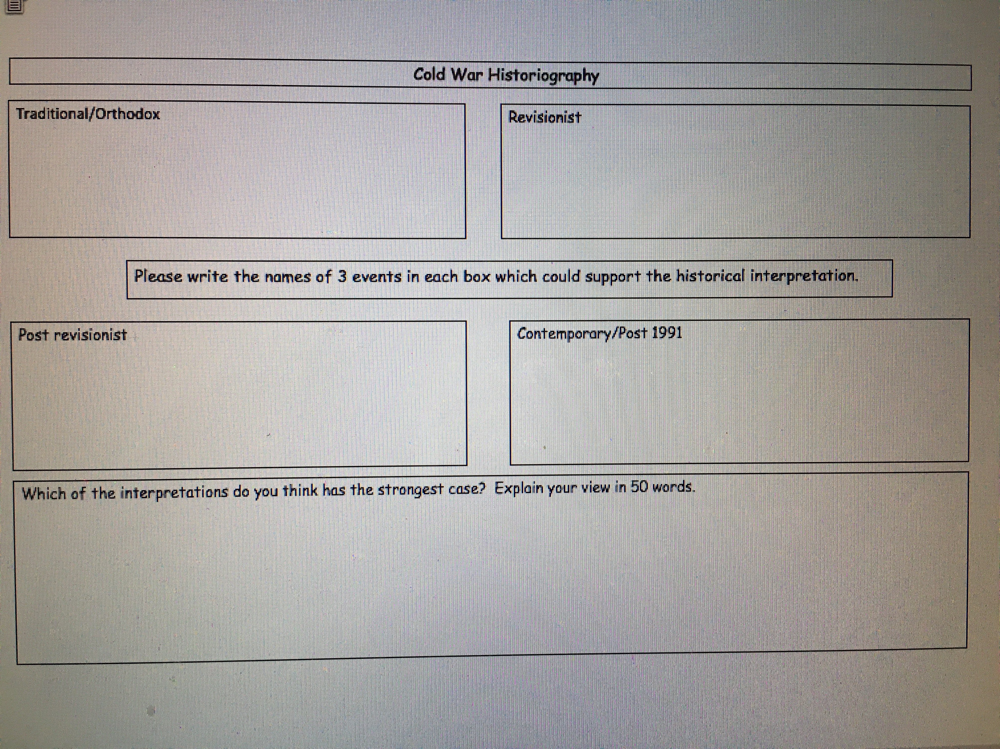
The Cold War
Activity 8: Using the Historiography sheet provided, write down three events in each box that could support the historical interpretation in a debate. Use the timeline to help – this is not a memory test.
Notes:
Using the completed timelines, students complete the boxes. They can feed back to the class or, in pairs, compare and discuss their responses. The explanation box could be used as am extension activity

Slide 41
The Cold War
Activity 9: On the Cold War interpretations chart, you are going to analyse an interpretation of the cause of the Cold War.
There are prompts on the sheet to help you.
You can use the timeline and the historiography sheet too.
You can also add any other information you feel is relevant.
The sheet will become a plan for you to answer the question at the top of the interpretations chart.
Notes:
The students are now ready to collect information to use in the exam question on the A3 sheet. The sheet will lead them to focus on the areas they will receive most marks for. They can use the resources from the lesson to help complete the preparation sheet. This can be completed individually or in pairs. The students can move on to answer the question as a full written question or leave it as a plan. There are two different sheets – one question from the OCR website and a different one if the students have already used the OCR example. Both can be marked using the same mark scheme.

Slide 42
The Cold War
Using the Cold War interpretations chart, write an answer to the question set in the title.
You have …….. minutes to complete the question.
Remember to consider SPaG.
Notes:
This final slide can be deleted if the exam question is not to be answered and has been left as a plan.

