Slide 1
Session 3: Representation
Who had the power?

Slide 2
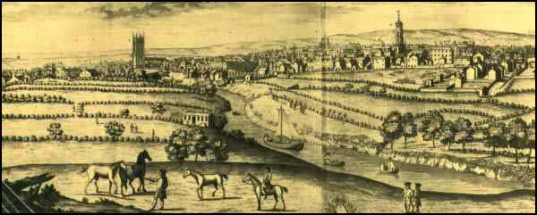
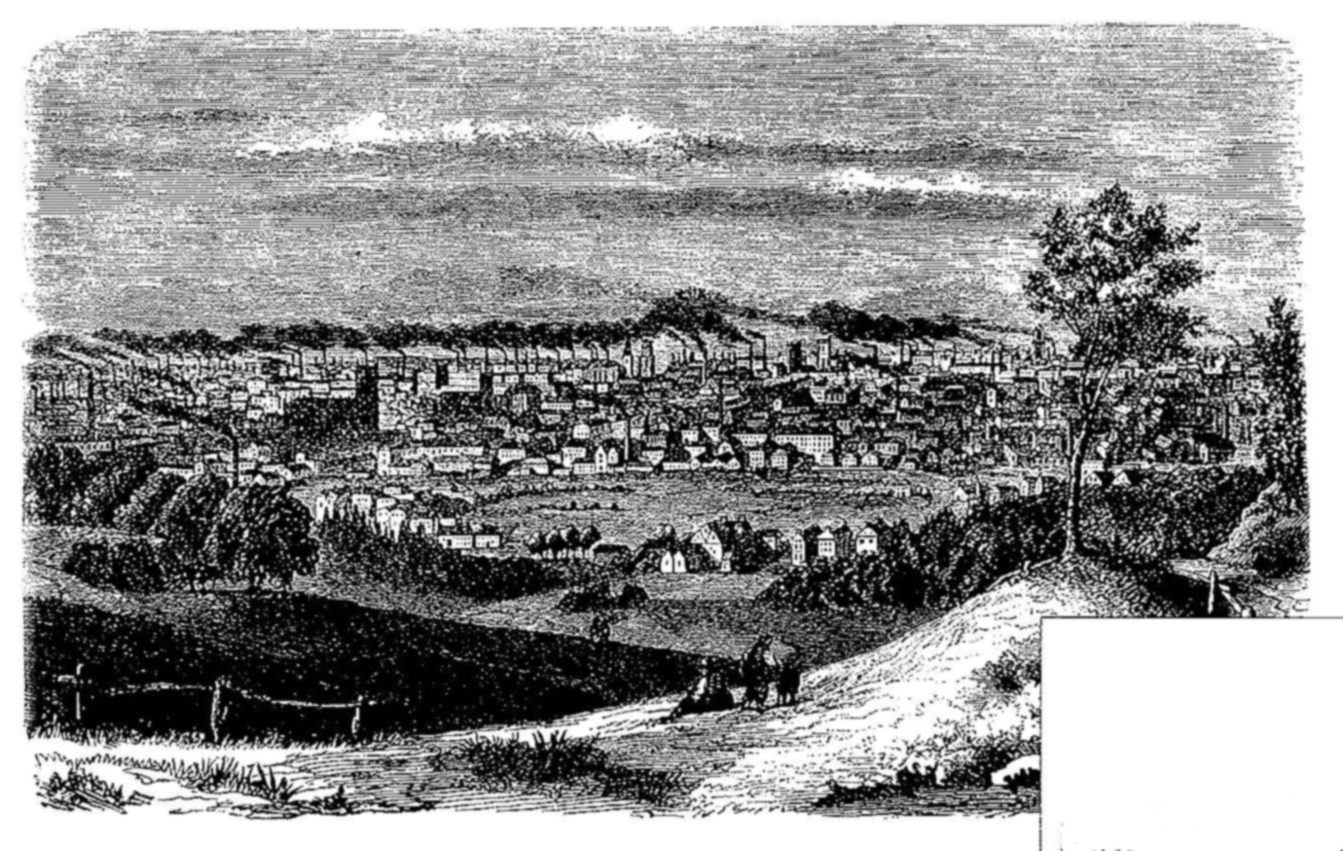
PAIRS: Spot the difference
1750
http://spartacus-educational.com/ITmanchester.htm
1850
http://grimshaworigin.org/grimshaw-involvement-in-the-industrial-revolution/manchester-the-first-industrial-city

Slide 3
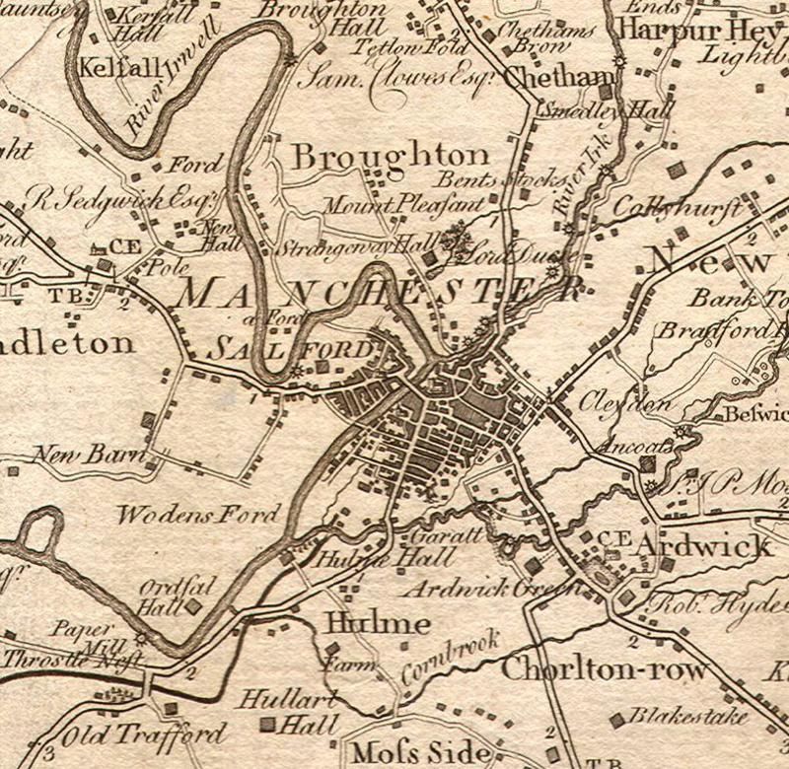
How and why did Manchester change?
HISTORY DETECTIVE: Highlight interesting information to show what it was like for ordinary working people.
https://www.manlitphil.ac.uk/events/early-maps-real-lancashire-and-their-makers
Manchester became the obvious place to build textile factories. Large warehouses were also built to store and display the spun yarn and finished cloth. The town's population grew rapidly. With neighbouring Salford, Manchester had about 25,000 inhabitants in 1772. By 1800 the population had grown to 95,000. The rich manufacturers built large houses around the Mosley Street area. At first the cheap housing for the factory workers were confined to New Cross and Newtown. However, as the population grew, close-packed houses were built next to factories all over Manchester. Spartacus Education
EXTENSION: Research Manchester: localhistories.com

Slide 4
How were the people represented?
HISTORY NOTE:
In the 17th century, ‘war’ broke out between king and Parliament, ending in the ‘Glorious Revolution’ of 1688. This established a constitutional monarchy, which is a ‘king-controlled-by-parliament’.
Throughout the Georgian period the political rights of ordinary men and women were extremely limited. Only those men with substantial property or wealth were entitled to vote – a tiny fraction of the population. Many Members of Parliament were elected to represent ‘rotten boroughs’ – these were boroughs in which just a handful of voters enjoyed totally disproportionate representation in Parliament. Many large towns such as Manchester, on the other hand, which were expanding quickly as a result of migration and industrialisation, had no representation at Westminster at all until the passing of the first Reform Act in 1832. (Matthew White)
HISTORY DETECTIVE: Using the quoted information, work out who was allowed to vote in 1800 and who wasn’t.

Slide 5
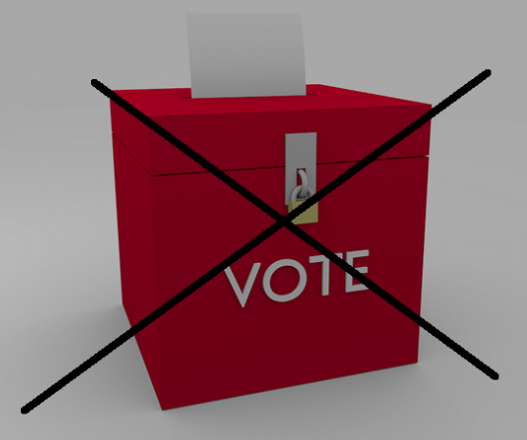
Who gets to vote in the 1800s?
HISTORY DETECTIVE:
Complete this phrase, which means that everyone can vote:
UNIVERSAL S__________ .
Role play

Slide 6
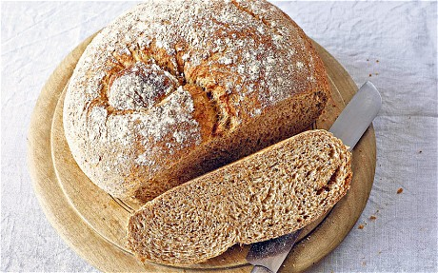
Georgian working-class people
Bread, beer and cheese or fatty bacon

Slide 7
What was the problem with the ‘Corn Laws’?
http://www.irows.ucr.edu/cd/appendices/asr00/asr00app.htm

Slide 8
The Corn Laws – bread
Bread was made from corn and was the most common food for working people.
The British farmers did not want the value of their corn to go down. High price = more profit.
A tax was charged on corn imported from other countries, so no cheap corn.
The government restricted the amount of corn that could be imported into Britain, keeping the price high.
How do you think poor people reacted?

Slide 9
How do these impact ordinary people?

Slide 10
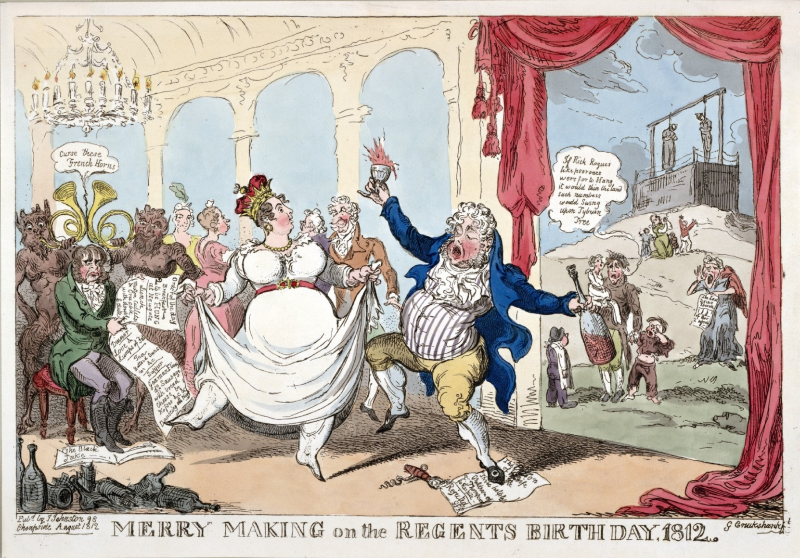
PAIRS: What differences between rich and poor can you discover?
https://www.loc.gov/item/2003689159/

Slide 11
TASK
Choose a person from the role play and stick it in your book.
Write around your character what their life is like.
Draw a thought bubble describing what they think about voting/not voting and the ‘Corn Laws’.
https://www.independent.co.uk/news/uk/home-news/refugee-week-the-huguenots-count-among-the-most-successful-of-britains-immigrants-10330066.html

