Slide 1
Session 6: Ripples through time
Why and how should we remember Peterloo?
What is the legacy of Peterloo?

Slide 2
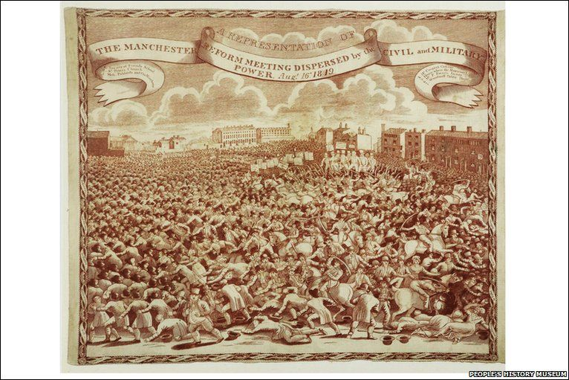
How is Peterloo remembered?
https://phm.org.uk/collections-display/?irn=5392

Slide 3
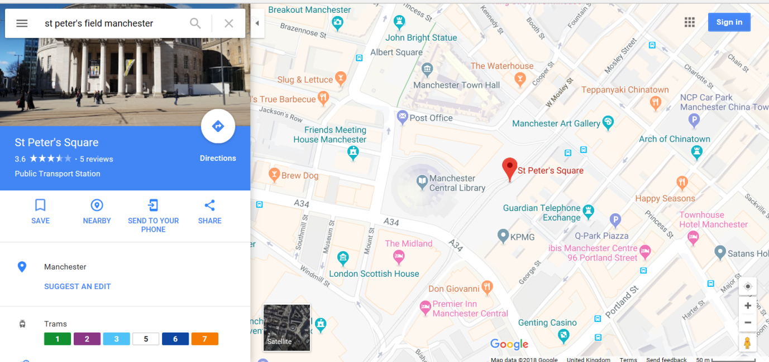
Find the memorial
PAIRS: Use the street view to look for a memorial that commemorates the Peterloo Massacre

Slide 4
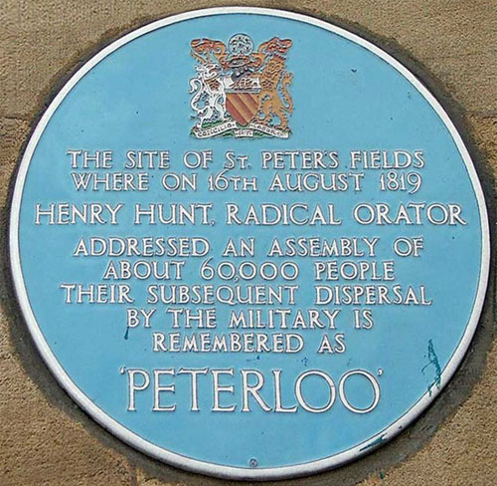
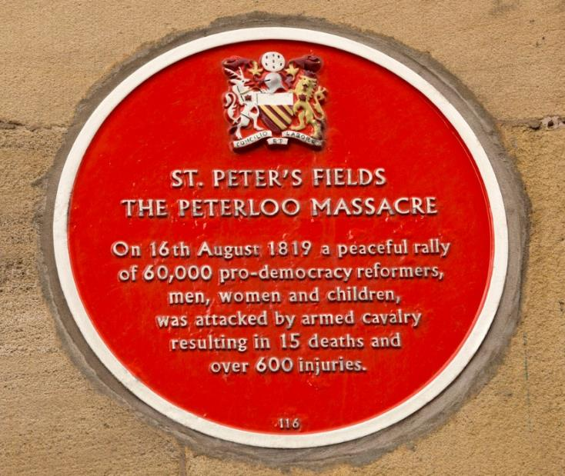
PAIRS: The Blue Plaque was replaced by the Red Plaque in 2007.
Why?
http://www.peterloomassacre.org/blue-plaque.html

Slide 5
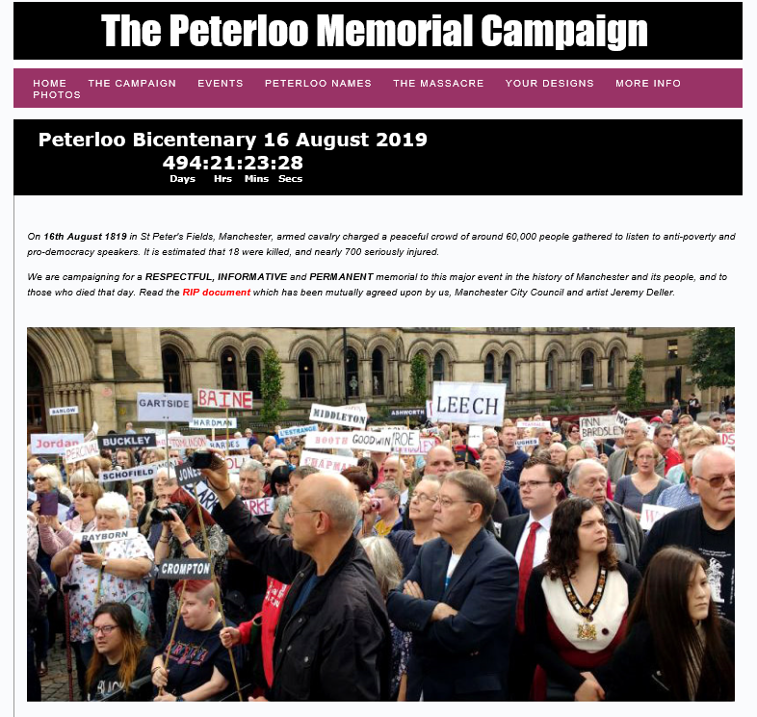
http://www.peterloomassacre.org/

Slide 6
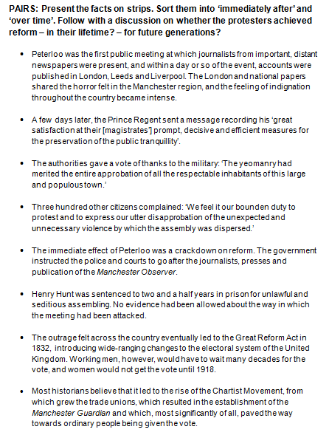
LEGACY STATEMENTS
PAIRS: Present the facts on strips. Sort them into ‘immediately after’ and ‘over time’.
DISCUSSION: Did the protesters achieve reform – in their lifetime? – for future generations?

Slide 7

TASK: Design a memorial
Design a memorial for the Peterloo Massacre.
Write a short speech for the unveiling, explaining your design.
http://news.bbc.co.uk/local/manchester/hi/people_and_places/history/newsid_8198000/8198410.stm
A proposed design by George Cruickshank at the time

Slide 8
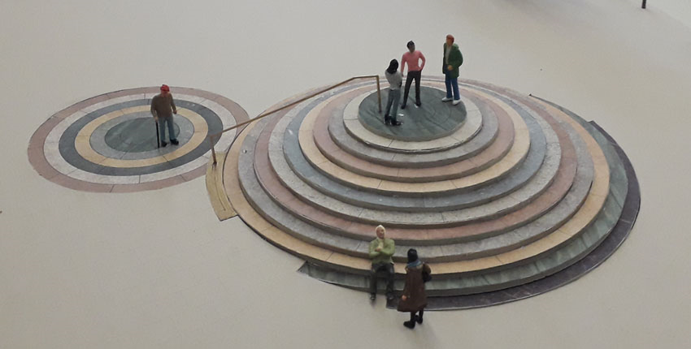
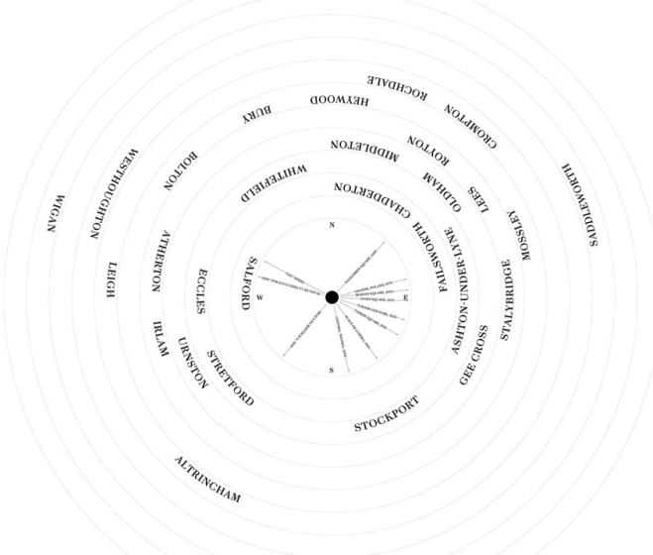
http://www.peterloomassacre.org/design7.html
Peterloo Memorial 2019
How do the two proposed designs differ? How are they different to your design? What does that tell us about society 200 years ago and society today?

Slide 9
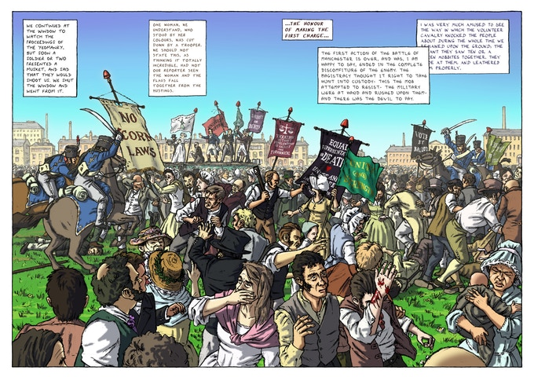
Graphic novel
https://peterloo.org/

Slide 10
Reflection: Do you agree?
According to Nick Mansfield, director of the People’s History Museum in Manchester,
‘Peterloo is a critical event not only because of the number of people killed and injured, but because ultimately it changed public opinion to influence the extension of the right to vote and give us the democracy we enjoy today. It was critical to our freedoms.’

