Slide 1
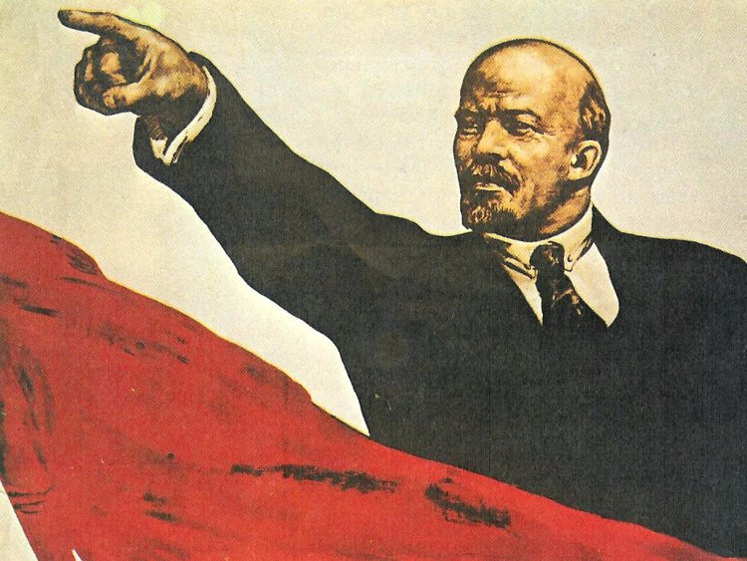
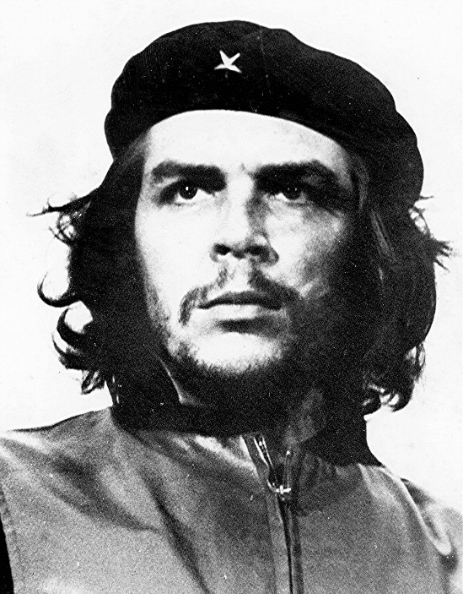
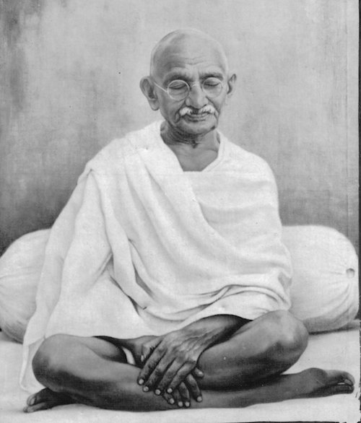
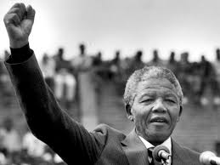
Discuss: Who are these people?

Slide 2
Discuss: What about now?
Russia
Cuba
South Africa
India

Slide 3
Lenin
Che Guevara
Nelson Mandela
Gandhi

Slide 4
Discuss: What links these people?
Lenin
Che Guevara
Nelson Mandela
Gandhi

Slide 5
What links these people?
A cause
An ideology
A clear message
Prepared to use violence
Use of propaganda
Desire for change
(Sometimes their carefully chosen image and clothes)
30 seconds: Is there a word for people like this?

Slide 6
These people were REVOLUTIONARIES.
They were all following in the footsteps of people before them who had been successful at carrying out revolutions.
From the eighteenth century, there was a clear template for how to lead a revolution. But this had to start somewhere…
Lenin
Che Guevara
Nelson Mandela
Gandhi

Slide 7
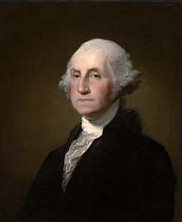
Lenin
Che Guevara
With this in mind: WHO IS HE?
Nelson Mandela
Gandhi

Slide 8
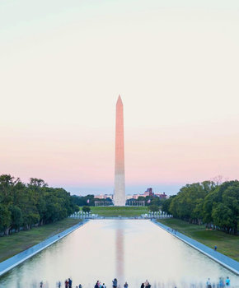
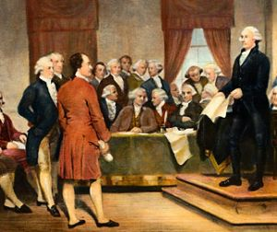
George Washington (1732–1799)
Born in the USA, during British rule.
A successful soldier in the state of Virginia.
Found himself leading the rebels looking to overthrow British rule in America.
Became the first President of the USA.
Along with some other young men, became known as one of the ‘FOUNDING FATHERS’.
And, unlike the revolutionaries we just looked at, they were making it up as they went along…

Slide 9
Would the Founding Fathers have considered themselves ‘revolutionaries’?
As we begin a short sequence of lessons looking at a time when a series of revolutions changed the world, we ask:
A twentieth-century revolutionary:
A cause
An ideology
A clear message
Prepared to use violence
Use of propaganda
Desire for change
(Sometimes their carefully chosen image and clothes)
The Founding Fathers:
?

Slide 10
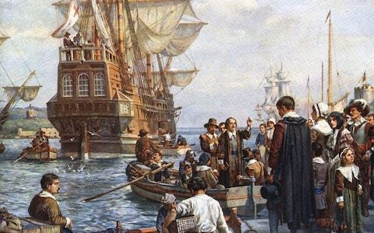
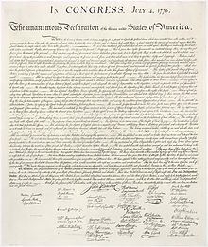
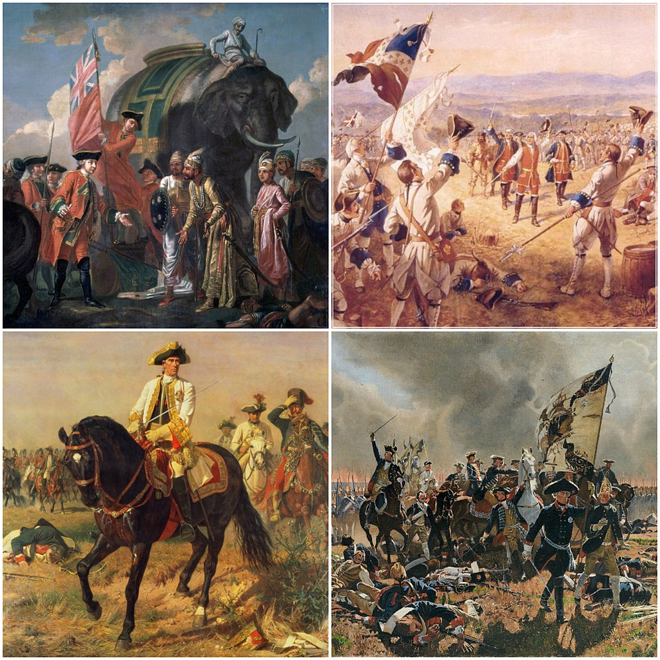
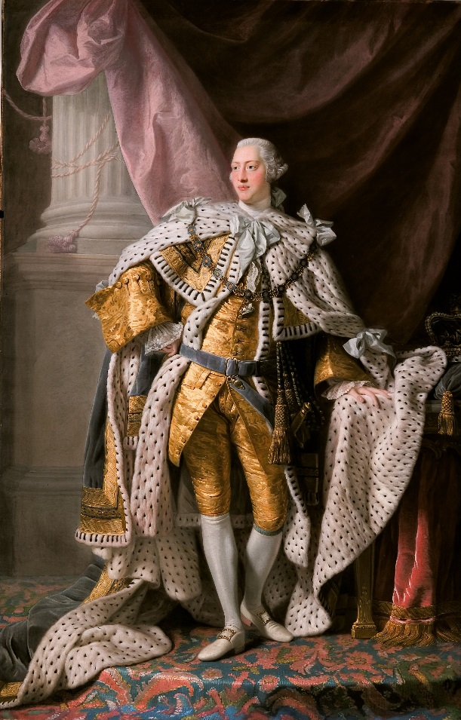
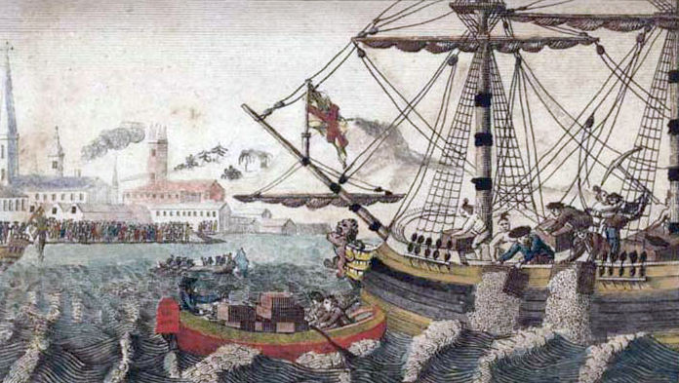
What happened in the Thirteen Colonies of the USA between 1620 and 1776?
Reading the information sheet together… be ready for questions!

Slide 11
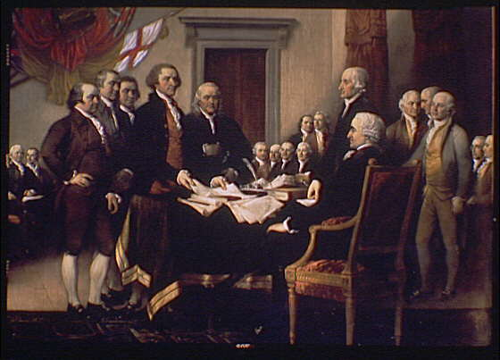
Who were the people involved in starting the American Revolution and how revolutionary were they?
Benjamin Franklin
John Adams
Thomas Jefferson
Roger Sherman
Robert Livingstone
George Washington
You have got six character cards . Five are the men who drew up the Declaration of Independence in 1776. One is George Washington, who was Commander-in-Chief of the army.
You are about to be asked some big questions about them – write the initials of each Founding Father where you think they should go on each spectrum.

Slide 12
When did they decide this was a revolution for independence?
As early as the Seven Years’ War in 1763
Still sceptical in 1776

Slide 13
How loyal to Britain had each Founding Father been in the past?
Try to use terminology: Loyalist – someone from North America at this time who was loyal to the British crown and British rule
Patriot – someone from North America at this time who wanted to break free from British rule
Always distrusted the British rule
Fiercely loyal, saw themselves as British

Slide 14
How revolutionary was each Founding Father against our criteria?
Revolutionary!
A cause
An ideology
A clear message
Prepared to use violence
Use of propaganda
Desire for change
(Sometimes their carefully chosen image and clothes)
Not revolutionary as we understand the term

Slide 15
Time to discuss the BIG question.
Would the Founding Fathers have considered themselves ‘revolutionaries’?
Revolutionary!
A cause
An ideology
A clear message
Prepared to use violence
Use of propaganda
Desire for change
(Sometimes their carefully chosen image and clothes)
Not revolutionary as we understand the term

Slide 16
For next time…
Watch an 11-minute video on the American Revolution.
Type into YouTube: The American Revolution: Crash Course World History
Note that it is fast-paced and you will need to regularly pause it.
Your task is to write down ten interesting things about the American Revolution that we have not covered in this lesson.

