Slide 1
Before you get your books and homework out, what would you argue were the most significant events during the American Revolution (1756–1790) and why?
1.
2.
3.

Slide 2
Get your timelines out
As we know, the American revolutionaries were largely making it up as they went along. They were also not acting alone, as they were supported by the French during their revolution.
In 1789, the French, having seen what happened in America, had their own revolution, which begs the question…
1763
1776
1787
1790
1789
1799

Slide 3
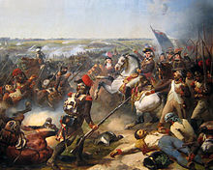
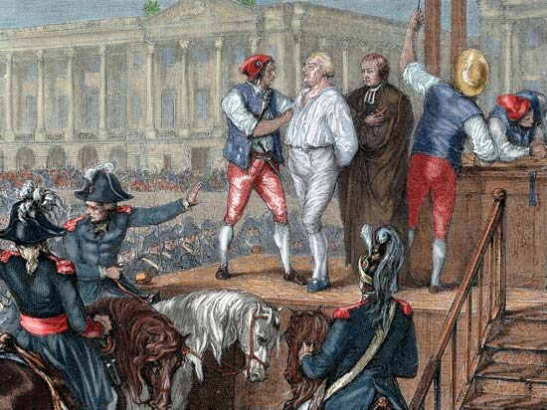
How similar was the French Revolution to the American Revolution?

Slide 4
What happened in France between 1789 and 1799?
Reading the information sheet together… be ready for questions!
However, this time you need to add key information to your timelines as we go (we will stop as we go so that you have time).

Slide 5
Using your timelines
Start by highlighting any moment or event when people in either revolution argued about the point of their revolution…
1763
1776
1787
1790
1763
1789
1799

Slide 6
Using your timelines
With this complexity in mind, it is time to start identifying similarities and differences between the revolutions so that we can answer the big question: How similar was the French Revolution to the American Revolution?
1763
1776
1787
1790
1763
1789
1799

Slide 7
Similarities between the revolutions | Differences between the revolutions

Slide 8
Similarities between the revolutions | Differences between the revolutions
Part of the new Enlightenment thinking. Concerned about liberty. Led by an unrepresented majority. Led by men (often young). The aim of the revolution was contested. A monarchy was removed. A new constitution was introduced. The new constitution was reluctantly introduced. Some people who had been strongly in favour of the revolution became concerned about the direction it was taking. The 1756–63 Seven Years’ War had been influential in causing the revolution – partly through tax increases. At crucial moments, the monarch showed poor decision-making. At some point, both countries fought against the British. | The French were inspired by the American Revolution. There was far more violence in France. The king was executed in France. Slavery in the USA was not made illegal. The French Revolution ended with an unelected leader, while the American Revolution ended with an elected president. The Americans had to borrow money and soldiers from abroad in order to emerge victorious. The French Revolution took place in Europe, so more major powers were concerned.

Slide 9
How similar was the French Revolution to the American Revolution?
Time to discuss the BIG question.
They were two completely different and distinct revolutions
They were incredibly similar revolutions
(And what does this tell you about revolution in the Age of Revolution?)

