Slide 1
Starter:
So far we have learned about the American and French Revolutions.
Can you come up with five words/phrases that you associate with the word ‘revolution’ during this period.
Revolution meant ____________
Revolution meant ____________
Revolution meant ____________
Revolution meant ____________
Revolution meant ____________

Slide 2
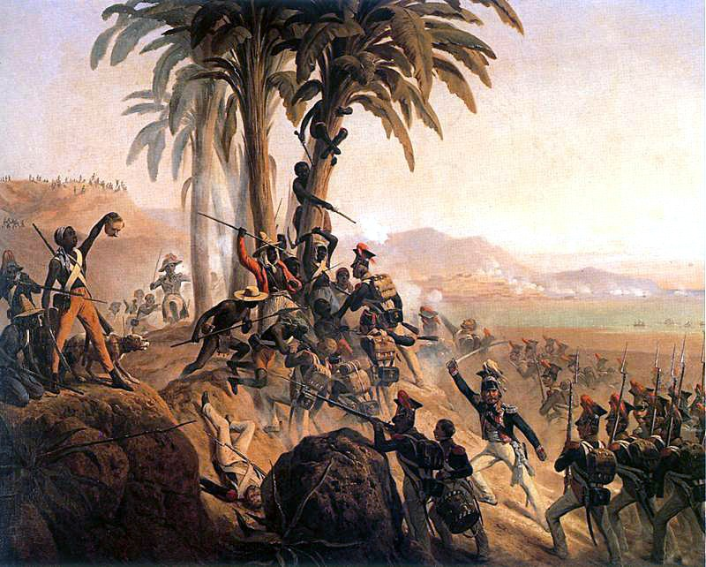
How far was the Haitian Revolution a completely different revolution?
Even if you have started to get your head around what ‘revolution’ meant in the Age of Revolution, we are going to look a very different one today: a revolution led by slaves…

Slide 3
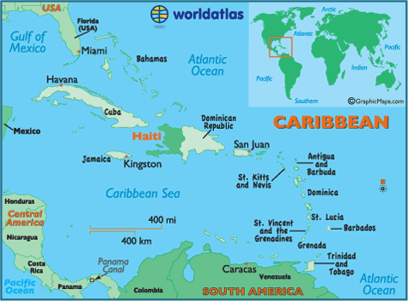
Haiti was known as Saint-Domingue before 1800 (although we will call it Haiti today).
Haiti was a French colony.
Haiti made lots and lots of money for the French because there was lots of SUGAR, which European countries wanted desperately.
Between 1791 and 1804, there was a revolution in Haiti, which removed French rule forever.
Haitians had been inspired by the American and French Revolutions, but it was also very, very different.

Slide 4
What happened during the Haitian Revolution?
Reading the information sheet together… be ready for questions!

Slide 5
Your task:
a. Copy this Venn diagram into your books (take up a whole page).
b. Categorise the different statements according to whether they applied to each revolution.
For instance, if the statement was:
25. The revolution did not happen in Europe.
… you would write ‘25’ in the space between Haitian and American Revolution.
Haitian Revolution
French Revolution
American Revolution

Slide 6
The initial rebellion was led by an unrepresented majority
The rebellion was led by slaves
There were racial divides within the country
A new constitution was introduced
The aims of the rebels changed as the ‘revolution’ developed
The revolution was led by someone who would consider themselves a ‘revolutionary’
At times the fighting was brutal and indiscriminate
There were many deaths after the revolution had finished
Independence was declared
A monarchy was overthrown and the monarch executed
The British were heavily involved
The Spanish were involved
The rebels were inspired by Enlightenment ideas
The rebels showed hypocrisy about slavery within their revolution
The revolution was heavily inspired by another revolution
At some point a foreign power sent troops to help the rebels
There were massive disputes about the direction of the revolution among the rebels
The rebels had initially been angry about taxes (to either increase the king’s finances or pay off the Seven Years’ War)
A some point a ruler with dictatorial powers was put in place
There is a lasting legacy to this day
The leaders of the revolution that we have studied were mainly men
There was no real template for what a ‘revolutionary’ was
If you finish… try to come up with different characteristics about at least one of the revolutions.

Slide 7
French Revolution
Haitian Revolution
2, 3, 6, 8, 12
10
7, 15, 19
1, 4, 5, 11, 13, 18, 20, 21
14, 17
9, 16
22
American Revolution

Slide 8
How far was the Haitian Revolution a completely different revolution?
Time to discuss the BIG question.
The Haitian Revolution was actually pretty similar to the other revolutions.
The Haitian Revolution was a completely different revolution.
(And what does this tell you about revolution in the Age of Revolution?)

