Slide 1
How did the British view revolution during the Age of Revolution?
With the person next to you, discuss and justify the best word to put in the gap.
The American Revolution was _______________ for the British.
The French Revolution was _______________ for the British.
The Haitian Revolution was _______________ for the British.

Slide 2
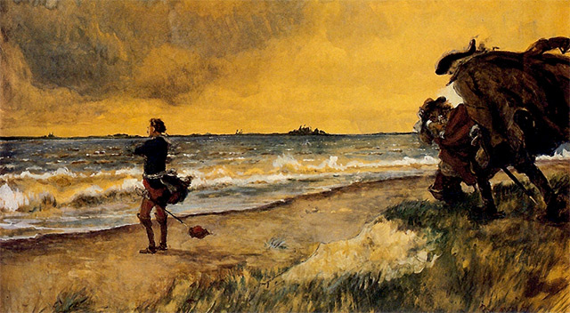
We have learned that the British fought overseas during all three revolutions:
In America, the British Army fought George Washington’s Continental Army to keep the Thirteen Colonies in the Empire.
In France, the British army fought in the Revolutionary Wars (later called the Napoleonic Wars).
In Haiti, the British army were sent to try to seize the colony for themselves.
By 1800, Britain had been unsuccessful in all three.
However, as the British looked out over the seas to where the Age of Revolution was fought, the ideas and politics had a deep and lasting impact on Britain.

Slide 3
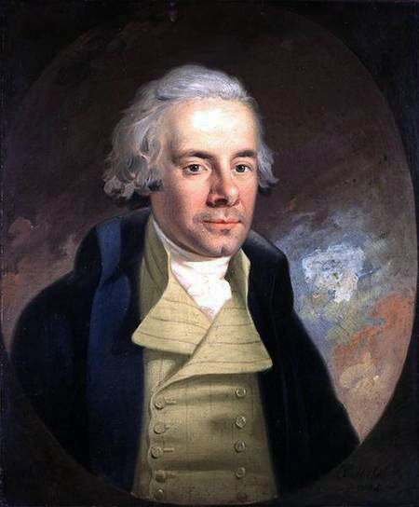
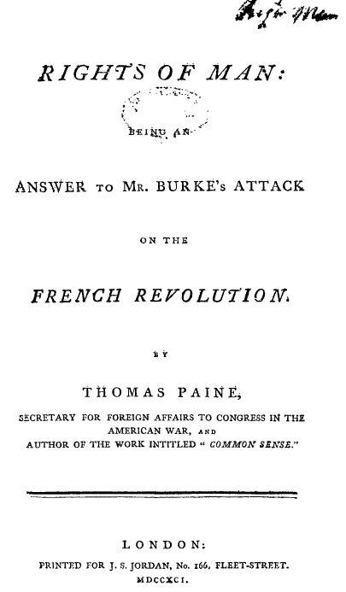
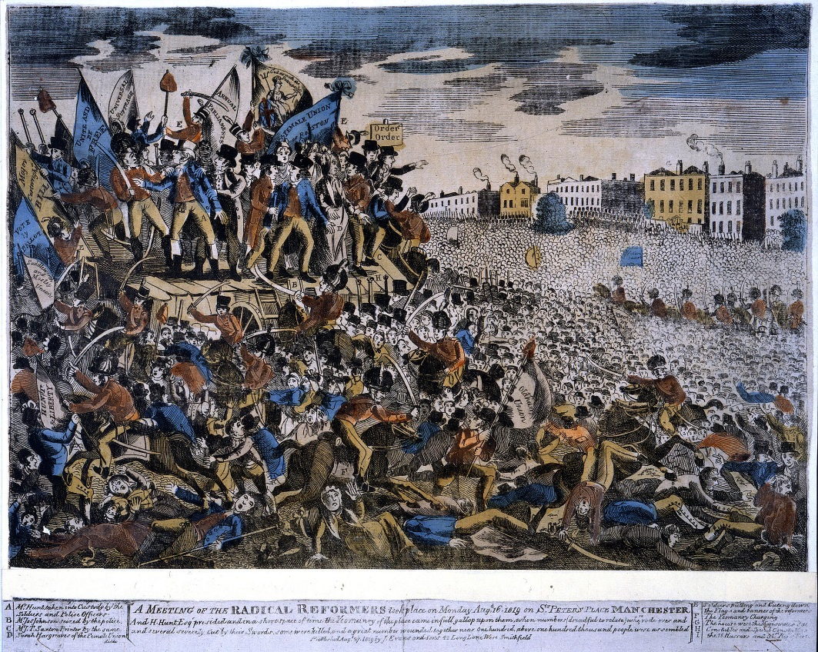
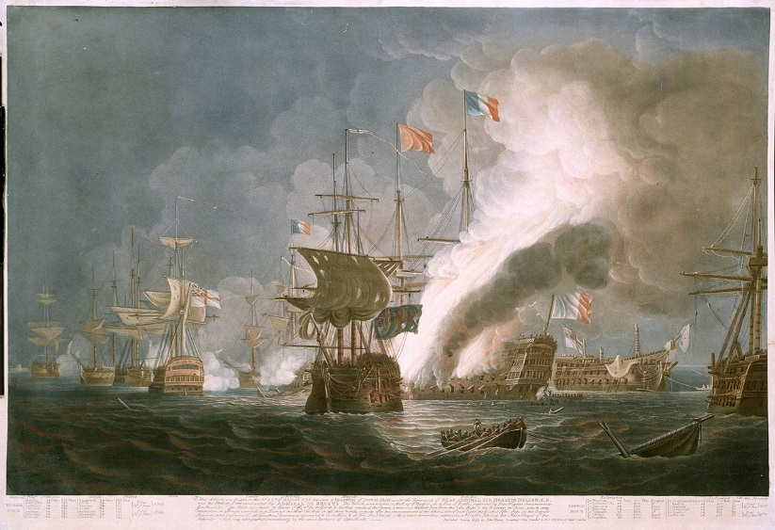
What was happening in Britain during the Age of Revolution?
Reading the information sheet together… be ready for questions!

Slide 4
Scenario figures
In order to consider the changing nature of British reactions to ‘revolution’ during the Age of Revolution, you are going to be given a British person in a specific year. Your task is to:
Decide what would have been the most pressing issue on their mind at that time.
Explain what ‘revolution’ meant to them at that moment.

Slide 5
King George III in 1793 Most pressing concern from around the world: At this moment, to them ‘revolution’ was: | Member of Parliament who had been inspired by the Enlightenment in 1792 Most pressing concern from around the world: At this moment, to them ‘revolution’ was: | A working-class person who had recently moved to a city to work in a factory in 1789 Most pressing concern from around the world: At this moment, to them ‘revolution’ was:
A British soldier who had volunteered to fight in the Revolutionary Wars in 1798 Most pressing concern from around the world: At this moment, to them ‘revolution’ was: | William Wilberforce in 1801 Most pressing concern from around the world: At this moment, to them ‘revolution’ was: | A radical factory worker in 1794 Most pressing concern from around the world: At this moment, to them ‘revolution’ was:
William Pitt the Younger, British Prime Minister, in 1803 Most pressing concern from around the world: At this moment, to them ‘revolution’ was: | King George III in 1776 Most pressing concern from around the world: At this moment, to them ‘revolution’ was: | A middle-class person reading about the failure of the British army in Haiti in 1799 Most pressing concern from around the world: At this moment, to them ‘revolution’ was:

Slide 6
How did the British view revolution during the Age of Revolution?
Next lesson, you are going to answer the question: What did ‘revolution’ mean in the Age of Revolution?
In order to begin to think about using rich, contested knowledge in a complex way, finish this sentence (we dare you to embrace the complexity!):
‘To the British, ‘revolution’ during the Age of Revolution meant ____________________________________________________________________________________________________________________________’

Slide 7
Homework
Next lesson, you will answer the BIG question without notes:
What did ‘revolution’ mean in the Age of Revolution?
In order to think historically about this, you will need to be secure about the chronology, key events and people involved.
Spend your homework time revising and thinking about what ‘revolution’ meant at this time.

