Slide 1
HA Resource Hub Submission Form
Resource Title: What was the impact of the Norman Conquest on England?
Age Range: Year 10 (GCSE)
Author name and email contact: Sally Burnham Salburnham@yahoo.co.uk
Resource Details: 2x PPTs
Necessary prior learning to complete this:
Students should have studied the Battle of Hastings and how the Normans established control. It is based on the OCR B SHP course.
What does it lead to next?
Exam question on the impact of the Conquest.
Explanation: How should this resource be used?
Students need access to a textbook – the pages here are from the OCR B SHP textbook but teachers could easily use the pages in their own textbook.
For the Domesday Book work you might want to change the weblink to your local Domesday Book records.
Students work through the PPT following instructions, answering questions and finally completing the essay question.

Slide 2
What was the Impact of the Norman Conquest on England by 1087?
You need to use chapter 5 from the SHP Norman Conquest book alongside this powerpoint.
Notes:
Write the title in your book.

Slide 3

Simon Schama says… Read Simon Schama’s interpretation – what is he arguing? Sum up in your book his main argument.
‘Historians like a quiet life, and usually they get it. For the most part, history moves at a deliberate pace, working its changes subtly and incrementally. Nations and their institutions harden into shape or crumble away like sediment carried by the flow of a sluggish river. But there are moments when history is unsubtle; when changes arrives in a violent rush, decisive, bloody, traumatic; as a truck-load of trouble, wiping out everything that gives a culture its bearings – custom, language, law and loyalty. 1066 was one of those moments.’

Slide 4
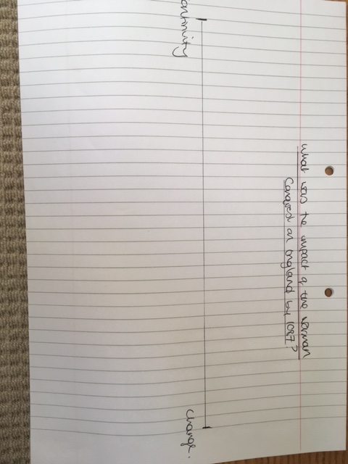
We are going to investigate the impact of the Norman conquest on England
Take a clean page and draw a change continuity line across the page. As you look at each section you are going to put them onto the change/continuity line.
Land ownership
Farming
Ordinary people
Names
Towns
Taxes
Markets
Coins
Laws
Language
Church

Slide 5
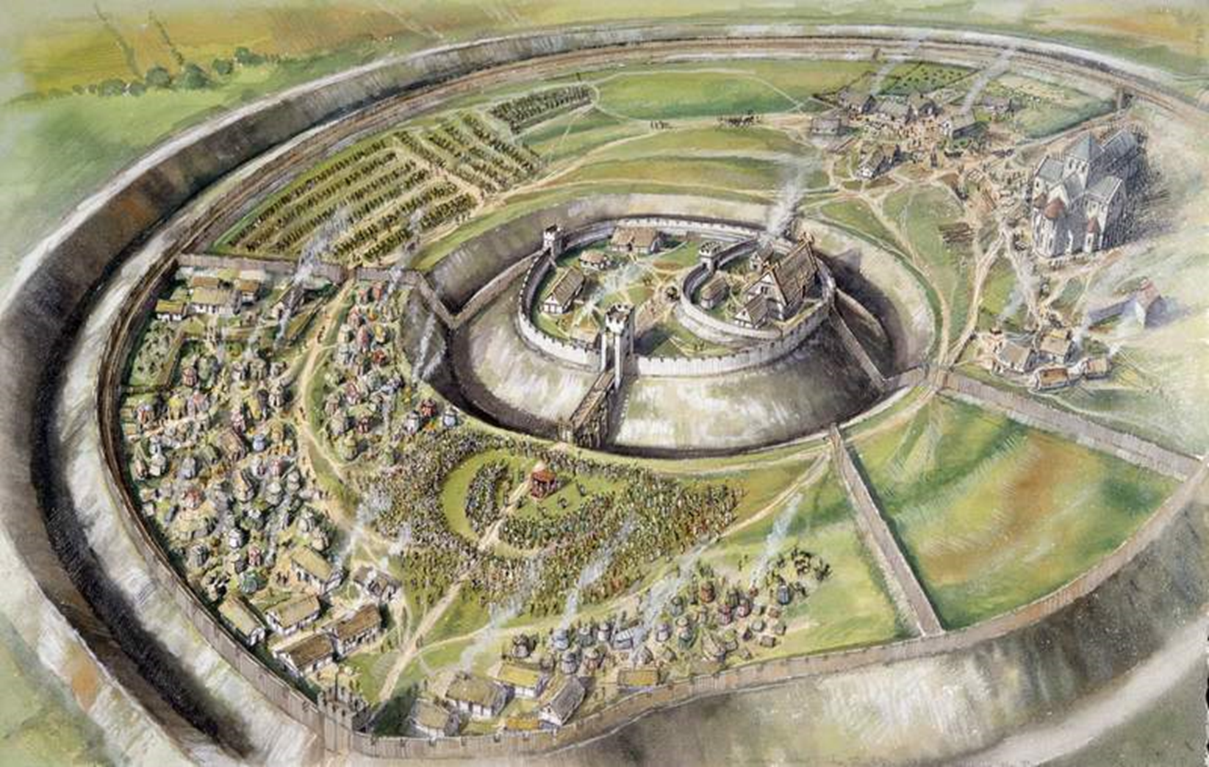
Old Sarum

Slide 6
Old Sarum
Read p 80-81
Write a side heading Old Sarum
Write a summary that could go with this image to explain what happened at Old Sarum.
Write a side heading William’s Death
Write a summary of how William died.

Slide 7
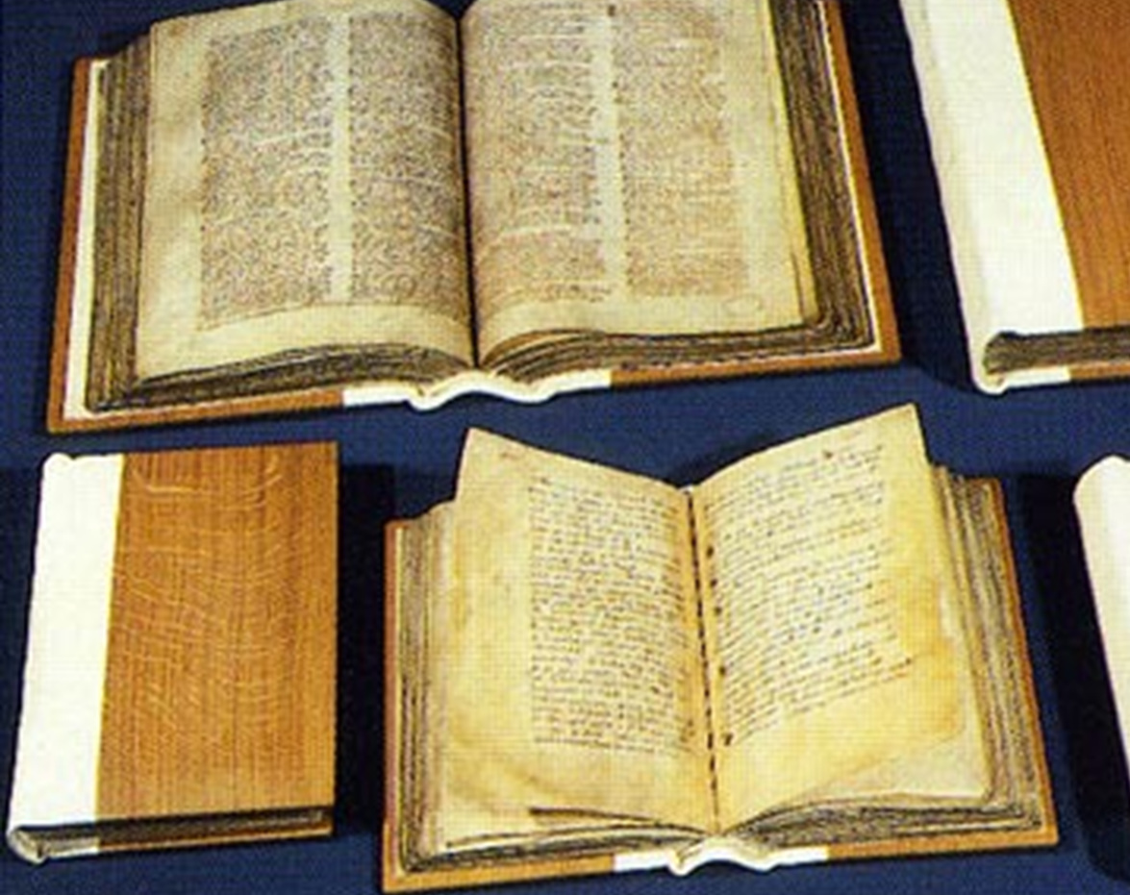
The Domesday Book
Notes:
Write the title The Domesday Book in your book.

Slide 8
The Domesday Book
Read p82-83
Answer the following questions in your book in full sentences:
Why is the name Domesday Book misleading?
How was the survey carried out?
What sort of questions were asked?
What were ‘inquests’ and why were they needed?

Slide 9

What was the Domesday Book really for?
Listen to the explanation and then write a paragraph explaining how interpretations have changed about the purpose of the Domesday Book.

Slide 10
Landownership
Write Losing the Land as a title.
Read p 86-87
Answer the following two questions in full sentences.
How had landownership changed in England by 1086?
What does the case study of Alan Rufus tell us about the new Norman landowner

Slide 11
What about landownership in our area?
Click on this link
https://opendomesday.org/place/TF0646/new-and-old-sleaford/
1. Who owned the land in 1066? Who owned the land in 1086?
2. Look at other local villages – how does land ownership change?
3. If you look carefully at the entries you see that William didn’t give the same Norman landlord lots of land in one area (Edward had landowners with huge areas of land in a region) instead he gave them land scattered across the country. Why do you think this was?

Slide 12
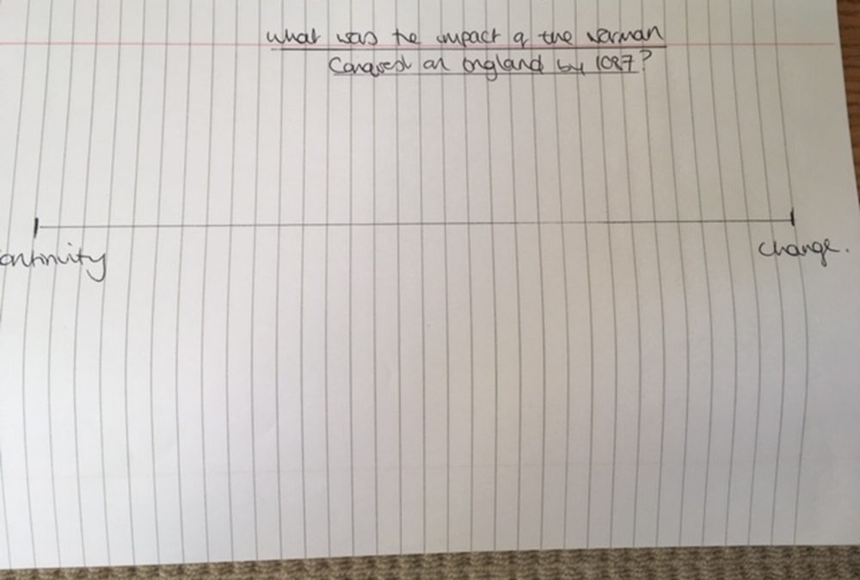
Landownership – change or continuity?
Go to your change and continuity line in your book. Put landownership on your line with a sentence to justify why you have put it there.

Slide 13
Farming, towns, markets and taxes
Read p88-89
Answer the following questions:
How did life change for English peasants between 1066 and 1086?
Did the Norman Conquest improve life in English towns?
Did taxation change?

Slide 14
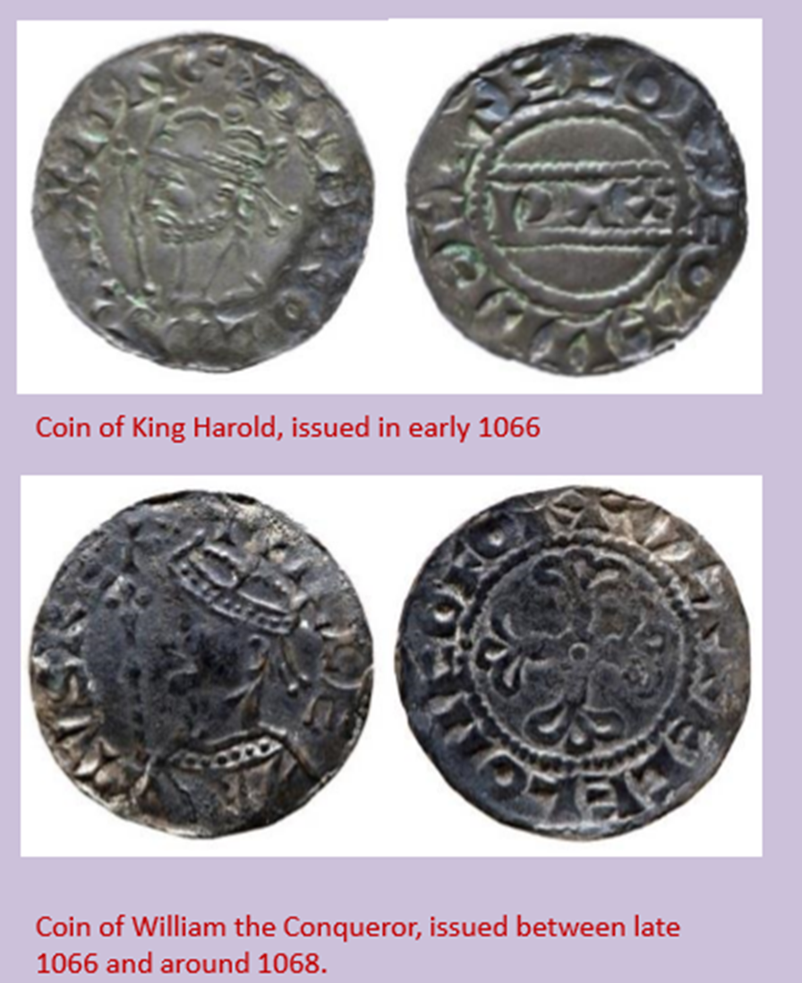
These are coins from Harold’s reign and William’s. They are very similar in design and historians think the same people who made the coins (moneyers) under Edward and Harold made the coins for William.

