Slide 1
What was the Impact of the Norman Conquest on England by 1087?
You need to use chapter 5 from the SHP Norman Conquest book alongside this powerpoint. Part 2
Notes:
Write the title in your book.

Slide 2
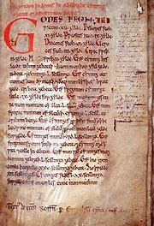
Laws
Read p90
Answer the following question
1. How did the Normans change English laws?

Slide 3
Language
Read p91.
Watch the following clip:
http://www.youtube.com/watch?v=wA2xRVMOThc
Look at the next slide and find examples of English words (tend to be simpler) and Norman words. Write out 5 examples of pairs in your notes e.g. drink (Anglo Saxon) beverage (Norman)

Slide 4
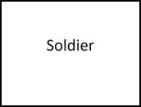
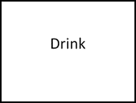

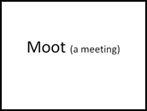
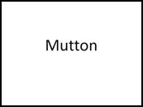
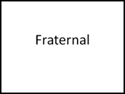

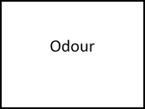

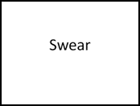
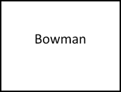
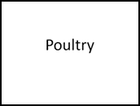
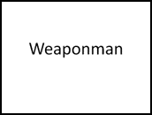
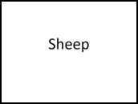


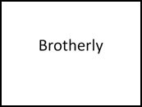
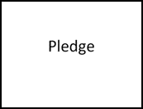

Slide 5
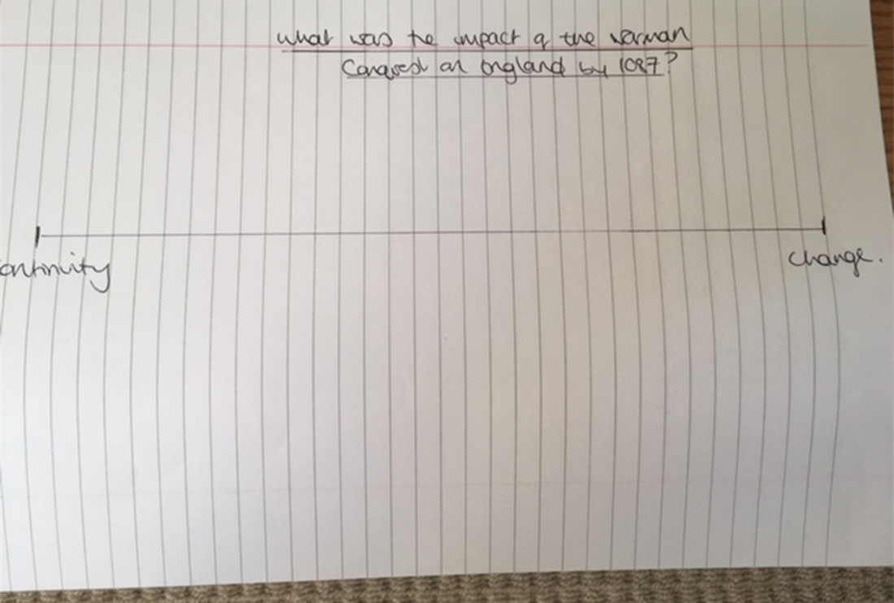
Language
Answer the following question in your book:
How did the Norman Conquest change English language?
Go back to your change/continuity line and add on farming, towns, markets, taxes, laws, languages. Each time justify why you have put it there.

Slide 6

Church
Read p92-93
Answer the following questions
What impact did the Normans have on cathedrals?
What impact did the Normans have on monasteries?
What impact did the Normans have on parish churches?
Add Church to your change/continuity line.

Slide 7
Quick Quiz – test yourself
How many landowners were English by 1086?
What happened to the number of slaves in England?
How much did rents rise by?
How many English bishops were left by 1080?
Who was the new Archbishop of Canterbury?
What was the Norman word for cow?
What was the punishment for hunting under the Forest Law?
Why do historians now think the Domesday Book was written?
Who owned Sleaford in 1066?
Who owned Sleaford in 1086?

Slide 8
Quick Quiz answers
How many landowners were English by 1086? 4 out of 180
What happened to the number of slaves in England? Fell 25%
How much did rents rise by? 30%
How many English bishops were left by 1080? 1 out of 18
Who was the new Archbishop of Canterbury? LanFranc
What was the Norman word for cow? Beef
What was the punishment for hunting under the Forest Law? Chopped two fingers off
Why do historians now think the Domesday Book was written? To confirm Norman landowners as legitimate owners of the land.
Who owned Sleaford in 1066? Barthi
Who owned Sleaford in 1086? Bishop of St Mary Lincoln (Norman)

Slide 9
Using your change/continuity line answer the following question
Do this on word and put it on to the submit drive/email it to me so I can mark it.
Simon Schama said that ‘the Norman Conquest changed everything for the English.’ How far do you agree? [18 marks]

