Slide 1
HA Resource Hub Submission Form
Resource Title: Perspectives on the ‘Storming’ of the Winter Palace | Age Range: Could be used KS3-5
Author name and email contact: Bob Stradling Bob.stradling@btinternet.com | Resource Details: (e.g. how many documents does it consist of? In which order?) A PPT
Necessary prior learning to complete this: Is part of studying Russia in Revolution | What does it lead to next? The post Nov 1917 events in Russia
Explanation: How should this resource be used? It is designed as an online PPT and Bob would be pleased for it to be used. The students are prompted to think about each section, focusing on what the eyewitnesses, the people at the time who collected information and kept a record, the mythmakers and the historians have said. It promotes thinking about the variety of perspectives that have shaped our view of the ‘Storming’ of the Winter Palace and why it is difficult to be sure what actually happened.

Slide 2
25-26 October, 1917
Different perspectives on the storming of
the winter palace

Slide 3
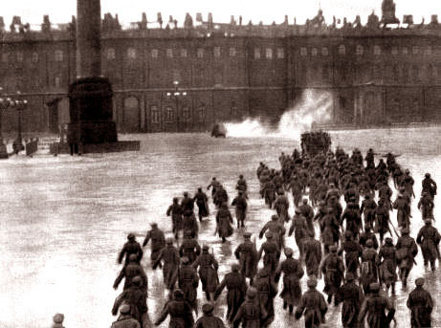
How do we know what happened?

Slide 4
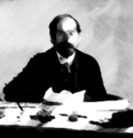
Sources
People who were there: - the eyewitnesses
People at the time who collected information and kept a record: - political leaders and party organisers, police, diplomats
Mythmakers: - Party spokesmen, propagandists for and against the revolution, film makers,
Historians: – writing soon after the event and much later both inside and outside the Soviet Union

Slide 5
It is not as easy as you would think to find out exactly what happened.

Slide 6
Eye-Witness Accounts
Multiple perspectives do not necessarily bring you closer to the truth (or what REALLY happened)
What you get is a fuller but often a more chaotic picture which needs to be explained.
Being close to events (i.e. eye witnesses) does not necessarily give their observations greater credibility than those of historians writing later.
It is rare to be able to leave the sources “to speak for themselves”. They usually need some interpretation and some contextual information.

Slide 7
People who were there
Volodya Averbakh
A resident.
Red Guards
Bessie Beatty
Journalist
John Reed
Journalist
Albert Williams
Journalist

Slide 8
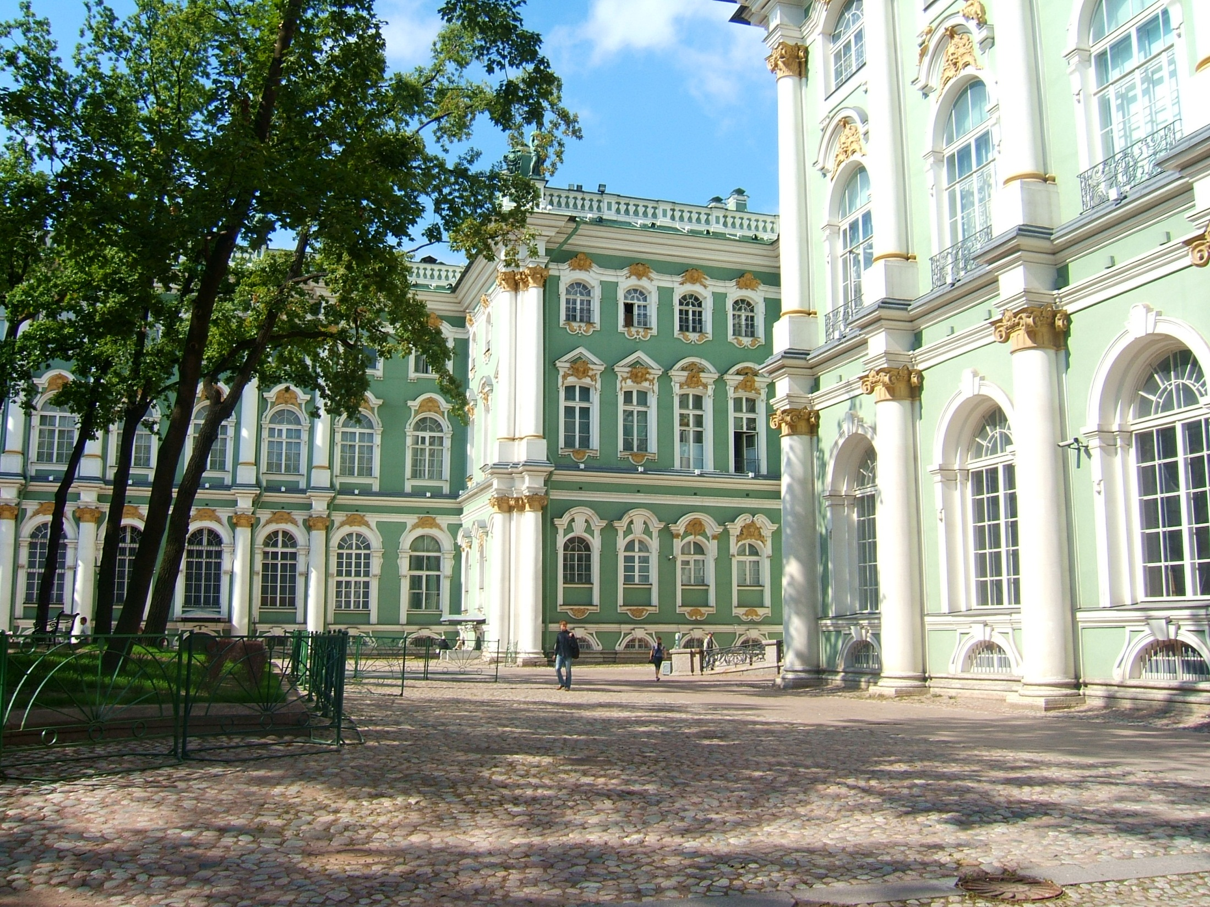
11:00pm
“About 11 o’clock we broke in the doors… the officer cadets took away our guns; still our fellows kept coming up, little by little, until we had a majority. Then we turned around and we took away the cadets’ guns.”
This is an account by one of the sailors from the nearby Kronstadt naval base.By 9.00pm the Winter Palace was surrounded by Red Guards, sailors from the Baltic fleet and some army units. The Palace had been guarded by Cossacks, some cadets and the Women’s Battalion, although it appears that many defenders had left the Palace by 11.00pm.
Notes:
http://upload.wikimedia.org/wikipedia/commons/4/46/Inside_Winter_Palace.jpg

Slide 9
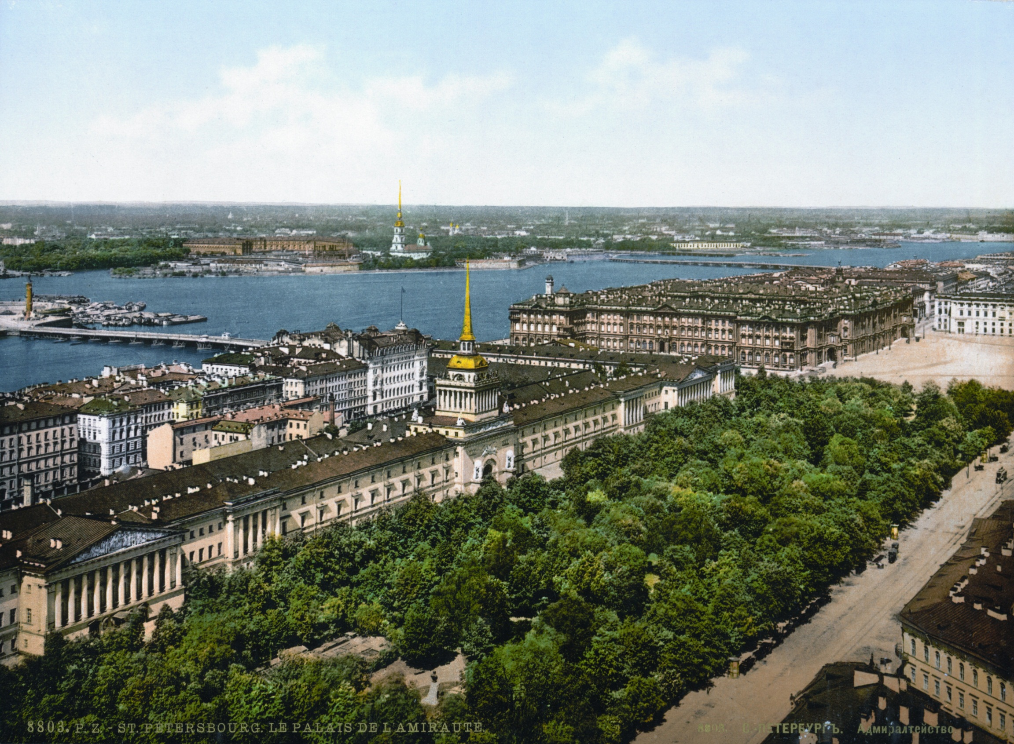
11:00pm
“The street was completely deserted. The night was quiet and the city seemed dead. We could even hear the echo of our own footsteps on the pavement.”
Volodya Averbakh wrote up his memories of the Revolution in 1924. He recalled that at 11.00pm on the night of 25 October 1917 he was walking home along a street just 100 metres away from the Winter Palace. And yet he heard nothing to suggest that the Palace was being attacked by revolutionaries.
Notes:
http://en.wikipedia.org/wiki/File:SPB_Admiralty_1890-1900.jpg, http://pixabay.com/en/walking-man-male-figure-sportive-149724/

Slide 10
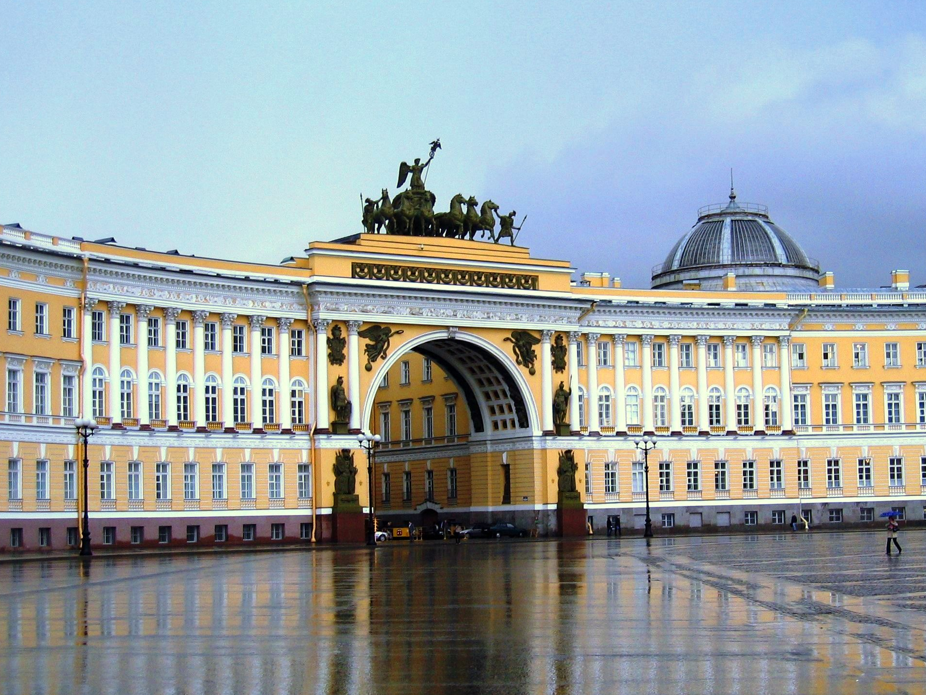
11.00 p.m.
“As we come into the Palace Square the booming of the guns dies away. The rifles no longer crackle through the dark. The Red Guards are crawling out to carry off the dead and dying.”
Albert Rhys Williams had been covering the war for the American magazine, Outlook. He had been sent to Petrograd after the February Revolution. He headed for the Winter Palace as soon as he heard firing from the Battleship Aurora.
Notes:
http://upload.wikimedia.org/wikipedia/commons/1/16/L'ermitage_-_Edifici_Estat_Major_des_de_pla%C3%A7a_interior.jpg

Slide 11
2:00am
“Like a black river, filling all the street, without song or cheer we poured through the Red Arch, when the man just ahead of me said in a low voice: ‘Look out comrades! Don’t trust them. They will fire, surely!’ In the open we began to run, stooping low and bunching together… “How many of you did they kill?! I asked. ‘I don’t know. About ten…’.”
John Reed, an American journalist with socialist sympathies, who knew Lenin and Trotsky and supported the new revolutionary government. At 2.00am on 26 October Reed was with a group of sailors in the square outside the Winter Palace.
Notes:
http://upload.wikimedia.org/wikipedia/commons/1/16/L'ermitage_-_Edifici_Estat_Major_des_de_pla%C3%A7a_interior.jpg

Slide 12
“Three rifle shots shattered the quiet. We stood speechless, awaiting a return volley; but the only sound was the crunching of broken glass spread like a carpet over the cobblestones…. Suddenly a sailor emerged from the black. ’It’s all over!’ he said ‘They have surrendered.’”
2:00am
Bessie Beatty, was another American journalist who also supported the revolution but she was not as committed to the Bolshevik cause as John Reed. Her account is less dramatic than Reed’s, even though she was also in the Palace Square at the same time and with the same group of sailors.
Notes:
http://upload.wikimedia.org/wikipedia/commons/1/16/L'ermitage_-_Edifici_Estat_Major_des_de_pla%C3%A7a_interior.jpg

Slide 13
Different points of view
There are essentially three elements to understanding the motives behind these different points of view, whether they are the perspectives of the authors of the various sources or of the person or persons referred to in those sources.
Trying to understand the logic behind the view being expressed. Why would they think this?
De-constructing the text or image (verifiable facts, opinions, hearsay, use of analogies, irony, symbols, etc.)
Collating and analysing contextual information about each source since this enables us to understand more fully where the person stating a point of view “is coming from”, their background, their associates, allegiances and affiliations.

Slide 14
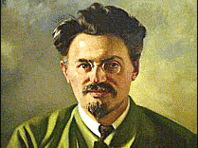
“The attack on the Palace was opened by a few blank rounds being fired from the Fortress…followed by a massed onslaught from all sides, armoured cars and machine guns firing at the Palace from under the archway on the square…Both the women soldiers and the cadets had put up a brave defence, but they were greatly outnumbered.”
In October 1917 Trotsky was second only to Lenin in the Bolshevik hierarchy. While the Winter Palace was being taken he was at the meeting of the Congress but receiving regular reports on what was happening.

Slide 15
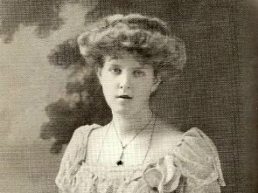
‘The actual bombardment of the Palace ceased at about eleven. The Women's Battalion fought heroically til the last, though luckily they did not suffer any very severe casualties. Many stories concerning the siege were circulated later on [including] that there was a Bolshevik agent inside the Palace who .. finally opened the doors leading into the Hermitage, letting in the crowd of soldiers and sailors….’
Meriel Buchanan was the daughter of the British ambassador. From an Embassy window she could see the firing from the Aurora and the Peter and Paul fortress. When the Palace was being attacked, she was inside the Embassy listening to the reports coming in from British diplomatic staff and military observers.

Slide 16
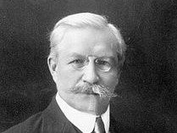
"Those of the Women's Battalion who had not died under fire were seized by the Bolsheviks, subjected during that evening and night to the frightful attentions of the soldiers, to violence and execution."
Pavel Miliukov was the leader of the Kadet Party and had been Foreign Minister in the Provisional Government but forced to resign because of his stated intention to keep Russia in the war.

Slide 17
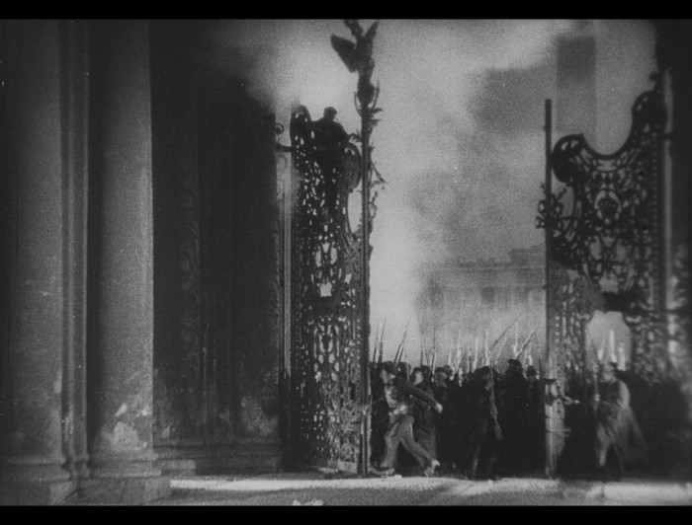
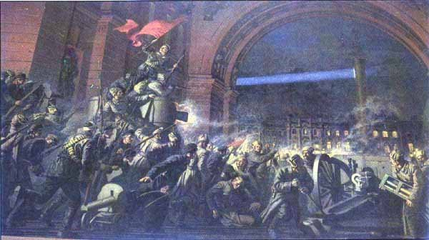
The Mythmakers
Notes:
http://openclipart.org/detail/170979/camera-icon-by-qubodup-170979

Slide 18
1920
In 1920 on the third anniversary of the October Revolution the Bolshevik government staged a spectacle called The Storming of the Winter Palace in front of over 100,000 spectators. Over 2500 workers, actors and students took part and there were tanks and armoured cars and controlled explosions. It ended with Kerensky running away pursued by Red Guards and a blank shell fired by the Aurora signaled victory.

Slide 19
1926
In 1926 the Bolshevik government commissioned Sergei Eisentein to make the film Oktober about the Revolution. Modern historians tend to regard it as Bolshevik propaganda. But his treatment of a lot of the events seems to coincide with contemporary reports. He relied heavily on John Reed’s book. The real issue is about his treatment of the storming of the Palace, which has a pitched battle between the Red Guards and the defenders. But he was not a historian. He was a film maker and he needed drama.

Slide 20
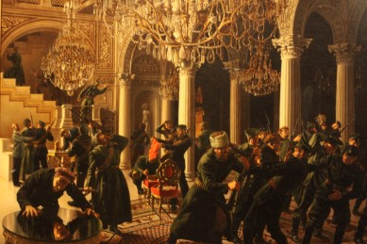
1958
1937
Here we have the work of two artists from different cultures and artistic traditions who painted works about the storming of the Winter Palace. On the left is ‘Russian Revolution’ by the American artist C.N. Jones Jr who produced this for Life Magazine in 1958. Jones depicts a struggle between Red Guards and Cadets while others loot the palace. On the right is ‘Revolution’, a painting by the Soviet artist, Kiriakov, painted in 1937. Here the emphasis is on conveying a sense of a popular uprising.

Slide 21
A multiplicity of historical accounts and interpretations (including accounts produced at different times, for different purposes and for different audiences).
Historians also have their preconceptions and preoccupations. Their perspectives are not just shaped by the evidence in the sources to which they have access. A historian who seeks to offer a political perspective of events is likely to present what happened in a different way, emphasise different factors, assign greater significance to certain consequences and developments than, say, the economic or social historian.
It is also clear that historians and other commentators on the past, like the rest of us, are children of their time and of their place.
Historians often come to different conclusions.

Slide 22
The Historians
Notes:
http://upload.wikimedia.org/wikipedia/commons/8/86/Anatoly_Lunacharsky.jpg

Slide 23
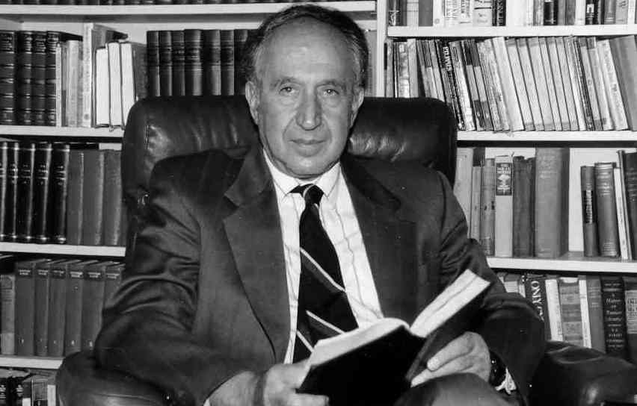
‘The Winter Palace was not taken by assault: the image of a column of storming workers, soldiers, and sailors as depicted in Eisenstein's film, “Days of October,” is pure invention, an attempt to give Russia its own Fall of the Bastille.’
Polish-American historian Richard Pipes is widely perceived as a Cold War historian who resists any suggestion that what happened in October 1917 was the result of revolutionary action by the masses.

Slide 24
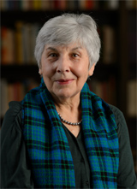
. By the afternoon of the 25th, the coup was all but accomplished – except, provokingly, for the taking of the Winter Palace, which was still under siege with the Provisional Government members inside. The Palace fell late in the evening, in a rather confused assault against a dwindling body of defenders.
Russia’s working class …was exceptionally militant and revolutionary…..By the middle of 1917, [the Bolshevik Party] had become an open mass party,.. the only party uncompromised by association with the bourgeoisie and the February regime, and the party most firmly identified with ideas of workers’ power and armed uprising.
Australian historian, Sheila Fitzpatrick, like Pipes, uses the term ‘coup’ but there the similarity ends. In her view the Bolshevik Party was responding to the revolutionary demands of the Russian working class.

Slide 25
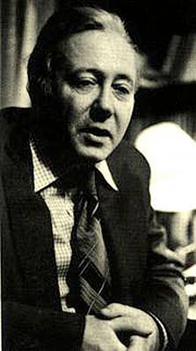
‘On the evening of October 25th, the Bolsheviks assembled about 20,000 Red Guards, sailors and soldiers… within the palace there were not more than 3000 defenders, and many of those left their posts during the night…. There were no serious battles in the capital ..and the total number killed on both sides was no more than 15, with no more than 60 wounded.’
Roy Aleksandrovich Medvedev, a Russian historian who was expelled from the Communist Party in the Soviet Union for his critique of Stalin and Stalinism and is now a supporter of President Putin, presents an account quite similar to that of Trotsky.

Slide 26
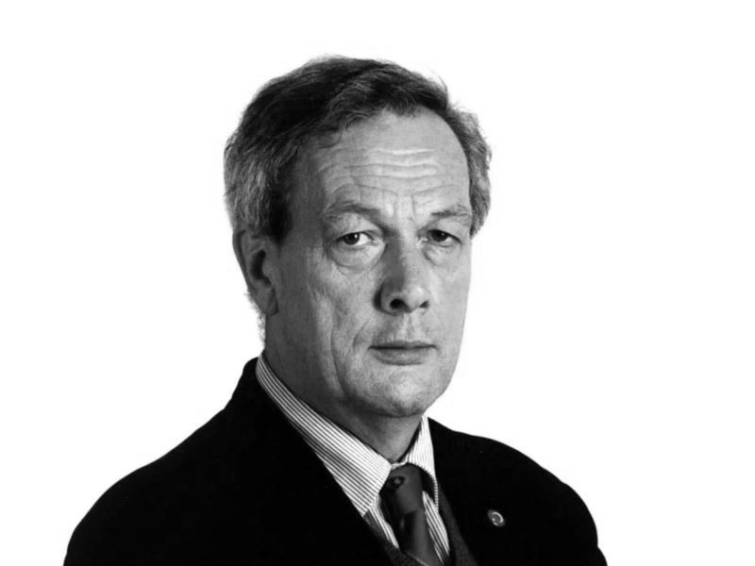
‘There were so many entrances to the Winter Palace that the Red Guard forced their way in quite easily; and there were no scuffles – no shooting in the corridors and picture galleries. When they occupied the Winter Palace there were only six fatal casualties.’
Norman Stone, British historian, writing just before the end of the Cold War, highlights the relative lack of opposition to the Red Guards in the Palace but states that there were fatalities.

Slide 27
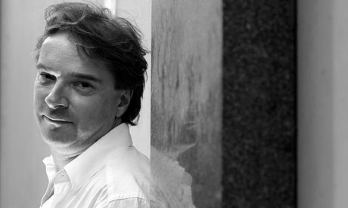
‘During the evening of the 25th there were probably something in the region of 10,000 to 15,000 people milling around in the Palace Square, but not all of them were actually involved in the ‘storming of the palace’. …None of the familiar images of a people’s revolution – crowds on the street, barricades and fighting – were in evidence. Elsewhere the life of Petrograd carried on as normal.’
While acknowledging that the seizure of the Palace was relatively peaceful Orlando Figes supports Trotsky’s account in terms of the large numbers massing in the Palace Square.
Notes:
http://www.flickr.com/photos/shordzi/3688727434/sizes/o/

Slide 28
Having considered all these perspectives, what is your view about the events?
25-26 October, 1917
Different perspectives on the storming of
the winter palace

