Slide 1
HA Resource Hub Submission Form
Resource Title: Was World War Two Hitler’s fault? | Age Range: Year 8/9
Author name and email contact: Sally Burnham Salburnham@yahoo.co.uk | Resource Details: (e.g. how many documents does it consist of? In which order?) One PPT Worksheet – causes worksheet
Necessary prior learning to complete this: Students would benefit from having studied the Treaty of Versailles, Communism and League of Nations, but this isn’t crucial. | What does it lead to next? World War Two
Explanation: How should this resource be used? I envisage this task taking at least two lessons. Pupils need to work through the PPT and use the worksheet and complete the tasks on the PPT. I have asked them to work in their books except for the bits that I will mark and my students will email these to me – you may want all the work done online so it can be emailed through. You may want to break the PPT up into sections so students aren’t faced with all the activities at once.

Slide 2
Was World War Two Hitler’s fault?

Slide 3

Your enquiry…
Listen to the teacher instructions

Slide 4
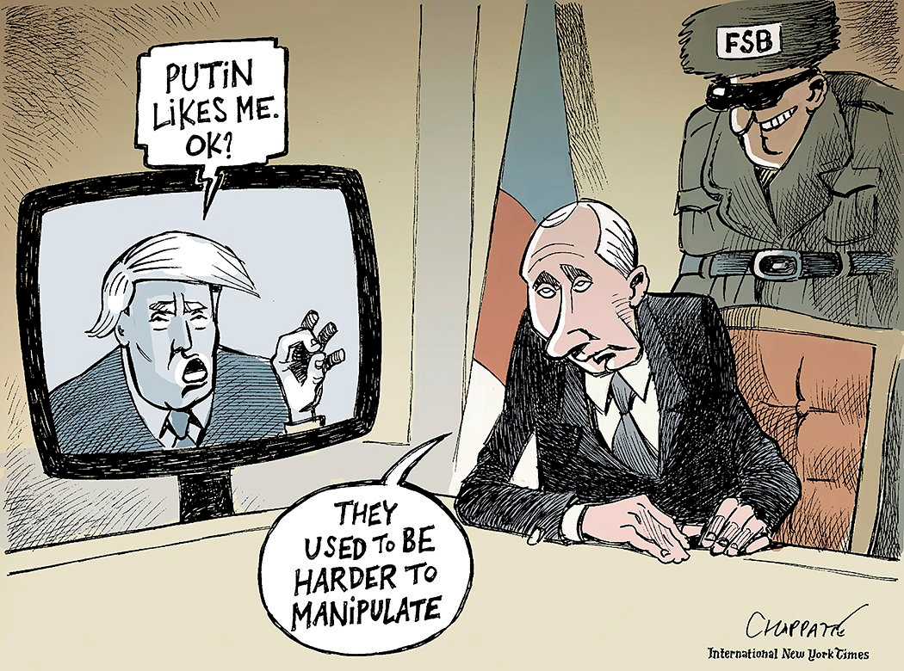
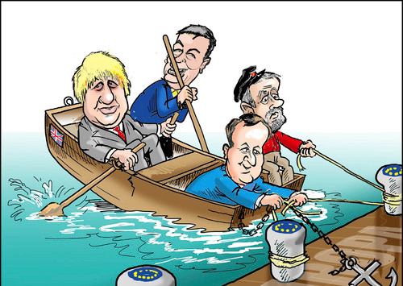
Can you work out the messages from the following political cartoons?

Slide 5
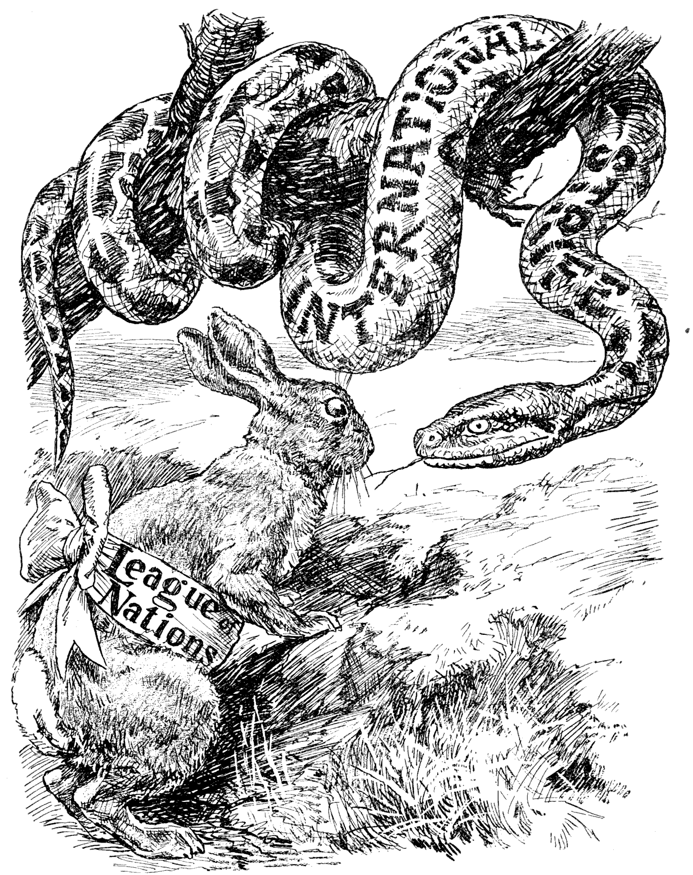
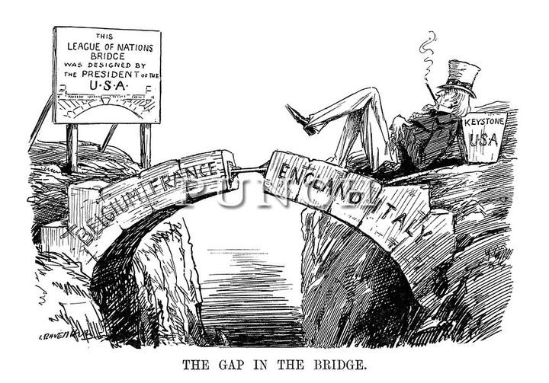
Can you work out the message from these cartoons about the League of Nations?

Slide 6
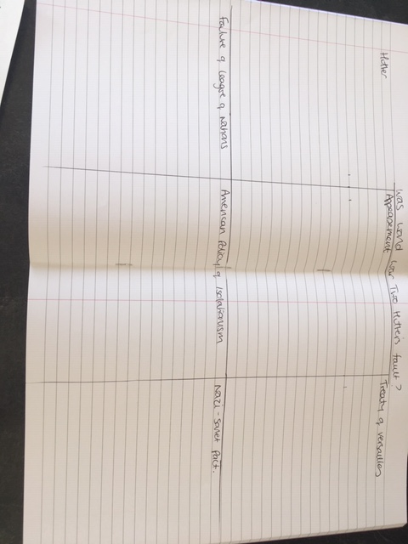
Was World War Two Hitler’s fault?
Divide a double page in your exercise book into 6 boxes.
Put a heading in each of the boxes:
Hitler
Appeasement
Treaty of Versailles
Failure of the League of Nations
American policy of isolationism
The Nazi Soviet Pact

Slide 7
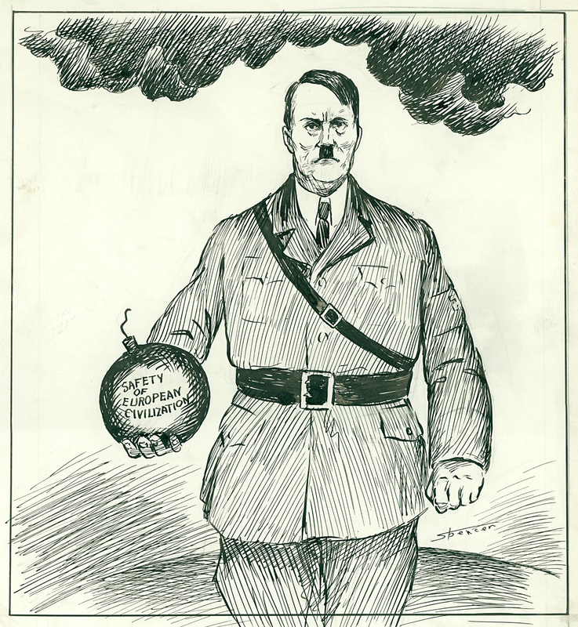
How did Hitler cause World War Two?
Read the Hitler section of the worksheet
In the box in your book explain what Hitler did (his actions) and how that helped lead to war.

Slide 8
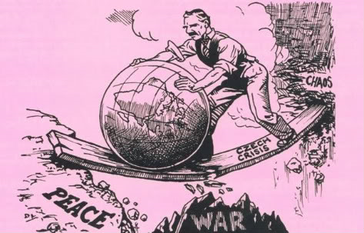
How did Appeasement cause World War Two?
Read the Appeasement section on the worksheet
In the box in your book explain:
1. What appeasement was
2. Why Chamberlain tried to appease Hitler.
3. Explain why some historians think appeasement helped cause the war.

Slide 9
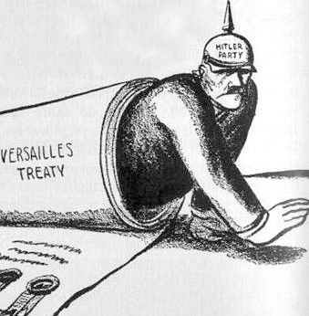
How did the Treaty of Versailles cause World War Two?
Read the Treaty of Versailles section on the worksheet
Explain how the Treaty of Versailles helped cause World War Two in the third box in your book.

Slide 10
How did the failure of the League of Nations cause World War Two?
Read the failure of the League of Nations section on the worksheet.
Explain how the failure of the League of Nations helped cause World War Two in the fourth box in your book.

Slide 11
How did the American policy of isolationism cause World War Two?
Read the American policy if isolationism section on the worksheet
Explain how the American policy of isolationism helped cause World War Two in the fifth box in your book.

Slide 12
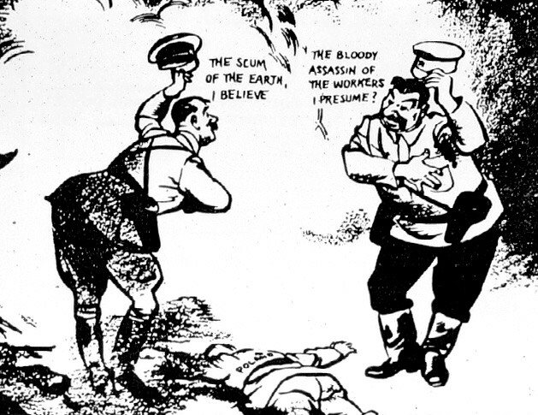
How did the Nazi-Soviet Pact cause World War Two?
Read the Nazi-Soviet Pact section on the worksheet
Explain how the Nazi-Soviet Pact helped cause World War Two in the sixth box in your book.

Slide 13
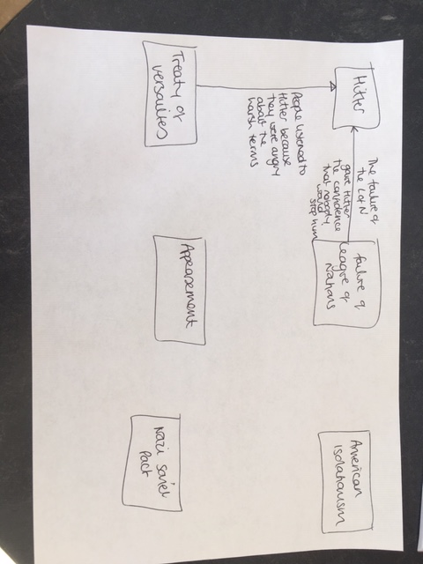
Now you have the main causes of World War Two can you see links between the causes?
Create a diagram on one page of your book like this and draw the links between the causes. I have done two for you but there are lots!

Slide 14
Which cause do you think was the most important cause of World War Two?
Write a paragraph in Word explaining which cause/causes you think was most important in causing the Second World War.

Slide 15
Can you design your own political cartoon?
Have a look at these cartoons on the next 3 slides that other students have drawn to show what they think was the most important cause of World War Two. Can you work out what they think was the most important cause?

Slide 16
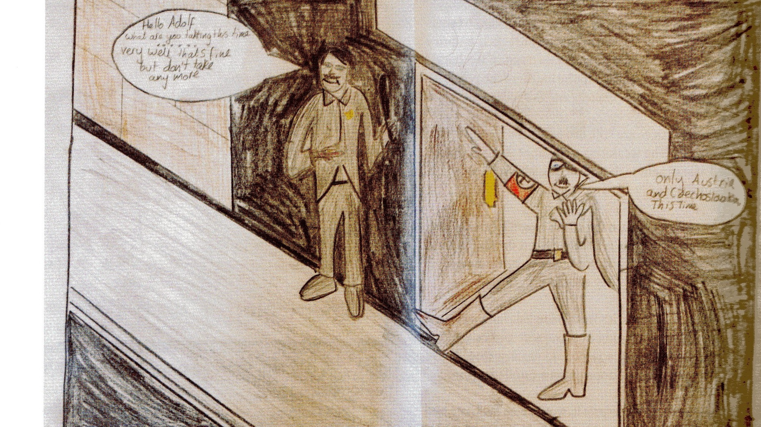

Slide 17
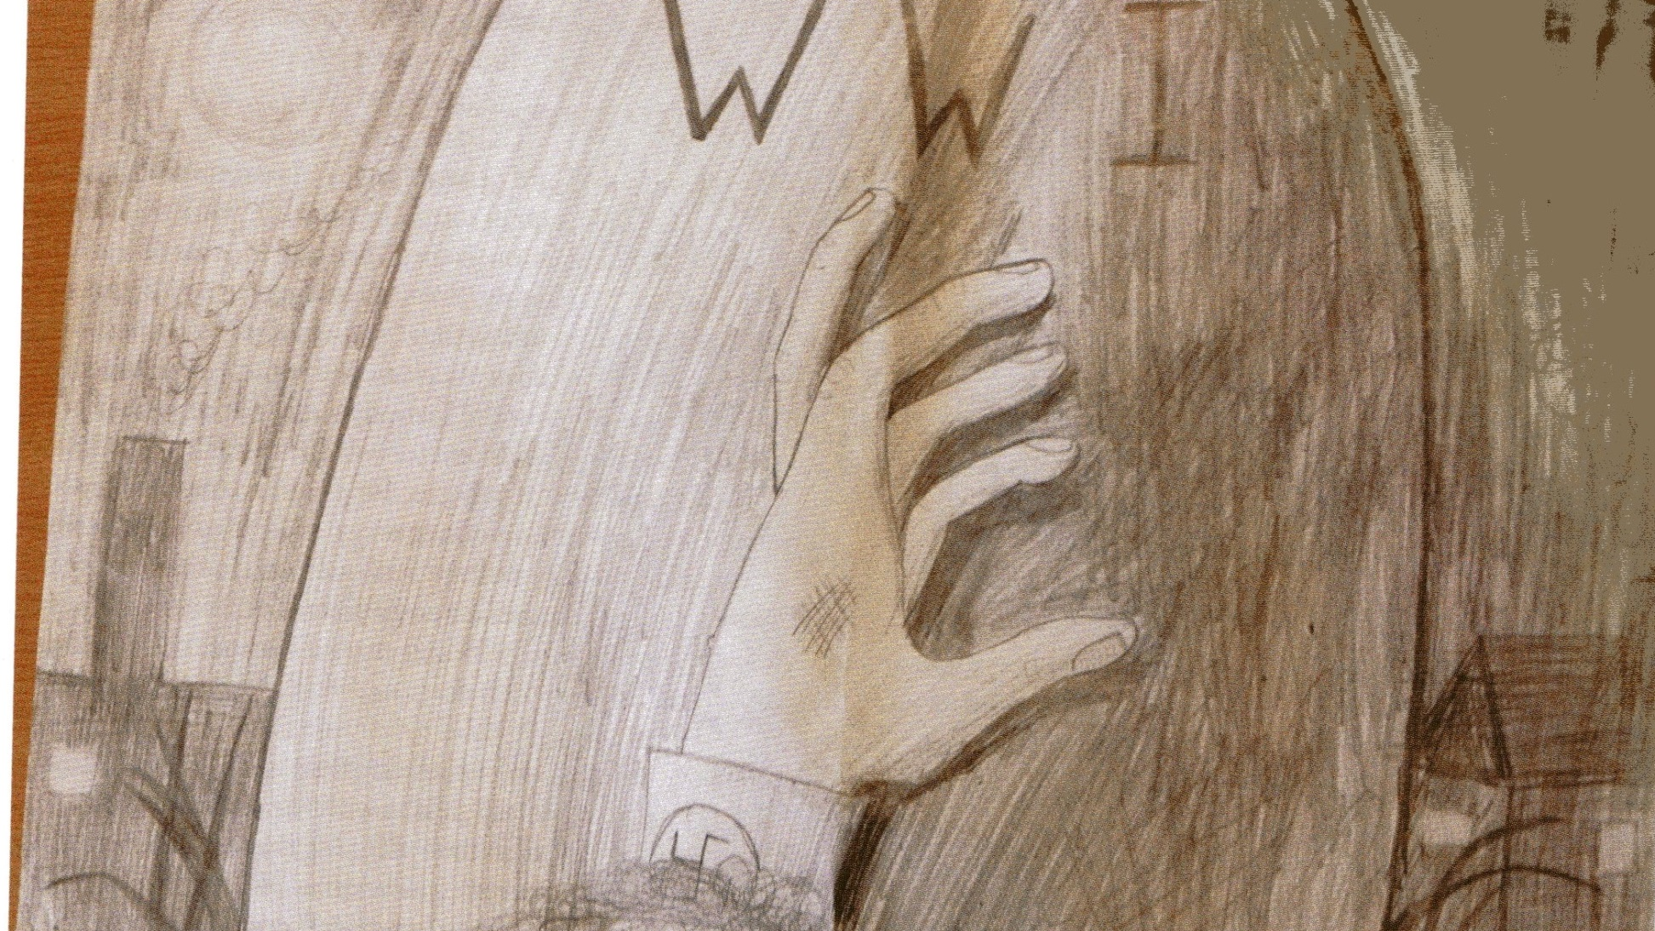

Slide 18
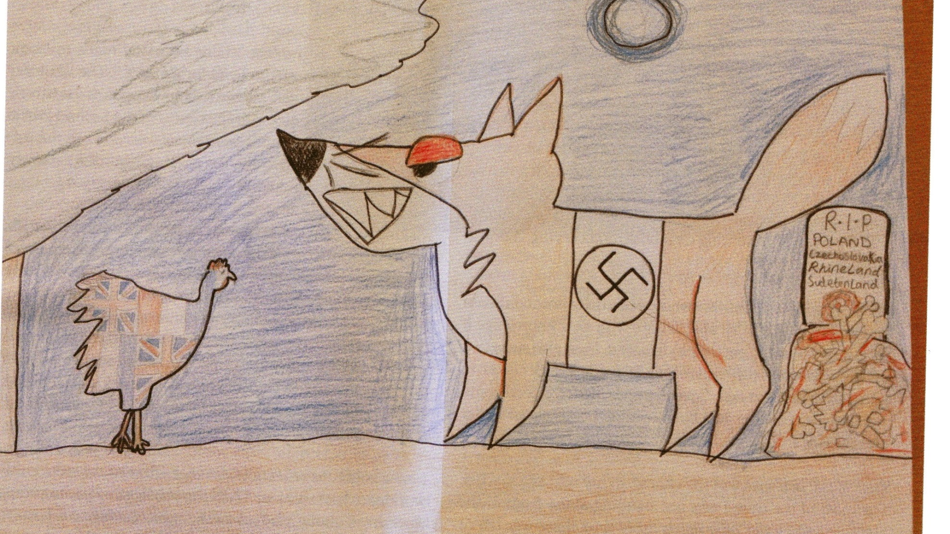

Slide 19
Task
Draw your own cartoon to show what you think was the most important cause of World War Two.
If you hate drawing, you can write a detailed description of what should be on your cartoon.

