Slide 1
What Are Your Ideas About The Middle Ages?
Medieval
Lives
Mattered
See also PDF ‘What are your ideas about the Middle Ages?’

Slide 2
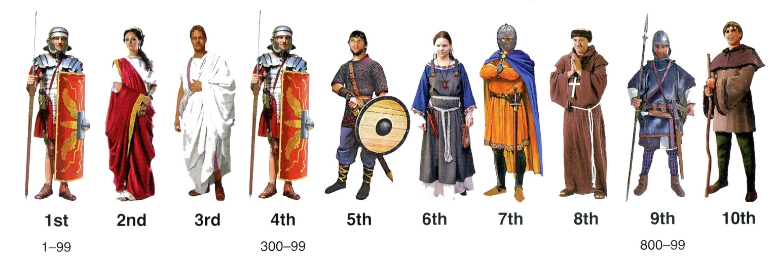
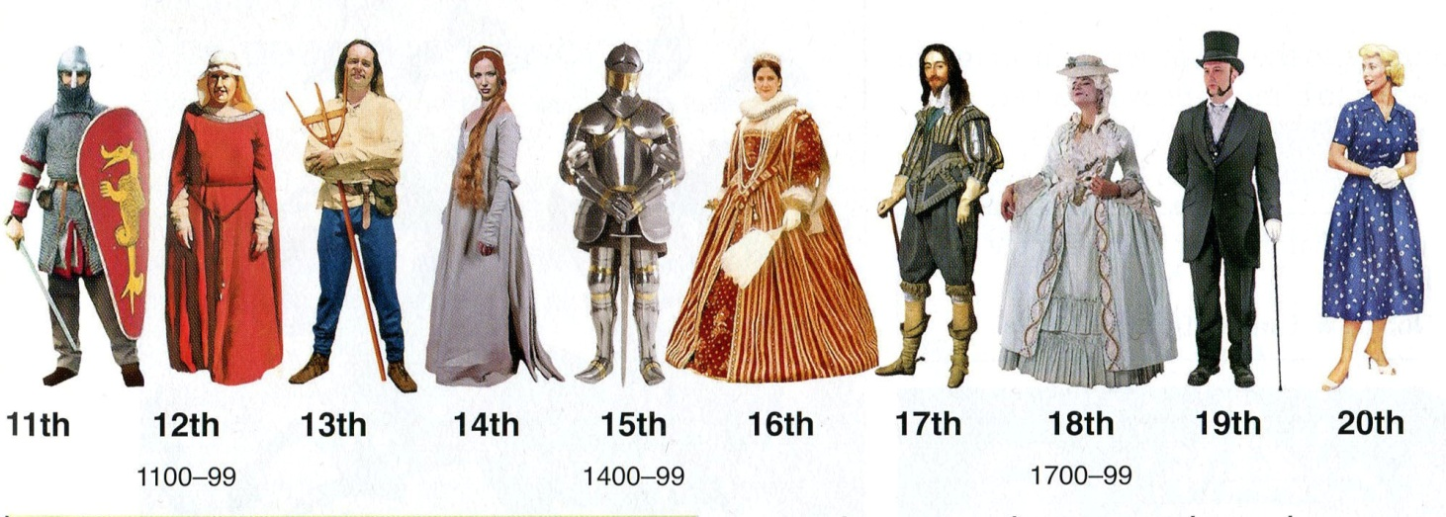
When were the Middle Ages?

Slide 3
The Chronology Game

Slide 4
The Middle Ages

Slide 5
What are your ideas about the Middle Ages?
1. Which THREE words do you think best describe ordinary people and their lives in the Middle Ages?
Clever | Dirty | Enjoyable | Violent | Practical
Loving | Nasty | Ambitious | Dangerous | Hard-working
Inventive | Superstitious | Comfortable | Miserable | Stupid

Slide 6
What are your ideas about the Middle Ages?
2. What kind of work did over 80% of people do in the Middle Ages?
3. How important was religion to people in the Middle Ages?
Soldiering | Farming | Being monks and priests | Making and selling clothes and shoes
Very important | Important | Quite important | Not important at all

Slide 7
What are your ideas about the Middle Ages?
4. Did people care about dirt in streets in the Middle Ages?
5. How much violence was there in the Middle Ages compared with today?
Yes | No
A great deal more | A little more | About the same | Less

Slide 8
What are your ideas about the Middle Ages?
6. Which THREE words do you think best describe kings, noblemen and their families in the Middle Ages?
Intelligent | Violent | Superstitious | Loyal | Loving
Brave | Inventive | Hard-working | Power-mad
Ruthless | Treacherous | Ambitious | Honourable | Thoughtful

Slide 9
What are your ideas about the Middle Ages?
7. Did people try to stay healthy in the Middle Ages?
8. Were barons keen to rebel against the king to increase their own power and wealth?
Yes | No
As often as possible | Quite Often | Very Occasionally | No

Slide 10
What are your ideas about the Middle Ages?
9. Was the king expected to consult his barons and knights before taking important decisions?
10. How interested were working people in national political events?
11. Were people in the Middle Ages as intelligent as people today?
Yes | No
Very interested | Interested | Not at all interested
Yes | No

Slide 11
What are other students’ ideas about the Middle Ages?
Evidence A
This word cloud shows the words that school students most associated with the Middle Ages.

Slide 12
What are other students’ ideas about the Middle Ages?
Evidence B
School students thought these words best describe ordinary people in the Middle Ages:
School students thought these words best describe kings and noblemen in the Middle Ages:
Religious | Hard-working | Dirty | Superstitious | Miserable
 | Power-mad | Religious | Ruthless

Slide 13
What are other students’ ideas about the Middle Ages?
Evidence C
The research into the ideas of over 900 school students showed that:
90% thought that medieval people were less intelligent than people today
92% said that medieval people did not care about dirt
95% said that religion was important or very important to people in the Middle Ages
73% said that people were not good at solving problems in the Middle Ages

Slide 14
Are people right to be so negative about the Middle Ages?

Slide 15
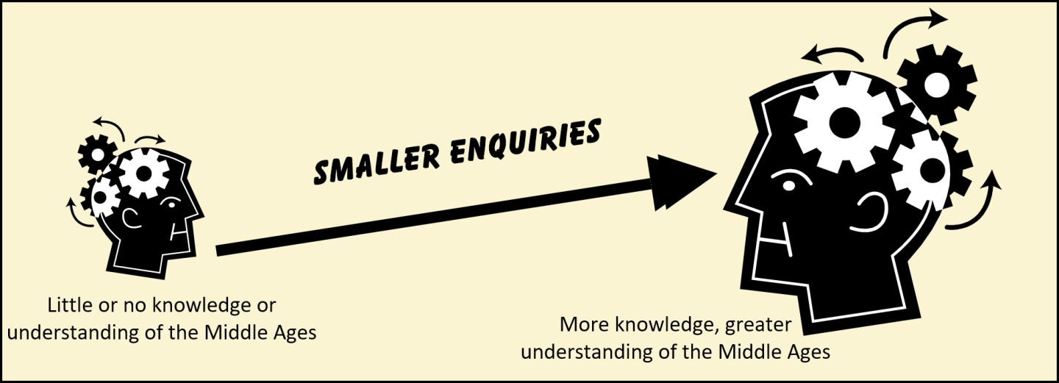
Are people right to be so negative about the Middle Ages?

