Slide 1
What Kinds Of Things Mattered To People in The Middle Ages?
Medieval
Lives
Mattered
See also PDF ‘What kinds of things mattered to people in the Middle Ages?’

Slide 2
What kinds of things matter to you?

Slide 3
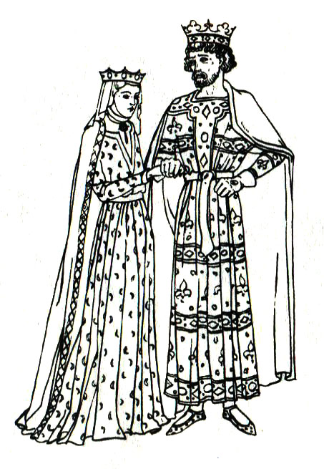
What mattered to Kings and Queens?
Kings and Queens
Kings and Queens

Slide 4
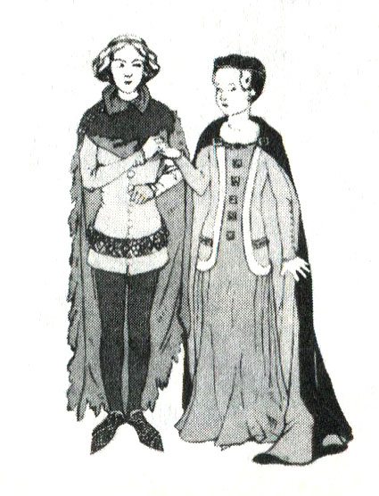
What mattered to wealthy families?
Kings and Queens
Wealthy Men and Wealthy Women

Slide 5
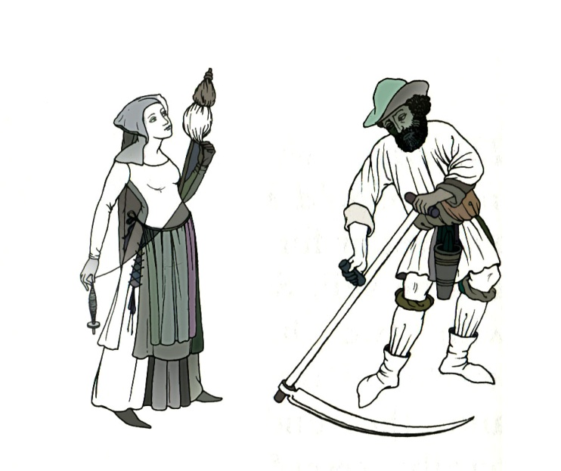
What mattered to the Commons?
Kings and Queens
Commons: Men and Women

Slide 6
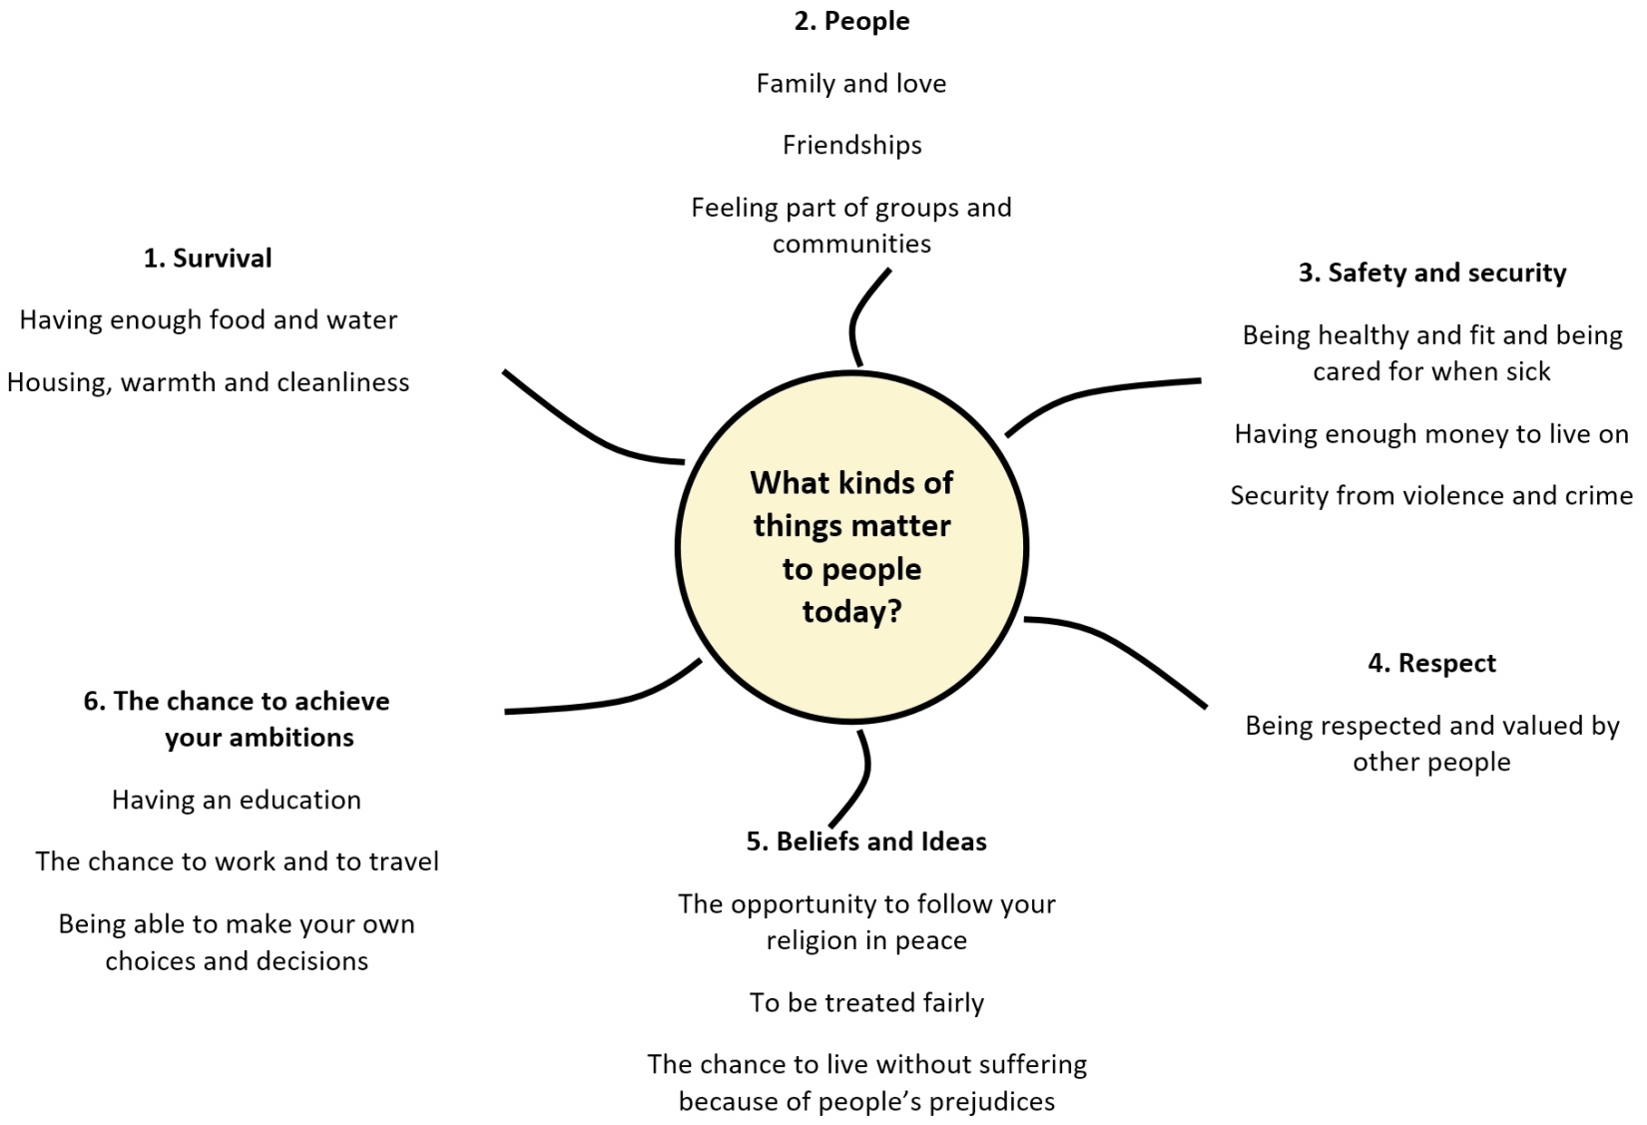
What kinds of things matter to people today?

Slide 7
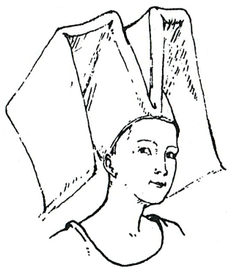
What kinds of things mattered to Margaret Paston?

Slide 8
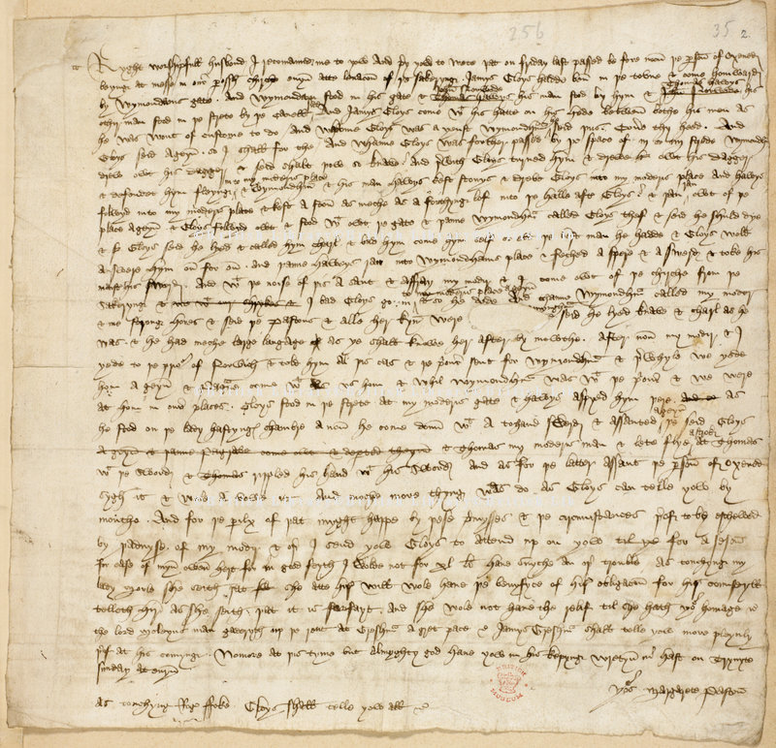
Letter from Margaret Paston to her husband, John, 1448
The letter was dictated by Margaret and written by one of her servants, James Gresham.

Slide 9
What mattered to Kings and Queens?
Their husband, wife and family | Their soul going to heaven | Keeping control of the country
Looking after the country’s people | Having an honourable reputation | Displaying the country’s power and wealth

Slide 10
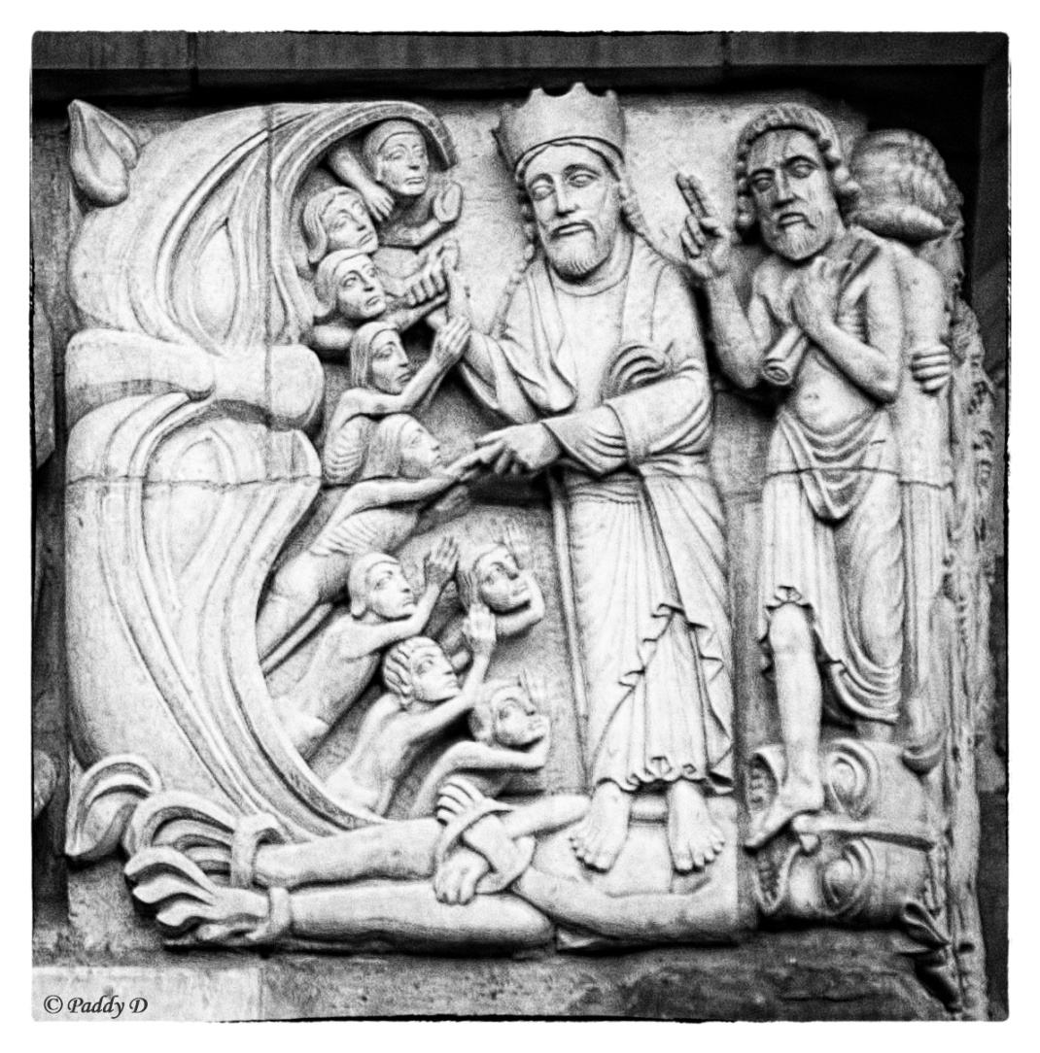
Hell’s Mouth: Lincoln Cathedral

Slide 11
How did religion affect everyday lives?
A. Having fun
B. Roads, water-supplies, hospitals and the poor
F. One of the most common types of work
Six topics or events affected by religious beliefs
C. Saying prayers on All Souls Day – November 2nd
E. Loyalty to the king; fear of rebelling against the king
D. Ideas about why people became sick with diseases such as the plague

Slide 12
How did religion affect everyday lives?
1. God controlled everything that happened to men and women. | 2. One of God’s Ten Commandments was ‘Thou Shalt not Kill.’ | 3. God decided the work that every person did and who was powerful. He chose who would be king and queen, who would be priests, who would work as farmers.
Six beliefs that people had about God and religion
4. Wealthy people left money to pay for priests to pray for their souls. This would reduce the time they spent in purgatory. But the poor had no money to pay for prayers for their souls. | 5. Everyone celebrated Christmas and Easter and had holy-days (holidays) on Saints’ days to celebrate the lives of individual saints. Holy-days were times for singing, dancing or going to the fair. | 6. Everyone knew that they would spend less time in Purgatory if they helped people in their community. Many left money to improve conditions in their town or to help the poor.

Slide 13
What kinds of things mattered to Geoffrey Luttrell?

Slide 14
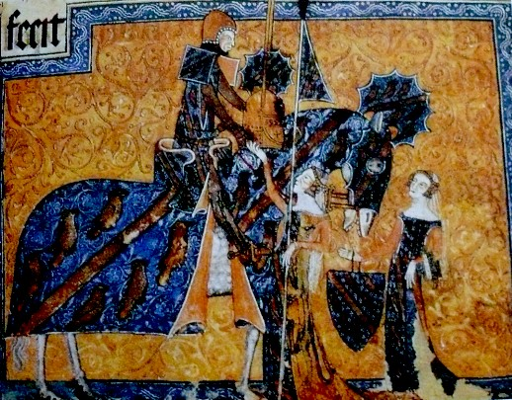
Geoffrey Luttrell

Slide 15
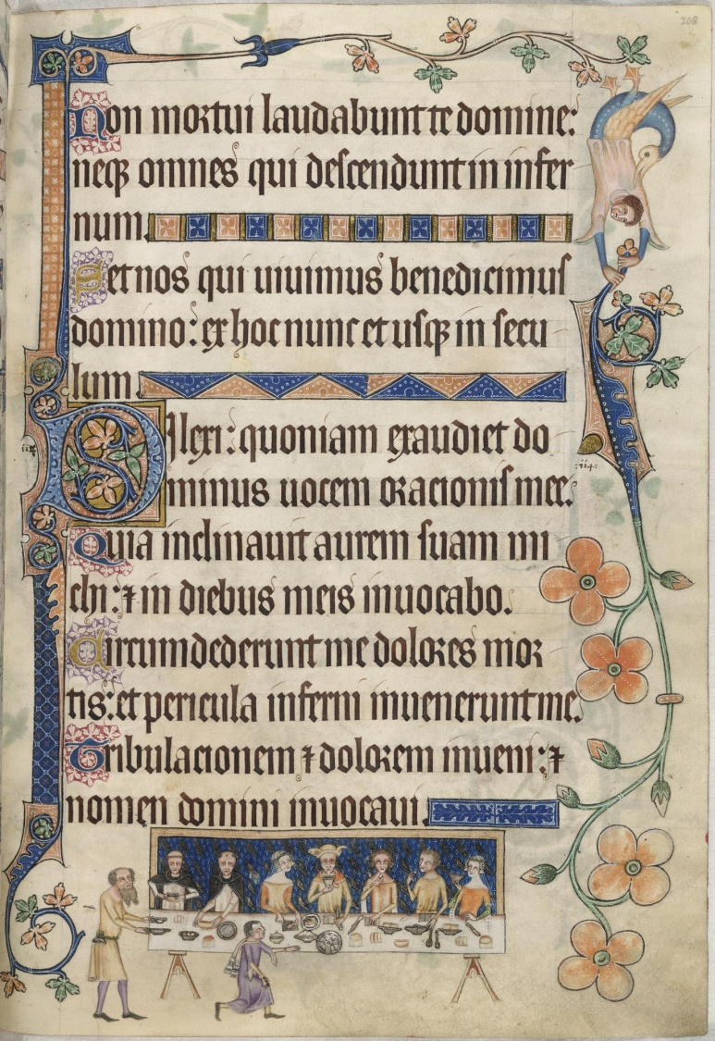
A page from the Luttrell Psalter

Slide 16
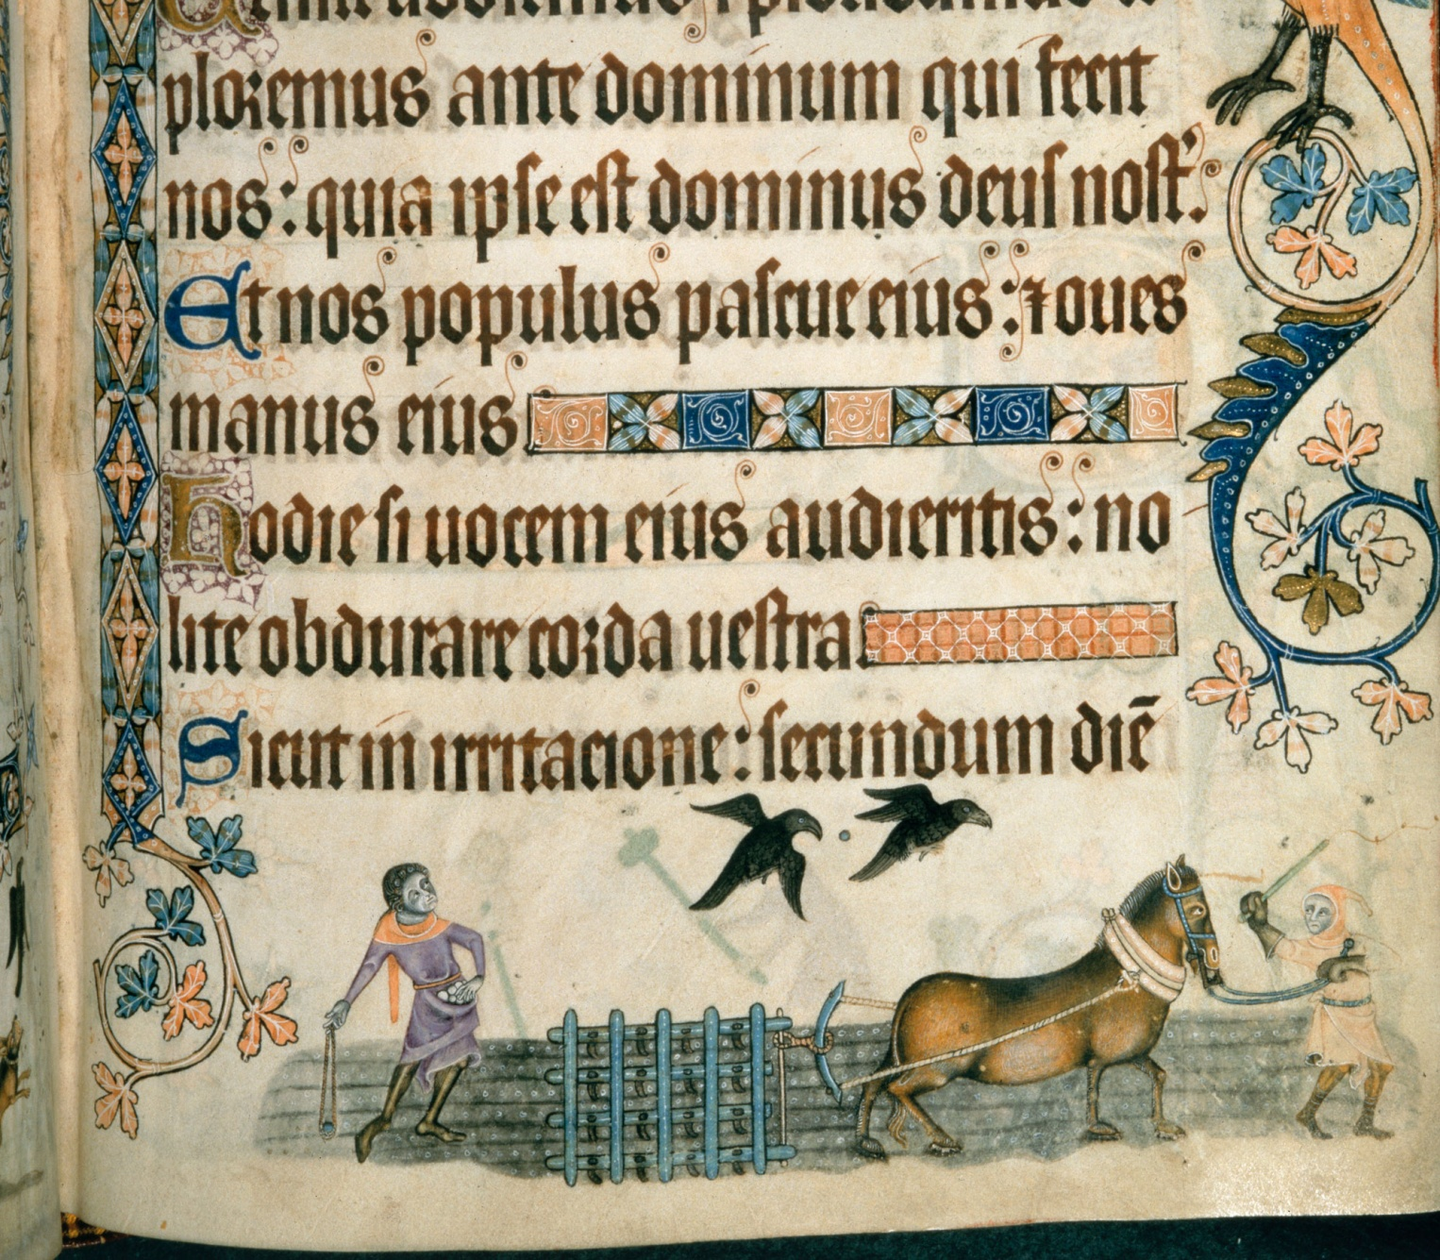

Slide 17
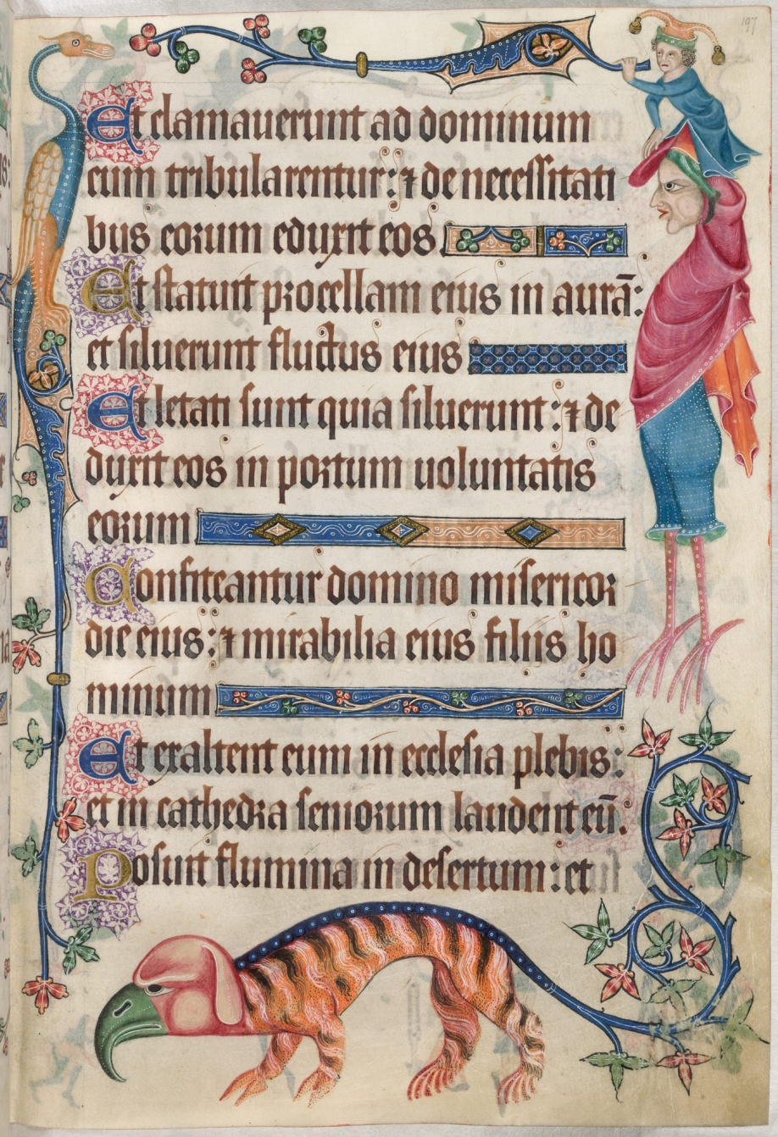

Slide 18
What kinds of things mattered to Geoffrey Luttrell?
Making sure his soul would go to heaven after he died
His family – including passing on his lands and wealth onto his son.
Being loyal to his king, including fighting in his wars
Being a good lord – looking after his workers and servants
Being a man of ‘good worship’ which meant being respected by other wealthy landowners
Making sure life that life stayed peaceful and stable. This meant everyone had to do the work God had given them to do.

