Slide 1
We will be answering two questions in this lesson.
1. How did the Black Death spread?
2. What were the symptoms of the Black Death?

Slide 2
Write the title and today’s date:
How did the Black Death spread?

Slide 3
How did the Black Death spread?
TASK 1
Watch a short film about the Black Death.
Watch up to 1.45 and answer the following questions in full sentences:
Where did the Black Death first arrive in England?
What year did it arrive?
Who brought the disease?
Click on the link to watch a short film about the Black Death.

Slide 4
How did the Black Death spread?
Click on the link to watch a short film about the Black Death.
Task 2
Watch from 1.45 to 4.20 and answer the questions below:
4. How did the city of Norwich try to protect itself from the disease?
5. Why didn’t this work?
6. Where did the city bury the bodies of the victims?

Slide 5
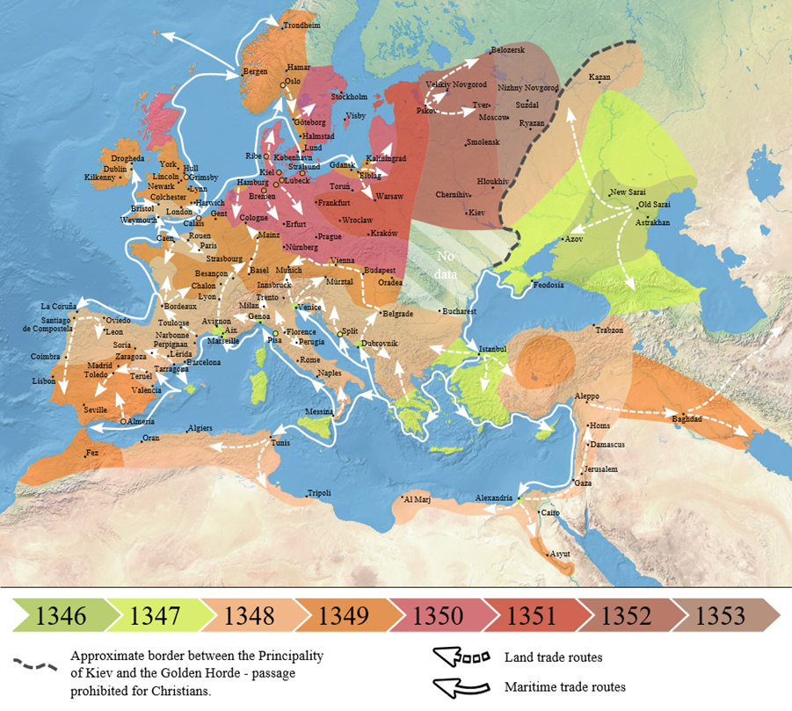
The Map shows how the disease spread through Europe. Study it carefully.
How did the Black Death spread?
Notes:
By Flappiefh - Own work from:Natural Earth ;The origin and early spread of the Black Death in Italy: first evidence of plague victims from 14th-century Liguria (northern Italy) maps by O.J. Benedictow., CC BY-SA 4.0, https://commons.wikimedia.org/w/index.php?curid=66468361

Slide 6
THINK:
Where did the Black Death come from?
Why did it spread through the Mediterranean first?
(Answers are on the next slide)
Notes:
By Flappiefh - Own work from:Natural Earth ;The origin and early spread of the Black Death in Italy: first evidence of plague victims from 14th-century Liguria (northern Italy) maps by O.J. Benedictow., CC BY-SA 4.0, https://commons.wikimedia.org/w/index.php?curid=66468361

Slide 7
ANSWERS: Where did the Black death come from? The Black Death started in China. Why did it spread through the Mediterranean first? Merchants traded goods such as spices and silk with China. The disease spread with the traders and continued along the trade routes around the Mediterranean sea. Then it spread through the rest of Europe.
Notes:
By Flappiefh - Own work from:Natural Earth ;The origin and early spread of the Black Death in Italy: first evidence of plague victims from 14th-century Liguria (northern Italy) maps by O.J. Benedictow., CC BY-SA 4.0, https://commons.wikimedia.org/w/index.php?curid=66468361

Slide 8
1350
TASK 3:
In your book draw a sketch map of Britain. Shade the map to show how the Black Death moved up the country between 1348 and 1350.
1349
1348

Slide 9
New Title: What were the symptoms of the Black death?

Slide 10
Day 1 Painful swelling appear in the victim’s armpits and groin. They could swell to the size of an apple. | Day 2 The victim develops a fever and starts to vomit | Day 3 The blood vessels under the skin begin to break down and bleed. This causes black bruises to appear all over the body.
Day 4 The nervous system begin to be attacked causing the victim to twitch and spasm. This is very painful. | Day 5 Sometimes the buboes would burst and leak a foul smelling black liquid. When this happened the victim might live. Most victims would become unconscious and die.

Slide 11
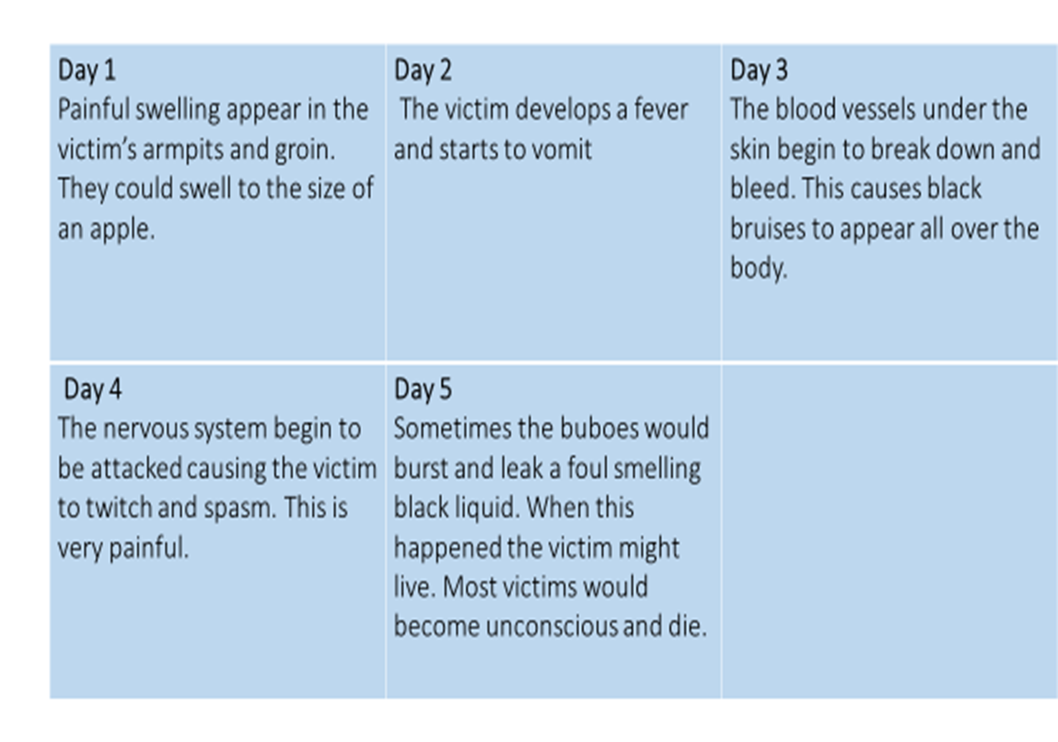
Task 4: Draw 5 stick men/women
Add notes onto each figure to show the different symptoms on each day. (Example below)
Day 1:
Buboes (swellings) under the arms

Slide 12
“ The victims died almost immediately. They would swell beneath the armpits and in the groin and fall over while talking. Fathers abandoned their child, wives their husband, one brother another. This illness seemed to strike through breath and sight… . In many places great pits were dug and piled deep with the dead. And they died by the hundreds, both day and night”
Task 5: Read this account…
Source A:
A first hand account from 1348

Slide 13
Task 6: Using the information from Source A fill in the gaps
Source A describes people with the Black death as having the following symptoms. The victims died almost………………… They had swellings in their……………..and……………………
Families did not stay together, but ran away from each other. The illness seems to be spread through………… and ………….. In many places great ……..are dug and piled with the……………….. They died in their …………………….. Both day and..................
Hundreds, Armpits, night, instantly, groin, sight, dead, pits, breath

Slide 14
Now find your knowledge organizer for this unit. (It is attached to Class charts)
Task 7:
Revise the highlighted areas. Make a quiz and test yourself.

Slide 15
Answers : mark with your green pens.
Task 1
1. Weymouth, Dorset
2. 1348
3. Sailors from France
Task 2
4 Closed the city gates
5 The infection was already in the city.
6. Plague pits in the Cathedral grounds
THINK – answers on PPT. Note how the disease travelled along the trade routes from China, along the Mediterranean and up through Europe.
Task 3. Check you have copied your map correctly and labelled the key
Task 4. You should have 5 stick men with labels.
Task 6 on next slide..

Slide 16
Task 6 answers
Source A describes people with the Black death as having the following symptoms. The victims died almost…instantly They had swellings in their groin.. and…armpits
Families did not stay together, but ran away from each other. The illness seems to be spread through sight and …breath. In many places great ……pits..are dug and piled with the……dead………….. They died in their …………hundreds………….. Both day and............night..

