Slide 1
Resource sheet 1.1C (page 1)
Timeline of the Korean War
1950
25 June 1950 – North Korea invaded South Korea with approximately 100,000 troops. North Korean troops overwhelmed the South’s forces. By September 1950, all except a small corner of south-east Korea was under communist control.
27 June 1950 – The United Nations sent troops to Korea. In 1950, UN and South Korean forces numbered between 80,000 and 100,000, increasing to 240,000 by spring 1951.
15 September 1950 – United Nations forces stormed ashore at Inchon in September 1950. At the same time, other UN forces and South Korean troops advanced from Pusan. The North Koreans were driven back beyond their original border (the 38th parallel) within weeks.
20 October 1950 – But the Americans did not stop. Despite warnings from China, the UN approved a plan to advance into North Korea. By October, US forces had taken the North Korean capital Pyongyang and reached the Yalu River and the border with China.
25 October 1950 – 200,000 Chinese forces entered Korea. As the war progressed, China’s involvement increased and eventually rose to around 1 million.
1951
4 January 1951 – Chinese and North Korean forces drove the UN and South Korean forces back again. As the freezing cold winter weather drew in, the Chinese advance continued and they recaptured South Korea’s capital Seoul on 4 January 1951.
March 1951 – In the next few months the UN and South Korean forces were able to regroup. They retook Seoul in March 1951.
April 1951 – Chinese and North Koreans launched another offensive in April 1951 along the Imjin River. Ferocious fighting followed, including a famous action by British troops from the Gloucestershire Regiment. There were heavy casualties on all sides but the defences held to the north of Seoul and in the valley of the Imjin River.
May 1951 – By now, fighting was focused on the 38th parallel, with each side having been pushed back to their own respective area of Korea. What followed was a stalemate, similar to the trench warfare that had been seen on the Western Front in the First World War.
1953
27 July 1953 – Peace talks had begun in June 1951. There is much debate about why this stalemate continued until July 1953. An armistice was finally signed in July 1953, but the war never officially ended. North Korea remains divided today and the border zone between the two Koreas remains a tense and heavily fortified area.

Slide 2
Resource sheet 1.1C (page 2)
Maps of the Korean War, 1950 – 1953
Read the narrative and place the maps on page 3 in the correct order below:
Key
Land controlled by North Koreans and Chinese
Land controlled by South Koreans, Americans and UN forces
Communist advances
UN advances
Start of September 1950
October 1950
January 1951
July 1953

Slide 3
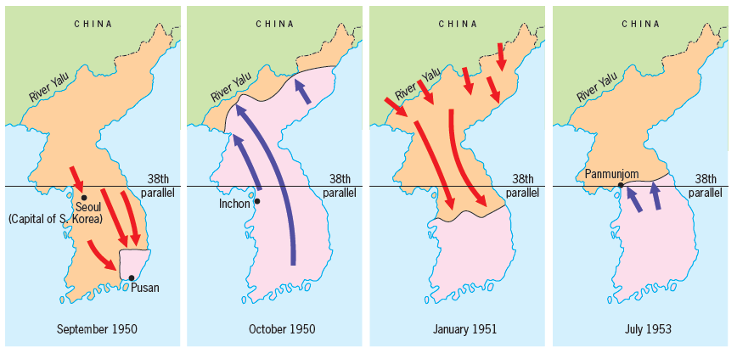
Resource sheet 1.1C (page 3)
Maps of the Korean War, 1950 – 1953
Notes:
Images from Walsh, B. (2013) Cambridge™ IGCSE Modern World History, Hodder Education

