Slide 1
Resource sheet 7.2A
Activity 1 Recording grid (enlarge to A3 if possible)
Source | Experience What was the individual’s experience during the war? | Nature of war What can you learn about the nature of the war from this account? | Impact What was the long-term impact of the war on the individual? | Usefulness How is the source valuable for understanding how Korean people experienced the war?
1
2
3
4
5
6
7

Slide 2
Source 1:
‘A child’s life during the Korean War’ (The story of Jeom Yong Yeum)
EVIDENCE PACK
Resource sheet 7.2A
‘I was 12 years old when the war started… At the time, I was a sixth grader, first year in middle school. During the time, because I was so young, I didn’t realise it was a war until after the war was over. I later heard on the news that there had been a war… I was not able to attend school because I remember that all the buildings were on fire. There was no classroom so I had to study underneath trees. When I was 12 years old, I had to carry rice on my back and wear the same clothes to walk 40 kilometres down the road to the nearest city. It was very tiring finding new refuge.’
Video available at
www.youtube.com/watch?v=U_7srkZh_5k

Slide 3
EVIDENCE PACK
Resource sheet 7.2A
Source 2:
A poem by Ko Un -Yi
Jŏng-yi’s Family
They walked all the way from Chinnamp’o in North Korea
to Hongsŏng in South Korea’s Ch'ungch’ŏng Province.
They walked and walked,
for twenty days they fled.
Yi Jŏn-hae
and her sister Yi Jŏng-yi
with their parents following them.
All day long walking with nothing to eat.
When they found a well they drank
then walked on in the flesh-biting cold.
They dreaded the American troops
so they smeared their clothes
with their own shit.
They spread soot from kitchen chimneys
over their faces.
The mother became
a beggar-mom,
her daughters beggar kids.
Their bodies stank of shit.
Instead of American troops, dogs came running.
Their robust father
likewise
blackened his face. The teeth inside his lips looked stronger still.
When snow fell
they ventured into a village
and were saved by a shed
or an empty cowstall.
Three hundred miles they walked,
arrived at Hongsŏng, settled there.
When China attacked in January ’51,
they never reached there,
being held back near the 38th parallel.
They began a new life amidst the hills and fields of Hongsŏng,
purchased a big hospital.
One daughter, Yi Jŏng-yi got married,
became the poet Kim Young-Moo’s wife. Never late for Mass.
Notes:
Citation: Ko, U. et al. (2007) ‘Five poems from Maninbo (ten thousand lives)’ in Azalea: Journal of Korean Literature & Culture, 1, pp. 295–303. Project MUSE, https://muse.jhu.edu/article/253619

Slide 4
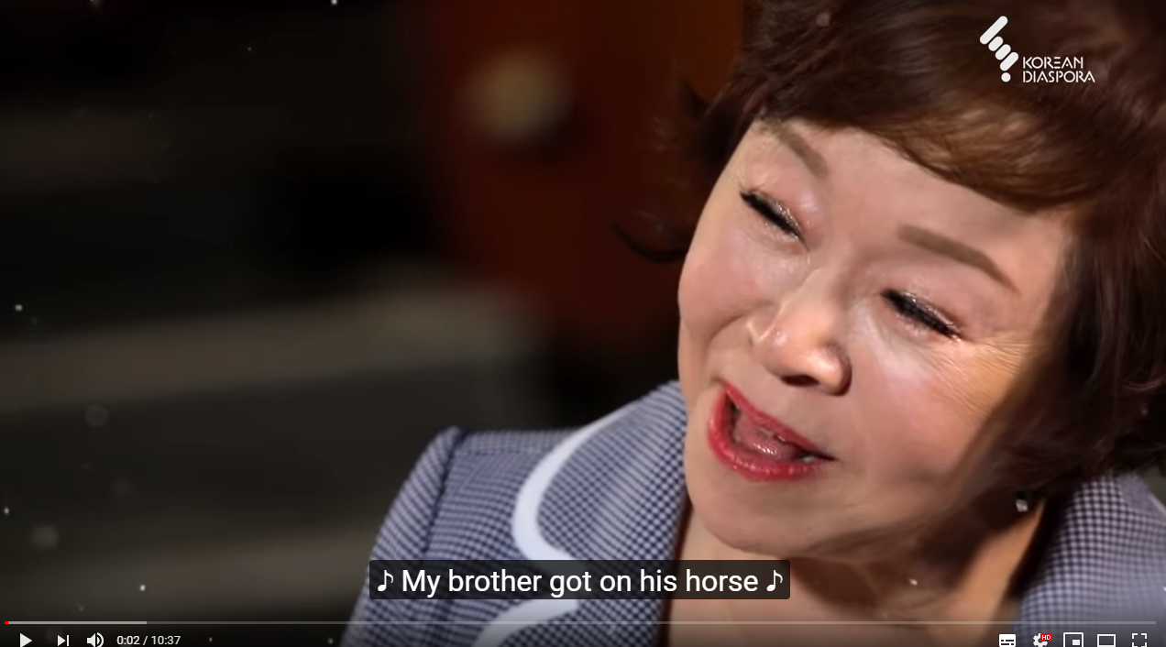
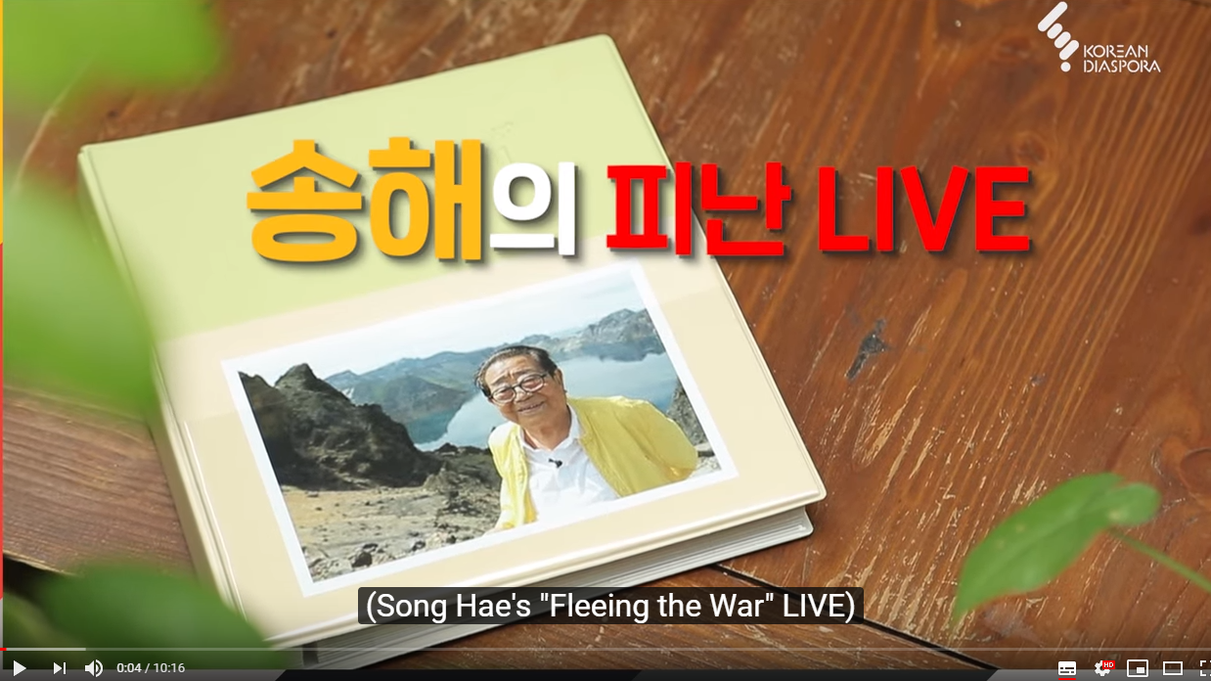
Source 3:
Lee Ji-yeon’s tearful reunion with her North Korean brother – family separation
EVIDENCE PACK
Resource sheet 7.2A
Source 4:
‘My war story’ – Song Hae,
‘Fleeing the war’
Notes:
Left: www.youtube.com/watch?v=WgCExWZaGLU
Right: www.youtube.com/watch?v=tF6Ew8KBNxo

Slide 5
EVIDENCE PACK
Resource sheet 7.2A
Source 5:
‘My grandmother’s real experience during the war’ (Mrs Hong – housewife)
‘During the Korean War, the North Korean army occupied Seoul in three days. The South Korean army were not prepared. Nobody thought they would attack us, but they suddenly attacked us. At the time I was staying near a Red Cross hospital. Everybody was saying we should run away, so we moved to a friend’s house in Mapo (on the edge of Seoul). I saw some soldiers were limping towards us on the way. We thought they were North Korean soldiers and I was terrified, but they were South Korean. During the occupation, there was a communist group called Woman Alliance something and some girls came to visit me several times and asked how much rice I have and how much money I had in the wardrobe. They visited me many times. I was so annoyed that they asked me about things that I owned. At that time, my husband was working in the post office and the North Korean army gave him some accounting work as he was good at mathematics. After the South Korean army recovered Seoul again, I thought we were dead because my husband had worked for the North. But fortunately a friend of my husband was able to persuade the South not to harm him. One North Korean soldier who did not know that the South had recovered Seoul found my husband and held his shoulder and asked him where he was going. He said he had to go to the head office for a budget issue and was released. The North Koreans in Seoul were later moved. I saw some people died and burned on the street. His belly was so swollen and dark. It was horrible.
When the North came again, it was really horrible that time. We had to move to Gongju (90 miles from Seoul) on foot. It was very rough and mountainous. I was holding my baby with my bare hands. We stayed in Gongju for two days, I got bad kidney problems and found it hard to urinate. After the situation changed we went to Busan. We had two chicken and we raised them so they got big. But, one night a guy tried to steal them, but their noise scared him off. However, as he ran off he caused a fire; we tried to throw water on it, but it only made things worse. We threw a chamber pot on the fire. My husband burnt his hands. In my home, there were more than 17 people living in one house, so we ran out of money. But our neighbours thought we were rich.’
Notes:
Transcribed from: www.youtube.com/watch?v=_iTK2fglwuI

Slide 6
EVIDENCE PACK
Resource sheet 7.2A
Source 6:
‘My war story’ – President Moon, South Korean President, 2017
‘Almost 200,000 refugees gathered in Hungnam Port (in North Korea) with 100,000 Korean soldiers who failed to
retreat. According to my parents, the only escape route was by sea, so they went to the port carrying their
belongings. They went to the port everyday to try and get on a ship, but couldn’t, until one day they finally got aboard
(the SS Meredith). The cargo holds were packed with people and they couldn’t lie down or stretch their legs – they travelled for three days in a crouching position. The ship arrived at Geoje Island in December. The American soldiers gave out candy to all the refugees, telling them it was Christmas Eve.
At the time, the population of Geoje island was 100,000. 91,000 refugees from Hungnam arrived. When you added refugees from other regions there were around 150,000 refugees. The residents kindly gave the refugees cooking pots and some food. My parents rented a room in a thatched house. There was a prisoner of war camp that the Americans were managing; my father worked at that base. As for my mother, she bought eggs from famers and would go all the way to Busan to sell the eggs. She took the ferry in the morning to Busan and came back at night. Because life was so hard for refugees, however, many times she wanted to run; however she couldn’t run away and leave Korea because she didn’t know English.’
Notes:
Transcribed from: www.youtube.com/watch?v=3TaVwYHggrw
Start at 4'10

Slide 7
EVIDENCE PACK
Resource sheet 7.2A
Source 7:
‘‘A Korean war Bride’ – Pega Crimbchin (Lee Oksun)
‘Everybody was thirsty, hungry… my parents died. In the beginning, people carried everything. Pots and pans and blankets. Gradually they threw everything down and just walked: even a baby. They wrapped the baby in a blanket, set him in the snow and the baby cried. Nobody could pick it up.
Nobody wanted me. But one lady, thought about it a bit and she said “I can give you a room… you have to bring an American soldier.” I said “I’m scared…” so she went out and said “Who wants a wife?” to three soldiers who were outside. So, my [future] husband and two friends laughed at each other and said “Who wants a wife, let’s go see.”
I felt at the time he was just going to use me. So I wanted to run away and go someplace nobody knew what I was. So I packed up some clothes – he came to see… He showed me his hand and said that he was going to come back for me and marry me. [Marriage between US soldiers and locals was banned at the time.]
(Oksun’s husband petitioned to congressmen and various state departments. She was allowed to become the first bride of an American soldier to be allowed to go and live in the USA.)
Notes:
Transcribed from: www.youtube.com/watch?v=cRrD975R6-s
Start at 1'20

Slide 8
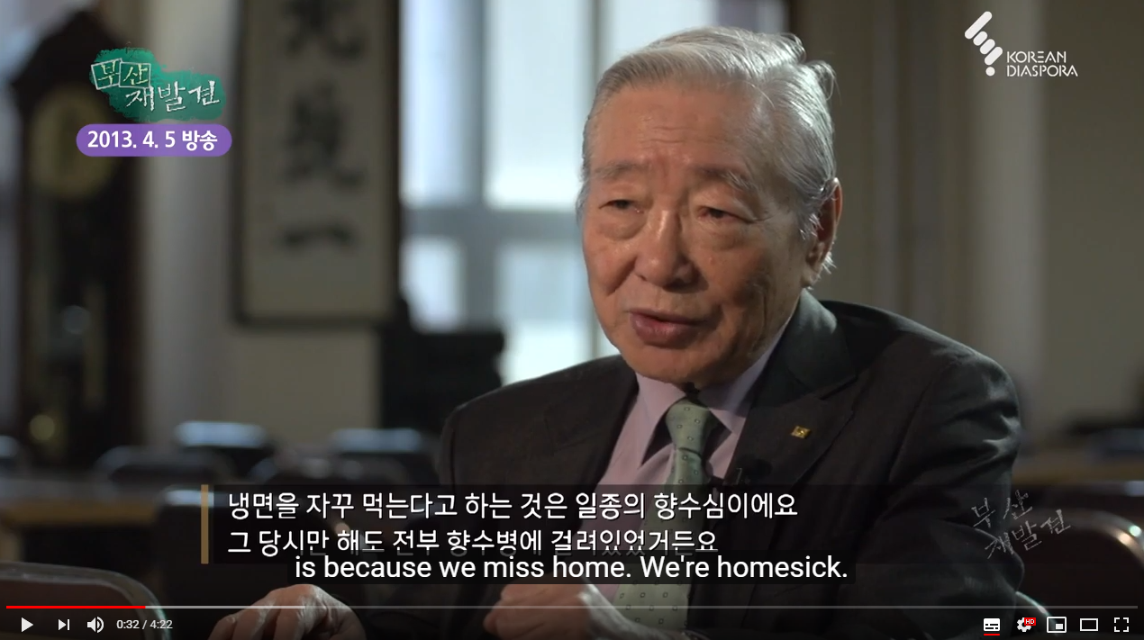
Source 8:
Cold noodles and a survivor’s wish
EVIDENCE PACK
Resource sheet 7.2A
Source 9:
An orphan’s life during the war –
Choi Min-ja
‘When we went to Anyang, I went too fast and lost my parents. I didn’t have any shoes. So barefoot… I was hungry and fainted. Soon after,
a strange Turkish soldier was smiling when I opened my eyes. They tried very hard to get shoes for me.’
[She then became a key part of the Turkish barracks.] Without the soldier, I would not be alive now. Perhaps I would be dead.’
Notes:
Left (Source 8): www.youtube.com/watch?v=rHMQI2GkhGs
Right (Source 9): Transcribed from: www.youtube.com/watch?v=3_VowxgTdKU
From 8:50 ~ 11:25

