Slide 1
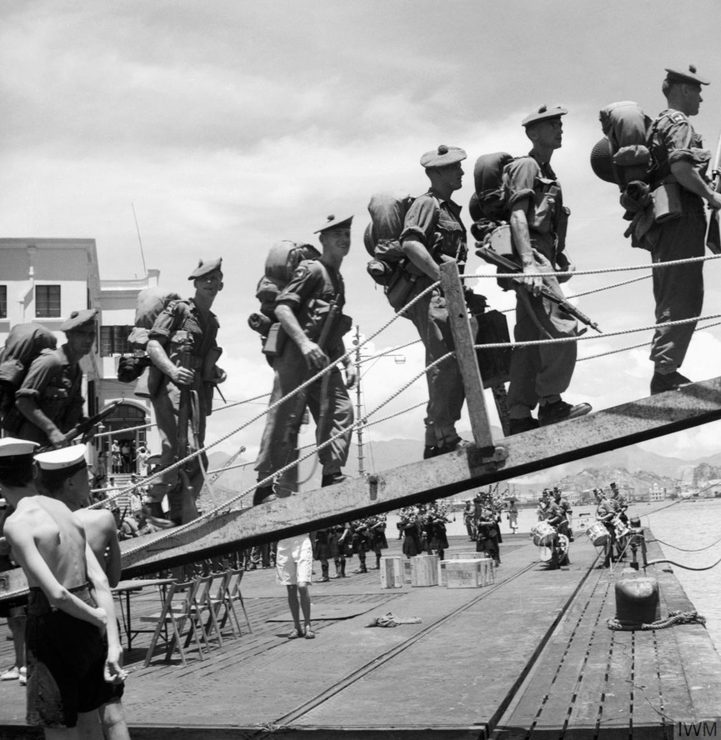
Enquiry 1: An unpopular war? Why did Britain go to war (again) in 1950?
Notes:
Image: © IWM GOV 2738 https://www.iwm.org.uk/collections/item/object/205189536

Slide 2
Why did Captain John Shipster take his golf clubs to war?
Starter part 1
Listen to the one-minute audio clip from an interview with Captain John Shipster.
Then discuss the following questions:
Which country do you think Captain Shipster is from?
To which country do you think he was sent to go to war?
Why do you think he took his golf clubs?
What might that tell us about his expectations of this war?
Notes:
Audio clip at: www.iwm.org.uk/history/voices-of-the-korean-war

Slide 3
Follow the clues to find out more
Starter part 2
Now examine the five more clues that will be displayed on the board. On your whiteboard or Resource sheet 1.1A, write down:
In which country do you think this war might be happening?
Which countries do you think the soldiers have come from?
What were the conditions like in the war?
Why do you think this war might be happening?
Make sure that you can support your answers with evidence from the clues.
Clue #1
It was really terribly, terribly cold. I remember we went to ground for just twenty minutes and in that time, we froze to the ground and our machine guns froze up. As we tried to get up, our clothes were stuck to the ground with dry ice because it was twenty degrees below zero.
We did have petrol heaters in the huts but sometimes they used to set fire to your sleeping bag… and that wasn’t always very funny.
Captain Alberic Stacpoole, a British Army officer

Slide 4
Clue #2
Audio clip from Private Patrick Knowles
‘They give you a stretcher …’
Notes:
www.iwm.org.uk/history/voices-of-the-korean-war – ‘They give you a stretcher’

Slide 5
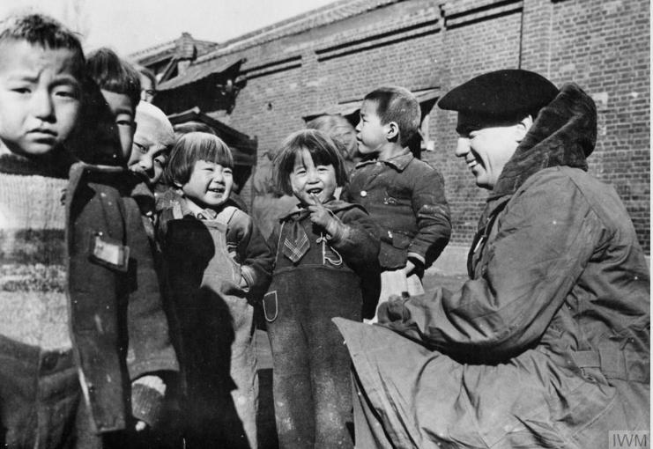
Clue #3
A British soldier talking with some local children
Notes:
Image: © IWM MH 32850 www.iwm.org.uk/history/25-photographs-of-the-korean-war

Slide 6
Clue #4
This peninsula is a symbol to the whole world. If we allow it to fall to Communism, we will have lost another round in our match with the Soviet Union. Our status and the hopes of everyone who places their faith in us will suffer.
A statement from the government of the USA in 1950. A peninsula is an area of land that is mostly but not completely surrounded by water.
Notes:
Quoted in Ferriby, D., Martin, D. and Walsh, B. (2016) Understanding the Modern World, London: Hodder, p. 335

Slide 7
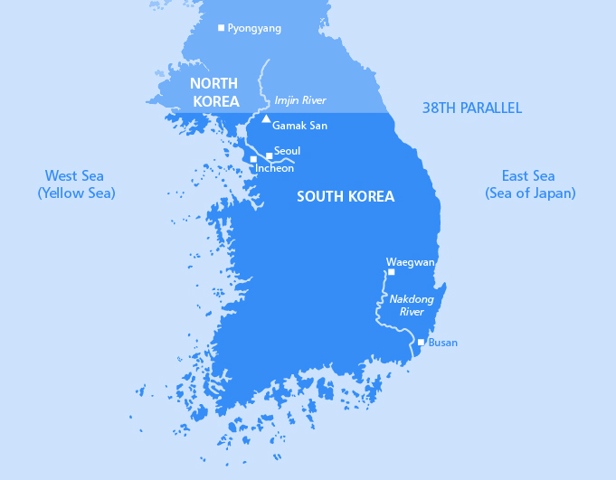
Clue #5
Map of the Korean Peninsula in 1950

Slide 8
Enquiry overview: Why did Britain go to war (again) in 1950?
Lesson 1.1
Why was there a war in Korea and why did Britain join in?
Lesson 1.2
How significant was opposition to the Korean War in Britain?

Slide 9
Lesson 1.1 overview
Lesson 1.1
Why was there a war in Korea and why did Britain join in?
Content covered in the rest of this lesson:
Why did war break out in Korea in 1950?
What happened during the Korean War?

Slide 10
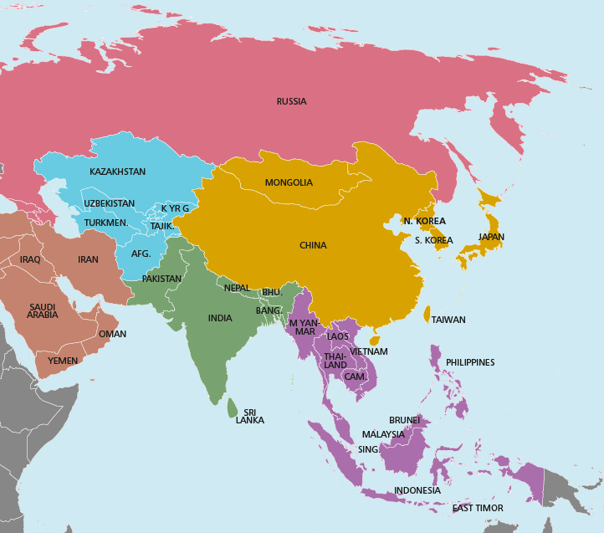
Why did war break out in Korea in 1950?
During the Second World War, Korea was occupied by Japanese troops.
After the war it was divided.
The North was led by a communist, Kim Il Sung.
The South was led by Syngman Rhee. He was not very democratic but he was highly anti-communist.
The Soviet Union supported the North while the South was under the influence of the USA.
Notes:
Image: https://commons.wikimedia.org/wiki/File:Map_of_Asia.svg

Slide 11
Why did war break out in Korea in 1950?
On 25 June 1950, the North’s Korean People’s Army (KPA) invaded South Korea.
The United Nations was quick to respond and encouraged its members to support the South. Many countries sent troops, including the USA, Great Britain, Australia, Canada, India, New Zealand and South Africa.
Explanation A: Some historians believe that the war happened mainly because of tension between the USSR and the USA, who were using Korea as a ‘puppet’ in their Cold War.
Explanation B: Other historians believe that the war was more to do with internal tension inside Korea.
Activity 1
Read the evidence in your explanation grid on the next slide or on Resource sheet 1.1B. Colour-code each card to show which of the explanations it supports.

Slide 12
Why did war break out in Korea in 1950? Explanation grid.
At the end of the Second World War, there were Soviet troops all over Eastern Europe. The Americans saw this as expansion of communism and they determined to stop any further expansion. This policy became known as containment. | China had also become communist in 1949. The Americans had always seen China as their ally and were stung by this. Now, suddenly, a massive new communist state had appeared on the map. China shared a border with Korea. | Korea already had bitter internal divisions in 1945. Peasants made up about 80% of the population and were treated poorly by their landlords. This created tensions within Korean society.
Japan had occupied Korea between 1910 and 1945. Many poorer Koreans believed that their landlords and those higher up in society collaborated (sided with) the Japanese, betraying them. | American spies reported to the US President Truman that the USSR was providing support and resources to help communists to win power in Malaya, Indonesia, Burma, the Philippines and Korea. | When Korea was liberated from Japan in 1945, many Koreans wanted to set up a Korean People’s Republic to give land back to the peasants. But the US occupiers in the South refused to let this happen. They allowed the undemocratic Syngman Rhee and his supporters to take over.
There was already widespread violence, uprisings and assassinations across the South under Syngman Rhee before 1950. | There was bitter hostility between the North Korean communist leader, Kim Il Sung, and Syngman Rhee, President of South Korea. | Kim Il Sung was eager to gain more power. North Korea quickly set up strong links with the new communist regime in China. Kim tried to convince both China and the USSR to support a plan to try to take control of the whole Korean Peninsula. They were eventually persuaded.
 | Supports Explanation A: Evidence that the war was caused by tension between the USA and the USSR.
 | Supports Explanation B: Evidence that the war was caused by tension that already existed within Korea.
Notes:
This is a resource, not a slide to display

Slide 13
Why did war break out in Korea in 1950?
Activity 1 recap
Which of the following statements do you most agree with?
‘War broke out in Korea because of tension between the USSR and the USA, who were using Korea as a “puppet” in their Cold War.’
‘War broke out in Korea because of internal tension inside Korea.’
‘War broke out because of local tensions, which were made worse by the tension between the USA and the USSR.’

Slide 14
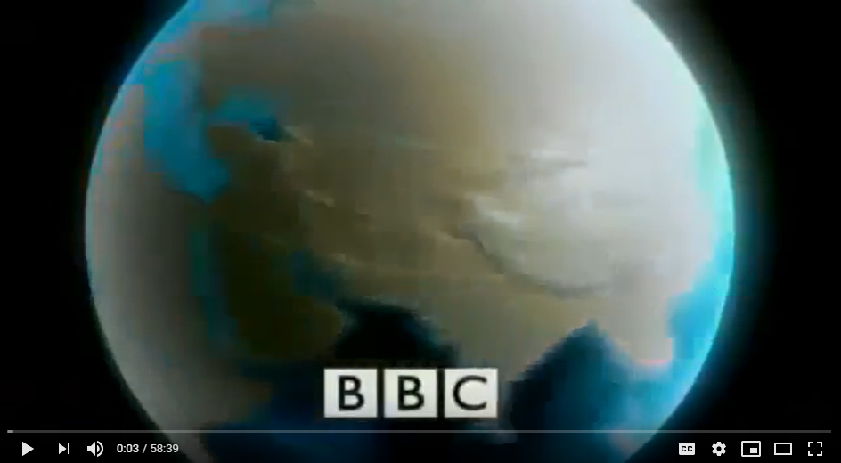
What happened during the Korean War?
Activity 2
Watch the short video clip, which introduces the war.
Read the timeline on the next slide, then use Resource sheet 1.1C to place the four maps in correct date order.
Notes:
Video: www.youtube.com/watch?v=iLV3eonORPc (20th Century Battlefields: 1951 Korea, by Dan and Peter Snow, BBC)

Slide 15
Timeline of the Korean War
1950
25 June 1950 – North Korea invaded South Korea with approximately 100,000 troops. North Korean troops overwhelmed the South’s forces. By September 1950, all except a small corner of south-east Korea was under communist control.
27 June 1950 – The United Nations sent troops to Korea. In 1950, UN and South Korean forces numbered between 80,000 and 100,000, increasing to 240,000 by spring 1951.
15 September 1950 – United Nations forces stormed ashore at Inchon in September 1950. At the same time, other UN forces and South Korean troops advanced from Pusan. The North Koreans were driven back beyond their original border (the 38th parallel) within weeks.
20 October 1950 – But the Americans did not stop. Despite warnings from China, the UN approved a plan to advance into North Korea. By October, US forces had taken the North Korean capital Pyongyang and reached the Yalu River and the border with China.
25 October 1950 – 200,000 Chinese forces entered Korea. As the war progressed, China’s involvement increased and eventually rose to around 1 million.
1951
4 January 1951 – Chinese and North Korean forces drove the UN and South Korean forces back again. As the freezing cold winter weather drew in, the Chinese advance continued and they recaptured South Korea’s capital Seoul on 4 January 1951.
March 1951 – In the next few months, the UN and South Korean forces were able to regroup. They retook Seoul in March 1951.
April 1951 – Chinese and North Koreans launched another offensive in April 1951 along the Imjin River. Ferocious fighting followed, including a famous action by British troops from the Gloucestershire Regiment. There were heavy casualties on all sides but the defences held to the north of Seoul and in the valley of the Imjin River.
May 1951 – By now, fighting was focused on the 38th parallel, with each side having been pushed back to their own respective area of Korea. What followed was a stalemate, similar to the trench warfare that had been seen on the Western Front in the First World War.
1953
27 July 1953 – Peace talks had begun in June 1951. There is much debate about why this stalemate continued until July 1953. An armistice was finally signed in July 1953, but the war never officially ended. North Korea remains divided today and the border zone between the two Koreas remains a tense and heavily fortified area.
15

Slide 16
What happened during the Korean War?
Activity 2 review
Start of September 1950
October 1950
January 1951
July 1953
Notes:
From: Walsh, B. (2013) Cambridge™ IGCSE Modern World History, Hodder Education, p. 97

Slide 17
The never-ending war
Over the three years of war, 1950–1953:
The UN suffered over 30,000 casualties during the war, most of whom were US troops. There were around 500,000 Chinese casualties.
Britain suffered 1,078 killed in action, 2,674 wounded and 1,060 missing or taken prisoner.
Korea suffered 1.3 million causalities – with equal numbers from the North and South – and one in ten Korean civilians died.
At the end of the war:
There was an armistice (ceasefire) in 1953 but no peace treaty – ever! So, technically speaking, the two countries of North Korea and South Korea are still in a state of war.
Neither North nor South Korea obtained the united Korea that they were both fighting for. The border along the 38th parallel remains today.
Relationships between the two countries are often very tense.

Slide 18
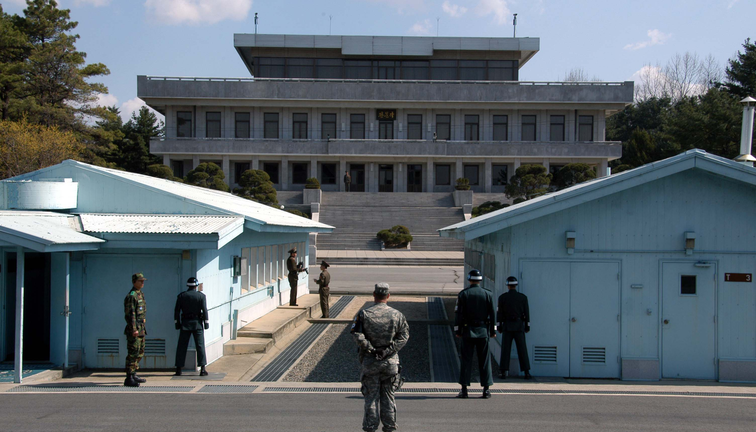
Plenary
Write a 25–50-word caption to go with this photograph. Make sure you include:
Why you think the war broke out.
What had happened in Korea by July 1953.
Notes:
Image: https://commons.wikimedia.org/wiki/File:070401_Panmunjeom3.jpg

