Slide 1
Enquiry overview: A forgotten war? Unearthing the voices of British veterans of the Korean War
Lesson 2.1
Why has the Korean war been called a forgotten war in Britain?
Lesson 2.2
Helping people to remember the Korean War

Slide 2
Lesson 2.2 Overview
Lesson 2.2
Helping people to remember the Korean War
An overview of the British soldiers’ experience in Korea

Slide 3
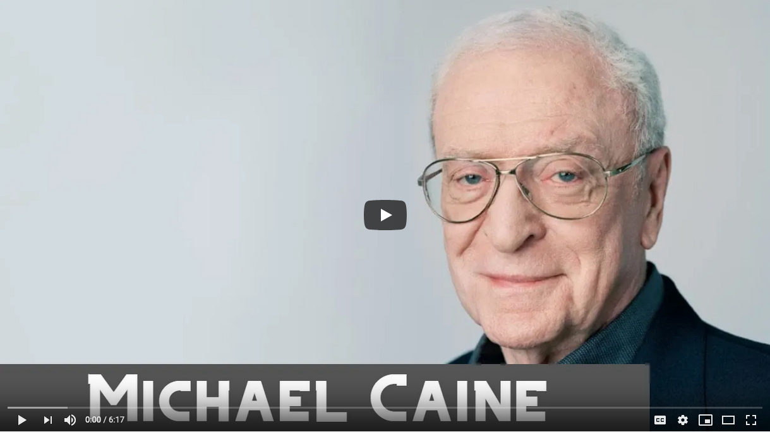
Recap
Listen to what Sir Michael Caine says:
How does he back up what we already know about Korea?
What does he say about his experiences as a soldier?
Notes:
Video: https://www.youtube.com/watch?v=DxJI7Uz8xnU
Image: https://commons.wikimedia.org/wiki/File:Sir_Michael_Caine,_28th_EFA_Awards_2015,_Berlin_(cropped).jpg

Slide 4
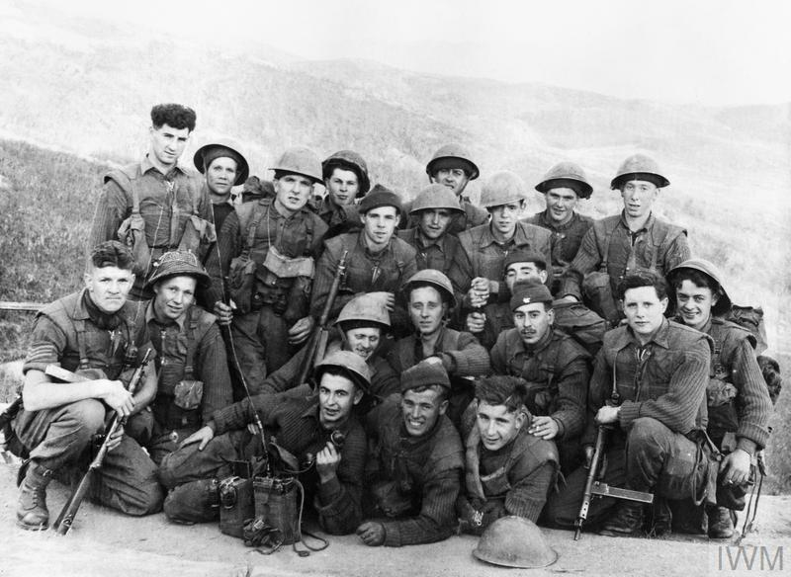
Initial impressions of the British soldiers’ experience in Korea
Use the photographs in your Source bank (Slides 5–9 or Resource sheet 2.2A) to gather impressions of the war in Korea.
Consider:
Terrain
Climate
Types of warfare
The Chinese Army
How the war affected Korean civilians, including children
1st Battalion The Black Watch pose for the camera before going out on patrol.
Notes:
Image: © IWM (KOR 617) www.iwm.org.uk/collections/item/object/205124608

Slide 5
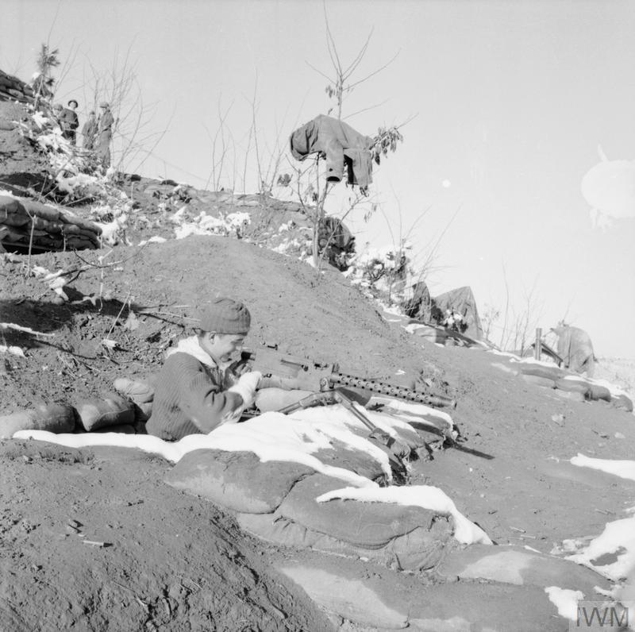
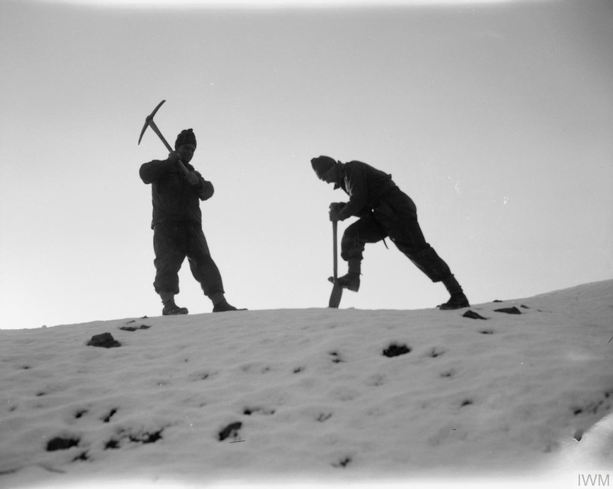
SOURCE BANK
Source A
Private Frank Holden of the 1st Battalion, The King’s (Liverpool) Regiment, cleaning his Browning machine gun in Korea.
Source B
Men of the 1st Battalion, The Royal Ulster Rifles in ‘Happy Valley’, north of Seoul, just before the Chinese attack of 2 January 1951.
Notes:
Left: © IWM BF 10896 www.iwm.org.uk/collections/item/object/205190661
Right: © IWM BF 223 www.iwm.org.uk/collections/item/object/205190848

Slide 6
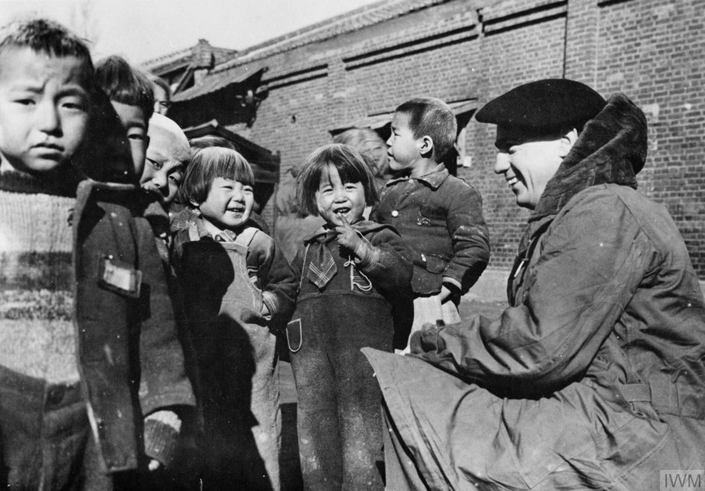
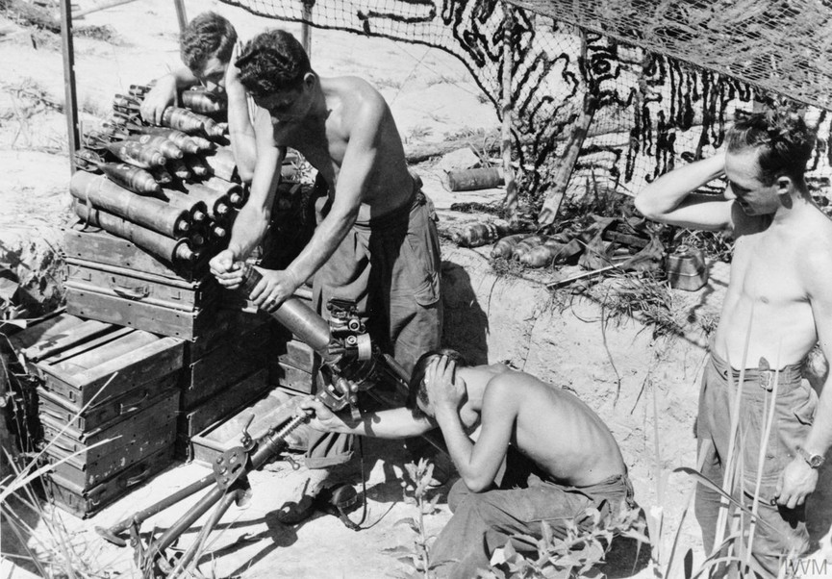
SOURCE BANK
Source C
A British soldier talks with Korean children.
Source D
The King’s Own Scottish Borderers during an intensive bombardment of Chinese-held hills. Left to right: Lance Corporal Bill Hunter; Private Jim Beveridge; and Private Tony Donaldson.
Notes:
Left: © IWM MH 32850 www.iwm.org.uk/collections/item/object/205190740
Right: © IWM BF 10896 www.iwm.org.uk/collections/item/object/205191685

Slide 7
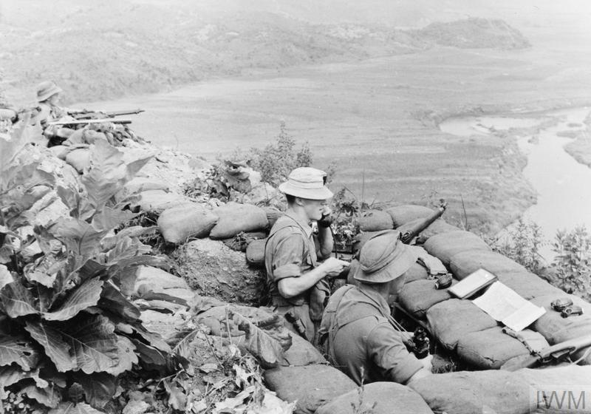
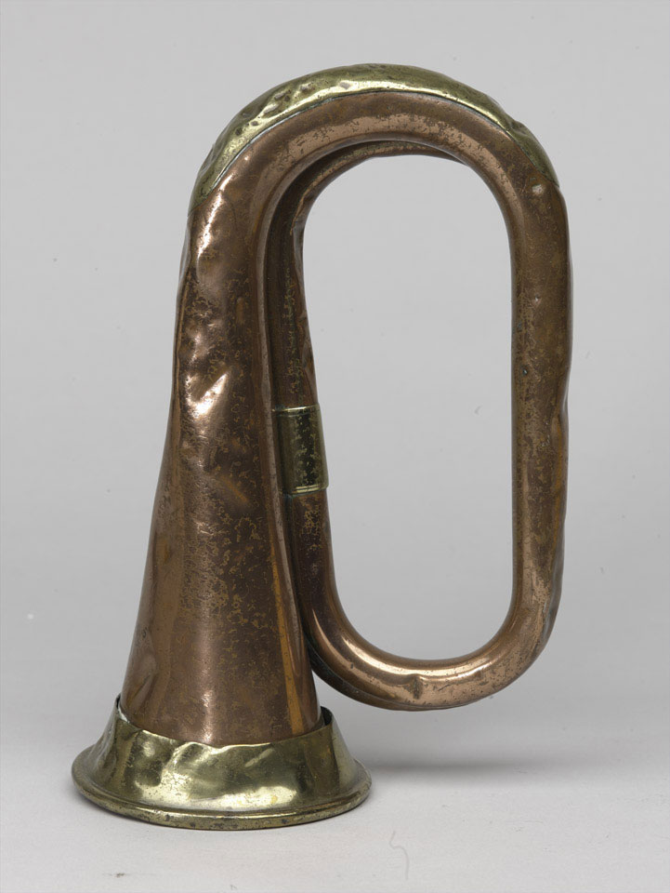
SOURCE BANK
Source E
The King’s Own Scottish Borderers: Lance Corporal John Private John Dunbar, Private John Devine (with rifle) and Lance Corporal Ted Arbuthnott watch for enemy movement across the valley.
Source F
A means of communication used by the Chinese fighters.
Notes:
Left: © IWM KOR 607 www.iwm.org.uk/collections/item/object/205191682
Right: Image courtesy of the National Army Museum, London https://collection.nam.ac.uk/detail.php?acc=1997-07-44-1

Slide 8
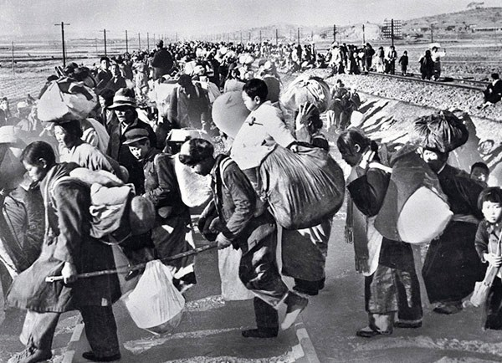
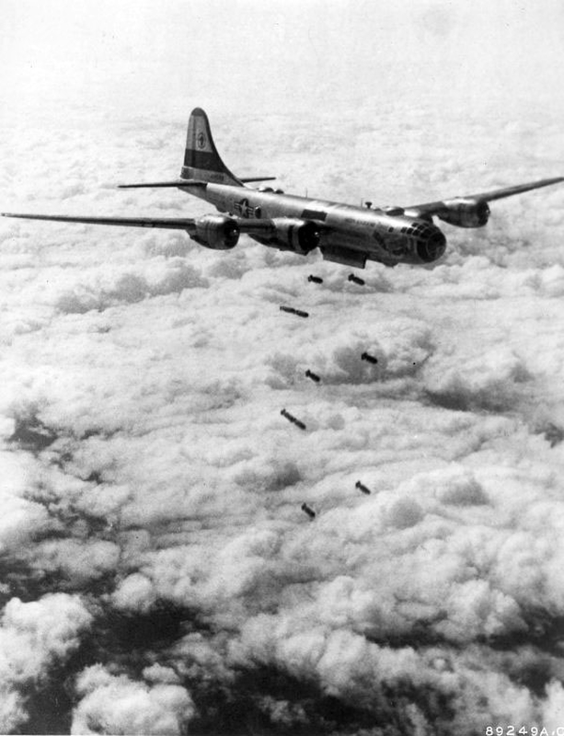
SOURCE BANK
Source G
Korean families made homeless and fleeing the fighting.
Source H
American bombers in action.
Notes:
Left: US Defense Department https://commons.wikimedia.org/wiki/File:South_Korean_refugees_mid-1950.jpg
Right: US Air Force https://commons.wikimedia.org/wiki/File:WarKorea_B-29-korea.jpg

Slide 9
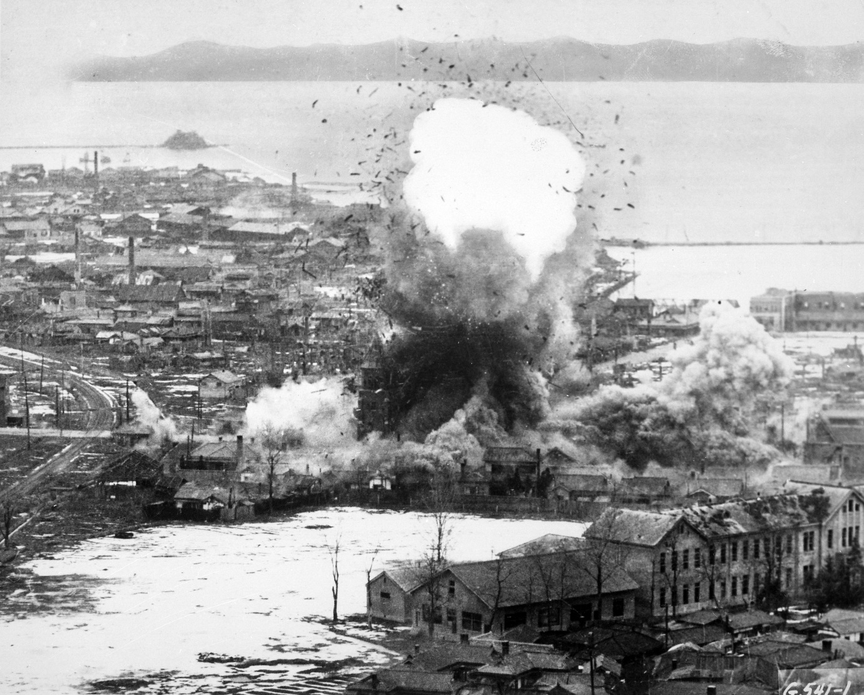
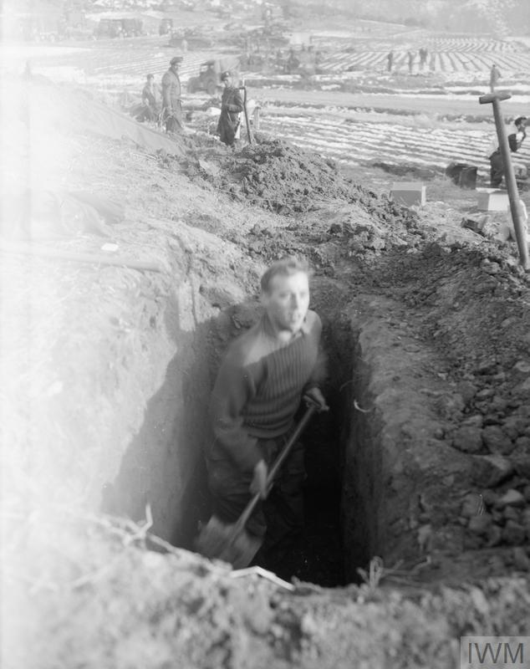
SOURCE BANK
Source I
American bombs falling on Wonsan in North Korea.
Source J
Member of the Royal Ulster Rifles digging a trench in Korea.
Notes:
Left: US Air Force https://commons.wikimedia.org/wiki/File:Korean_War_bombing_Wonsan.jpg
Right: © IWM BF 224 www.iwm.org.uk/collections/item/object/205190850

Slide 10
Timeline of the Korean War 1950–53
This brutal three-year war left millions of North and South Koreans dead, and over 100,000 casualties for the United Nations forces involved.
British casualties were high: 1,078 killed in action, 2,674 wounded and 1,060 missing or taken prisoner.
Estimates suggest that at least two million North and South Korean civilians died and at least 50,000 children became orphans.
Watch this clip and then complete the timeline activity on Resource sheet 2.2B.
Notes:
Video: www.youtube.com/watch?v=-X7nbwFxGRU

Slide 11
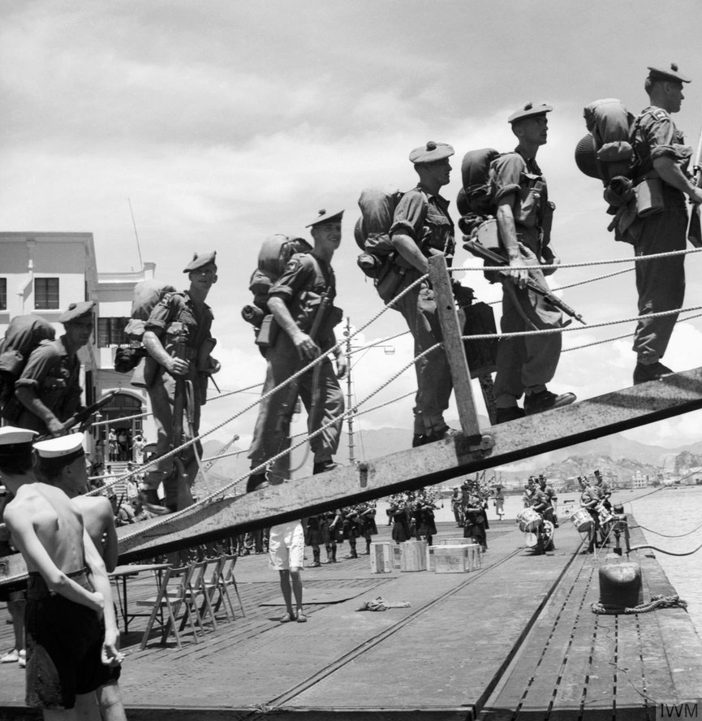
What the veterans say about the fighting
Gather evidence from the veterans’ testimonies on Resource sheet 2.2C about:
What it was like fighting in Korea
Trench warfare
What the soldiers say about the effects of the war on the Korean people and the cities in Korea
The Chinese Army
Then use all the evidence to complete your overview of the British soldiers’ experience in Korea.
Notes:
Image: © IWM GOV 2738

Slide 12
Korea does not have to be a ‘forgotten war’ and you can help
On your own copy of the United Nations Korea medal (Resource sheet 2.2D), write something that you remember about the Korean War – for example, something that has surprised you, shocked you or moved you.
Notes:
Image: https://commons.wikimedia.org/wiki/File:Korea_Medaille_van_de_Verenigde_Naties.jpg

