Slide 1
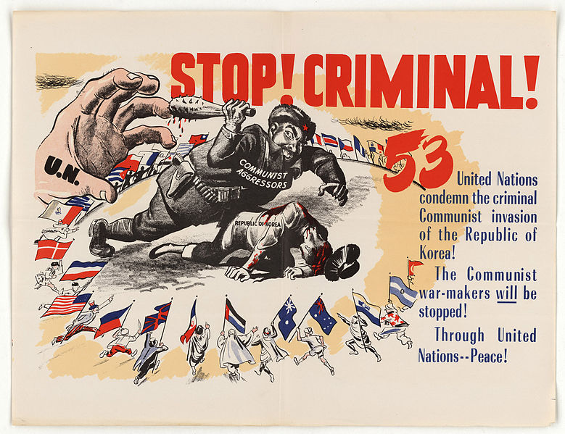
Source 1:
An American poster produced during the Korean War. The number ‘53’ refers to the number of countries in the UNO that condemned Chinese intervention in Korea.
Resource sheet 4.1A
Evidence pack
Notes:
Image: U.S. National Archives and Records Administration, https://commons.wikimedia.org/wiki/File:Stop_Criminal!_-_NARA_-_5730086.jpg

Slide 2
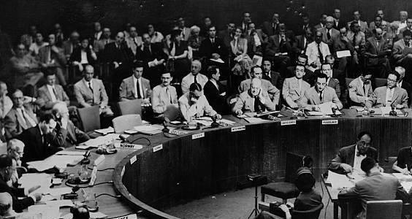
Resource sheet 4.1A
Evidence pack
Source 2:
This photo shows the Security Council meeting in 1950. Can you see whose chair is empty?
Notes:
Image: Credit unknown, https://nedforney.com/index.php/2018/07/03/united-nations-resolution-korean-war/

Slide 3
Source 3:
The UN Security Council votes to intervene in the Korean War
Resource sheet 4.1A
Evidence pack
‘At the State Department’s urgent request, a special session of the UN Security Council was called by Secretary General Trygve Lie for Sunday afternoon. The Soviet Union had walked out of the Security Council in January to protest the UN decision not to admit Communist China, and it was still boycotting the Council in June.
Under these extraordinary circumstances, the Security Council unanimously condemned North Korea’s aggression and called for a withdrawal to the 38th Parallel. Two days later, on 27 June, the UN went even further by calling on all member states to extend military aid to South Korea.
With the Soviets absent from the Security Council, the UN voted for the first time to send a military force to assist one country attacked by another.’
From Isaacs, J. and Downing, T. (1998) Cold War, Bantam Press, pp.100–101
State Department = a branch of the US government

Slide 4
Resource sheet 4.1A
Evidence pack
Source 4: UN Members that contributed to the UN force in the Korean War
Countries that sent armed forces
Country | Total man-days | Ground troops | Naval forces | Air forces
USA | 1,789,000 | 302,483 men (8 infantry divisions; 1 marine division; 2 regiment combat units) | Naval Forces Far East 7th Fleet | Air Forces Far East
UK | 56,000 | 14,198 men (2 infantry brigades; 1 marine commando) | 17 war vessels (including 1 aircraft carrier)
Australia | 8,407 | 2,882 men (2 infantry battalions) | 1 aircraft carrier; 2 destroyers; 1 frigate | 1 combat flying unit; 1 transport formation flying unit
Canada | 25,687 | 6,614 men (1 infantry brigade) | 3 destroyers | 1 transport flying unit
Netherlands | 5,322 | 819 men (1 infantry battalion) | 1 destroyer
New Zealand | 3,794 | 1,389 men (1 infantry battalion) | 1 destroyer
France | 3,421 | 1,119 men (1 infantry battalion) | 1 destroyer
Turkey | 14,936 | 5,455 men (1 infantry brigade)
Philippines | 7,420 | 1,496 men (1 infantry battalion)
Thailand | 6,326 | 1,294 men (or 2,274) (1 infantry battalion) | 7 frigates: 1 transport ship | 1 transport formation flying unit
Greece | 4,992 | 1,263 men (1 infantry battalion) |  | 1 transport formation flying unit
South Africa | 826 |  |  | 1 combat flying unit
Ethiopia | 3,518 | 1,271 men (1 infantry battalion)
Colombia | 5,100 | 1,068 men (1 infantry battalion) | 1 frigate
Belgium | 3,498 | 900 men (1 infantry battalion)
Luxemburg | 83 | 44 men (1 infantry platoon)
Countries that sent units in charge of medical treatments
Country | Total man-days | Personnel and supporting units
Sweden | 160 | 154 personnel; Red Cross hospital
India | 627 | 70 personnel; 60th field hospital
Denmark | 630 | 100 personnel; hospital ship
Norway | 623 | 105 personnel; mobile surgery
Italy | 128 | 72 personnel; 68th Red Cross hospital

Slide 5
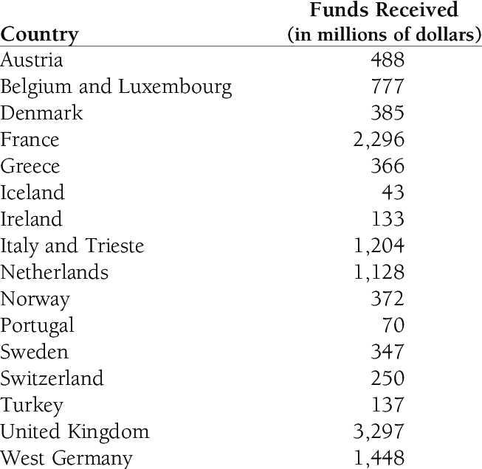
Source 5:
The funds that countries received in Marshall Aid from 1948–1951
Resource sheet 4.1A
Evidence pack
Notes:
Marshall Plan Aid, 1948-51 from The Triumph of Hope over Experience: A Marshall Plan for Sub-Saharan Africa? - Scientific Figure on ResearchGate. Available from: https://www.researchgate.net/figure/Marshall-Plan-Aid-1948-51_tbl1_228797846 [accessed 30 Dec, 2019]

