Slide 1

Resource sheet 4.2A
Enquiry question: How significant a role did members of the UN
play in the Korean War?
Case study 1
Denmark
Total man-days contributed | Number of people sent to Korea | Supporting units sent
630 | 100 | 1 hospital ship, the Jutlandia

Slide 2
Case study 1: Denmark
Resource sheet 4.2A
Guiding questions:
Read Source 2. From the first paragraph, what can you infer from the source about Danish people’s reaction to the Korean War?
According to Sources 2 and 5, in what ways did the Jutlandia serve soldiers fighting in the Korean War?
Why do you think that the author of Source 2 describes the Jutlandia as
‘a memorable chapter in history that Danes are proud of’? Hint: Look at the provenance of the source to help you to answer this question.
How significant was the Danish contribution to the Korean War? Use all of the sources and your own knowledge to help you to answer this question.

Slide 3
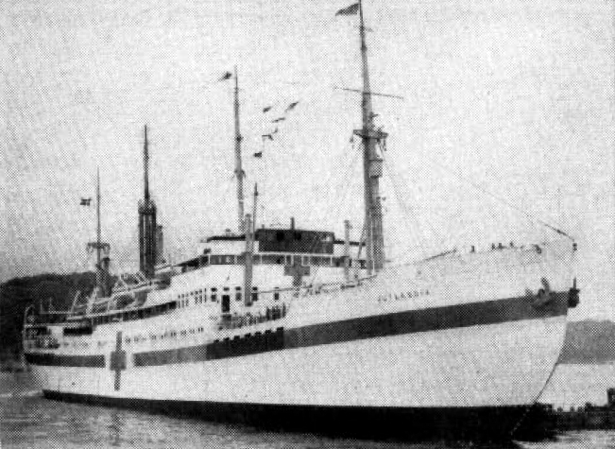
Resource sheet 4.2A
Case study 1: Denmark
Source 1: Photo of the Danish medical ship Jutlandia in Korea, 1951
Notes:
Image: US Navy, https://commons.wikimedia.org/wiki/File:Danish_hospital_ship_Jutlandia_in_Korea_1951.jpg

Slide 4
Resource sheet 4.2A
Case study 1: Denmark
The Jutlandia is a memorable chapter in history that Danes are proud of. When the Danish government published advertisements to recruit medical personnel for the Korea mission, they were deluged with applications from across the country. For instance, when they needed to hire 42 nurses, 4,000 nurses applied nationwide. It was also the case for doctors. As a result, they were able to dispatch the best medical team with the most successful treatment rate among all the other multinational medical teams dispatched to Korea at the time.
During the Korean War, around 5,000 U.N. soldiers were treated aboard the Jutlandia, and only 29 of them died. A number of U.N. soldiers were found to have attached a memo to their military identification tags stating, ‘Please let me be treated on the Jutlandia if I am injured.’ The medical staff on the ship also left a deep impression among Koreans as they also treated thousands of civilians, mostly young children. This was made possible by the state-of-the-art technology of the Jutlandia as well as the humanism of the staff on board.
Source 2: Article from the Korean Herald from 2016 – the author is Ma Young-Sam, Korea’s ambassador to Denmark. The article was written in celebration of the 65th anniversary of the dispatch of the Jutlandia to Korea.

Slide 5
Resource sheet 4.2A
Case study 1: Denmark
‘Wow, talk about luxury, I even had my own stateroom. I also had the best looking
blood technician God ever put on the face of this earth. Young, sweet, blonde, slim, gorgeous... but she also was the lady who did the blood smears each morning...’
Source 3: A young marine patient, after his second of three wounds during the Korean War
Notes:
www.koreanwaronline.com/arms/jutland.htm

Slide 6
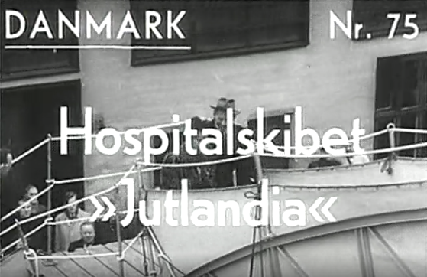
Resource sheet 4.2A
Case study 1: Denmark
Video http://euscreen.eu/item.html?id=EUS_C7D2B053249F463EA19D420490D10E1B
Source 4: The hospital ship Jutlandia is inspected by the Danish King before departure to Korea
Notes:
Video: http://euscreen.eu/item.html?id=EUS_C7D2B053249F463EA19D420490D10E1B

Slide 7
Resource sheet 4.2A
Case study 1: Denmark
Jutlandia was originally a combined passenger and cargo ship, but it was rebuilt to fit the requirements of a hospital ship, when the Danish Government decided to support the UN Forces in 1950. The ship could accommodate more than 350 patients, and it was fitted with state of the art operating rooms and equipment. Furthermore the doctors on board were some of the most prominent surgeons at the time, and during the mission they performed ground breaking medical procedures. Even today Danes still commemorate the effort of Jutlandia and its crew during the Korea War, which is especially due to a famous song – ‘Jutlandia’ by Danish troubadour Kim Larsen, who described the heroic deeds performed on the ship.
Source 5: Article from the Ministry of Foreign Affairs of Denmark website, 2013

