Slide 1

Resource sheet 4.2B
Enquiry question: How significant a role did members of the UN
play in the Korean War?
Case study 2
The Netherlands
Total man-days contributed | Number of people sent to Korea | Supporting units sent
5,322 | 1 infantry battalion (819 men) | 1 destroyer (warship)

Slide 2
Resource sheet 4.2B
Case study 2: The Netherlands
Guiding questions:
Read Source 1. What did the Dutch government initially offer as its contribution
to the Korean War? In what way did the Netherlands change its contribution to
the conflict?
Look at Source 2. How much did the Netherlands receive in Marshall Aid from
the USA? How does this compare with other European countries? What does
this suggest about the relationship between the USA and the Netherlands during
the 1950s?
Read Source 3. What do you think the author of the source means by ‘the increase
of military spending became a condition for aid’?
According to Source 4, what was the USA’s aim in providing aid to Western
Europe in 1951?
Using all the sources, explain the reasons behind the Netherlands’ contribution to the Korean War.

Slide 3
Resource sheet 4.2B
Case study 2: The Netherlands
On 3 July 1950, the Dutch government offered to provide the destroyer HNLMS Evertsen, stationed in Indonesia, for the UN operation in Korea. On 15 July 1950, Secretary-General Trygve Lie once again called upon the Dutch government.
The UN was in dire need of reinforcements in the form of infantry battalions. Bowing to immense pressure from the US, the cabinet agreed to provide an infantry unit made up
of volunteers: the Netherlands Detachment United Nations (NDVN). 2 rifle companies,
a support company and a headquarters and headquarters company were formed from these volunteers. Between a 100 and 300 Katusas (Korean Army Troops United States Army), also known as ROKS (Republic of Korea Soldiers), were assigned to the unit.
Source 1: ‘Korean War: the Dutch contribution’ from the Dutch Ministry of Defence website
Notes:
https://english.defensie.nl/topics/historical-missions/mission-overview/1950/the-korean-war/dutch-contribution

Slide 4
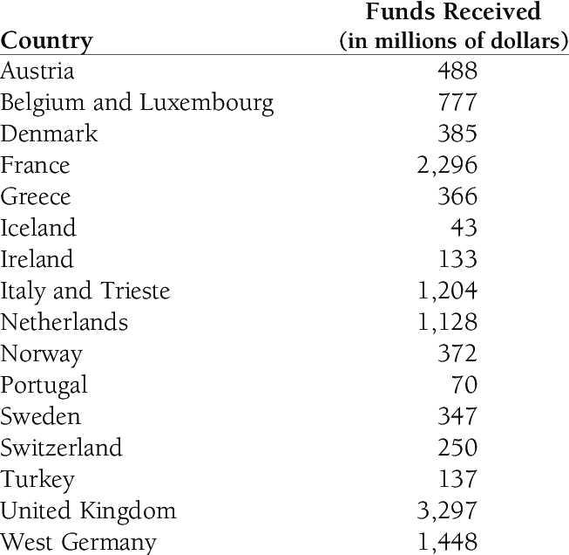
Resource sheet 4.2B
Case study 2: The Netherlands
Source 2: The funds that European countries received from Marshall Aid from 1948–1951
Notes:
Marshall Plan Aid, 1948–51 from ‘The Triumph of Hope over Experience: A Marshall Plan for Sub-Saharan Africa?’ – scientific figure on ResearchGate. www.researchgate.net/figure/Marshall-Plan-Aid-1948-51_tbl1_228797846

Slide 5
Resource sheet 4.2B
Case study 2: The Netherlands
In the course of the years the European Recovery Plan (Marshall Aid) increasingly became a political instrument in the US Cold War strategy. From 1951 onwards, the increase of military spending became a condition for aid. As phrased in a document outlining what this meant for Economic Cooperation Administration (ECA) information policy, the ‘recovery phase’ had ended
and the ‘defense phase’ begun. Under the Mutual Defense Assistance Program, the U.S. went to also give military aid to European countries, among which [was] the Netherlands.
The ECA recognized that its ‘evolution into a principal implement for free world rearmament’ demanded a ‘fresh direction’ in their informational policies and operations. While it was important for the ECA to ‘retain [their] own clear identity and freedom of action,’ closer cooperation with the Department of State and Defense had now become necessary. In October 1951, the economic and military aid programs were dissolved into the Mutual Security Act. The ECA then became the Mutual Security Agency.
The ECA was a US Government Agency set up in 1948 to administer the Marshall Plan.
Source 3: ‘Selling the Marshall Plan to the Dutch: the ECA Mission to the Netherlands’ from The Roosevelt Institute for American Studies
Notes:
www.roosevelt.nl/%E2%80%9Cselling%E2%80%9D-marshall-plan-dutch-eca-mission-netherlands

Slide 6
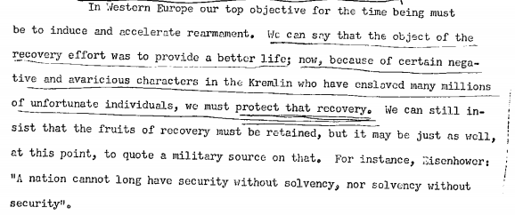
Resource sheet 4.2B
Case study 2: The Netherlands
Source 4: ECA Informational Guidance, a US government document written in 1951.
The ECA was the government department that administered Marshall Aid.
Notes:
www.roosevelt.nl/sites/zl-roosevelt/files/219-224_1951_eca_informational_guidance.pdf

Slide 7
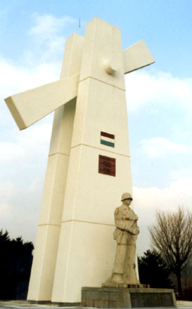
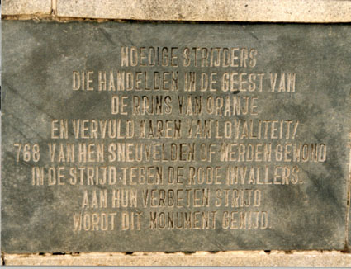
Resource sheet 4.2B
Case study 2: The Netherlands
Source 5: The Dutch memorial to soldiers who were killed in the Korean War
Valiant fighters, who acted in the spirit
of the Prince of Orange,
and were filled with loyalty,
768 of them fell or were wounded
in the struggle against the red invaders
to their determined fight
this monument is dedicated
Notes:
Images: www.zum.de/whkmla/region/lowcountries/ndvn.html

