Slide 1
Resource sheet 4.2C
Enquiry question: How significant a role did members of the UN play in the Korean War?
Case study 3
Turkey
Total man-days contributed | Number of people sent to Korea | Supporting units sent
14,936 | 1 infantry brigade (5,455 men) | Nil

Slide 2
Resource sheet 4.2C
Case study 3: Turkey
Guiding questions:
Read Source 1. In what ways did Turkish troops contribute to the UN coalition during the Korean War? Bullet-point your ideas using the source.
Look at Source 4. What can you infer from the source about conditions that soldiers faced at the Battle of Kunu-ri in November, 1950?
What do Sources 2 and 3 show about the significance of the Turkish contribution to the Korean War? What do they also suggest about the limitations of a multi-national UN army?
What is the attitude of the Turkish officer towards his captors in Source 4?
How useful is Source 5 in understanding the role that Turkish soldiers played in the Korean War?
How far does Source 5 corroborate the claims made about the Turkish soldiers in Source 6?

Slide 3
Resource sheet 4.2C
Case study 3: Turkey
The Turkish intervention in Korea was unique in its timeliness and urgency. The 5,000-man Turkish brigade arrived in October 1950 as U.S. forces, then acting as part of a United Nations coalition, were struggling to survive a powerful Communist Chinese offensive. The following month, the brigade managed to halt an onslaught of six Chinese divisions around Kunu-ri. After the brigade helped stabilize the front, the Commander of the UN Coalition Forces, General Douglas MacArthur, said, ‘the Turks are the hero of heroes. There is no impossibility for the Turkish Brigade.’
As the war went on, Turkish soldiers continued to bravely aid UN forces, earning recognition from General Walton H. Walker, commander of the U.S. 8th Army, and President Harry Truman, who awarded the Turkish brigade a Presidential Unit Citation. The prestigious award, given to units of the U.S. Armed Forces and allied countries for extraordinary heroism against an armed enemy, recognized the Turkish brigade’s efforts to save the U.S. 2nd Division from total annihilation, losing 717 men in the process.
Turkey ultimately became the fourth largest military contributor to the UN effort, with a total of 15,000 Turkish troops serving in Korea at various times during the war. The camaraderie on the battlefield led to deep relations between American and Turkish soldiers. After they arrived in Korea, the Turkish troops were trained and equipped by the U.S. Army, giving soldiers and officers several opportunities to strengthen their personal and professional ties.
Source 1: Extract from an article ‘Turkey: Forgotten Ally in a Forgotten War’ (2012) by Richard Weitz, an American political-military analyst.
Notes:
www.hudson.org/research/9164-turkey-forgotten-ally-in-a-forgotten-war

Slide 4
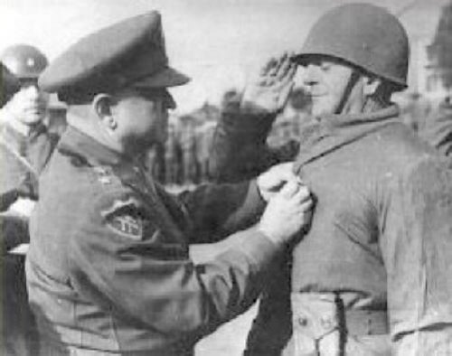
Resource sheet 4.2C
Case study 3: Turkey
Source 2: The leader of the Turkish Brigade, Tahsin Yazici, is decorated by the US four-star general Walton Walker, following the action at Kunu-ri (also known as the Battle of Wawon)
Notes:
Image: US Army, https://commons.wikimedia.org/wiki/File:WaltonWalker%26TahsinYazici.jpg

Slide 5
Resource sheet 4.2C
Case study 3: Turkey
Their commander, aging Brig. Gen. Yazici, was highly regarded in the Turkish military establishment and willingly stepped down a rank in order to command the first contingent of Turks in Korea. He had only one drawback – no real command of English – yet he was attached to an American division. Later, that lack of language proficiency would prove to be a major hindrance to his understanding of orders and troop deployments.
Source 3: From an article featured in Military History (December 1997)
Notes:
www.historynet.com/korean-war-1st-turkish-brigades-baptism-of-fire.htm

Slide 6
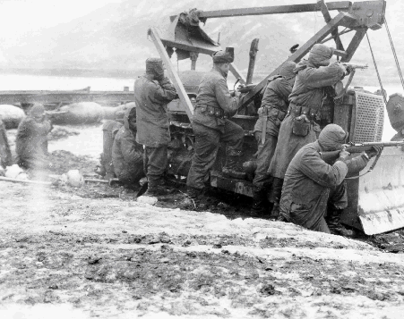
Resource sheet 4.2C
Case study 3: Turkey
Source 4: This photograph shows UN troops in action near Kunu-ri, where Turkish troops played a key role in securing the UN frontline as part of the Battle of Ch’ongCh’on River
Notes:
Image: https://commons.wikimedia.org/wiki/File:Rear_Guard_at_Kunu-Ri.gif

Slide 7
Resource sheet 4.2C
Case study 3: Turkey
‘I told the Chinese commander of the camp that I was in charge of my group. If he wanted anything done, he was to come to me, and I would see that it was done. If he removed me, the responsibility would fall not on him but on the man next below me, and after that on the man below him. And so on, down through the ranks, until there were only two privates left. Then the senior private would be in charge. They could kill us, I told him, but they couldn't make us do what we didn't want to do.
Discipline was our salvation, and we all knew it. If a Turk had questioned an order from his superior to share his food or lift a [stretcher], the way I understand some of your men did, he would literally have had his teeth knocked in. Not by his superior, either, but by the Turk nearest to him. The Communists made attempts to indoctrinate [us]… but they failed completely, and eventually gave up.’
Source 5: A Turkish officer’s account of his experience as a POW in the Korean War
Notes:
www.historynet.com/korean-war-1st-turkish-brigades-baptism-of-fire.htm

Slide 8
Resource sheet 4.2C
Case study 3: Turkey
When a Turk got sick, the rest nursed him to health. If he was ordered to the hospital, two well Turks went along to minister to him hand and foot and to carry him back to the compound when he was discharged. At mealtime two Turks were dispatched to carry the food back, and it was divided equally down to the last morsel. There was no hogging, no rule of dog eat dog, not ever. Death by ‘give-up-it is’ was impossible. While an American might curl up alone at night and die in the bitter cold, the Turks all piled together in one corner of their cell, and every hour the two on the outside would rotate to the center of the pile. The Chinese guards actually grew to fear their Turkish prisoners, as they watched the interminable wrestling matches which kept them so tough – and, paradoxically, so loyal to one another.
Source 6: Extract from ‘The Wrestling Turks and American Military Morale in the Korean War’ from the Turkish Cultural Foundation website
Notes:
http://www.turkishculture.org/lifestyles/turkish-culture-portal/the-people-505.htm

