Slide 1
Resource sheet 6.2A
Evidence pack
Source A:
Information about the origins of the source
The International Scientific Commission for the Investigation of the Facts concerning Bacterial Warfare in Korea and China – Final Report. The Commission was headed by British scientist Joseph Needham, who had long been an expert on China.
The ISC was an organisation that was part of the World Peace Council – A Soviet-backed organisation designed to promote ‘peace’ around the world.
‘In the light of all these and other similar facts, the Commission had no option but to conclude that the American Air Force was employing in Korea methods very similar to,
if not exactly identical with, those employed to spread plague by the Japanese during the Second
World War.’

Slide 2
Resource sheet 6.2A
Evidence pack
Source B:
Information about the origins of the source
From an article by George Burchett in Counterpunch
(written in February 2018). Burchett is the grandson of Wilfred Burchett, a communist-sympathising journalist from Australia. Counterpunch is a radical left-wing political magazine.
‘The U.S. had been pursuing an active biological warfare program since 1942. After Japan’s defeat in 1945, the Americans absorbed the more advanced Japanese BW research and began an accelerated development program at Fort Detrick, Maryland and other secret facilities. They had already conducted secret tests by spraying anthrax over San Francisco Bay, in Alaska and elsewhere. (As revealed in the German documentary Codename Artichoke.) Now they had to test them in real war conditions, on “gooks” and “reds” that stubbornly refused [to] yield to conventional military force and the natural superiority of the God-Fearing White Christian Man.
(If you want to learn how deeply and fundamentally racist the Korean War was, read Bruce Cumings’ excellent The Korean War.)
According to Supotnitskiy [a Russian biologist], dropping a few rats with plague-bacteria-infected fleas, contaminated feathers, disease-carrying insects etc. into caves and tunnels where “red rats” were hiding was very tempting and effective, both on an experimental and operational level.’

Slide 3
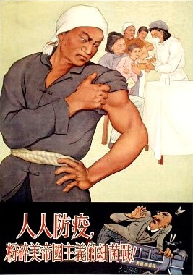
Resource sheet 6.2A
Evidence pack
Source D:
Information about the origins of the source
Chinese propaganda poster from the Korean War era. The caption reads: ‘Vaccinate everyone, to crush the germ warfare of American imperialism!’
The Chinese government launched a Patriotic Hygiene Campaign to fight back against the alleged biological attacks.
The population was mobilised in a mass campaign to eradicate all fleas, rats, mosquitos and flies in the country.
Notes:
Image: Chinese government, https://en.wikipedia.org/wiki/File:1950s_Chinese_propaganda_poster_against_American_biowarfare.jpg

Slide 4
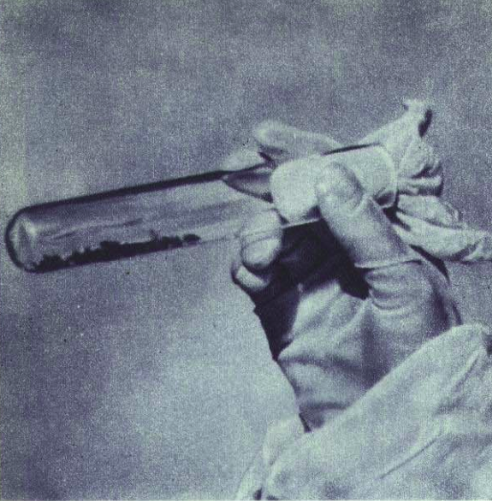
Resource sheet 6.2A
Evidence pack
Source C:
Information about the origins of
the source
This is a Chinese photograph of a vial containing infected fleas allegedly spread by the United States.
Notes:
Image: Chinese government, https://commons.wikimedia.org/wiki/File:1952-03_%E6%9C%9D%E9%B2%9C%E6%88%98%E4%BA%89%E7%BE%8E%E5%86%9B%E6%8A%95%E6%94%BE%E5%B8%A6%E6%9C%89%E7%BB%86%E8%8F%8C%E7%9A%84%E8%B7%B3%E8%9A%A4.png

Slide 5
Resource sheet 6.2A
Evidence pack
Source E:
Information about the origins of the source
Written by historian Milton Leitenberg to the New York Review of Books in 2018. Leitenberg is a senior research scholar at the University of Maryland.
‘… There was no biological warfare carried out by any agency of the US government during the Korean War,
or for that matter by anyone else.
The false allegation was disproved as long ago as 1998 when documents from the Soviet Central Committee Archives that had been sent to Mao Zedong and to Kim Il Sung in the month following Stalin’s death in 1953 were obtained from the Soviet Presidential Archive. They were published in 1998 in the Bulletin of the Cold War International History Project at the Woodrow Wilson Center in Washington, D.C.’

Slide 6
Resource sheet 6.2A
Evidence pack
Source F:
Information about the origins of the source
The evidence used by historians like Milton Leitenberg to refute the Chinese and North Korean allegations has itself been challenged by other historians.
The historians Stephen Endicott and Edward Hagermann have written extensively on US use of biological weapons and broadly agree that they were used. They say about Leitenberg’s evidence:
‘The claim that two places were concocted to fool foreign visitors does not prove that all the sites of alleged biological warfare were also contrived. Our research in Chinese archives shows that the Chinese army in Korea and the Korean medical service serving with it identified occurrences of plague in 13 places during February and March 1952 as well as outbreaks of anthrax, encephalitis and other abnormal diseases. The Soviet documents, if they are genuine, add a twist to the main documentation which, so far, is to be found in the Chinese and United States archives. Questions raised by the documents about their source, who ordered the falsification of evidence, and motive would need to be resolved.’

Slide 7
Resource sheet 6.2A
Evidence pack
Source G:
Information about the origins of the source
The following points come from Frank Dikotter’s The Tragedy of Liberation (2013). Dikotter is a Dutch historian from the University of Hong Kong.
‘On 6 April 1952, the New York Times published an article demonstrating that the photos presented by the People’s Daily were fraudulent.
It was pointed out by one scientist that infected lice and fleas would not be able to survive the freezing temperatures of North Korea in winter.
Li Shantang, a domestic opponent of the regime, said that “This is all communist propaganda in an attempt to get the world to hate America, don’t listen to all that rubbish!’”

Slide 8
Resource sheet 6.2A
Evidence pack
Source H:
Factual information
The United States gave immunity to Japanese scientists from Unit 731, which was a germ warfare research organisation from Japan during the Second World War.
This was in exchange for obtaining the research data and information that they had developed.
This information was withheld from other wartime allies and the grant of immunity was covered up by the USA for many decades.
Information found in
Rogaski, R. (2002) ‘Nature, annihilation and modernity’ in Journal of Asian Studies, 61, no. 2
Notes:
Citation from Ruth Rogaski, Nature Annihilation and Modernity Journal of Asian Studies 61.2 (2002)

Slide 9
Resource sheet 6.2A
Evidence pack
Source I:
Factual information
Two of the key sources of evidence produced by China and North Korea for allegations of germ warfare were captured US prisoners of war who confessed to being involved in dropping infected insects on Korea and China.
The USA claimed that these confessions were extracted as a result of torture and brainwashing.

Slide 10
Resource sheet 6.2A
Evidence pack
Source J:
Information about the origins of the source
This is an explanatory note from Glukhov (a Soviet diplomat) to Beria (head of the Soviet Secret Police) in 1953. It is published
on the Wilson Center website. The bold emphasis has been added by us.
‘The Koreans stated that the Americans had supposedly repeatedly exposed several areas of their country to plague and cholera. To prove these facts, the North Koreans, with the assistance of our advisers, created false areas of exposure. In June–July 1952 a delegation of specialists in bacteriology from the World Peace Council [the Needham Commission] arrived in North Korea. Two false areas of exposure were prepared. In connection with this, the Koreans insisted on obtaining cholera bacteria from corpses which they would get from China.’
Notes:
https://digitalarchive.wilsoncenter.org/document/113748

